Slide 1

Муна А.X
Тема: The OSI Model

Slide 2
The OSI Model
OSI “ Open Systems Interconnection".
OSI model was first introduced in 1984 by the International Organization for Standardization (ISO).
  Outlines WHAT needs to be done to send data from one computer to another.
  Not HOW it should be done.
  Protocols stacks handle how data is prepared for transmittal (to be transmitted)
In the OSI model, The specification needed
  are contained in 7 different layers that interact with each other.

Slide 3
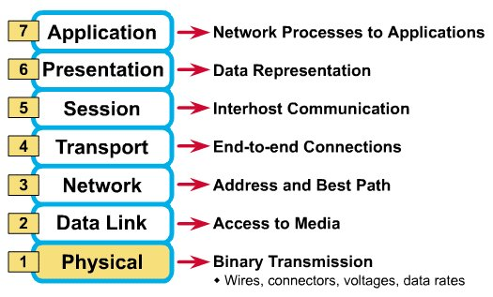
What Each Layer Does
²

Slide 4
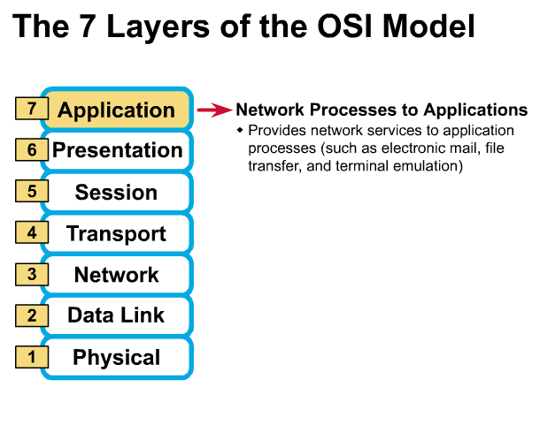
Gives end-user applications access to network resources
Where is it on my computer?
  Workstation or Server Service in MS Windows
³

Slide 5
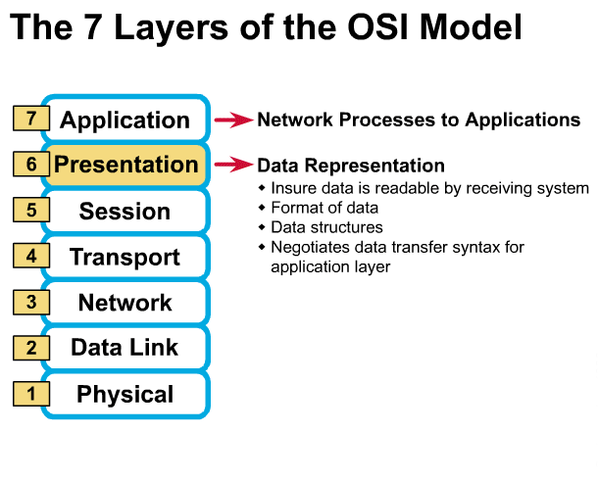
Presentation Layer
³

Slide 6
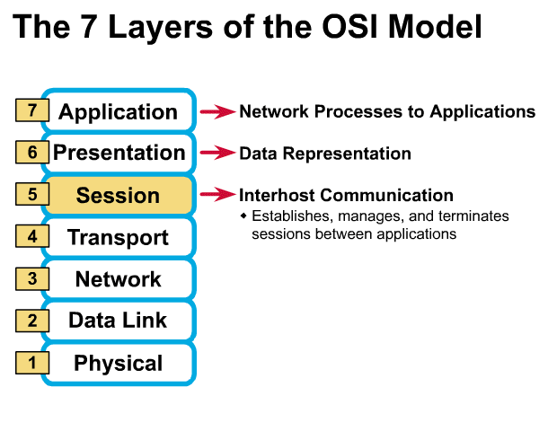
Session Layer
Allows applications to maintain an ongoing session
Where is it on my computer?
  Workstation and Server Service (MS)
  Windows Client for NetWare (NetWare)
³

Slide 7
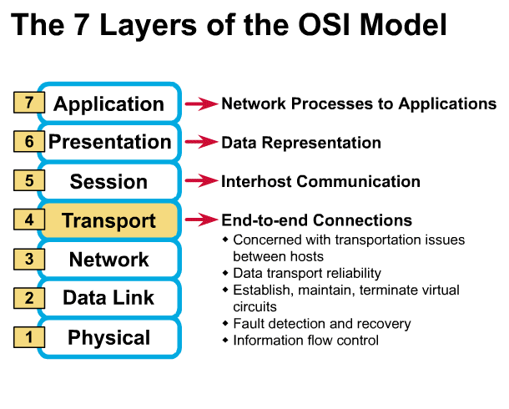
Transport Layer
Provides reliable data delivery
It’s the TCP in TCP/IP
Receives info from upper layers and segments it into packets
Can provide error detection and correction
³

Slide 8
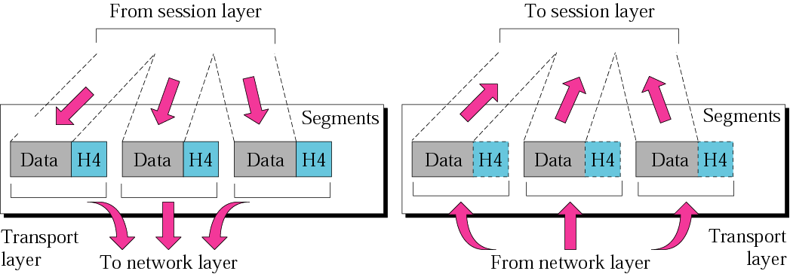
Figure 2.9 Transport layer
The transport layer is responsible for the delivery of a message from one process to another.

Slide 9
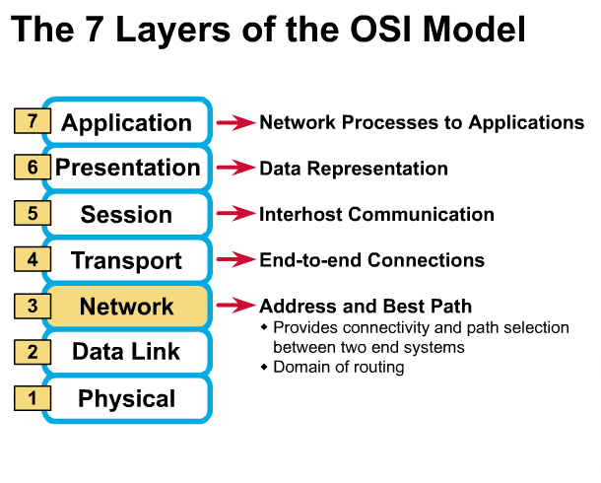
Network Layer
Provides network-wide addressing and a mechanism to move packets between networks (routing)
Responsibilities:
  Network addressing
  Routing
Example:
  IP from TCP/IP
³

Slide 10
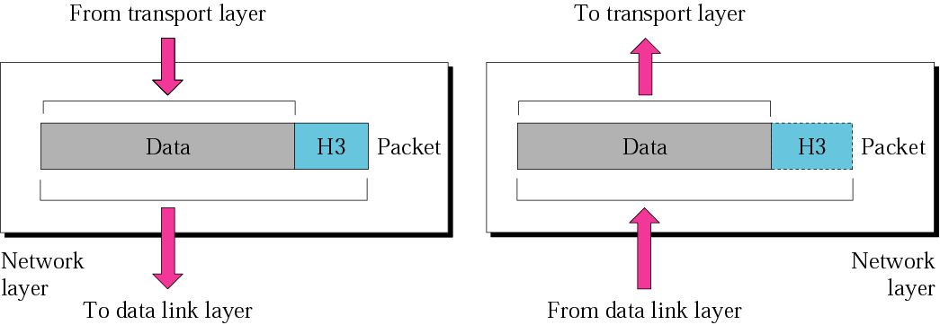
Network layer
The network layer is responsible for the delivery of individual packets from the source host to the destination host.

Slide 11
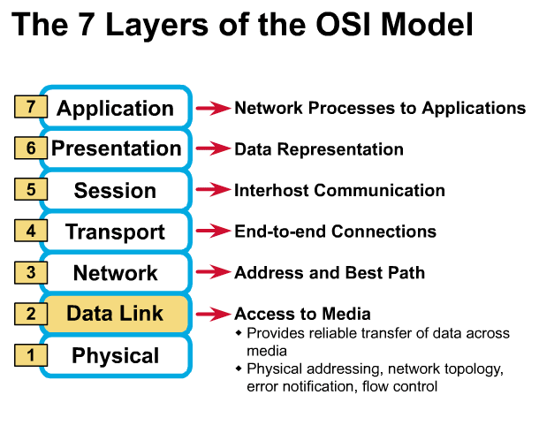
Data Link Layer
Places data and retrieves it from the physical layer and provides error detection capabilities
³

Slide 12
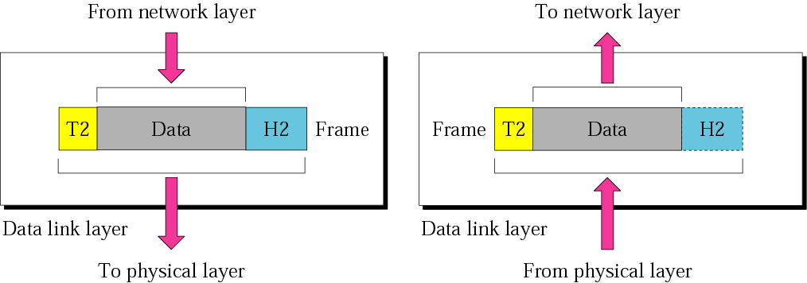
Data link layer
The data link layer is responsible for moving frames from one hop (node) to the next.

Slide 13
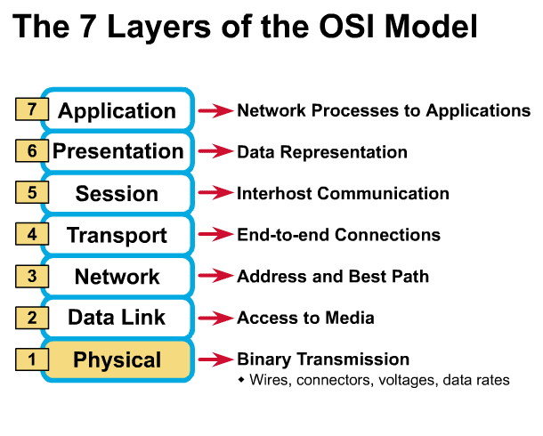
Physical Layer
Determines the specs for all physical components
  Cabling
  Interconnect methods (topology / devices)
  Data encoding (bits to waves)
  Electrical properties
Examples:
  Ethernet (IEEE 802.3)
  Token Ring (IEEE 802.5)
  Wireless (IEEE 802.11b)
³

Slide 14
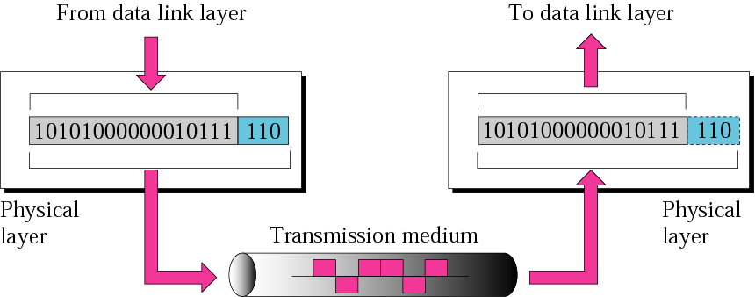
Physical layer
The physical layer is responsible
for the movement of individual bits from one hop (node) to the next.

Slide 15
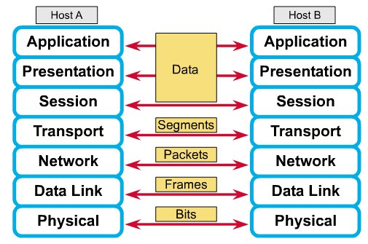
How Does It All Work Together
Each layer contains a Protocol Data Unit (PDU)
  PDU’s are used for peer-to-peer contact between corresponding layers.
  Data is handled by the top three layers, then Segmented by the Transport layer.
  The Network layer places it into packets and the Data Link frames the packets for transmission.
  Physical layer converts it to bits and sends it out over the media.
  The receiving computer reverses the process using the information contained in the PDU.
²

Slide 16
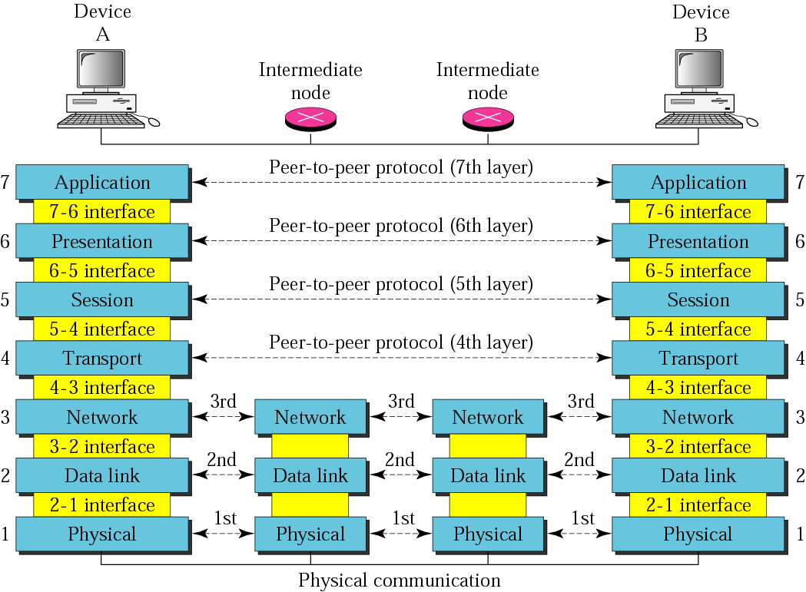
Figure 2.2 OSI layers

Slide 17
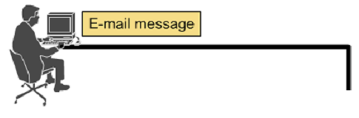




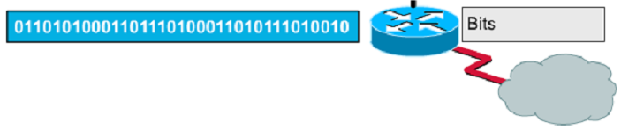
Encapsulation example: E-mail

Slide 18
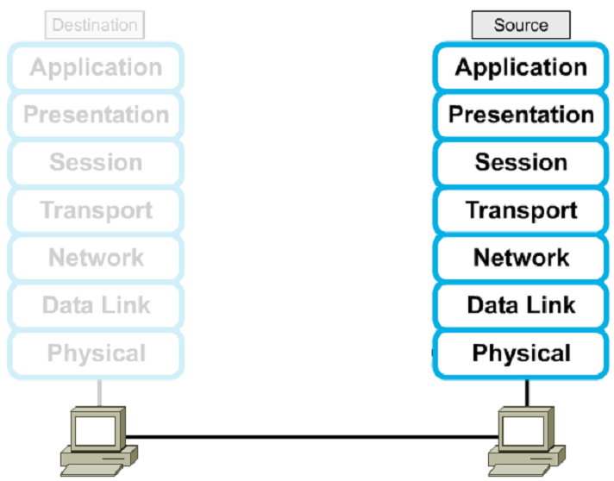




Encapsulation

Slide 19
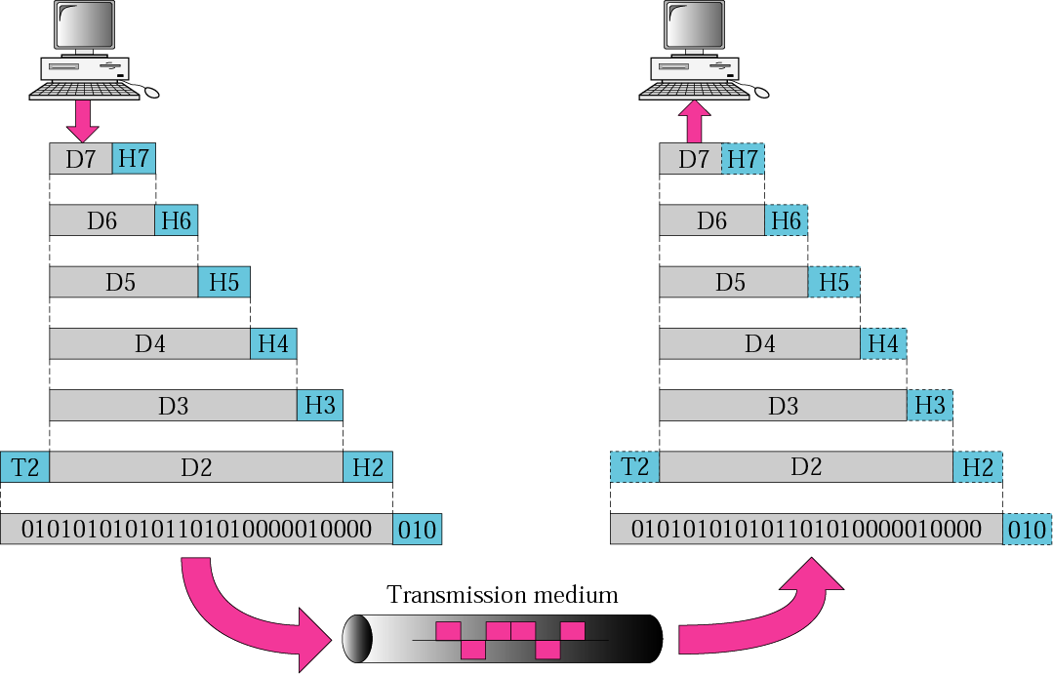
Figure 2.3 An exchange using the OSI model

Slide 20
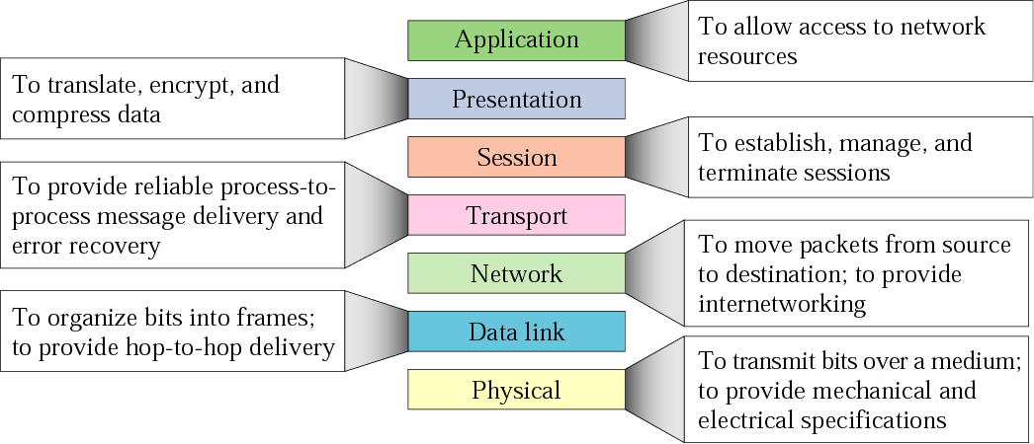
Figure 2.14 Summary of layers

Slide 21
Remembering the 7 Layers
7 - Application All
6 - Presentation People
5 - Session Seem
4 - Transport To
3 - Network Need
2 - Data Link Data
1 - Physical Processing

