Slide 1
QoS in IP Networks
By Geoffrey Juma

Slide 2
What is QoS ?
Is a mechanism of classifying/prioritizing different kinds of packets/traffic flows to guarantee quality of experience.
Defined by IETF RFC 2474.
Uses the 6-bits in ToS octet of the packet header structure.

Slide 3
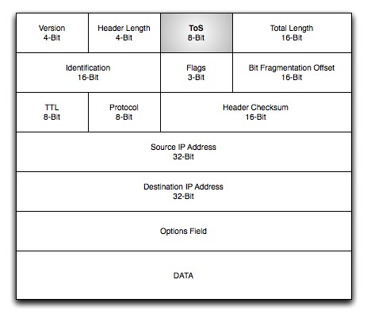
IP Packet Header Structure

Slide 4
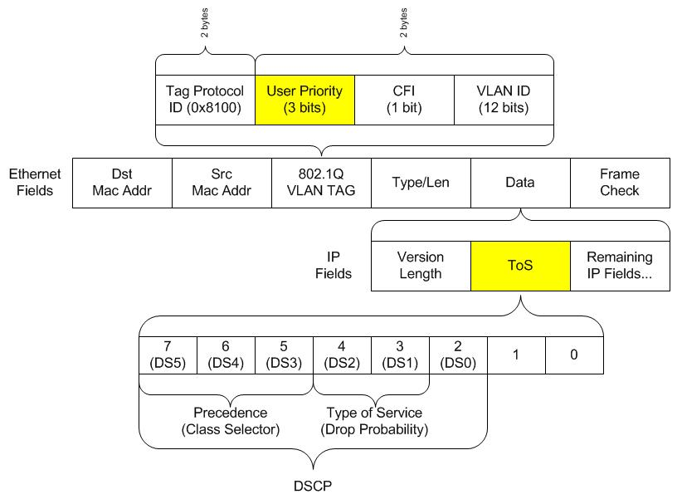
ToS octet zoomed..

Slide 5
Kinds of QoS
Best effort – The rule of the jungle :)
Differentiated Service -DiffSerf
Integrated Service -IntServ
Resource ReSerVation Protocol -RSVP

