Slide 1
Analysis of diabetes hospital data
Geoffrey Kip

Slide 2
Dataset Information
Represents 10 years (1999-2008) of clinical care at 130 US hospitals and integrated delivery networks
Includes over 50 features representing patient and hospital outcomes
Criteria encounters to be included in the dataset include the following:
(1) It is an inpatient encounter (a hospital admission). (2) It is a diabetic encounter, that is, one during which any kind of diabetes was entered to the system as a diagnosis. (3) The length of stay was at least 1 day and at most 14 days. (4) Laboratory tests were performed during the encounter. (5) Medications were administered during the encounter.

Slide 3
Outcome of interest: Hospital admission within 30 days
Readmission rates have increasingly been used as an outcome measure in health services research and as a quality benchmark for health systems (https://en.wikipedia.org/wiki/Hospital_readmission)
It is a good indicator that something was missed in the patient’s first hospital admission.
It is a large driver of cost in the healthcare system.

Slide 4
Analysis Approach
Download dataset from UCI machine learning repository
Load data into local MySQL 5.7 database.
Use SQL CASE WHEN queries to code and map codes eg admission_type_id.
Cross tabulate data by race, gender and readmission type using sql queries.
Generate plots and statistics in Python Jupyter notebook

Slide 5
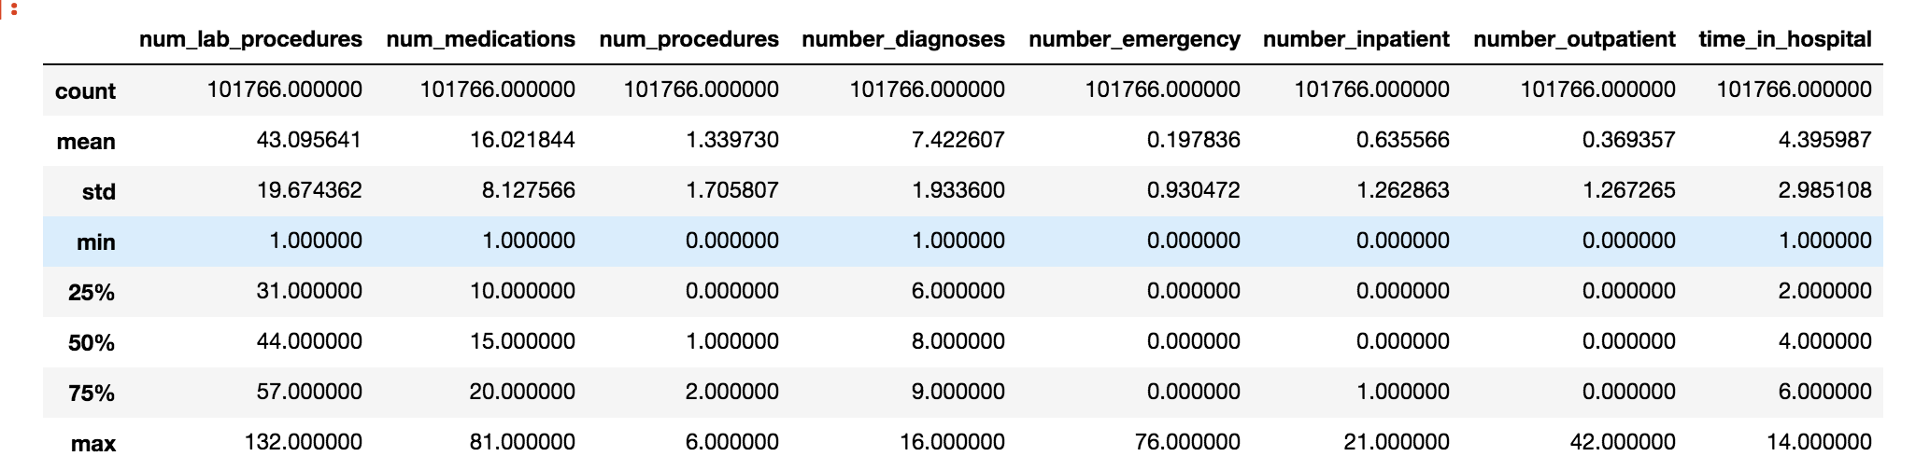
Dataset Exploration
Dataset has 101766 rows with 53 features.

Slide 6
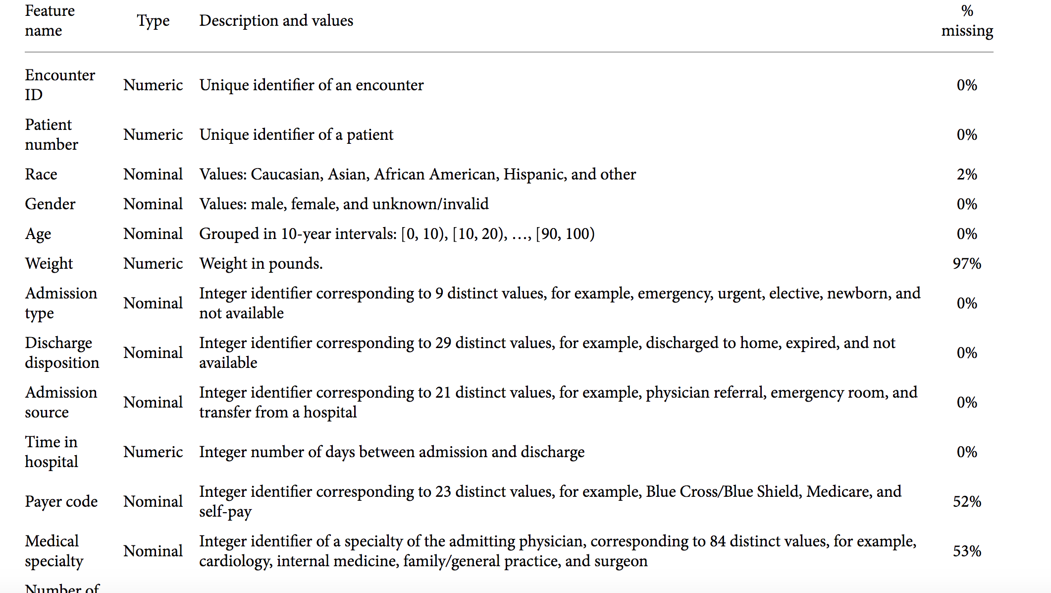
Dataset Exploration

Slide 7
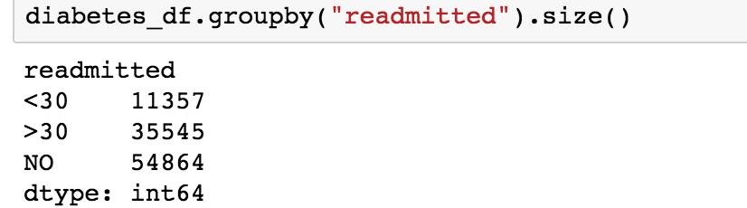
Dataset Exploration
About 11,357 (11%) patients were readmitted within 30 days.
Majority of patients were not readmitted.
35,545 (35%) patients were readmitted after 30 days.

Slide 8
Hypothesis
Data measurements of a patient such as age, weight, number of medications, number of procedures should affect the readmission rate.
The hypothesis is that patients of higher age, weight and patients who have more medications and procedures are more likely to get readmitted sooner than patients who are of younger age or normal weight for example.
It is also believed that the glucose serum levels that are not normal and any change in medications should affect the hospital readmission rate.

Slide 9
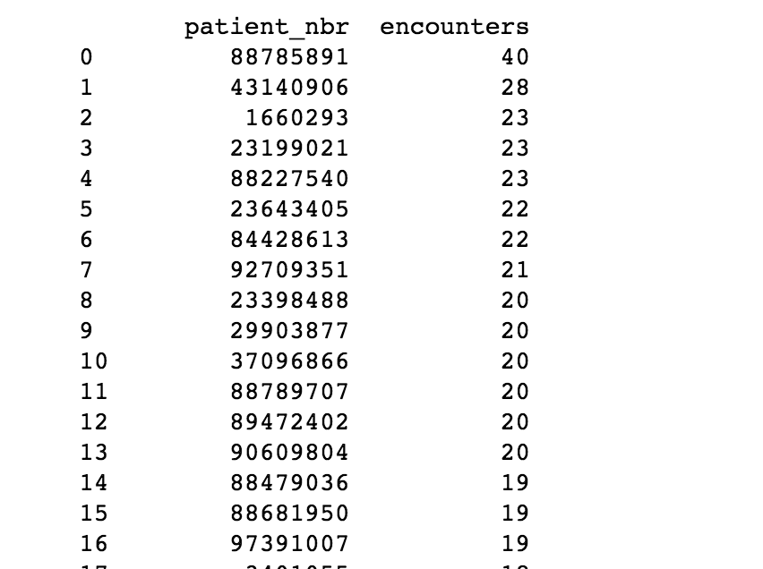
Exploratory Data Analysis: How many encounters by patient
The average number of encounters by patient was approximately 1.42 encounters by patient.
There were a couple of outliers eg one patient having 80 encounters

Slide 10
Exploratory Data Analysis: Mean Averages
For all patients in the dataset:
The average number of procedures = 1.34 procedures
The average number of medications = 16.02 medications
The average number of lab procedures = 43.10 procedures
The average time in hospital = 4.40 days
The average number of outpatient visits = 0. 37 visits
The average number of emergency visits = 0.20 visits
The average number of diagnoses = 7.42
The average number of inpatient visits = 0.64 visits.

Slide 11
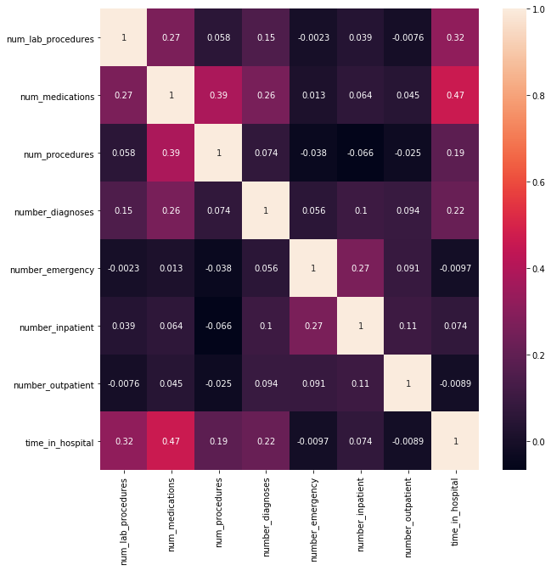
How are variables correlated to each other?
Number of procedures and number of medications have a positive correlation of 0.39.
Time in hospital also has a high positive correlation (0.47) with the number of medications.
Number of lab procedures also has a positive correlation (0.32) with the time in hospital.
There are some variables that are slightly negatively correlated with each other.
For example number of outpatient visits is negatively correlated (-0.076) with number of lab procedures.

Slide 12
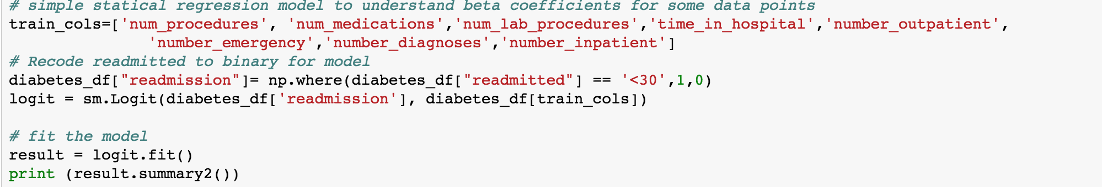
What can a simple logistic regression statistical model tell us?
Recoded readmission to a binary outcome. 1= <30 days readmission and 0= no readmission or >30 days readmission
Used the same measurements earlier that we explored correlation relationships between.
Fit logistic regression model using statsmodels API in python.

Slide 13
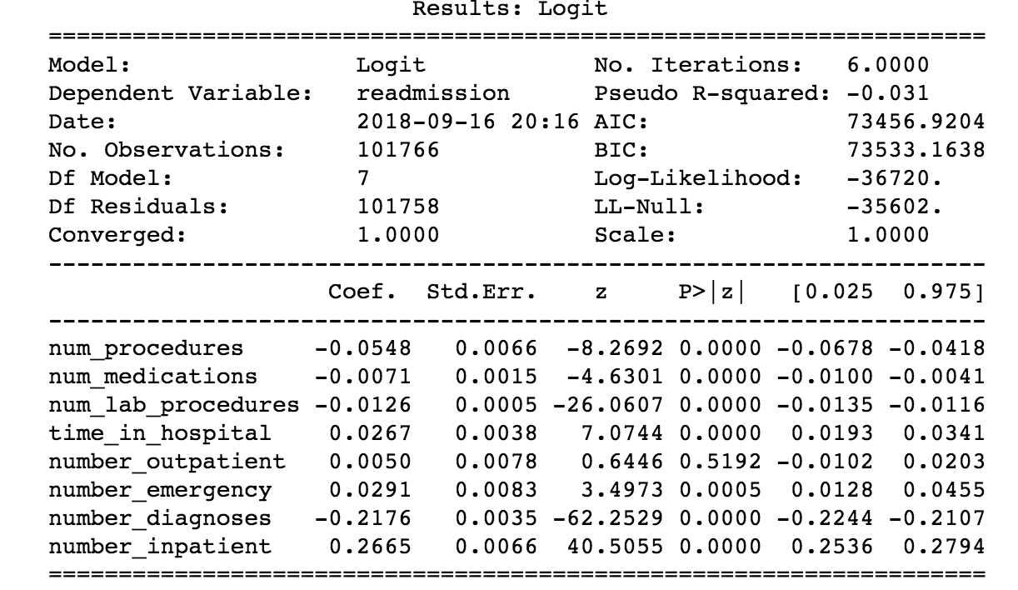
Model interpretation
According to a p-value of 0.05 , number of procedures, number of medications, number of lab procedures, time in hospital, number of outpatient and number of emergency visits are significant predictors for readmission.
Some interesting relationships: number of procedures and number of medications are inversely related to readmission.
Outpatient visits and time in hospital are positively related to readmission.

Slide 14
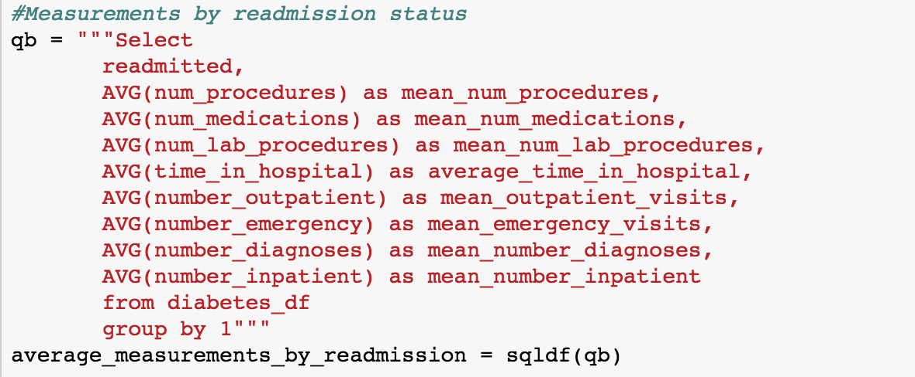
Compare measurements by readmission status

Slide 15
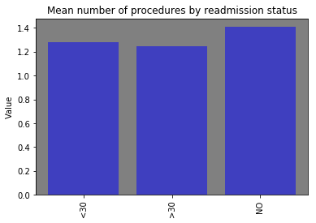
Mean number of procedures by readmission status
People who have the highest number of procedures were often not readmitted which the logistic regression model also supported (Beta coefficient of -0.0548)

Slide 16
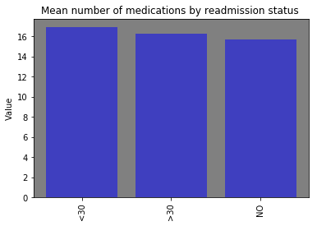
Mean number of medications by readmission status
Data shows that people who were readmitted in 30 days had the highest number of medications on average (~>16).

Slide 17
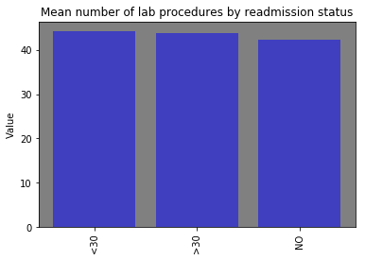
Mean number of lab procedures by readmission status
Patients readmitted in 30 days also had the highest number of lap procedures (~45 procedures).

Slide 18
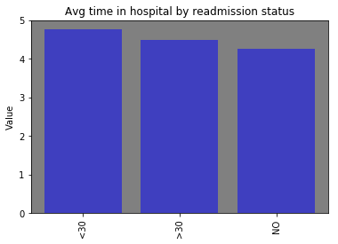
Mean number of medications by readmission status
Patients who were readmitted within 30 days also had the highest amount of time spent in the hospital which the earlier model agreed with (beta coefficient = 0.0267)

Slide 19
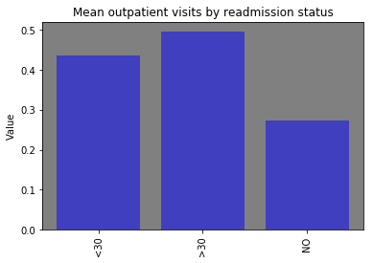
Mean number of outpatient visits by readmission status
Patients readmitted after 30 days ended up having the highest number of outpatient visits compared to patients who were not readmitted or readmitted within 30 days.

Slide 20
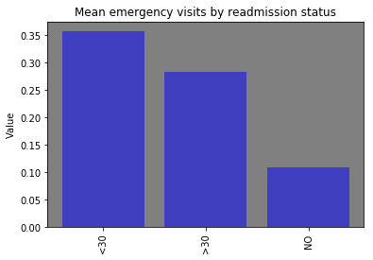
Mean number of emergency visits by readmission status
Patients readmitted within 30 days had the highest average number of emergency visits.

Slide 21
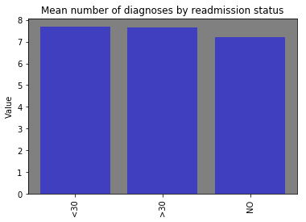
Mean number of diagnoses by readmission status
Patients readmitted within 30 days also slightly had the highest number of diagnoses.

Slide 22
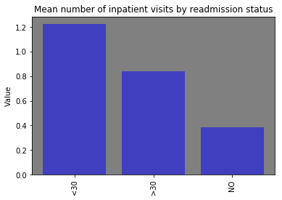
Mean number of inpatient visits by readmission status
Patients readmitted within 30 days had the highest number of inpatient visits.

Slide 23
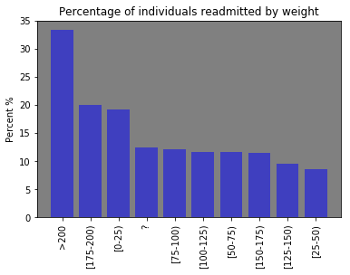
How is weight related to readmission status?
Hypothesis is that overweight patients have a higher likelihood of being readmitted within 30 days. Does the data show that?

Slide 24
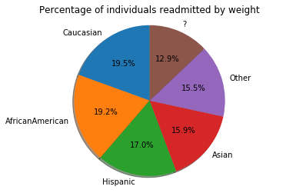
How does race affect readmission status?
Out of all the patients, Caucasian patients accounted for the most readmission visits within 30 days (19.2%).

Slide 25
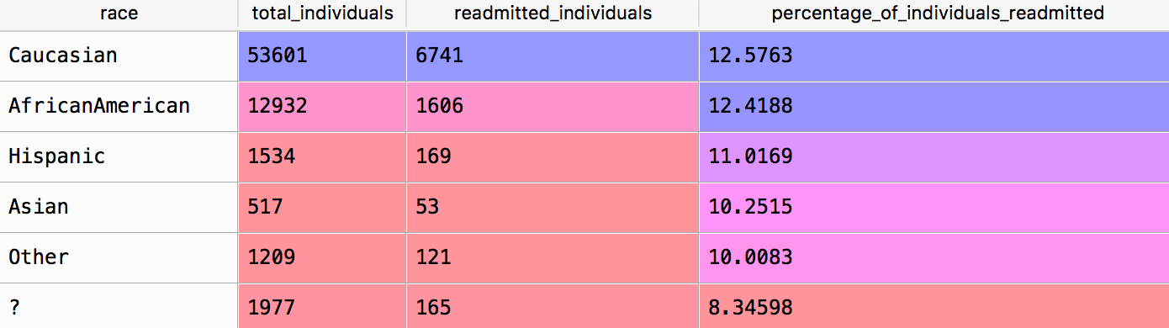
How about within race percent’s?
Looking at row wise percent figures, Caucasian patients still had the highest percentage of individuals readmitted followed by African American and Hispanic.

Slide 26
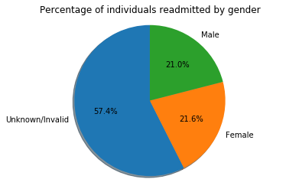
How does gender affect readmission status?
Out of all the patients admitted majority were of unknown gender (57.4%) followed by an equal distribution of male and female gender.

Slide 27
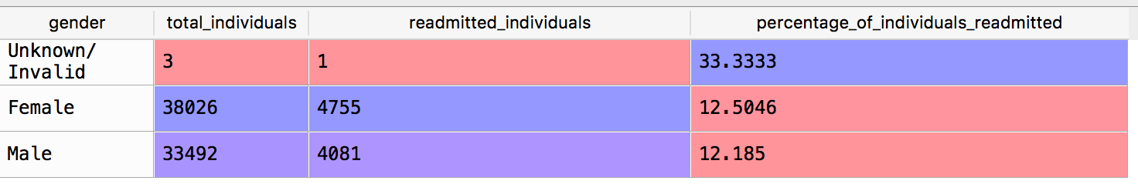
How about within gender percent’s?
Looking among gender it looks like male had a slightly higher percentage of
readmitted individuals compared to females

Slide 28
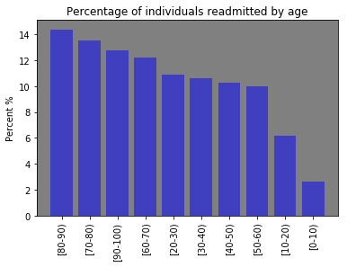
Age and readmission status?
Hypothesis was that older individuals are more likely to be readmitted within 30 days.
Data shows that the highest readmission percentages are for individuals between 80-90 years old.

Slide 29
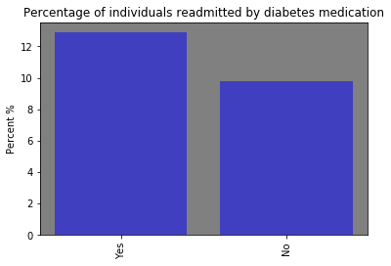
Is diabetes medication related to readmission within 30 days?
Initially thought that patients not taking diabetes medication would have higher readmission rates but the data shows the contrary.

Slide 30
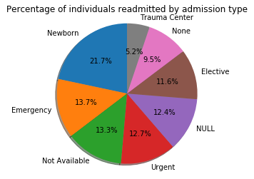
Does admission type affect readmission?
Newborn and emergency admission type led to the most readmission visits within 30 days.

Slide 31
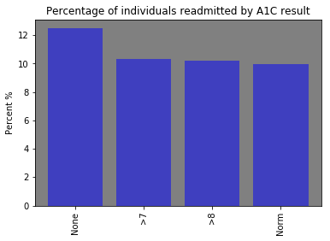
How does the A1C result affect readmission type?
Patients who had a normal A1C result had the least percentage of readmission visits within 30 day as would be expected.

Slide 32
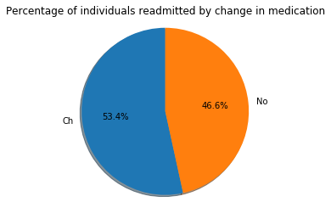
Does a change in medication affect readmission type?
Majority (53.4%) of the patients who were readmitted within 30 days reported a change in medication.

Slide 33
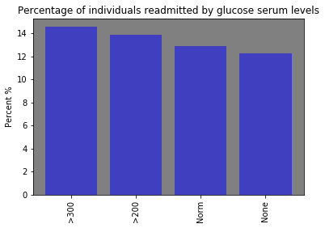
How do glucose serum levels affect readmission?
As expected elevated or higher glucose serum levels are related to higher percentages of readmission rates within 30 days.

Slide 34
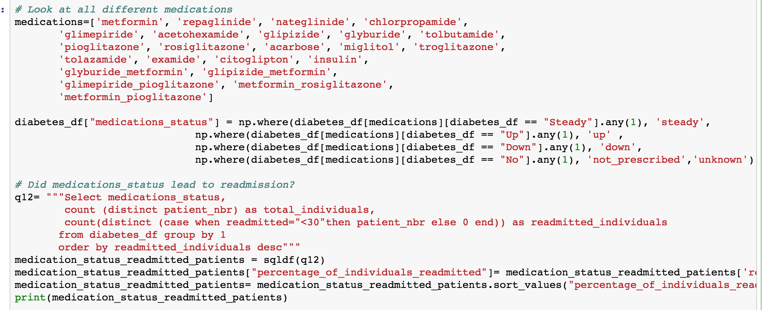
Does a change in any medication affect readmission rates?

Slide 35
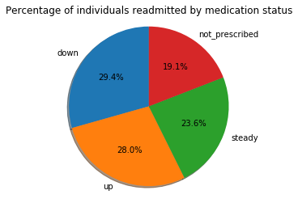
Does a change in any medication affect readmission rates?
Data shows that the majority (29.4%) of patients readmitted had at least one of their medications go down for them to be readmitted.

Slide 36
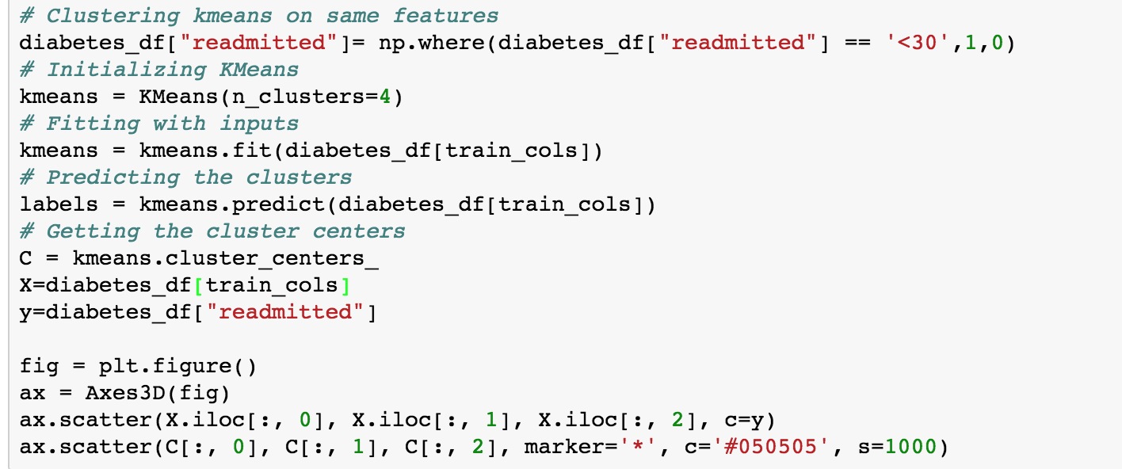
Does the data have clusters of people similar to each other?

Slide 37
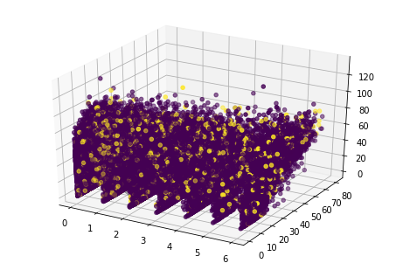
Does the data have clusters of people similar to each other?
Hard to tell with so many data points but more work would need to be done to understand if there are different clusters and what data points distinguish them.

Slide 38
Conclusion
Readmission status within 30 days indicates that something might have gone wrong or was missed within the patient’s initial visit.
There are several factors that seem to explain higher readmission rates in some patients as opposed to others.
Higher age, higher weight, elevated glucose levels, change in medications, and longer time spent in the hospital are some factors that seem to increase readmission rates of the patients in this dataset.

