Slide 1
An Opposing Friendship
Grant & Longstreet

Slide 2
Section Header

Slide 3
Stuff other than the section header

Slide 4
Section Header (Slide 2)

Slide 5
Title (Slide 3)
Content

Slide 6
Title (Slide 4)
a
nested
bulleted
list
is
good
now

Slide 7
Title (Slide 5)
Content
Notes:
A note

Slide 8
Title (Slide 6)
Column 1
Column 2

Slide 9
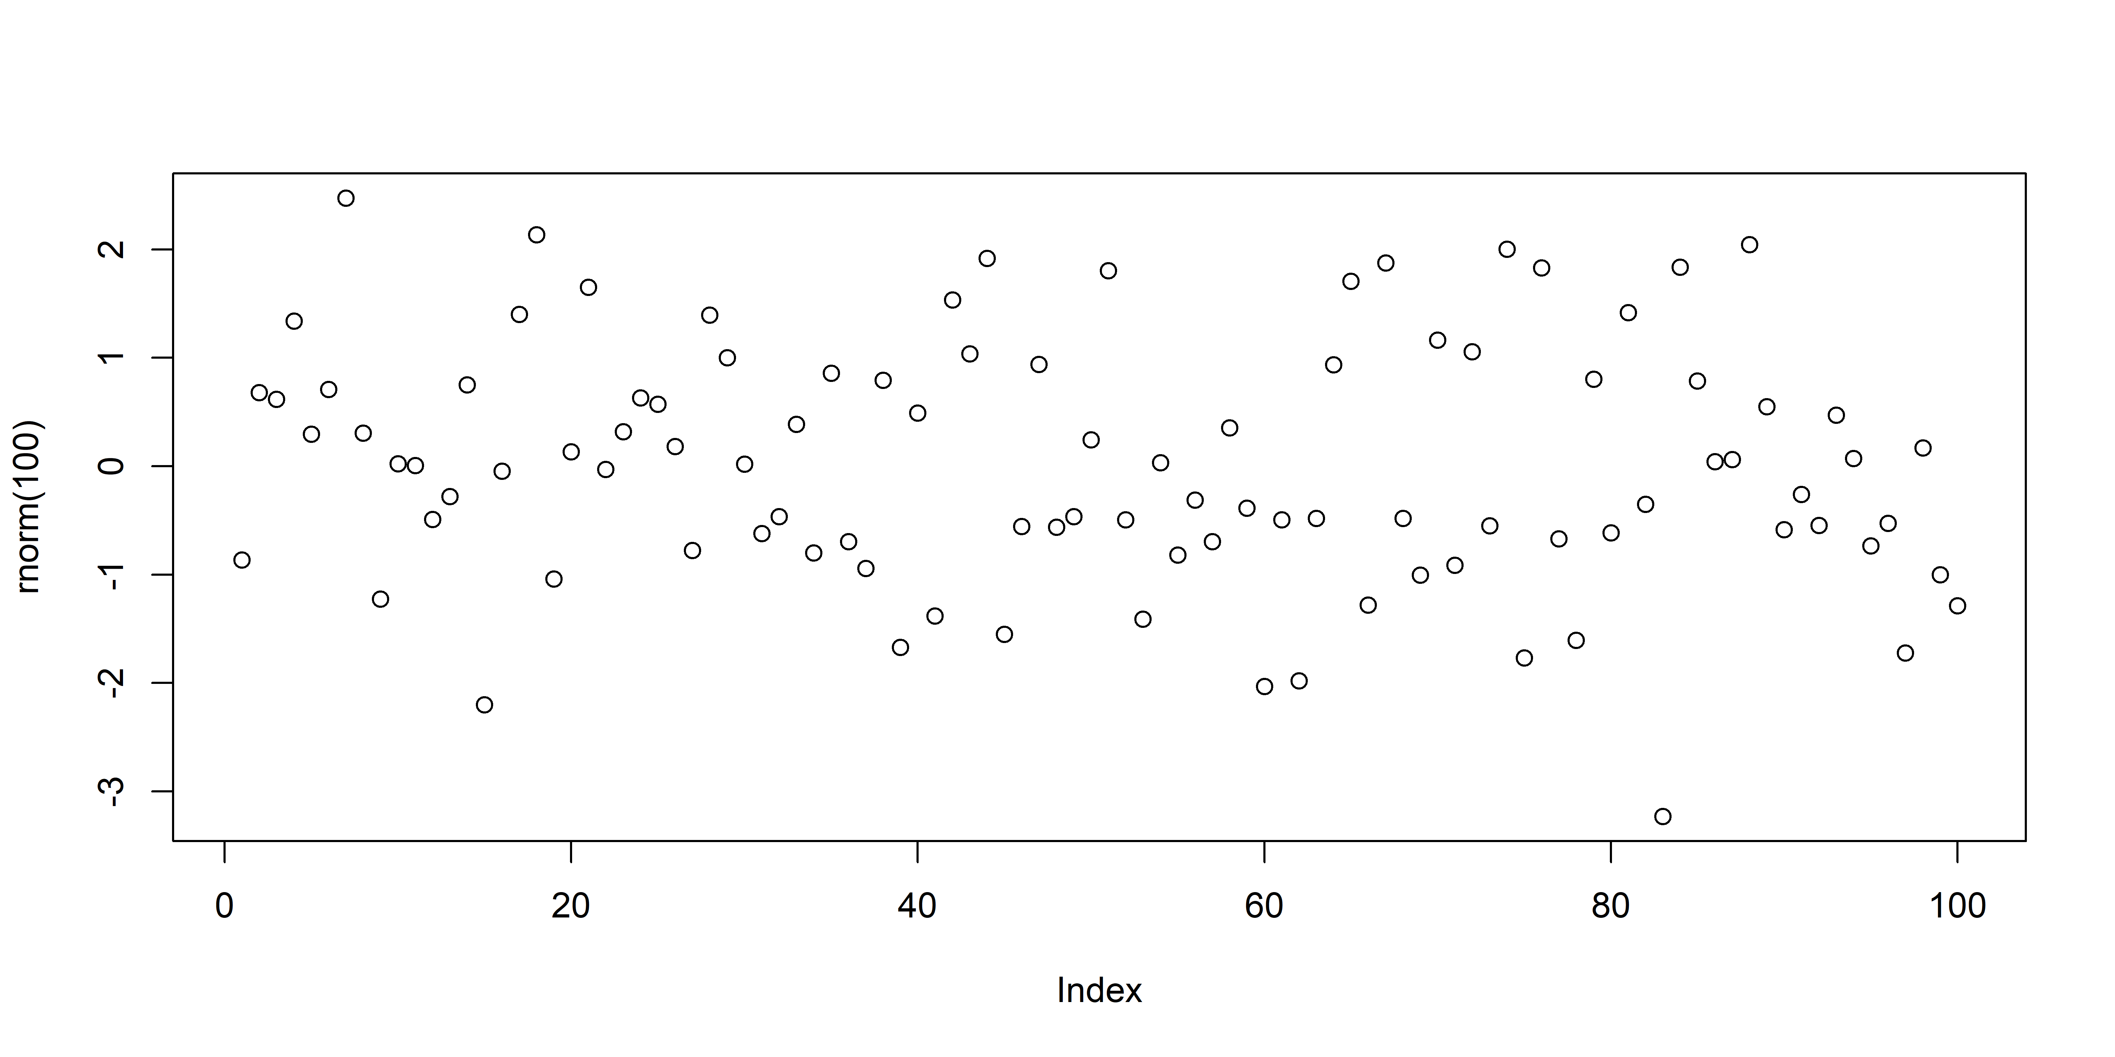
Title (Slide 7)
a caption!

Slide 10
Title (Slide 8)
italic bold strikeout _{subscript} ^{superscript} small caps verbatim
Block quote

Slide 11
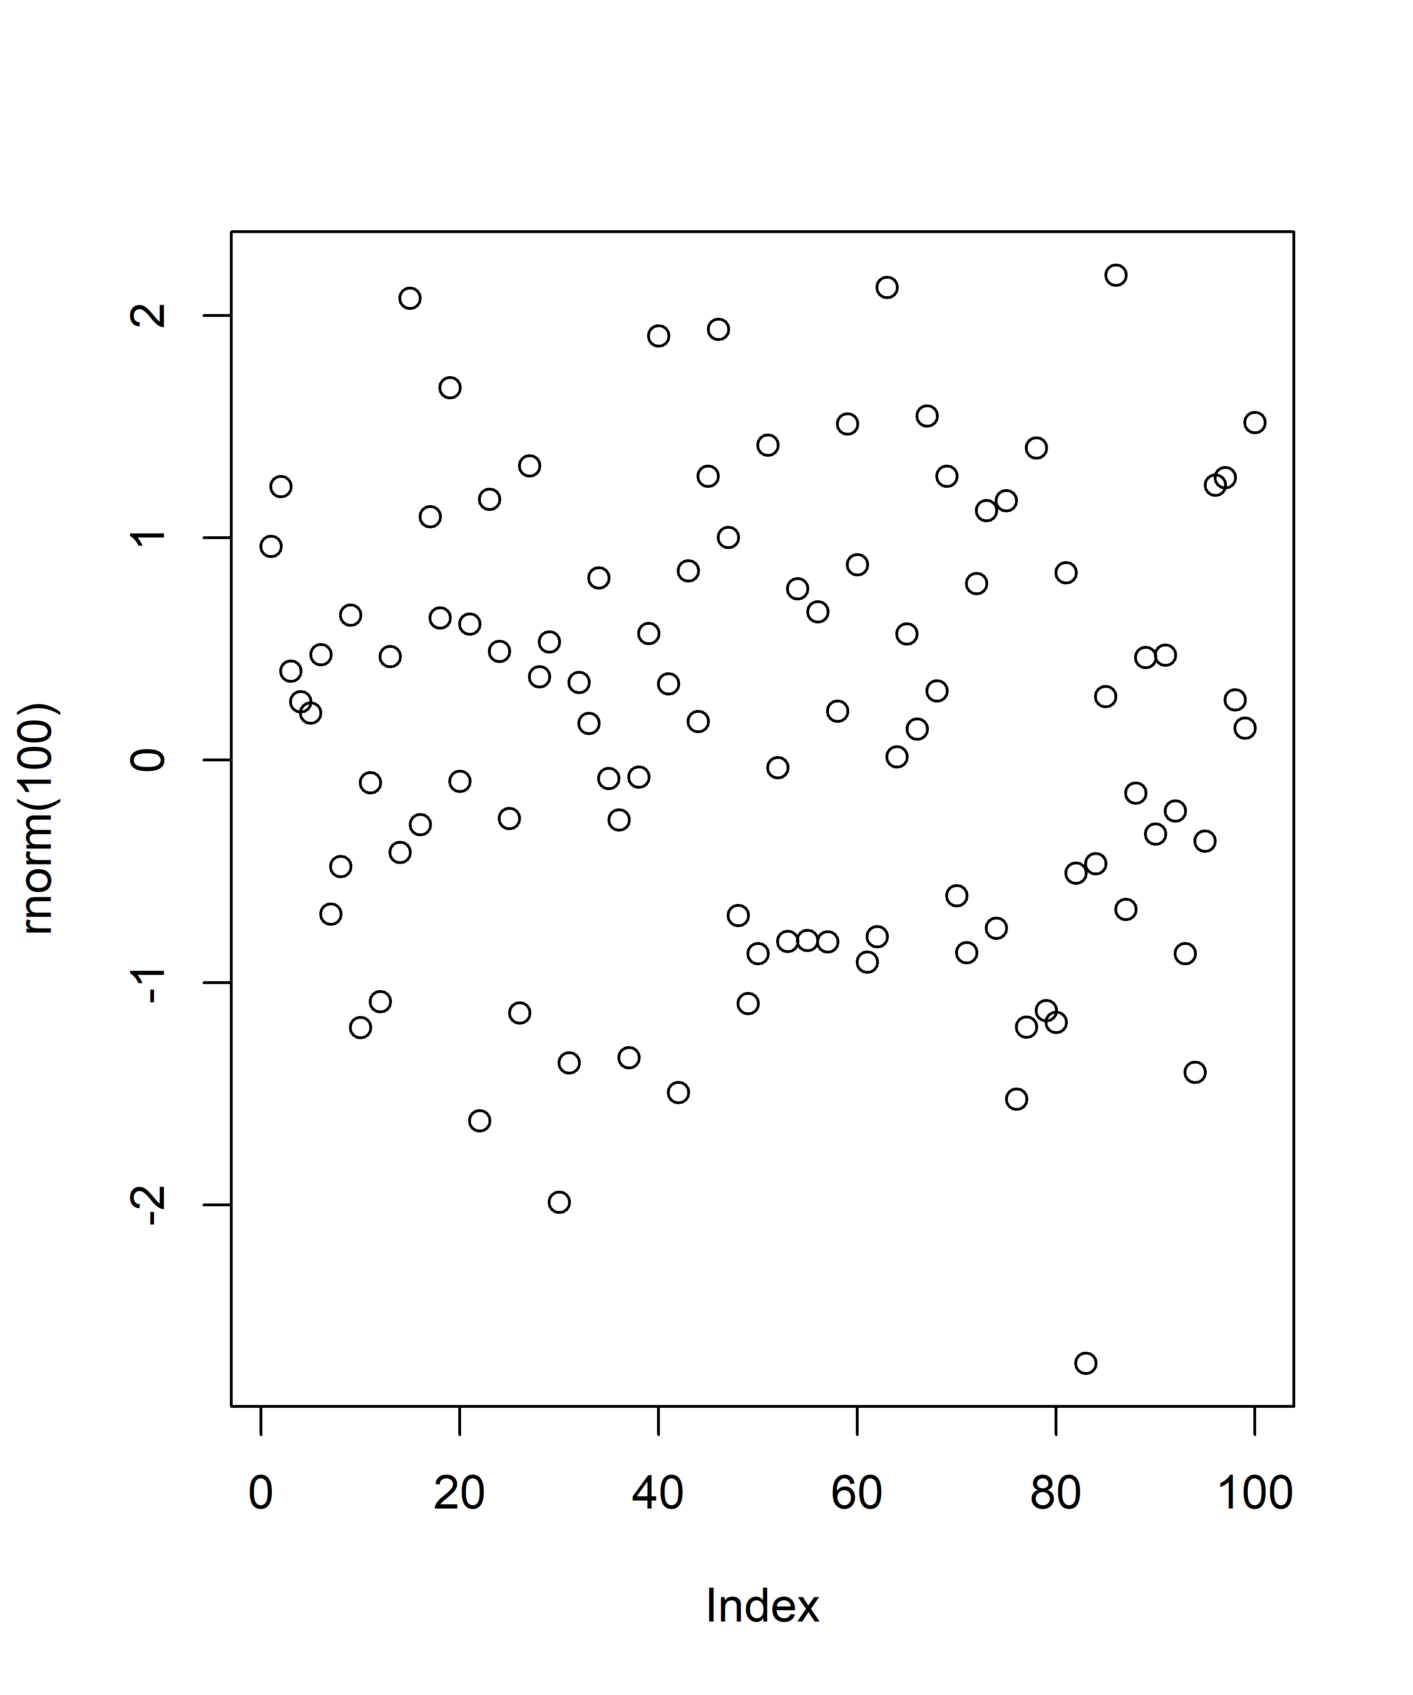
Title (Slide 9)
Content Header
Smaller Header
Smallest Header
stuff
a caption!

Slide 12
Title (Slide 10)
one | two | three | four | five
a | 1 | 2 | 3 | 4
b | 1 | 2 | 3 | 4

Slide 13
Title (Slide 11)
 | cyl | disp | hp | drat
Mazda RX4 | 6 | 160 | 110 | 3.90
Mazda RX4 Wag | 6 | 160 | 110 | 3.90
Datsun 710 | 4 | 108 | 93 | 3.85

Slide 14
Title (Slide 12)
Column 1
 | cyl | disp | hp | drat
Mazda RX4 | 6 | 160 | 110 | 3.90
Mazda RX4 Wag | 6 | 160 | 110 | 3.90
Datsun 710 | 4 | 108 | 93 | 3.85

