Slide 1
Writing Tests with Apache-Test
Geoffrey Young
geoff@modperlcookbook.org

Slide 2
Why Test?
Development is faster and easier
Code is more robust
Code is more maintainable
Code exponentially more valuable
Everyone else is doing it

Slide 3
Why Apache-Test?
Next cool thing
  Bundled with mod_perl 2.0
  Works with mod_perl 1.0
  Works with any odd Apache installation
    mod_php
    mod_cgi
    SOAP web services
    etc

Slide 4
What Apache-Test Is
Framework for testing Apache-based application components
  unit tests
Gives you a self-contained, pristine environment for testing
Provides HTTP-centric testing tools

Slide 5
What Apache-Test Is Not
Front-To-Back testing engine
Not designed for testing a series of pages

Slide 6
Apache-Test by Example
Write a simple module
Integrate Apache-Test
Extras if we have time

Slide 7
BasicAuth.pm
package Apache::BasicAuth;
use Apache::Constants qw(OK AUTH_REQUIRED);
use strict;
sub handler {
my $r = shift;
my ($status, $password) = $r->get_basic_auth_pw;
return $status unless $status == OK;
return OK if ($r->user eq 'geoff' && $password eq 'geoff');
$r->note_basic_auth_failure;
return AUTH_REQUIRED;
}
1;

Slide 8
Testing, Testing... 1, 2, 3
Generate the test harness
Configure Apache
Write the tests

Slide 9
Step 1 - The Test Harness
Generally starts from Makefile.PL
mod_perl 2.0 example
Example for everyone else

Slide 10
Makefile.PL
use Apache::TestMM qw(test clean);
use Apache::TestRunPerl ();
# configure tests based on incoming arguments
Apache::TestMM::filter_args();
# generate the test harness
Apache::TestRunPerl->generate_script();

Slide 11
filter_args()
$ perl Makefile.PL -apxs /usr/local/apache/bin/apxs

Slide 12
filter_args()
$ perl Makefile.PL -httpd /usr/local/apache/bin/httpd

Slide 13
t/TEST
t/TEST is the actual harness that coordinates testing activities
Apache::TestRunPerl->new->run(@ARGV);

Slide 14
Makefile.PL
mod_perl 2.0 example
Example for everyone else

Slide 15
Makefile.PL
sub MY::test {
eval {
require Apache::TestMM;
require Apache::TestRunPerl;
Apache::TestMM->import(qw(test clean));
Apache::TestMM::filter_args();
Apache::TestRunPerl->generate_script();
return Apache::TestMM->test;
}
or return <<EOF;
test::
\t\@echo This test suite requires Apache-Test,
\t\@echo which is available from the mod_perl 2.0
\t\@echo sources, CPAN, or the httpd-test distribution.
EOF
}

Slide 16
Step 1 - The Test Harness
Don't get bogged down with Makefile.PL details
Lather, Rinse, Repeat

Slide 17
Testing, Testing... 1, 2, 3
Generate the test harness
Configure Apache

Slide 18
Step 2 - Configure Apache
Apache needs a basic configuration to service requests
  ServerRoot
  DocumentRoot
  ErrorLog
  Listen
Content is also generally useful

Slide 19
Apache-Test Defaults
Apache-Test provides server defaults
  ServerRoot t/
  DocumentRoot t/htdocs
  ErrorLog t/logs/error_log
  Listen 8529
Also provides an initial index.html
  http://localhost:8529/index.html
You will probably need more than the default settings

Slide 20
Adding to the Default Config
Supplement default httpd.conf with custom configurations
Define t/conf/extra.conf.in

Slide 21
extra.conf.in
Same directives as httpd.conf
Pulled into httpd.conf via Include
Provides variable substitution

Slide 22
Create the Configuration
Our handler is an authentication handler

Slide 23
Create the Configuration
Our handler is an authentication handler
Let's set up a protected URI

Slide 24
extra.conf.in
Alias /basic @DocumentRoot@
<Location /basic>
Require valid-user
AuthType Basic
AuthName myrealm
PerlAuthenHandler Apache::BasicAuth
</Location>

Slide 25
extra.conf
Alias /basic /src/Apache-BasicAuth/t/htdocs
<Location /basic>
Require valid-user
AuthType Basic
AuthName myrealm
PerlAuthenHandler Apache::BasicAuth
</Location>

Slide 26
Testing, Testing... 1, 2, 3
Generate the test harness
Configure Apache
Write the tests

Slide 27
The t/ Directory
t/ is the ServerRoot
  t/htdocs
  t/cgi-bin
  t/My
Tests live in t/

Slide 28
Anatomy of a Test
Apache-Test works the same way as Test.pm, Test::More and others
plan() the number of tests
call ok() for each test you plan
All the rest is up to you

Slide 29
t/01basic.t
use Apache::Test;
use Apache::TestRequest;
plan tests => 1, (have_lwp &&
have_module('mod_auth'));

Slide 30
Apache::Test
Provides basic Test.pm functions
  ok()
  plan()
Also provides helpful plan() functions
  have_lwp()
  have_module()

Slide 31
Apache::TestRequest
Provides a basic LWP interface
  GET()
  GET_OK()
  POST()
  more

Slide 32
t/01basic.t
use Apache::Test;
use Apache::TestRequest;
plan tests => 1, (have_lwp &&
have_module('mod_auth'));
my $url = '/basic/index.html';
my $response = GET $url;
ok $response->code == 401;

Slide 33
Testing, Testing... 1, 2, 3
Generate the test harness
Configure Apache
Write the tests

Slide 34
Testing, Testing... 1, 2, 3
Generate the test harness
Configure Apache
Write the tests
Run the tests

Slide 35
Running the Tests
make test
t/TEST t/01basic.t
t/TEST t/01basic.t –verbose
  preamble "PerlTrace all"

Slide 36
[geoff@mainsheet Apache-BasicAuth]$ t/TEST t/01basic.t –v
*** setting ulimit to allow core files
ulimit -c unlimited; t/TEST 't/01basic.t' -v
/usr/local/apache/bin/httpd -X -d /src/Apache-BasicAuth/t
-f /src/Apache-BasicAuth/t/conf/httpd.conf
-DAPACHE1 -DPERL_USEITHREADS
using Apache/1.3.28-dev (prefork MPM)
waiting for server to start: .
waiting for server to start: ok (waited 0 secs)
server localhost:8529 started
01basic....1..1
# Running under perl version 5.009 for linux
# Current time local: Tue Jul 1 09:57:15 2003
# Current time GMT: Tue Jul 1 13:57:15 2003
# Using Test.pm version 1.24
ok 1
ok
All tests successful.
Files=1, Tests=1, 4 wallclock secs ( 3.20 cusr + 0.15 csys
= 3.35 CPU)
*** server localhost:8529 shutdown

Slide 37
What To Test?
use Apache::Const qw(HTTP_OK HTTP_UNAUTHORIZED);
# good pass
$res = GET $url, username => 'geoff', password =>'geoff';
ok $res->code == 200;
# bad pass
$res = GET $url, username => 'geoff', password => 'foo';
ok $res->code == 401;

Slide 38
Take Advantage of LWP
# check cache-friendliness
$last_modified = $res->header('Last-Modified');
$res = GET $uri, 'If-Modified-Since' => $last_modified;
ok $res->code == HTTP_NOT_MODIFIED;

Slide 39
It's not just for mod_perl
Apache-Test is generic enough to test any Apache-centric environment

Slide 40
extra.conf.in
<Location /Email>
SetHandler perl-script
PerlHandler Apache::SOAP
PerlSetVar dispatch_to "My::Email::SOAP"
</Location>

Slide 41
Perl
use Apache::Test;;
plan tests => 1, have_module('Apache::SOAP');
use SOAP::Lite
+autodispatch =>
uri => 'http://localhost:8529/My/Email/SOAP',
proxy => 'http://localhost:8529/Email';
my $rc = add_user('foo', 'foo.com', 'Pete', 'bar');

Slide 42
Non-Perl
use Apache::Test;
plan tests => 1, have_module('Apache::SOAP');
my $rc = qx!java email_soap_client
'http://localhost:8529/' Email
add_user foo foo.com Pete bar!;

Slide 43
Think Outside Your Platform
File::Spec is your friend
  catfile()
Apache::TestUtil
  t_write_perl_script()
Apache Directives
  AddDefaultCharset

Slide 44
Configuration Issues
%ENV for Perl modules
SetEnv for Apache modules
  PassEnv
PerlSetEnv for mod_perl modules
  PerlPassEnv
PerlSetVar
  ?

Slide 45
%ENV to PerlSetVar
sub handler {
my $r = shift;
$r->dir_config->do(sub {
my $key = shift;
$r->dir_config->set($key => $ENV{$key})
if $ENV{$key};
1;
});
return OK;
}

Slide 46
Where is Apache-Test?
mod_perl 2.0
CPAN
httpd-test project
  http://httpd.apache.org/test/

Slide 47
More Information
perl.com
  http://www.perl.com/pub/a/2003/05/22/testing.html
Apache-Test tutorial
  http://perl.apache.org/docs/general/testing/testing.html
Apache-Test manpages
mod_perl Developer's Cookbook
  http://www.modperlcookbook.org/
All the tests in the perl-framework part of the httpd-test project

Slide 48
You have no excuse!
Enabling Apache-Test is simple
  copy Makefile.PL
  edit t/conf/extra.conf.in
All the rest is deciding how to test the functionality in your code

Slide 49
Slides
These slides freely available at
http://www.modperlcookbook.org/~geoff/

Slide 50
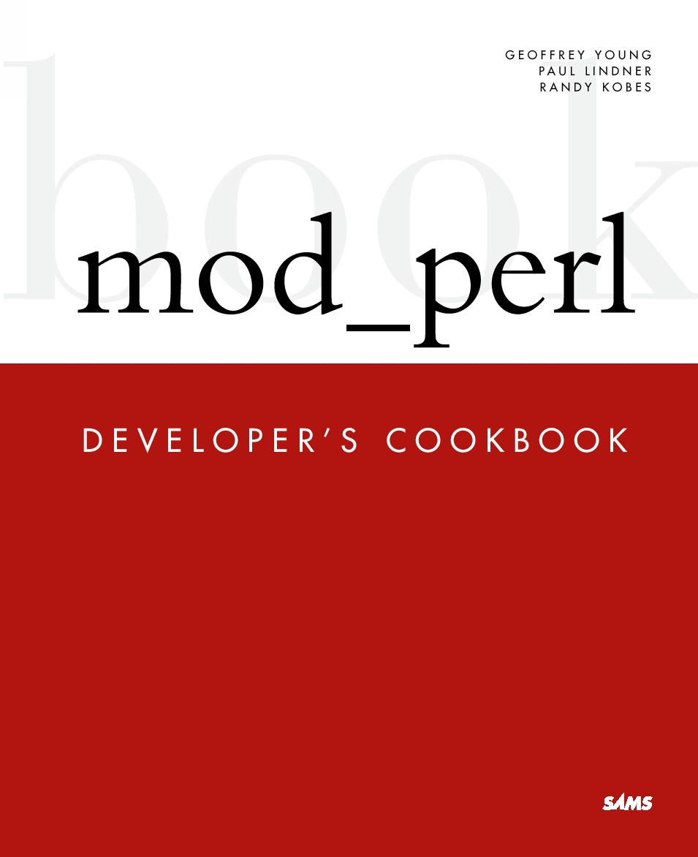
Book Signing, Chat, etc.
Today, 2 PM at Powell's

