Slide 1
Directive Handlers with mod_perl
Geoffrey Young
geoff@modperlcookbook.org

Slide 2
Apache Directives
If you have ever typo'd a directive in httpd.conf you've seen something like
Invalid command 'Foo', perhaps misspelled or defined by a module
not included in the server configuration
/usr/local/apache/bin/apachectl start: httpd could not be started
How does Apache know that Foo isn't a real directive?

Slide 3
Core Apache is small
Over 200 directives are supported by the standard Apache distribution
Less that 80 are from core Apache
All the rest are from C extension modules
  Alias /perl-bin /usr/local/apache/perl-bin
  mod_alias
  SetHandler perl-script
  mod_mime
  PerlHandler
  mod_perl

Slide 4
How it works
For C modules the process is ordinary
  a module registers itself with Apache
  Apache parses httpd.conf
  finds a directive
  looks for a module that agrees to handle the directive
  defaults to http_core if no module agrees

Slide 5
Data Validation
If a module agrees to handle the directive
  module tells Apache how the data should be formatted
  Apache validates the data format in httpd.conf
  Apache passes the config to the module
  module is free to use the data

Slide 6
Data Validation
httpd.conf
  XBitHack One Two, Buckle My Shoe
Apache responds
Syntax error on line 19 of /usr/local/apache/conf/httpd.conf:
XBitHack takes one argument, Off, On, or Full
/usr/local/apache/bin/apachectl start: httpd could not be started

Slide 7
Directive Handlers
As with all things, mod_perl provides an API for creating our own Apache directives
API is not all that intuitive
Does make sense if you think of the steps Apache has to go through

Slide 8
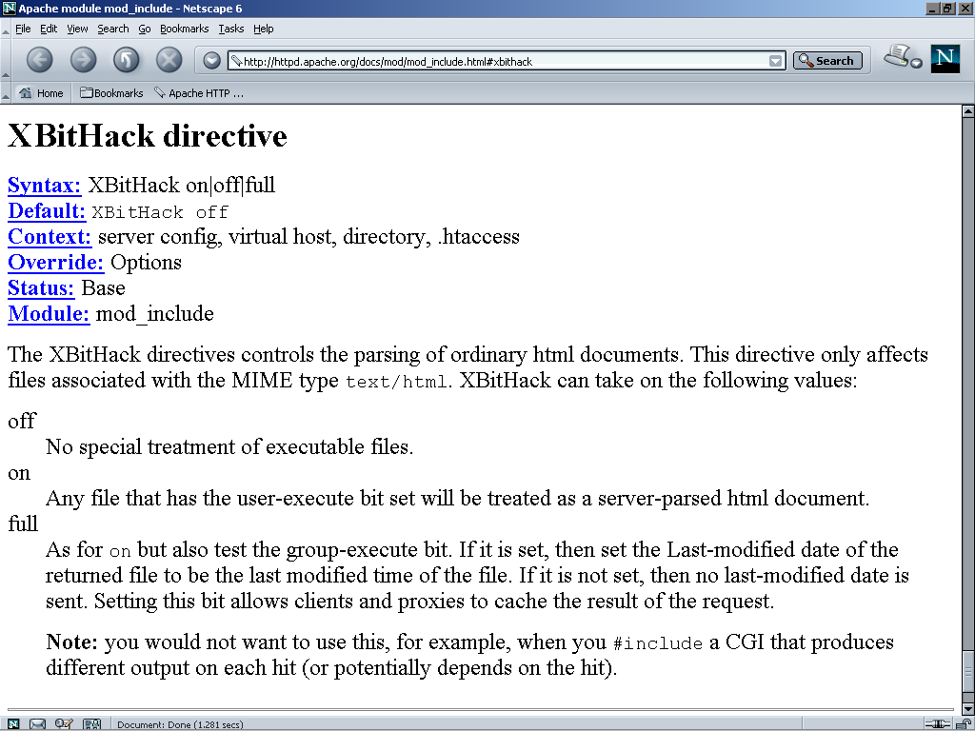

Slide 9
Our own XBitHack
Let's re-implement XBitHack in our own Perl module
Make it usable in for Apache on Win32
  on Unix - default to mod_include
  on Win32 - use our implementation
  PerlModule Cookbook::WinBitHack
  PerlFixupHandler Cookbook::WinBitHack
  XBitHack On

Slide 10
Step #1
Define what happens when Apache sees a good XBitHack directive

Slide 11
sub XBitHack {
my ($cfg, $parms, $arg) = @_;
# Let mod_include do the Unix stuff - we only do Win32.
return DECLINE_CMD unless $^O =~ m/Win32/;
if ($arg =~ m/^(On|Off|Full)$/i) {
$cfg->{_state} = uc($arg);
}
else {
die "Invalid XBitHack $arg!";
}
}

Slide 12
Step #2
Insert our request time processing
  PerlFixupHandler Cookbook::WinBitHack

Slide 13
sub handler {
my $r = shift;
my $cfg = Apache::ModuleConfig->get($r, __PACKAGE__);
return DECLINED unless (
$^O =~ m/Win32/ && # we're on Win32
-f $r->finfo && # the file exists
$r->content_type eq 'text/html' && # and is HTML
$r->allow_options & OPT_INCLUDES && # and we have Options +Includes
$cfg->{_state} ne 'OFF'); # and XBitHack On or Full
# Gather the file attributes.
my $attr;
Win32::File::GetAttributes($r->filename, $attr);
# Return DECLINED if the file has the ARCHIVE attribute set,
# which is the usual case.
return DECLINED if $attr & ARCHIVE();
# Set the Last-Modified header unless the READONLY attribute is set.
if ($cfg->{_state} eq 'FULL') {
$r->set_last_modified((stat _)[9]) unless $attr & READONLY();
}
# Make sure mod_include picks it up.
$r->handler('server-parsed');
return OK;
}

Slide 14
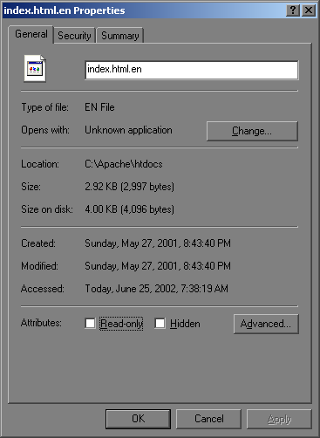
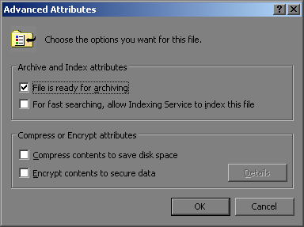
Win32 File Attributes

Slide 15
Step #3
Let Apache know our module exists

Slide 16
More than meets the eye
As Apache parses httpd.conf we have to let it know to check our Perl module when it encounters a directive
The mod_perl API essentially makes our Perl module into a C module using XS
Just a few simple steps in Makefile.PL

Slide 17
Makefile.PL
package Cookbook::WinBitHack;
use ExtUtils::MakeMaker;
use Apache::ExtUtils qw(command_table);
use Apache::src ();
use strict;
my @directives = (
{ name => 'XBitHack',
errmsg => 'Off, On, or Full',
args_how => 'TAKE1',
req_override => 'OR_OPTIONS', },
);
command_table(\@directives);

Slide 18
Magic
Running perl Makefile.PL has magically created WinBitHack.xs for us
static mod_perl_cmd_info cmd_info_XBitHack = {
"Cookbook::WinBitHack::XBitHack", "",
};
static command_rec mod_cmds[] = {
{ "XBitHack", perl_cmd_perl_TAKE1,
(void*)&cmd_info_XBitHack,
OR_OPTIONS, TAKE1, "Off, On, or Full" },
{ NULL }
};

Slide 19
mod_include.c
static command_rec mod_cmds[] = {
{ "XBitHack", perl_cmd_perl_TAKE1,
(void*)&cmd_info_XBitHack,
OR_OPTIONS, TAKE1, "Off, On, or Full" },
{ NULL }
};
static const command_rec includes_cmds[] =
{
{"XBitHack", set_xbithack, NULL, OR_OPTIONS, TAKE1, "Off, On, or Full"},
{NULL}
};

Slide 20
DynaLoader
package Cookbook::WinBitHack;
BEGIN {
eval{
require Win32::File;
Win32::File->import(qw(READONLY ARCHIVE));
};
}
use Apache::Constants qw(OK DECLINED OPT_INCLUDES DECLINE_CMD);
use Apache::File;
use Apache::ModuleConfig;
use DynaLoader;
use 5.006;
use strict;
our $VERSION = '0.01';
our @ISA = qw(DynaLoader);
__PACKAGE__->bootstrap($VERSION);

Slide 21
# apachectl start
PerlModule Cookbook::WinBitHack
__PACKAGE__->bootstrap($VERSION);

Slide 22
# apachectl start
PerlModule Cookbook::WinBitHack
XBitHack Full
Cookbook::WinBitHack::XBitHack()

Slide 23
# apachectl start
PerlModule Cookbook::WinBitHack
XBitHack Full
client request
URI-based init
URI translation
Cookbook::WinBitHack::handler()
PerlFixupHandler
file-based init
MIME setting
resource control

Slide 24
# apachectl start
PerlModule Cookbook::WinBitHack
XBitHack Full
client request
URI-based init
mod_include
content
URI translation
fixups
file-based init
MIME setting
resource control

Slide 25
Be Proud
What we've just accomplished is pretty amazing
  made our Perl module look like an Apache C extension module
  Altered the behavior of a standard Apache directive to meet new, previously unmet needs
  All with relatively little work
Now, we're doing more

Slide 26
AddHandler and mod_perl
The default AddHandler directive doesn't suit the needs of mod_perl developers
  AddHandler server-parsed .html
The problem is that mod_perl requires two directives in order to handle content
  AddHandler perl-script .html
  PerlHandler Apache::SSI
Wouldn't it be nice to have
  AddHandler Apache::SSI .html

Slide 27
Let's do it ourselves
Some things we need to do...
  override the default AddHandler directive
  schedule various extensions to use various Perl modules
  figure out where SetHandler overrides the file extension

Slide 28
package Cookbook::MIMEMapper;
use ExtUtils::MakeMaker;
use Apache::ExtUtils qw(command_table);
use Apache::src ();
use strict;
my @directives = (
{ name => 'AddHandler',
errmsg => 'stash AddHandler settings',
args_how => 'ITERATE2',
req_override => 'OR_FILEINFO', },
{ name => 'SetHandler',
errmsg => 'note SetHandler is active',
args_how => 'TAKE1',
req_override => 'OR_FILEINFO', },
);
command_table(\@directives);

Slide 29
sub AddHandler {
my ($cfg, $parms, $handler, $type) = @_;
# Intercept the directive if it looks like a PerlHandler.
# This is not an ideal check, but sufficient
if ($handler =~ m/::/) {
push @{$cfg->{$type}}, $handler;
return OK;
}
# Otherwise let mod_mime handle it.
return DECLINE_CMD;
}
sub SetHandler {
my ($cfg, $parms, $handler) = @_;
$cfg->{_set_handler} = 1;
# We're just marking areas governed by SetHandler.
return DECLINE_CMD;
}

Slide 30
sub handler {
my $r = shift;
my $cfg = Apache::ModuleConfig->get($r, __PACKAGE__);
# Also decline if a SetHandler directive is present.
# which ought to override any AddHandler settings.
return DECLINED if $cfg->{_set_handler};
my ($extension) = $r->filename =~ m!(\.[^.]+)$!;
# Set the PerlHandler stack if we have a mapping
if (my $handlers = $cfg->{$extension}) {
$r->handler('perl-script');
$r->set_handlers(PerlHandler => $handlers);
# Notify Apache::Filter if we have more than one
$r->dir_config->set(Filter => 'On') if @$handlers > 1;
}
return OK;
}

Slide 31
Setup
PerlModule Apache::MIMEMapper
PerlFixupHandler Apache::MIMEMapper
AddHandler Apache::RegistryFilter .pl
AddHandler Apache::SSI .html .pl
Alias /perl-bin/ /usr/local/apache/perl-bin/
<Location /perl-bin/>
SetHandler perl-script
PerlHandler Apache::Registry
Options +ExecCGI
PerlSendHeader On
</Location>

Slide 32
Fine Manuals
Writing Apache Modules with Perl and C
  http://www.modperl.com/
mod_perl Developer's Cookbook
  http://www.modperlcookbook.org/
mod_perl Pocket Reference
  http://www.refcards.com/
mod_perl Guide
  http://perl.apache.org/guide/
  http://www.modperlbook.org/
mod_perl at the ASF
  http://perl.apache.org/

Slide 33
Materials
These slides
http://www.modperlcookbook.org/~geoff/slides/YAPC
My modules
http://www.modperlcookbook.org/~geoff/modules

Slide 34
