Slide 1
Object Oriented mod_perl)
Geoffrey Young
geoff@modperlcookbook.org

Slide 2

Objects, smobjects
Object-oriented programming has many advantages
  subject of great debate
Programming mod_perl in OO makes all kinds of wizardy possible
  also makes julienne fries
Let's do more using OOP

Slide 3
Perl OO Primer
Some basic object-oriented features to understand
  classes
  methods
  objects
  inheritance

Slide 4

Pay Homage
The entire object-oriented Perl world owes Damian Conway a huge debt of gratitude
The definitions that follow are essentially his...
Any mistakes are unquestionably mine

Slide 5
Perl Classes
"To create a class, build a package"
Perl packages associate variables and subroutines together under a common namespace
  package My::Dinghy;
  use 5.006;
  use strict;
  1;

Slide 6
Perl Methods
"To create a method, build a subroutine"
Perl subroutines can be called as functional subroutines
  print $fh 'print() is a function';
or as methods
  $fh->print('print() is a method');
  sub print {
  my ($self, @data) = @_;
  }

Slide 7
Perl Objects
"To create an object, bless a referent"
Perl has a special function bless() that associates a variable with a class
  my $self = {};
  return bless $self, $class;
It's the variable that is associated with the class, not the reference to the variable

Slide 8
Perl Inheritance
To create a subclass, populate @ISA
  I made that up for consistency
@ISA controls how Perl searches for methods when it can't find any in the subclass
@ISA is a package global
  our @ISA = qw(My::Dinghy);
  use vars qw(@ISA);
  @ISA = qw(My::Dinghy);
  @My::12Meter::ISA = qw(My::Dinghy);

Slide 9
Guess What?
mod_perl has already introduced you to most of Perl's OO semantics
my $r = Apache->request;
my $host = $r->headers_in->get('Host');
In fact, mod_perl almost begs you to use OO

Slide 10
OO mod_perl
Programming using the mod_perl API forces us to use most of Perls OO tools already
We just need to fill in a few of the gaps for phenomenal cosmic power...

Slide 11
Step #1
Change our existing handlers to method handlers
Method handlers are just normal handlers called using OO syntax
Allow us to use OO techniques to our advantage

Slide 12
Prototyping
The classical way is to use Perl prototypes
  sub handler ($$) {
  ...
  }
Prototypes are deprecated in 2.0

Slide 13
Attributes
The new way is to use subroutine attributes
  sub handler : method {
  ...
  }
See the attributes manpage

Slide 14
Step #2
Change our handler() method to be able to receive an OO call
  sub handler : method {
  my ($self, $r) = @_;
  }
$self is the invoking class
  most of the time
$r is the same old Apache request object

Slide 15
Step #3
Call the handler using a method syntax
  PerlModule My::MethodHandler
  PerlInitHandler My::MethodHandler->handler
Pre-loading is required
The arrow syntax is not

Slide 16
So What?
Normal handlers and method handlers are equivalent in nearly all areas...
... but now you have the ability to inherit from other classes using OO techniques

Slide 17
For Example
Apache::SSI provides a Perl implementation of Server Side Includes
  <Files *.shtml>
  SetHandler perl-script
  PerlHandler Apache::SSI
  </Files>
Equivalent to mod_include except it adds a few important features...

Slide 18
Apache::SSI
Integrates with Apache::Filter to provide filtered content generation
    <Location /pipeline>
    SetHandler perl-script
    PerlHandler My::Content Apache::SSI Apache::Clean
    PerlSetVar Filter On
    </Location>
Pipelining like this is impossible using mod_cgi and mod_include
  in Apache 1.3 at least

Slide 19
Drawbacks
Apache::SSI is a huge win for people who like to modularize processing
There is one rather limiting drawback to the current implementation
If you use the exec or include SSI tag Apache::SSI must be the final filter in the chain
  PerlHandler My::Content Apache::SSI
  due to implementation constraints

Slide 20
There is Hope
Fortunately, Apache::SSI is implemented using method handlers
We can subclass Apache::SSI and provide our own exec and include implementations that fix the problem
We leave all the document parsing and other tag implementations alone
* Apache::SSI now includes Apache::FakeSSI which accomplishes the same thing, but is a complete implementation

Slide 21
package Cookbook::SSI;
use Apache::SSI;
use HTTP::Request;
use LWP::UserAgent;
use strict;
@Cookbook::SSI::ISA = qw(Apache::SSI);
sub ssi_include {
my ($self, $args) = @_;
return $self->error("Include must be of type 'virtual'")
unless $args->{virtual};
my $uri = Apache::URI->parse(Apache->request);
if ($args->{virtual} =~ m!^/!) {
$uri->path($args->{virtual}); # path is absolute
}
else {
my ($base) = $uri->path =~ m!(.*/)!; # path is relative
$uri->path($base . $args->{virtual});
}
my $request = HTTP::Request->new(GET => $uri->unparse);
my $response = LWP::UserAgent->new->request($request);
return $self->error("Could not Include virtual URL");
unless $response->is_success;
return $response->content;
}
1;

Slide 22
Setup
Just use our module wherever we used to use Apache::SSI
PerlModule Apache::SSI
<Location /pipeline>
SetHandler perl-script
PerlHandler My::Content Apache::SSI Apache::Clean
PerlSetVar Filter On
</Location>

Slide 23
But wait, there's more...
Method handlers are a nice thing to have
Not very interesting in themselves
Overriding core mod_perl classes is where the real fun begins

Slide 24
The Apache Class
The Apache class is at the heart of all we do in mod_perl
Implements most of the amazing things we associate with the mod_perl API
You can make mod_perl do your own evil bidding by extending and overriding Apache

Slide 25
Subclassing Apache
Let's make $r->bytes_sent() return KB instead of bytes
How? Create a simple subclass that does the calculation for us

Slide 26
package Cookbook::Apache;
use Apache;
use strict;
@Cookbook::Apache::ISA = qw(Apache);
sub new {
my ($class, $r) = @_;
$r ||= Apache->request;
return bless { r => $r }, $class;
}
sub bytes_sent {
return sprintf("%.0f", shift->SUPER::bytes_sent / 1024);
}
1;

Slide 27
H'wa?
What's going on here?
  our @ISA = qw(Apache);
  return bless { r => $r }, $class;
  ask Doug if you see him
  typemap
    r = sv2request_rec($arg, \"$ntype\", cv)
  sv2request_rec
    checks %$arg for _r or r keys
    calls sv2request_rec using _r or r for $arg
Hey, it works

Slide 28
Sample Usage
package My::Bytes;
use Apache::Constants qw(OK);
use Cookbook::Apache;
use strict;
sub handler {
my $r = shift;
my $c = Cookbook::Apache->new($r);
$c->log_error($c->bytes_sent, ' KB sent for ', $c->uri);
$r->log_error($r->bytes_sent, ' bytes sent for ', $r->uri);
return OK;
}
1;

Slide 29
Let's Simplify
We only used both $r and $c in this example to show the difference
Most of the time, you only need one request object, since your subclass inherits all the normal Apache methods
  sub handler {
  my $r = Cookbook::Apache->new(shift);

Slide 30
Kick it up a notch
Our sample Apache subclass isn't terribly interesting or terribly useful
Time to add a little heat

Slide 31
Cross-Site Scripting
As web developers, we should always check end-user input before using it
For system() calls, that means making sure no input is tainted
  running with -T switch
  PerlTaintCheck On
For HTML output, that means escaping input (< to &lt;) before displaying
  HTML::Entities::escape()
  Apache::Util::escape_html()

Slide 32
Lots of Overhead
For CGI or mod_perl developers, that means remembering lots of calls to encode() or escape_html()
  which, of course, everyone does. Right?
By subclassing the Apache class we can escape output automatically
We don't want to escape all output, just the stuff from the end-user
Get help from Taint.pm

Slide 33
Background
We need to add PerlTaintCheck On to our httpd.conf to mimic the -T switch
Use Taint::tainted() to determine whether data is tainted
    not eval { join("",@_), kill 0; 1 };
"send the data along"

Slide 34
package Cookbook::TaintRequest;
use Apache;
use Apache::Util qw(escape_html);
# Module load will die if PerlTaintCheck Off
use Taint qw(tainted);
use strict;
@Cookbook::TaintRequest::ISA = qw(Apache);
sub print {
my ($self, @data) = @_;
foreach my $value (@data) {
# Dereference scalar references.
$value = $$value if ref $value eq 'SCALAR';
# Escape any HTML content if the data is tainted.
$value = escape_html($value) if tainted($value);
}
$self->SUPER::print(@data);
}

Slide 35
What's missing?
So far all we have done is override mod_perl's $r->print()
We still have to create a constructor for our class
But what about just plain print()?
  print "<script>Heh!</script>";
Our constructor needs to be special

Slide 36
TIEHANDLE
Perl provides the TIEHANDLE interface as a way to override how filehandles behave when written to or read from
  print "foo";
  print STDOUT "foo";
mod_perl uses tied filehandles to our advantage

Slide 37
More mod_perl Magic
$r->print() sends data to the client
  wrapper around Apache API calls that write data over the wire
mod_perl ties standard streams to the Apache class
  writes to STDOUT use $r->print()
    why Apache::Registry works
  reads from STDIN use Apache API calls to get data from the wire
We need to intercept both $r->print() and print()s to STDOUT

Slide 38
Apache's TIEHANDLE
The Apache class provides a TIEHANDLE interface
When subclassing the Apache class, we can override the PRINT part of the interface
Leave the other TIEHANDLE parts in tact

Slide 39
sub new {
my ($class, $r) = @_;
$r ||= Apache->request;
tie *STDOUT, $class, $r;
return tied *STDOUT;
}
sub TIEHANDLE {
my ($class, $r) = @_;
return bless { r => $r }, $class;
}
sub PRINT {
shift->print(@_);
}
1;

Slide 40
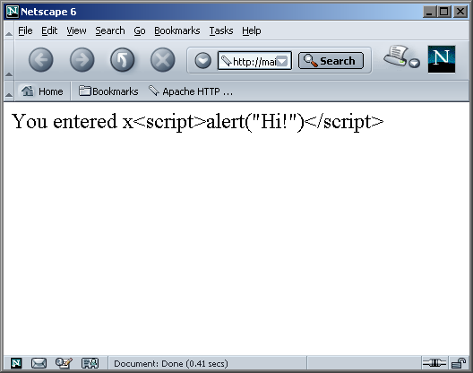
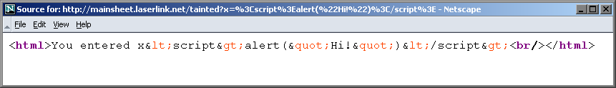
/tainted?x=<script>alert("Hi!")</script>

Slide 41
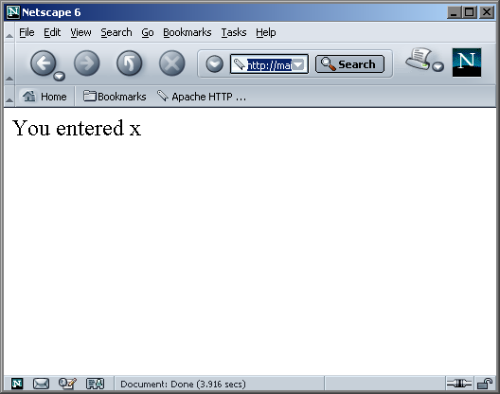
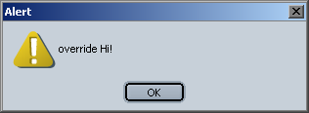
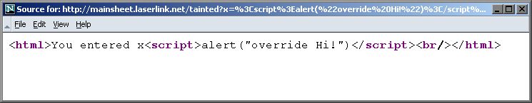
/tainted?x=<script>alert("override Hi!")</script>

Slide 42
Registry has issues...
Apache::Registry is incredibly cool
But it's not perfect
  Apache::Registry - Run unaltered CGI scrips under mod_perl
Scripts that work perfectly well under mod_cgi balk with Apache::Registry
  that's why there's Apache::PerlRun
Not even PerlRun can save you from some of the issues

Slide 43
For instance...
Mixing mod_perl with legacy CGI code can be difficult
  now you can isolate processing in phases other than content-generation
What happens when you need POST data in other phases and legacy Apache::Registry code?
What we need is a way to cache POST data that makes it accessible to legacy CGI scripts

Slide 44
Registry: The Next Generation
Apache::Registry is pretty complex and difficult to alter
Apache::RegistryNG behaves almost the same, but is object-oriented and a much better candidate for subclassing
Apache::RegistryNG is actually a subclass of Apache::PerlRun

Slide 45
Do more!
Let's do more by subclassing Apache::RegistryNG
tie STDIN instead...

Slide 46
package Apache::CachePOSTRegistry;
use Apache::RegistryNG;
use Apache::Request;
use strict;
@Apache::CachePOSTRegistry::ISA = qw(Apache::RegistryNG);
sub new {
my ($class, $r) = @_;
$r = Apache::Request->instance($r || Apache->request);
tie *STDIN, $class, $r;
return tied *STDIN;
}
sub TIEHANDLE {
my ($class, $r) = @_;
return bless { r => $r }, $class;
}

Slide 47
Apache::Request->instance()
Same as Apache::Request->new()
Stores away an Apache::Request object (with the POST data) and uses it for future instantiations
sub instance {
my $class = shift;
my $r = shift;
if (my $apreq = $r->pnotes('apreq')) {
return $apreq;
}
my $new_req = $class->new($r, @_);
$r->pnotes('apreq', $new_req);
return $new_req;
}

Slide 48
sub READ {
my $self = shift;
my $buf = \($_[0]); shift;
my $len = shift;
my $offset = shift || 0;
my @args = ();
$self->{r}->param->do(sub {
push @args, join '=', @_;
1;
});
my $input = join '&', @args;
$input =~ s! !+!g;
substr($$buf, $offset) = substr($input, 0, $len);
substr($input, 0, $len) = '';
return length substr($$buf, $offset);
}
1;

Slide 49
It Works!
sub My::InitHandler {
my $r = Apache::Request->instance(shift);
my @post = $r->param;
...
return Apache::Constants::OK;
}
1;
#!/usr/bin/perl
read(STDIN, my $posted, $ENV{'CONTENT_LENGTH'});
print "Content-type: text/plain\n\n";
print $posted;

Slide 50
It Works!
sub My::InitHandler {
my $r = Apache::Request->instance(shift);
my @post = $r->param;
...
return Apache::Constants::OK;
}
1;
#!/usr/bin/perl
use CGI;
my $q = CGI->new;
print $q->header(-type=>'text/plain');
print $q->param;

Slide 51
XS Anyone?
Just for kicks, let's throw some XS into the mix
XS is the glue that ties Apache and Perl together
  most of the mod_perl API lives in Apache.xs
Unfortunately, mod_perl 1.3 doesn't offer up all the Apache API, only selected parts
With XS, we can open up the rest...

Slide 52
Assbackwards
In Apache-speak, a request that is assbackwards is an HTTP/0.9 request
Apache still supports HTTP/0.9
$ telnet localhost 80
Trying 127.0.0.1...
Connected to localhost.
Escape character is '^]'.
GET /cgi-bin/sayhello.cgi

Slide 53
The assbackwards Flag
Apache marks HTTP/0.9 requests with the assbackwards flag in the request record
If r->assbackwards is set, Apache doesn't send any headers
mod_perl does not provide a way to access the assbackwards flag
but it uses it when convenient
  my $sub = $r->lookup_uri('/layline.html');
  $sub->run(1);
You can too!

Slide 54
Approach
Accessing parts of the Apache API that mod_perl does not natively support requires XS
  Assbackwards.pm
  Assbackwards.xs
  typemap
  Makefile.PL
Fortunately, in this case, all the parts are simple

Slide 55
package Apache::Assbackwards;
use 5.006;
use strict;
use warnings;
use DynaLoader;
our @ISA = qw(DynaLoader Apache);
our $VERSION = '0.01';
__PACKAGE__->bootstrap($VERSION);
sub new {
my ($class, $r) = @_;
$r ||= Apache->request;
return bless { r => $r }, $class;
}
1;

Slide 56
#include "EXTERN.h"
#include "perl.h"
#include "XSUB.h"
#include "mod_perl.h"
#include "mod_perl_xs.h"
MODULE = Apache::Assbackwards PACKAGE = Apache::Assbackwards
PROTOTYPES: ENABLE
int
assbackwards(r, ...)
Apache r
CODE:
get_set_IV(r->assbackwards);
OUTPUT:
RETVAL

Slide 57
The typemap Part
TYPEMAP
Apache T_APACHEOBJ
OUTPUT
T_APACHEOBJ
sv_setref_pv($arg, \"${ntype}\", (void*)$var);
INPUT
T_APACHEOBJ
r = sv2request_rec($arg, \"$ntype\", cv)

Slide 58
The Makefile.PL Part
use Apache::src ();
WriteMakefile(
NAME => 'Apache::Assbackwards',
VERSION_FROM => 'Assbackwards.pm',
INC => Apache::src->new->inc,
}

Slide 59
make
Just use the canonical
  $ perl Makefile.PL
  $ make
  $ sudo make install
and you're good to go

Slide 60
How do we use it?
package My::Assbackwards;
use Apache::Assbackwards;
use strict;
sub handler {
my $r = Apache::Assbackwards->new(shift);
$r->assbackwards(1);
return Apache::Constants::OK;
}
1;

Slide 61
$ telnet localhost 80
Trying 127.0.0.1...
Connected to localhost.
Escape character is '^]'.
GET /cgi-bin/sayhello.cgi HTTP/1.0
HTTP/1.1 200 OK
Date: Sat, 15 Jun 2002 19:08:48 GMT
Server: Apache/1.3.25-dev (Unix) mod_perl/1.27_01-dev Perl/v5.8.0
Expires: Sat, 15 Jun 2002 19:08:50 GMT
Connection: close
Content-Type: text/plain; charset=ISO-8859-1
Hi
$ telnet localhost 80
Trying 127.0.0.1...
Connected to localhost.
Escape character is '^]'.
GET /cgi-bin/sayhello.cgi HTTP/1.0
Hi

Slide 62
That was fun, but...
Ok, the assbackwards flag is amusing but not all too practical
How about something more applicable?
  ap_note_digest_auth_failure

Slide 63
The XS Part
#include "EXTERN.h"
#include "perl.h"
#include "XSUB.h"
#include "mod_perl.h"
MODULE = Apache::AuthDigest::API PACKAGE = Apache::AuthDigest::API
PROTOTYPES: ENABLE
void
note_digest_auth_failure(r)
Apache r
CODE:
ap_note_digest_auth_failure(r);

Slide 64
The Perl Part
...
our $VERSION = '0.01';
our @ISA = qw(DynaLoader Apache);
__PACKAGE__->bootstrap($VERSION);
...
sub new {
my ($class, $r) = @_;
$r ||= Apache->request;
return bless { r => $r }, $class;
}
...
unless ($response) {
$log->info("Client did not supply a Digest response");
$r->note_digest_auth_failure;
return AUTH_REQUIRED
}

Slide 65
More?
Apache provides for something called "registered cleanups"
$r->register_cleanup(\&cleanup);
PerlCleanupHandler My::Cleanup
Apache->server->register_cleanup(\&cleanup);
Cleanups allow you to schedule processing at various end points in the Apache runtime

Slide 66
More?
Apache provides for something called "registered cleanups"
$r->register_cleanup(\&cleanup);
PerlCleanupHandler My::Cleanup
Apache->server->register_cleanup(\&cleanup);
Cleanups allow you to schedule processing at various end points in the Apache runtime
All use Apache's concept of memory pools

Slide 67
Keepalives
HTTP/1.1 allows for more than one request per connection
  Connection: Keep-Alive
Connections are interfaces with the Apache::Connection class
  my $c = $r->connection;
Apache creates a per-connection memory pool
mod_perl provides no way to register per-connection cleanups

Slide 68
Per-connection Cleanups
Unfortunately, mod_perl wasn't designed so you could subclass the Apache::Connection class
Let's subclass the Apache class and re-bless $r->connection into our class

Slide 69
package Apache::ConnectionCleanup;
use 5.006;
use strict;
use Apache;
use Apache::ConnectionCleanup::RegisterCleanup;
our @ISA = qw(Apache);
sub new {
my ($class, $r) = @_;
$r ||= Apache->request;
return bless { r => $r }, $class;
}
sub connection {
my $connection = shift->SUPER::connection;
return bless $connection,
'Apache::ConnectionCleanup::RegisterCleanup';
}
1;

Slide 70
package Apache::ConnectionCleanup::RegisterCleanup;
use 5.006;
use strict;
use warnings;
use Apache::Connection;
use DynaLoader;
our @ISA = qw(DynaLoader Apache::Connection);
our $VERSION = '0.01';
__PACKAGE__->bootstrap($VERSION);
1;

Slide 71
#include "EXTERN.h"
#include "perl.h"
#include "XSUB.h"
#include "mod_perl.h"
...
static void ApacheConnection_register_cleanup(conn_rec *c, SV *cv)
{
pool *p = c->pool;
...
register_cleanup(p, conn, conn_cleanup_handler, mod_perl_noop);
}
...
void
register_cleanup(conn, cv)
Apache::Connection conn
SV *cv
CODE:
ApacheConnection_register_cleanup(conn, cv);

Slide 72
Fine Manuals
Writing Apache Modules with Perl and C
  http://www.modperl.com/
mod_perl Developer's Cookbook
  http://www.modperlcookbook.org/
mod_perl Pocket Reference
  http://www.refcards.com/
mod_perl Guide
  http://perl.apache.org/guide/
  http://www.modperlbook.org/
mod_perl at the ASF
  http://perl.apache.org/

Slide 73
Materials
These slides
http://www.modperlcookbook.org/~geoff/slides/YAPC
My modules
http://www.modperlcookbook.org/~geoff/modules

Slide 74
