Slide 1
Why mod_perl 2.0 Sucks
Why mod_perl 2.0 Rocks
Geoffrey Young
geoff@modperlcookbook.org

Slide 2
A Long Time Ago...
I figured it was time to take mod_perl 2.0 for a test drive...

Slide 3
Laziness, Impatience, Hubris
"I know mod_perl pretty well..."
"Compat layers and docs are for weenies..."
"It's still HTTP, so not much can change..."
"This will be easy."

Slide 4
The Adventure Begins
So, I take an existing, complex handler and just plug it in...

Slide 5
Let's Try Again
"Hmm, maybe something simpler won't dump core."

Slide 6
Let's Try Again
"Hmm, maybe something simpler won't dump core."
So, I try a new, but simple, program...

Slide 7
package My::Foo;
use Apache::Constants qw(OK);
use strict;
sub handler {
my $r = shift;
my $log = $r->server->log;
$log->info('*** processing uri ', $r->uri);
my $foo = $r->dir_config->get('Foo');
$r->content_type('text/plain');
$r->send_http_header;
$r->print("found $foo");
return OK;
}
1;

Slide 8
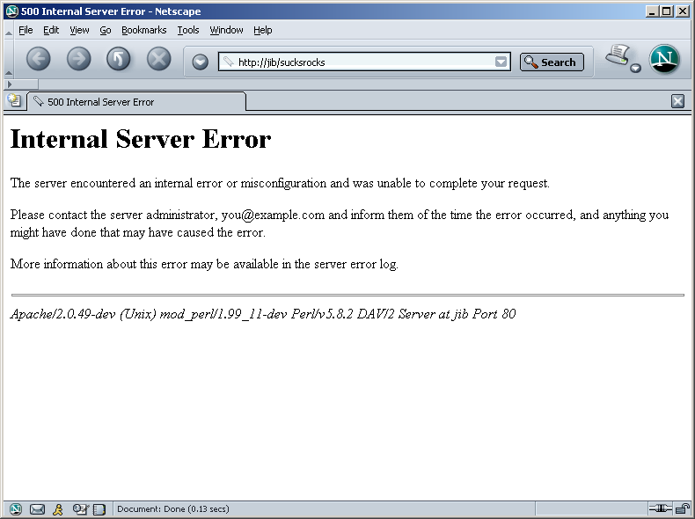

Slide 9
package My::Foo;
use Apache::Const qw(OK);
use Apache::RequestRec ();
use Apache::Server ();
use Apache::Log ();
use Apache::RequestUtil ();
use APR::Table ();
use Apache::RequestIO ();
use strict;
sub handler {
my $r = shift;
my $log = $r->server->log;
$log->info('*** processing uri ', $r->uri);
my $foo = $r->dir_config->get('Foo');
$r->content_type('text/plain');
$r->print("found $foo");
return OK;
}
1;

Slide 10
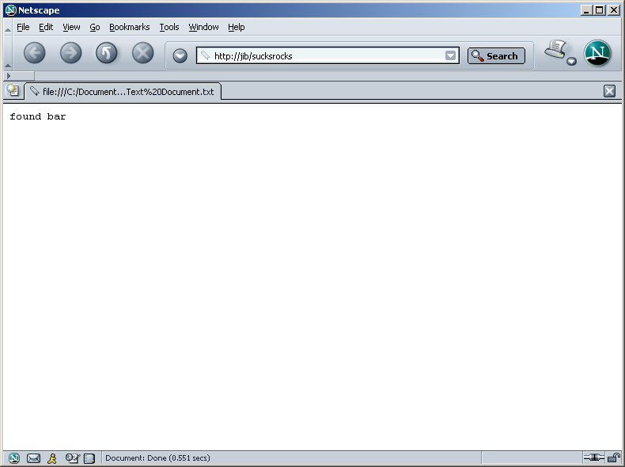

Slide 11
DWIMmy
use Apache::Constants qw(OK);

Slide 12
un-DWIMmy
use Apache::Const qw(OK);
use Apache::RequestRec ();
use Apache::Server ();
use Apache::Log ();
use Apache::RequestUtil ();
use APR::Table ();
use Apache::RequestIO ();

Slide 13
un-DWIMmy
use Apache::Const qw(OK);
use Apache::RequestRec ();
use Apache::Server ();
use Apache::Log ();
use Apache::RequestUtil ();
use APR::Table ();
use Apache::Util ();
use Apache::Response ();
use Apache::ServerUtil ();
use Apache::Process ();
use APR::Pool ();
use base qw(Apache::Filter);

Slide 14
speaking of use base...
sub handler {
my $r = shift
...
}

Slide 15
Subroutine Attributes
sub handler : method {
my $self = shift;
my $r = shift;
...
}

Slide 16
this space intentionally left blank
sub handler :
FilterRequestHandler
FilterHasInitHandler(\&init) {
my $f = shift;
...
}

Slide 17
Frustration
You know what you need
  $r->server->log()
  $r->uri()
  $r->dir_config->get()
  $r->content_type()
  $r->print()
You just can't get to it

Slide 18
Gripes
un-DWIMmy
Examples and docs difficult to find
Too many calls to grep(1)

Slide 19
Something Better Here?
use Apache::Const qw(OK);
use Apache::RequestRec ();
use Apache::Server ();
use Apache::Log ();
use Apache::RequestUtil ();
use APR::Table ();
use Apache::RequestIO ();

Slide 20
Class Separation
Reinforces what mod_perl really is
  access to the Apache C API in Perl

Slide 21
Apache::RequestRec
Makes $r more like r
Contains only methods for accessing request_rec slots
  $r->notes()
  $r->content_type()
  $r->headers_out()
  $r->per_dir_config()
  $r->pool()

Slide 22
This ROCKS!
Yes, mod_perl 2.0 has an assbackwards() method
Access to assbackwards slot in the request_rec

Slide 23
Assbackwards
In Apache-speak, an HTTP/0.9 request is assbackwards
Apache still supports HTTP/0.9
$ telnet localhost 80
Trying 127.0.0.1...
Connected to localhost.
Escape character is '^]'.
GET /cgi-bin/sayhello.cgi

Slide 24
The assbackwards Flag
Apache marks HTTP/0.9 requests by setting the assbackwards flag in the request record
If r->assbackwards is set, Apache doesn't send any headers
mod_perl 1.0 did not provide a way to access the assbackwards flag but it used it when convenient
  my $sub = $r->lookup_uri('/layline.html');
  $sub->assbackwards(1);
  $sub->run();

Slide 25
This ROCKS!
Yes, mod_perl 2.0 has an assbackwards() method
Access to assbackwards slot in the request_rec
Saying assbackwards is cool
Indicative of something even cooler...

Slide 26
Access to Everything
The goal of mod_perl has always been complete access to the Apache C API
1.0 - partially opened over time
2.0 - entire Apache C API is open by default
  autogenerated API access
  only closed where a Perl API isn't appropriate
Complete access just rocks

Slide 27
Output Filters
New in Apache 2.0
Allow you to post-process content after the content phase has run
mod_perl has been able to filter content for years
  limited to mod_perl generated content
    mod_perl can do lots, like CGI and SSI
Output filters let you filter everything
  no matter who generates the content

Slide 28
Perl Output Filters
Complete access to the Apache filtering API
  raw bucket brigade manipulations
mod_perl also makes Apache Perl-ish
  streaming filter API
Streaming filters are insanely easy to write

Slide 29
package My::Filter;
use Apache::Filter ();
use Apache::Const qw(OK);
sub handler {
my $f = shift;
while ($f->read(my $buffer, 1024)) {
# do something with $buffer
$f->print($buffer);
}
return OK;
}
1;

Slide 30
httpd.conf
PerlOutputFilterHandler My::Filter

Slide 31
httpd.conf
# alter _all_ PHP pages (just a bit)
PerlOutputFilterHandler Apache::Hijack

Slide 32
package Apache::Hijack;
use Apache::Filter ();
use Apache::RequestRec ();
use Apache::Const -compile => qw(OK DECLINED);
use strict;
sub handler {
my $f = shift;
my $r = $f->r;
return Apache::DECLINED
unless $r->handler eq 'php-script' or
$r->handler eq 'application/x-httpd-php';
while ($f->read(my $buffer, 1024)) {
$buffer =~ s!(<body>)!$1<h1>got mod_perl?</h1>!i;
$f->print($buffer);
}
return Apache::OK;
}
1;

Slide 33
package Apache::Hijack;
use Apache::Filter ();
use Apache::RequestRec ();
use Apache::Const -compile => qw(OK DECLINED);
use strict;
sub handler {
my $f = shift;
my $r = $f->r;
return Apache::DECLINED
unless $r->handler eq 'php-script' or
$r->handler eq 'application/x-httpd-php';
while ($f->read(my $buffer, 1024)) {
$buffer =~ s!(<body>)!$1<h1>got mod_perl?</h1>!i;
$f->print($buffer);
}
return Apache::OK;
}
1;

Slide 34
package Apache::Hijack;
use Apache::Filter ();
use Apache::RequestRec ();
use Apache::Const -compile => qw(OK DECLINED);
use strict;
sub handler {
my $f = shift;
my $r = $f->r;
return Apache::DECLINED
unless $r->handler eq 'php-script' or
$r->handler eq 'application/x-httpd-php';
my $extra;
while ($f->read(my $buffer, 1024)) {
$buffer = $extra . $buffer if $extra;
$buffer = substr($buffer, 0, - length($extra))
if (($extra) = $buffer =~ m/(<[^>]*)$/);
$buffer =~ s!(<body>)!$1<h1>got mod_perl?</h1>!i;
$f->print($buffer) unless $extra;
}
return Apache::OK;
}
1;

Slide 35
package Apache::Hijack;
use Apache::Filter ();
use Apache::RequestRec ();
use APR::Table ();
use Apache::Const -compile => qw(OK DECLINED);
use strict;
sub handler {
my $f = shift;
my $r = $f->r;
return Apache::DECLINED
unless $r->handler eq 'php-script' or
$r->handler eq 'application/x-httpd-php';
$r->headers_out->unset('Content-Length');
$r->headers_out->set('X-Powered-By' => 'mod_perl 2.0');
my $extra;
while ($f->read(my $buffer, 1024)) {
$buffer = $extra . $buffer if $extra;
$buffer = substr($buffer, 0, - length($extra))
if (($extra) = $buffer =~ m/(<[^>]*)$/);
$buffer =~ s!(<body>)!$1<h1>got mod_perl?</h1>!i;
$f->print($buffer) unless $extra;
}
return Apache::OK;
}
1;

Slide 36
package Apache::HijackFull;
use Apache::Filter ();
use Apache::RequestRec ();
use APR::Table ();
use Apache::Const -compile => qw(OK DECLINED);
use strict;
sub handler {
my $f = shift;
my $r = $f->r;
return Apache::DECLINED
unless $r->handler eq 'php-script' or
$r->handler eq 'application/x-httpd-php';
my $context;
unless ($f->ctx) {
$r->headers_out->unset('Content-Length');
$r->headers_out->set('X-Powered-By' => 'mod_perl 2.0');
$context = { extra => undef };
}
$context ||= $f->ctx;
while ($f->read(my $buffer, 1024)) {
$buffer = $context->{extra} . $buffer if $context->{extra};
if (($context->{extra}) = $buffer =~ m/(<[^>]*)$/) {
$buffer = substr($buffer, 0, - length($context->{extra}));
}
$buffer =~ s!(<body>)!$1<h1>got mod_perl?</h1>!i;
$f->print($buffer) unless $context->{extra};
}
$f->ctx($context) unless $f->seen_eos;
return Apache::OK;
}
1;

Slide 37
Apache-Test
Single best part of mod_perl 2.0
Framework for unit testing Apache-based applications
  mod_perl handlers
  CGI scripts
  SOAP servers
  more
So useful, it became the basis of the httpd-test project

Slide 38
Speaking of Tests...
Apache-Test used in mod_perl 2.0 development from the start
More, better tests in 2.0
Comes very close to exercising every part of the external API
More tests == better software

Slide 39
But Wait, There's More!
Better community support
APR
Proper stacked handler support
Pure-Perl directive handlers
Better cross-platform Makefile.PL support
Easier XS extension integration

Slide 40
Why mod_perl 2.0 Sucks
Different

Slide 41
Why mod_perl 2.0 Rocks
Better

Slide 42
More Information
mod_perl homepage
  http://perl.apache.org/docs/2.0/
My articles on perl.com
  http://www.perl.com/pub/au/Young_Geoffrey

Slide 43
Slides
These slides freely available at some long URL you will never remember…
http://www.modperlcookbook.org/~geoff/slides/YAPC
Linked to from my homepage
http://www.modperlcookbook.org/~geoff/

