Slide 1

Flight Delay Prediction
Using Apache Spark & Machine Learning
Geoffrey Cloud
Cloud Computing for Data Analysis
Dataset: BTS On-Time Performance

Slide 2




Project Overview
Ingest
Stream
Predict
Analyze
Simulate real-time streaming from 540k BTS flight records via batched CSV ingestion
Process micro-batches with Spark Structured Streaming using foreachBatch
Train a Logistic Regression model with MLlib to classify flight delays
(flight arrivals > 15 min)
Generate airline, airport, and hourly delay aggregations per batch

Slide 3
Dataset & Features
Data Source
Key Features
Bureau of Transportation Statistics (BTS) On-Time Performance Reporting Dataset
~540,000 flight records January, 2023
Stored in public AWS S3 bucket
Batch size: 75,000 rows per streaming batch
Temporal:
MONTH, DAY_OF_MONTH, DAY_OF_WEEK, FL_DATE, CRS_DEP_TIME, DEP_DELAY
Route:
ORIGIN, DEST, ORIGIN_CITY_NAME, DEST_CITY_NAME, DISTANCE
Carrier:
OP_UNIQUE_CARRIER
Target Variable
Delay Causes:
CARRIER_DELAY, WEATHER_DELAY, NAS_DELAY, SECURITY_DELAY, LATE_AIRCRAFT_DELAY
is_delayed = 1 if ARR_DELAY > 15 min else 0
Status:
CANCELLED, DIVERTED

Slide 4
Pipeline Architecture
1. Ingestion
2. Streaming
3. Transform
4. ML Model
ingestion.py
streaming.py
transformations.py
ml_pipeline.py
Reads from AWS S3 s3://flight-records-2023-2026/)
Splits into 75k-row batches
Writes to stream_input/
Spark Structured Streaming spark.readStream.csv()
foreachBatch processing
trigger(availableNow=True)
Feature engineering departure_hour, delay flags
Airport / airline / hourly delays / delay rate aggregations per batch
Logistic Regression
StringIndexer -> VectorAssembler
Trained on full dataset
Model saved to ./models/

Slide 5
Machine Learning Model
Model Pipeline
Input Features
MONTH
DAY_OF_MONTH
DAY_OF_WEEK
departure_hour (floor(CRS_DEP_TIME/100))
DISTANCE
DEP_DELAY
OP_UNIQUE_CARRIER (encoded)
ORIGIN (encoded)
DEST (encoded)
1. StringIndexer
Encode OP_UNIQUE_CARRIER, ORIGIN, DEST as numeric indices
2. VectorAssembler
Combine MONTH, DAY_OF_WEEK, departure_hour, DISTANCE + indexed categoricals
3. Logistic Regression
Binary classifier: is_delayed [0, 1]
4. PipelineModel.save()
Saved model to ./models/flight_delay_model — loaded per batch in streaming

Slide 6
ML Results - Full Dataset (538,837 records)
Confusion Matrix
Overall Accuracy
84.1%
Actual: Not Delayed
Actual: Delayed
Inflated by majority class
425,713
234
Class-1 Precision
99.1%
Correctly predicted
not delayed
Predicted delayed,
was on time
When it says 'delayed,' it's almost always right
Class-1 Recall
24.1%
85,698
27,192
Only catches 1 in 4 actual delays
Missed delays
(false sense of safety)
Correctly predicted
delayed
F1 Score
79.9%
Misleading on imbalance dataset

Slide 7
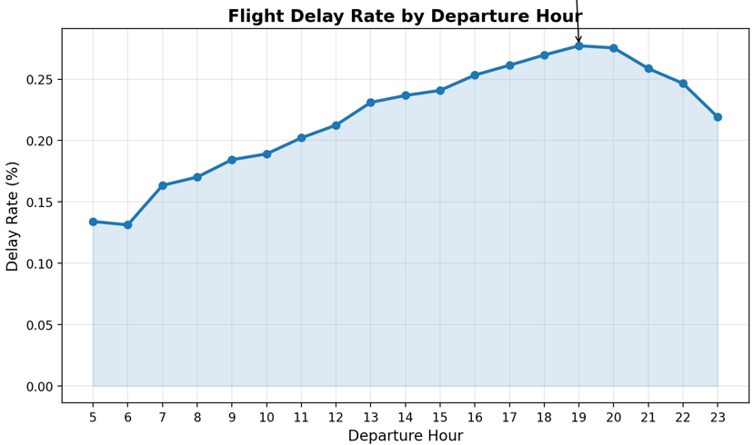
Delay Aggregation Outputs
Hourly Delay Rate (%)
Airline Delay Rates
(F9) Frontier
33.91%
(NK) Spirit
28.38%
(G4) Allegiant
28.00%
Top Delay Airports
JAC – Jackson Hole, WY
Mountain weather
EGE – Eagle/Vail, CO
Mountain + Resort + weather
ASE – Aspen, CO
Mountain + Resort + weather
ORD – Chicago O'Hare
Hub
Delays peak in the evening (6-8PM).
Hours 0-4 omitted because there were less than 500 flights for each hour
DEN – Denver, CO
Hub

Slide 8

Key Takeaways
Successfully built an end-to-end Spark pipeline from raw S3 data to ML predictions and aggregation outputs
Spark Structured Streaming with foreachBatch effectively simulated real-time ingestion at scale (540k records, 75k per batch)
Logistic Regression achieved 99.1% precision on delayed flights. Only reliable when it flags a delay. Low recall (24.1%) reveals class imbalance as the main model gap
Hourly delay analysis confirmed delay rates double from morning to evening peak
Airport analysis showed mountain/resort airports and congested hubs as top delay contributors
https://github.com/geoffreycloud/Flight-Delay-Prediction-Using-Apache-Spark/tree/main • v1.0.0 • June 2026

