Slide 1


STUDENT DROPOUT PREDICTIVE MODEL
A Machine Learning Approach to Understanding and Predicting Student Attrition in Kenyan Universities
Presented By: Group 8
Geoffrey Kemboi
Natasha Wangari
Antony Wala
Elvis Okeyo

Slide 2

Agenda
Project Background & Problem Statement
Data Overview & Processing
Exploratory Data Analysis (EDA)
Hypothesis Testing
Predictive Modelling Approach
Model Performance & Evaluation
Key Findings & Actionable Recommendations
Conclusion & Next Steps

Slide 3
The Problem: Student Dropout in Kenya
The Challenge: Student dropout from higher education is a critical issue in Kenya, leading to:
Wasted educational resources for institutions.
A reduction in the skilled workforce.
Increased unemployment and lower lifetime earnings for individuals.
The Goal: To understand the complex, multi-faceted factors (academic, financial, demographic) that contribute to this phenomenon and build a predictive model to identify at-risk students early.

Slide 4
Key Research Questions:
What is the primary driver of dropout: academic preparedness, current performance, or financial constraints?
How do financial factors interact with academic factors to influence dropout risk?
Does the impact vary significantly by demographics, programme of study, or engagement levels?
Can a predictive model accurately identify high-risk students?

Slide 5
Data Overview
Dataset: Student-level records from Kenyan higher education institutions.
Size: Over 118,000 students with 28 features.
Key Features:
Demographic: Gender, Age, County
Academic: Course Category, Exam Year, Admission details
Financial: Program Cost, Total Loan Allocated, Scholarship Applied, Loan Status
Family Background: Father educ level, Mother educ level
Target Variable: Drop out (0 = Stayed, 1 = Dropped Out)

Slide 6
Data Cleaning & Feature Engineering:
Dropped irrelevant/unusable columns (e.g., BURSARYBATCHNUMBER, INDEXNUMBER).
Removed rows with missing values in key columns.
Created new features: Loan To Cost Ratio, Enrollment Age, Age Group.
Focused final analysis on students enrolled in 2024, resulting in 39,166 records with a dropout rate of ~30.15%.

Slide 7
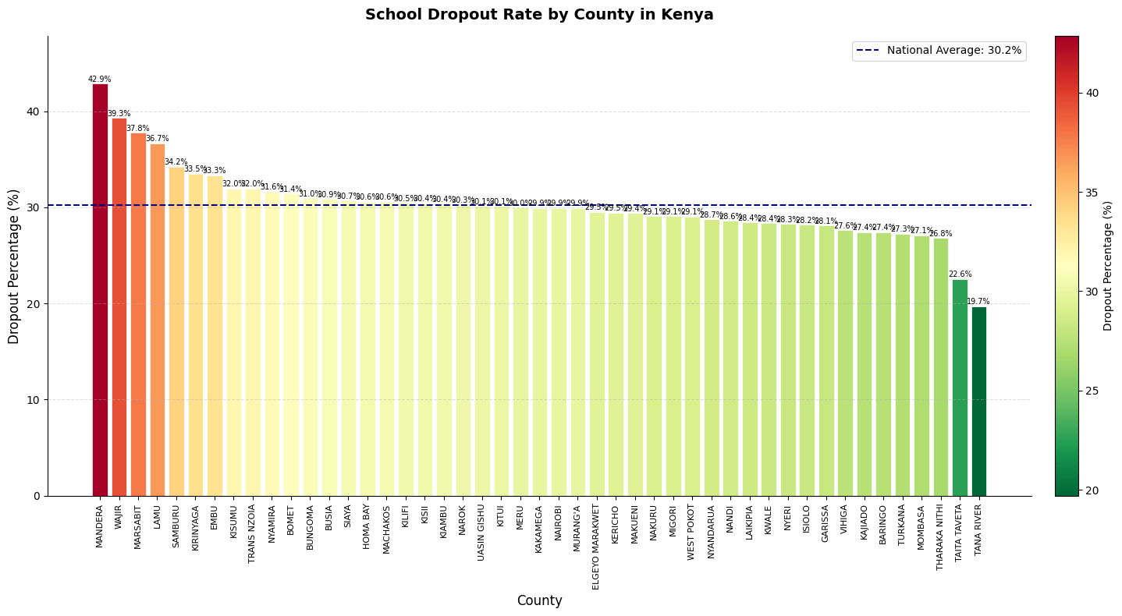
EDA - Dropout by County
Key Insights:
Highest Dropout Rates: Counties like Mandera (42.9%), Wajir (39.3%), and Marsabit (37.8%) show the highest attrition.
Regional Disparities: A clear geographical pattern exists, with many counties in the northern and eastern regions showing above-average dropout rates.
National Average: The national average dropout rate is approximately 30.2%.

Slide 8
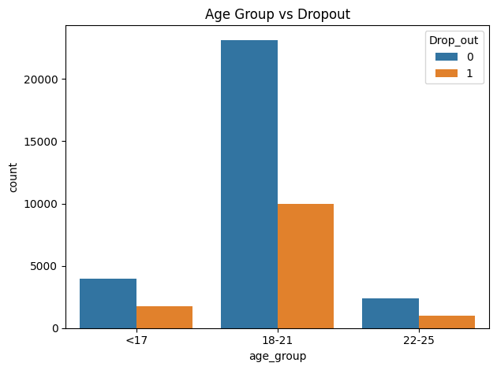
EDA - Dropout by Academic & Financial Factors
Key Insights
Younger students (18-21) show higher dropout rates
Non-traditional students (22+) show distinct patterns
Age distribution peaks at 19-21 years

Slide 9
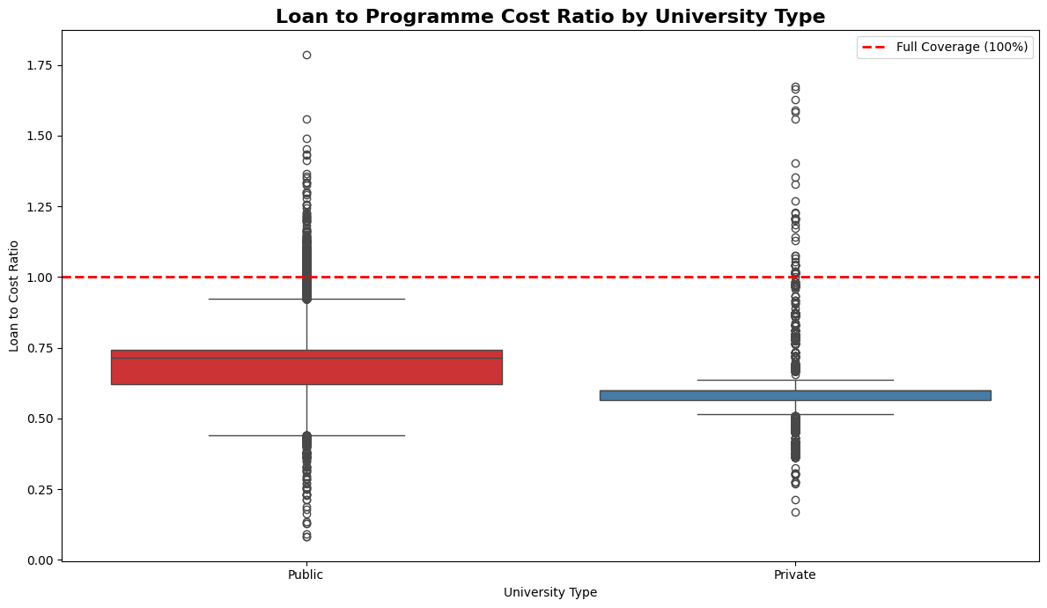
Dropout by Sponsorship & University Type:
Key insight
Self-sponsored students face a much lower loan-to-cost ratio, indicating a higher financial burden.
This financial strain correlates with a higher dropout rate at private institutions compared to public ones.

Slide 10
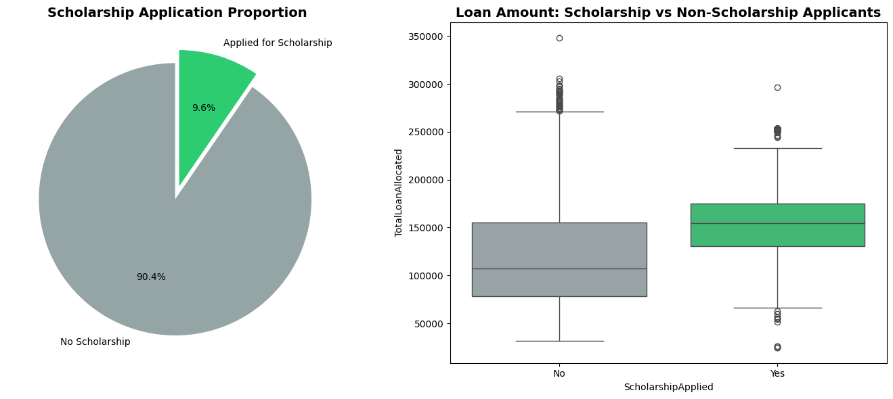
Loan Amount: Scholarship vs Non-Scholarship Applicants
Scholarship applicants receive higher median loan amounts

Slide 11
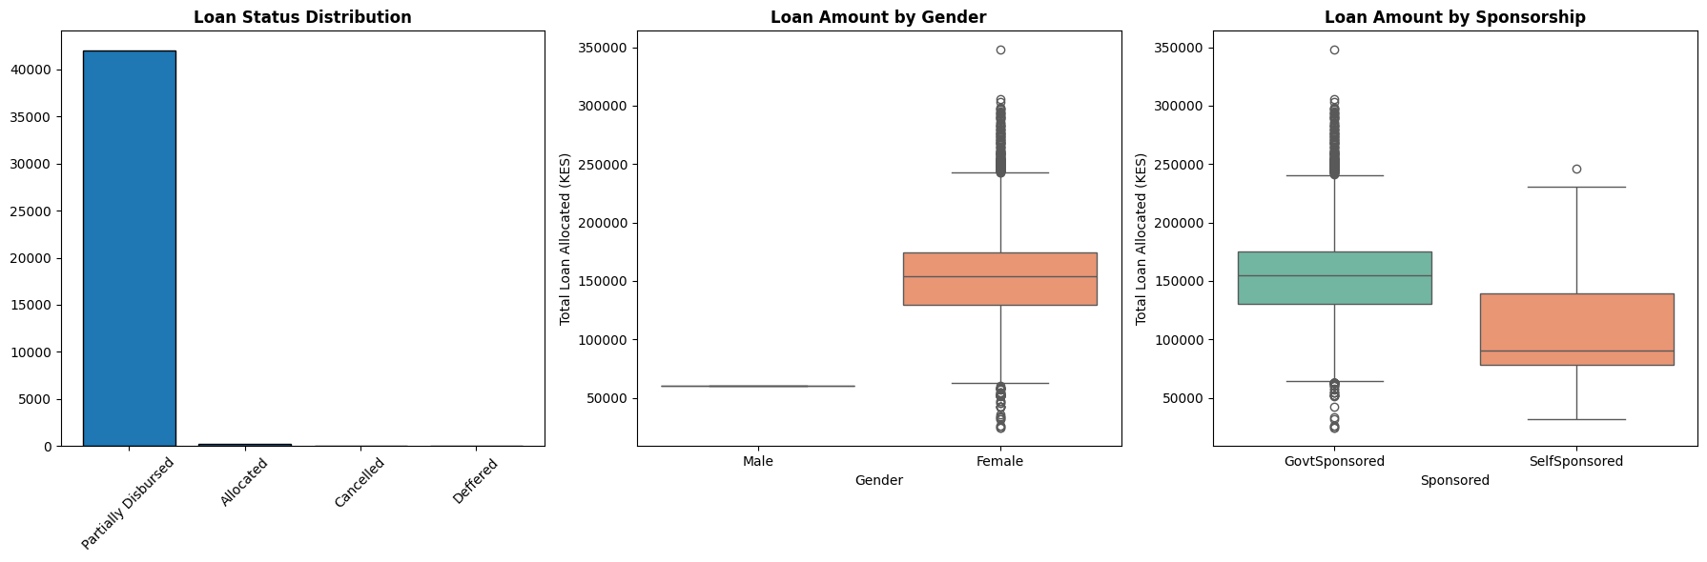
Loan Amount by Sponsorship
Self-sponsored students face a much lower loan-to-cost ratio, indicating a higher financial burden.

Slide 12
Hypothesis Testing
1. Scholarship Application vs. Dropout (Chi-square Test)
H₀: No significant association.
Result: Failed to reject H₀.
Interpretation: Applying for a scholarship does not show a statistically significant link to dropout status.

Slide 13
2. Loan Amount vs. Dropout (T-test)
H₀: No significant difference in loan amounts between those who stayed and those who dropped out.
Result: Failed to reject H₀.
Interpretation: There is no significant difference in the average loan amount for students who dropped out versus those who stayed.

Slide 14
3. Parental Education vs. Dropout (Chi-square Test)
H₀: No significant association.
Result: Failed to reject H₀ for father's, mother's, and highest parental education.
Interpretation: Parental education level alone is not a statistically significant predictor of dropout status in this model.

Slide 15
Predictive Modelling Approach
Target: Drop_out (imbalanced, 69.85% Stayed vs. 30.15% Dropped).
Preprocessing:
Label Encoding for categorical features.
Standard Scaling for Logistic Regression.
Models Tested:
Logistic Regression (Baseline)
Random Forest (Tuned)
XGBoost (Tuned)
Balanced Random Forest (Specifically designed for imbalanced data)
Gradient Boosting (Baseline)
Stacking Ensemble (Combination of base models)
Class Imbalance Handling: Used class_weight='balanced' t during model training to give more importance to the minority (dropout) class.

Slide 16
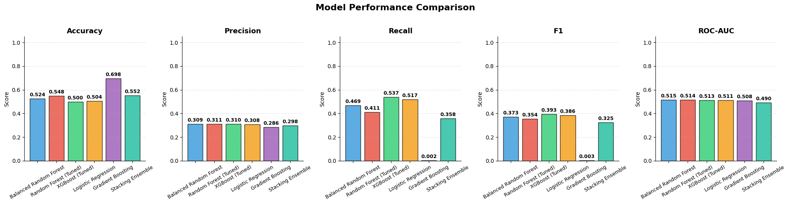
Model Performance Comparison

Slide 17
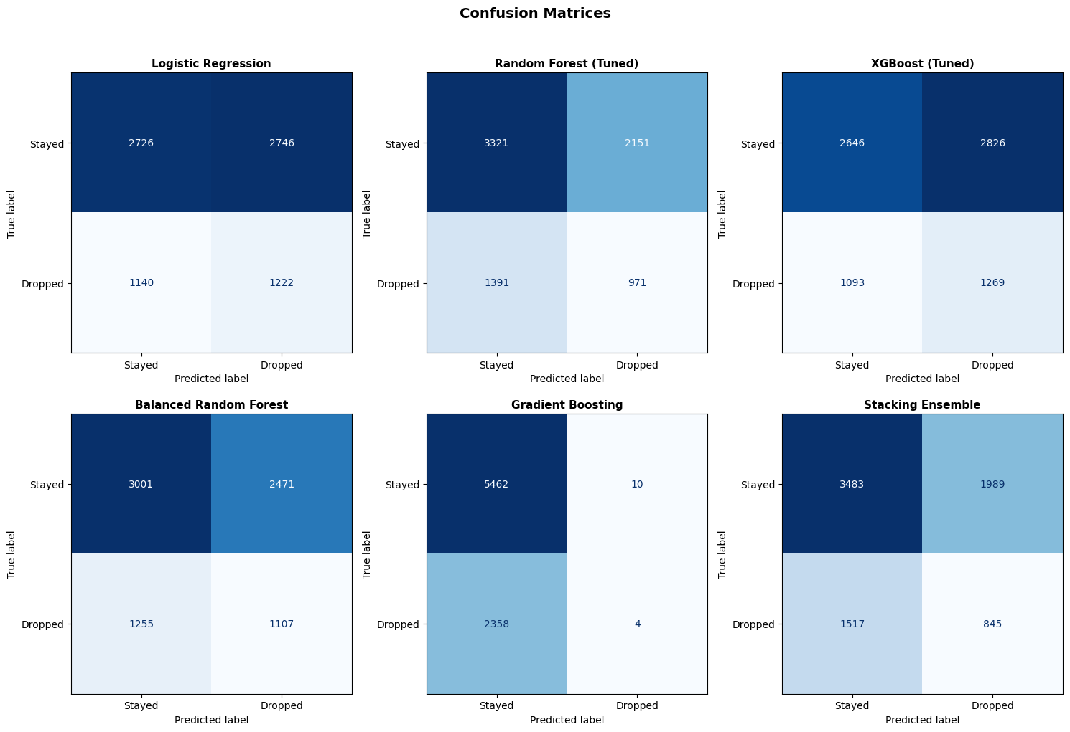

Slide 18
Best Model
The XGBoost(Tuned) model achieved the highest recall (0.5373) making it the most effective at identifying students who eventually dropped out.
Conclusion: The XGBoost is the best-performing model for this prediction task.

Slide 19
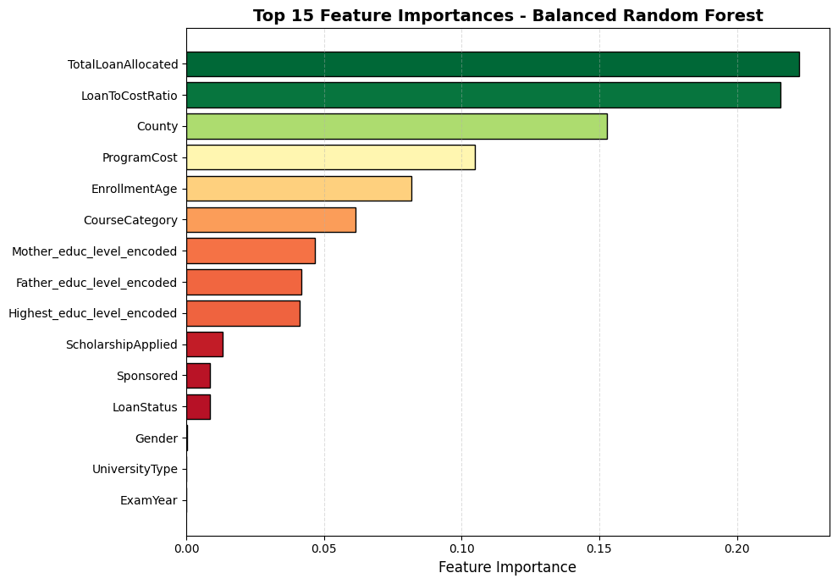
Feature Importance (Top Drivers of Dropout)
Top Drivers:
LoanToCostRatio: The most important feature. A higher ratio (less loan covering cost) is a strong risk factor.
Institutional Factors: UniversityType and Sponsored are key predictors.
Academic & Demographic: CourseCategory, EnrollmentAge, and County also play significant roles.
Parental Education: Highest_educ_level_encoded has moderate predictive power.
Interpretation: Financial strain is the single most powerful predictor of dropout.

Slide 20
Actionable Recommendations: For Policymakers & University Administrators:
Enhance Financial Aid Programs:
Action: Target students with a high LoanToCostRatio (those whose loans cover a smaller portion of their fees).
Why: This is the strongest predictor of dropout. Provide supplementary bursaries, work-study opportunities, or emergency funds.
Implement Early Warning Systems:
Action: Use the model in real-time to flag students with high-risk profiles (e.g., high LoanToCostRatio, specific CourseCategory, older EnrollmentAge).
Why: Allows for proactive academic advising, financial counseling, and targeted support before the student disengages.
Regional & Institutional Interventions:
Action: Develop specific retention programs for high-risk counties (e.g., Mandera, Wajir) and for students in self-sponsored or private university programs.
Why: Dropout risk varies significantly by geography and institutional type. Customized strategies will be more effective.

Slide 21
Recommended Next Steps:
Deploy the Model: Integrate the model into a student information system for automated risk flagging.
Feature Enhancement: Incorporate new data sources like real-time academic performance (grades, attendance) and student engagement metrics (library usage, online portal logins) to improve the model.
Pilot Intervention Programs: Launch a pilot program based on the model's top risk factors (e.g., a targeted financial aid or academic coaching program) and measure its impact.
Continuous Monitoring: Regularly retrain the model with new data to ensure its accuracy and relevance over time.

Slide 22
THE END
Thank you!

