Slide 1
Using Predictive Modeling to Identify Key Test Parameters
By Geoffrey Sitwell

Slide 2
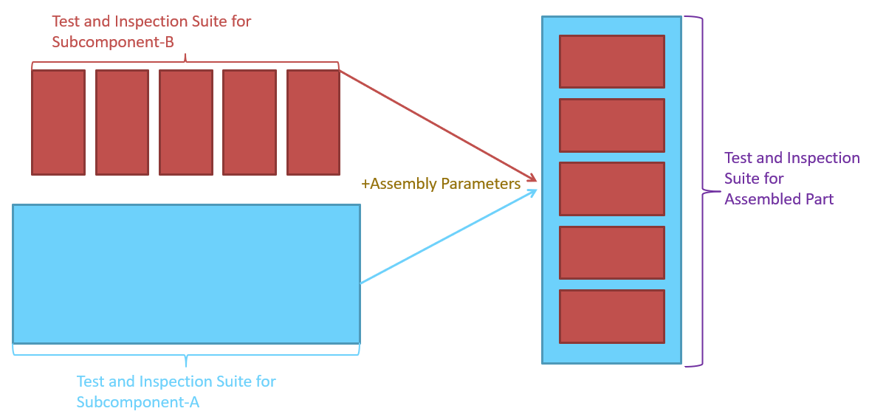
Problem Statement
Predicting the final performance of assembled parts based on test and inspection results from subcomponents, meta data about the assembly process and final screening criteria for the assembled part

Slide 3
Summary
32662 of the 33723 rows are passing and so a naive model would predict all devices pass and would have an accuracy of 96.8%.
The model with the highest score is the Decision Tree model, but it is likely inappropriate for this exercise since it is probable that it will just find prescribed pass/fail thresholds.
The most appropriate model based on score and speed is the Logistic Regression model which consistently scores above 99% in test score and executes on the order of a few seconds.
The Logistic Regression model lends us some interesting insights but the one I'll highlight here is for Param9 which has considerably different effects by channel.
Param9-1 is strongly (the most strongly of any parameter) positively correlated with Passing chips, Param9-2 and 9-4 are amongst the most negatively correlated parameters.

Slide 4
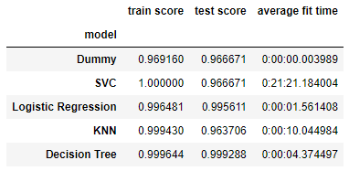
Model Results
Logistic Regression was most well-suited to our problem due to very low test times and high accuracy

Slide 5
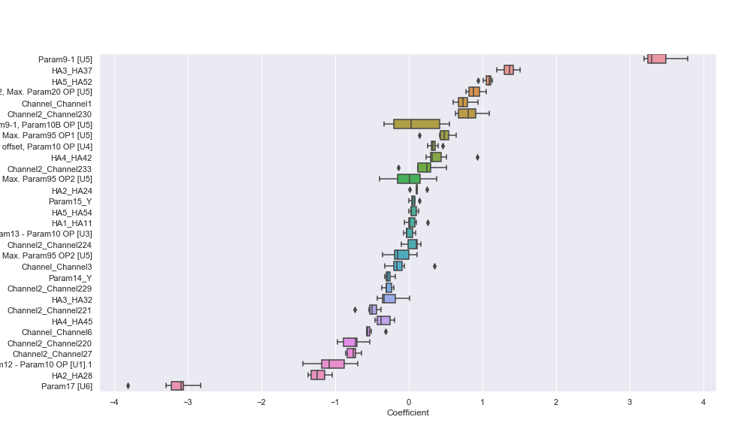
Logistic Regression
The Logistic Regression was dominated by a few parameters (plot below shows every 5th) with most parameters showing to have very little influence over the final result.
This is evidence that some elements of the screening can reliably be cut-out with no substantial impact on the predictive power which will increase throughput

