Slide 1

Literature Mining: A Hands-On Tutorial
Geoffrey Weal
iDM Tutorial
29th of March 2023

Slide 2



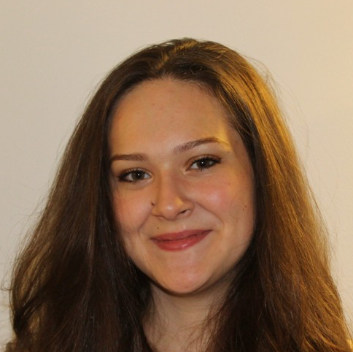


Acknowledgements
Today’s Helpers
Daniel Packwood
Chayanit (First) Wechwithayakhlung
Caitlin Casey-Stevens
Olivia Sato
Paul Hume
Justin Hodgkiss

Slide 3
Future Tutorial
Use Machine Learning (ChatGPT) to gather data from multiple papers. For example:
Gathering heat capacities of various materials → To develop material that can adsorb a large amount of thermal energy with minimal change in temperature
We will send out a follow up Google Survey to ask how you would like to use machine learning in literature mining.
Will use your responses to develop a potential second literature mining tutorial.

