Slide 1

7 July 2026
Reaction Mechanisms in ORCA
Geoffrey Weal

Slide 2






































Members
Universities
CRIs
Independent research organisations
ITPs and Wānanga
Associates

Slide 3
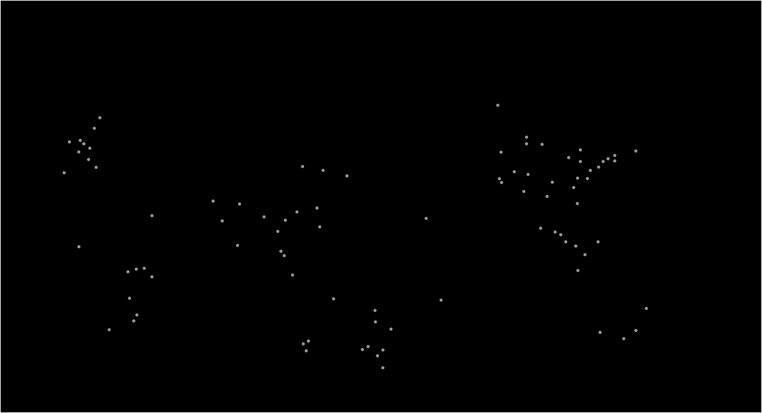



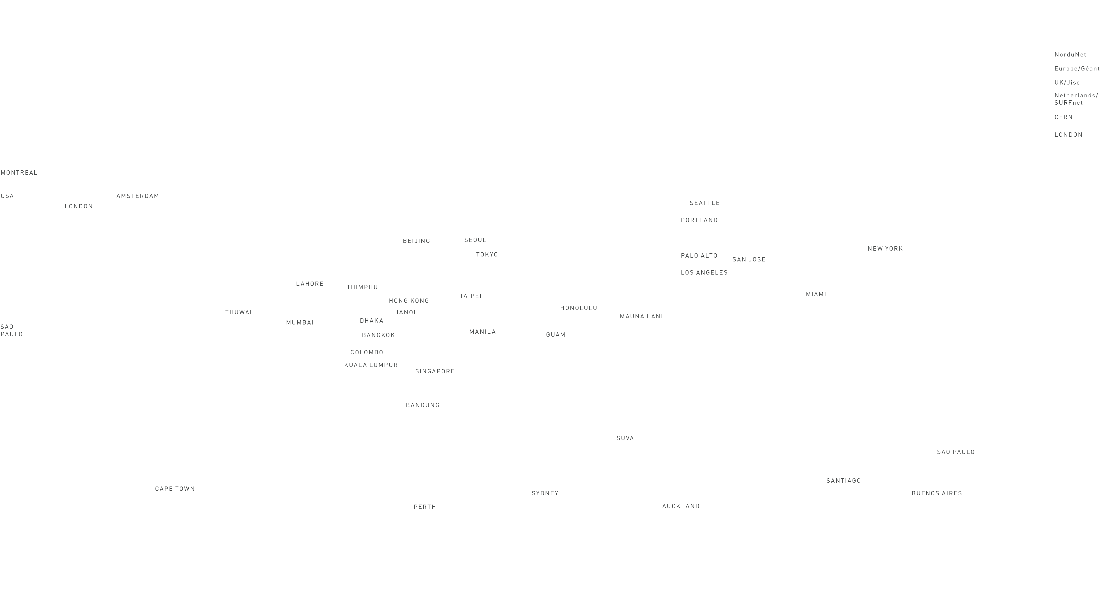

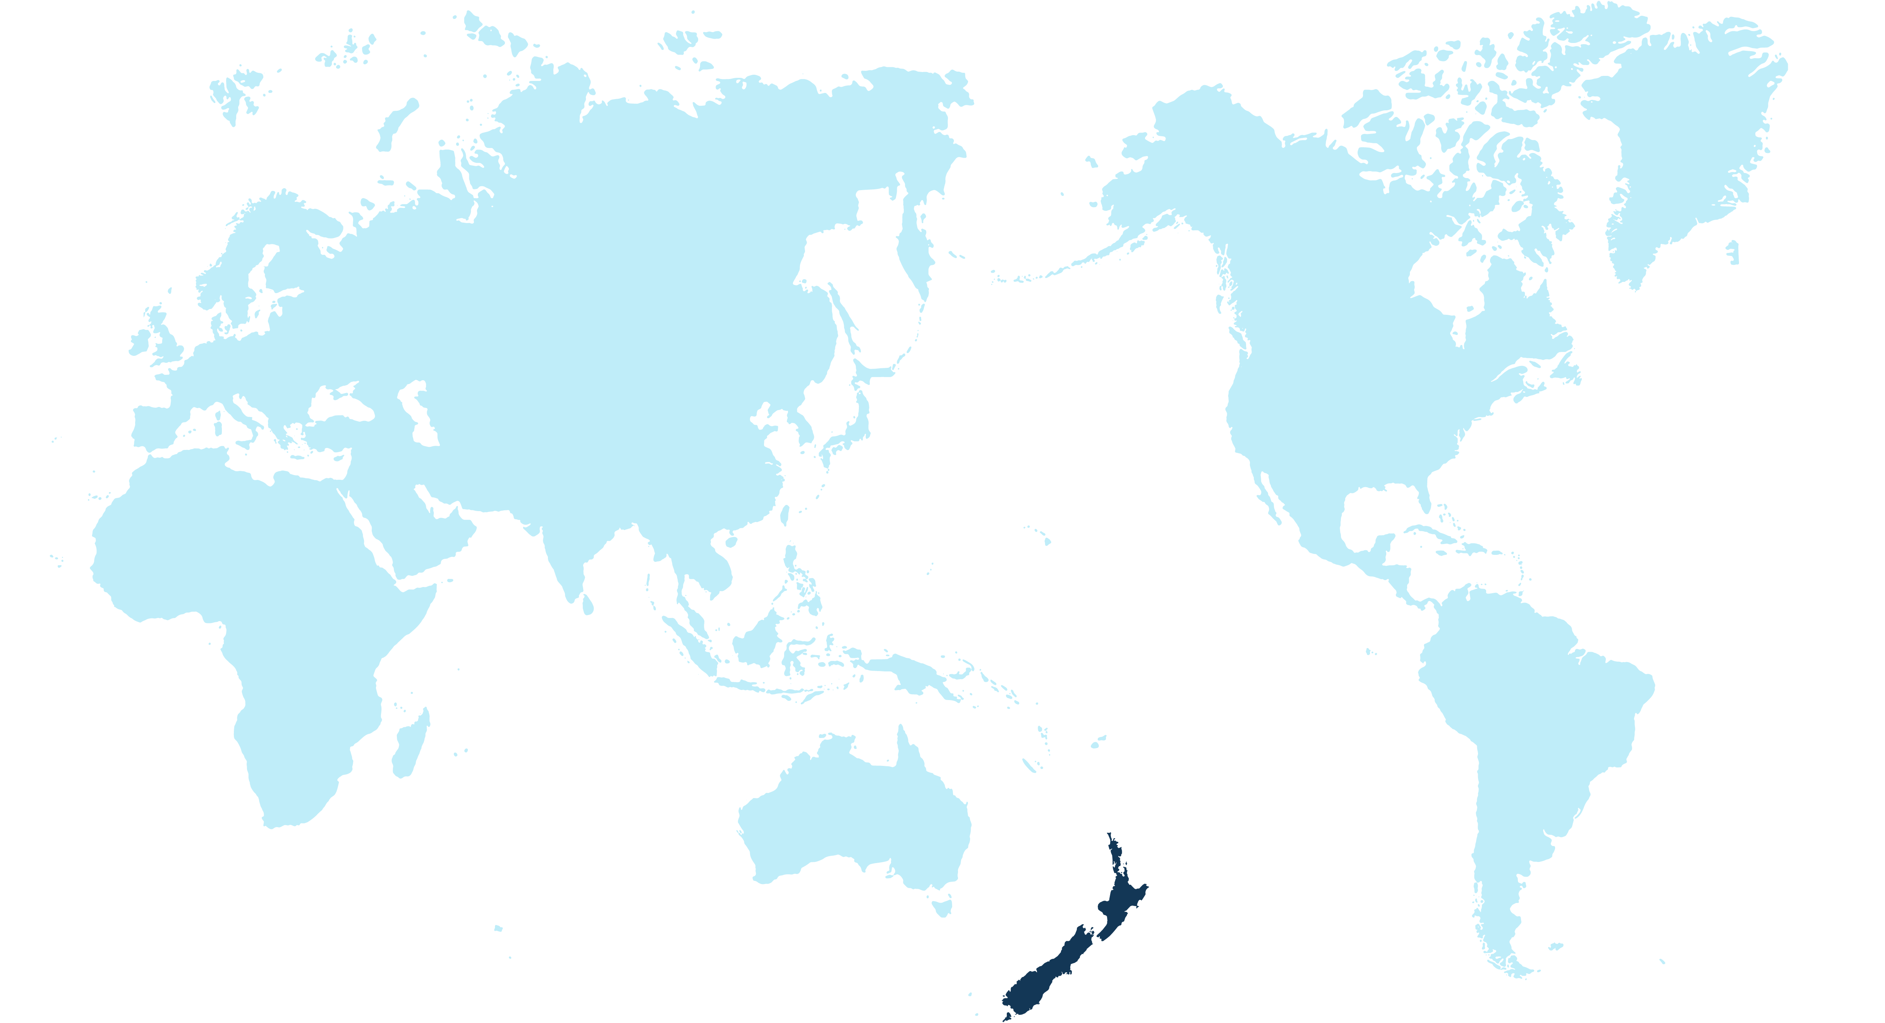

Slide 4
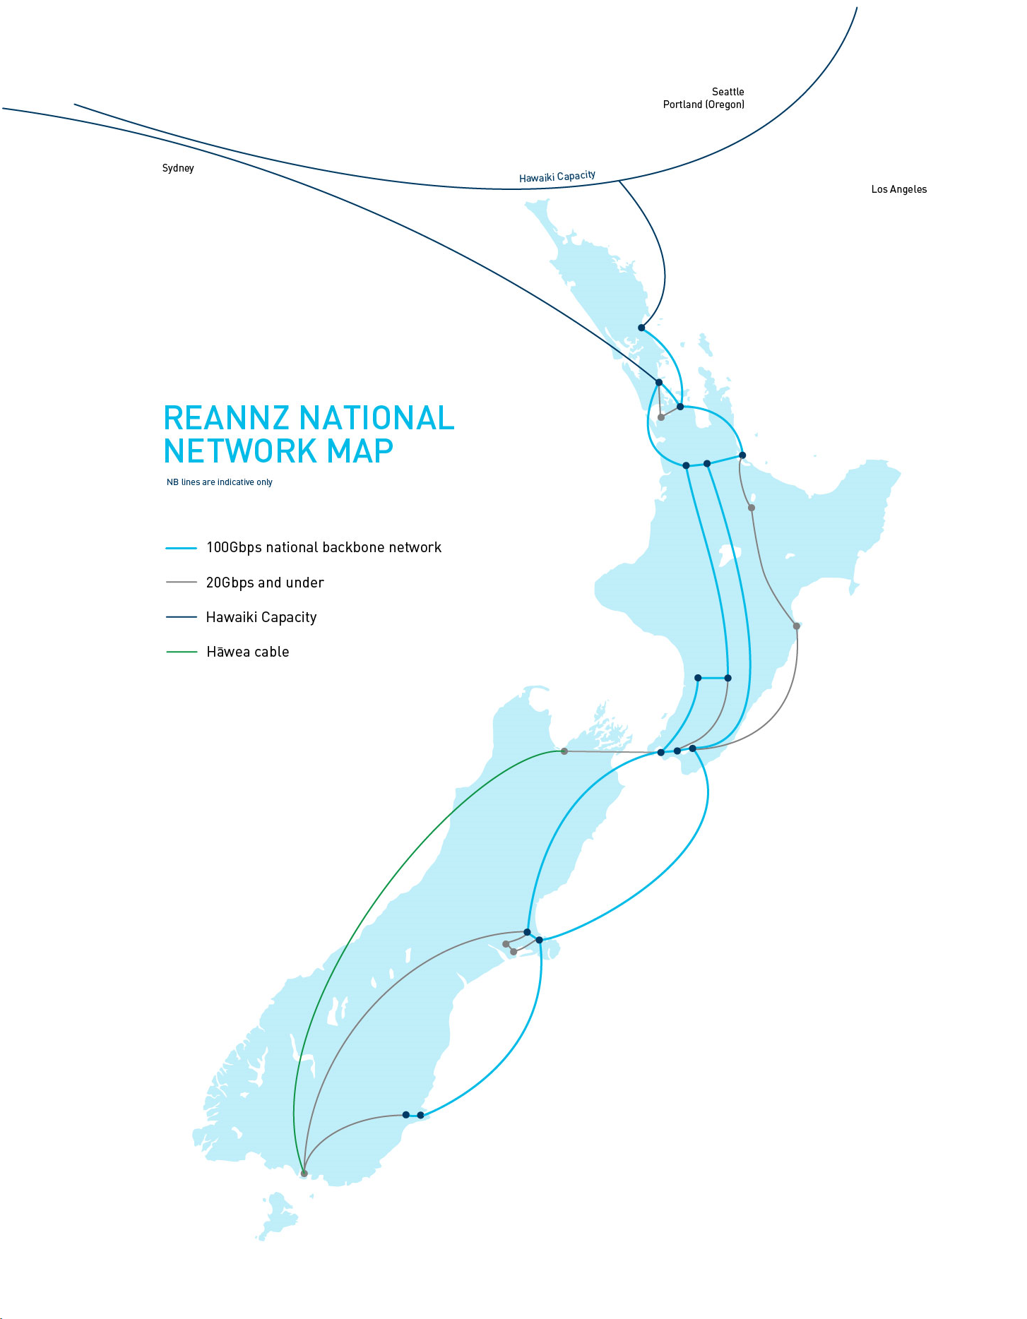

Slide 5
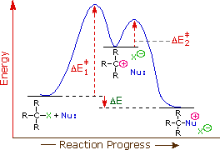
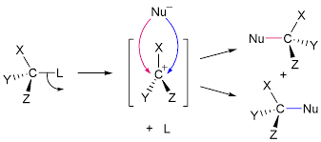
What is a Reaction Mechanism
Describes the steps of how a reaction works
Example: S_{N}1 mechanism
Energy Profile of S_{N}1 mechanism
Goal: To obtain the transition state energies for each mechanistic step

Slide 6


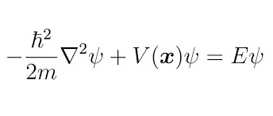
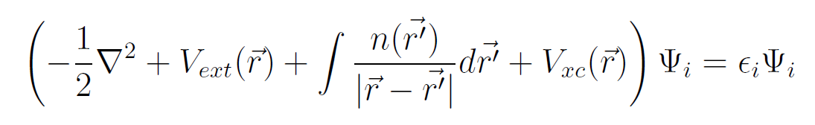
How to obtain transition energies? ORCA
ORCA is a program designed to perform DFT calculations on molecules
What is DFT (Density Functional Theory)?
A way to approximately solve the Schrödinger equation for molecules
Schrödinger equation
Schrödinger equation implementation used in DFT

Slide 7
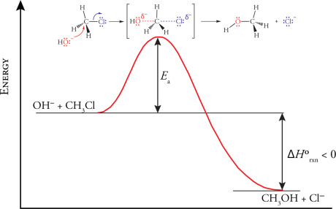
Investigating Mechanistic Steps: The General Idea
Ouellette, R. J. and Rawn, J. D. (2018), Haloalkanes and alcohols Nucleophilic Substitution and Elimination Reactions, Elsevier, pp. 255--298.

Slide 8

Investigating Mechanistic Steps: Like Going Down a Slide
There are 4 steps to playing on a slide
1. Stand at the bottom of the ladder
2. Climb the ladder
3. Sit at the top of the slide
4a. Go down the slide
4a. Get scared and climb back down the ladder
4b. Get off the slide
4b. Get off the slide

Slide 9
Investigating Mechanistic Steps: Like Going Down a Slide
Likewise, there are 5 steps to computationally investigate mechanistic steps
1. Optimise Reactants or Products
2. Search for a Transition State
3. Optimise the Transition State
4a. Go down the Energy Surface in the Forward Direction
4a. Go down the Energy Surface in the Backward Direction
4b. Optimise Forward Molecules
4b. Optimise Backward Molecules
Ouellette, R. J. and Rawn, J. D. (2018), Haloalkanes and alcohols Nucleophilic Substitution and Elimination Reactions, Elsevier, pp. 255--298.

Slide 10
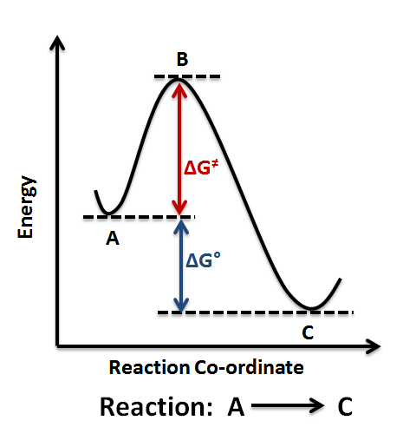
1. Optimise Reactants or Products
It is important to make sure we have found the local minimum
This is the bottom of the energy well
This is to make sure that we definitely have a reactant, intermediate, or product.

Slide 11
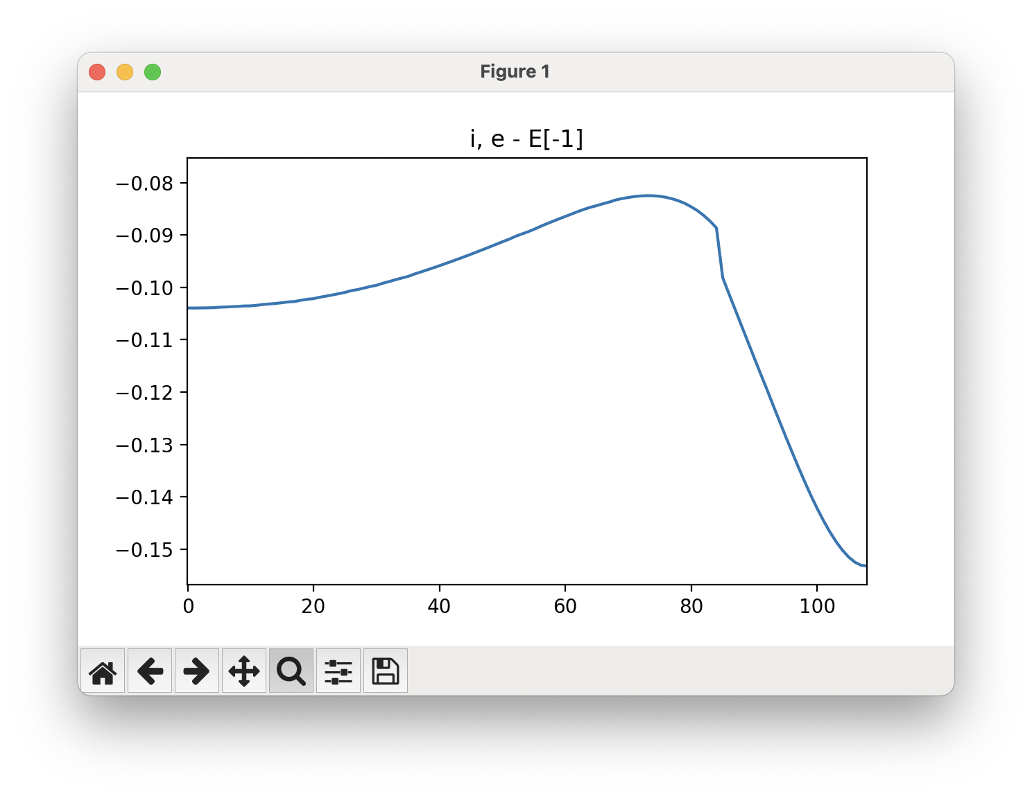
2. Search for a transition point
We then perform some sort of method to scan between the reactant and product.
We measure the energy at each point along the path
From this, we take the transition state as the point of highest energy from along the path

Slide 12
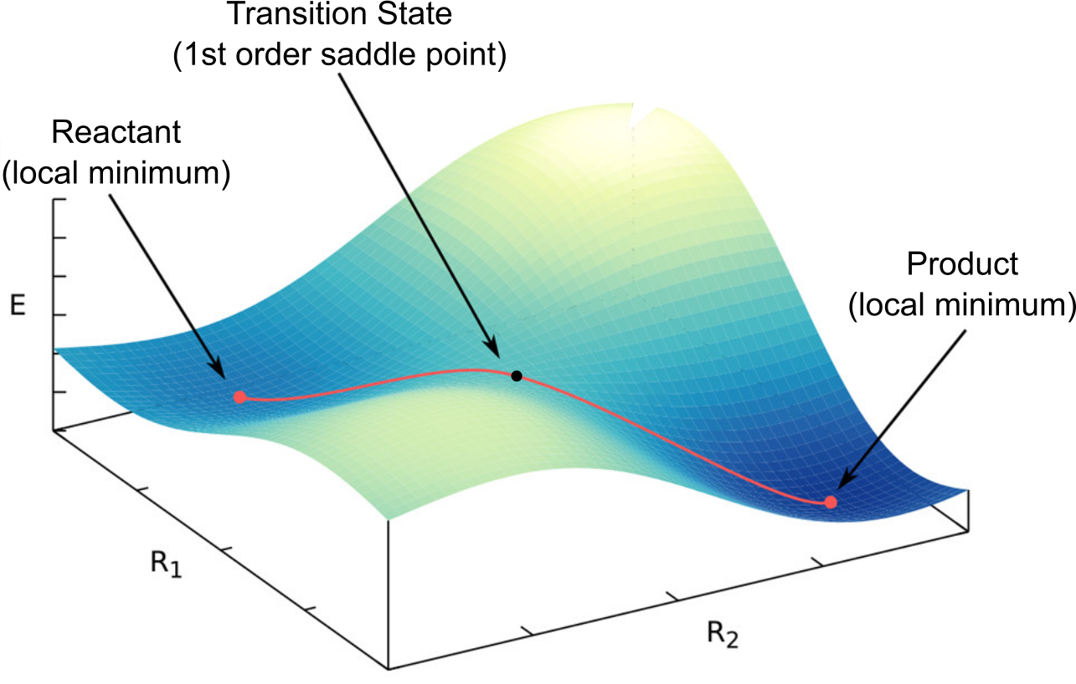
3. Optimise the transition state
When we choose the highest point along our path, we optimize it further for two reasons
To find the state along the path of highest energy, and
Most importantly, to make sure the transition state is a first-order saddlepoint
J. A. Keith, V. Vassilev-Galindo, B. Cheng, S. Chmiela, M. Gastegger, K.-R. Müller, and A. Tkatchenko; Chem. Rev. 2021, 121, 16, 9816–9872

Slide 13
4a. Check the transition state falls to Reactant and Product
We perform a check to make sure that our transition state does fall naturally to the reactant and the product.
This is because the transition state we found might fall to another reactant/product than the ones we care about.
4b. Optimise the reactants and products we find and confirm they are roughly the same structurally as the reactants and products we started with.

Slide 14
Investigating Mechanistic Steps: Like Going Down a Slide
There are 4 steps to playing on a slide
1. Stand at the bottom of the ladder
2. Climb the ladder
3. Sit at the top of the slide
4a. Go down the slide
4a. Get scared and climb back down the ladder
4b. Get off the slide
4b. Get off the slide

Slide 15
Investigating Mechanistic Steps: The General Idea
Ouellette, R. J. and Rawn, J. D. (2018), Haloalkanes and alcohols Nucleophilic Substitution and Elimination Reactions, Elsevier, pp. 255--298.

Slide 16

OK, lets get into the online tutorial and login to Mahuika
Can you do the following:
Open the github tutorial page: https://geoffreyweal.github.io/ORCA_Mechanism_Procedure
Open up either a terminal on your computer or on NeSI OnDemand: https://ondemand.nesi.org.nz/public/

Slide 17
7 July 2026
THANK YOU
Are there any questions?

