Slide 1
HIPAA

Slide 2
HIPAA Compliance
Standard Formats for Claims, etc
HIPAA Privacy Rule
HIPAA Security Rule
HIPAA Enforcement Rule

Slide 3
HIPAA Privacy Rule
Protects Personal Health Information
Name, address, birth date, SSN (social security number)
Any information about physical or mental health
Any care provided to individual
Information concerning payments

Slide 4
HIPAA Security Rule
Requires safeguards around personal health information
Requires identification of internal and external sources of PHI
Requires understanding of threats to PHI

Slide 5
Security Threats

Slide 6
Security Threats
Technical Attacks
Social Engineering
Both

Slide 7
Phishing

Slide 8
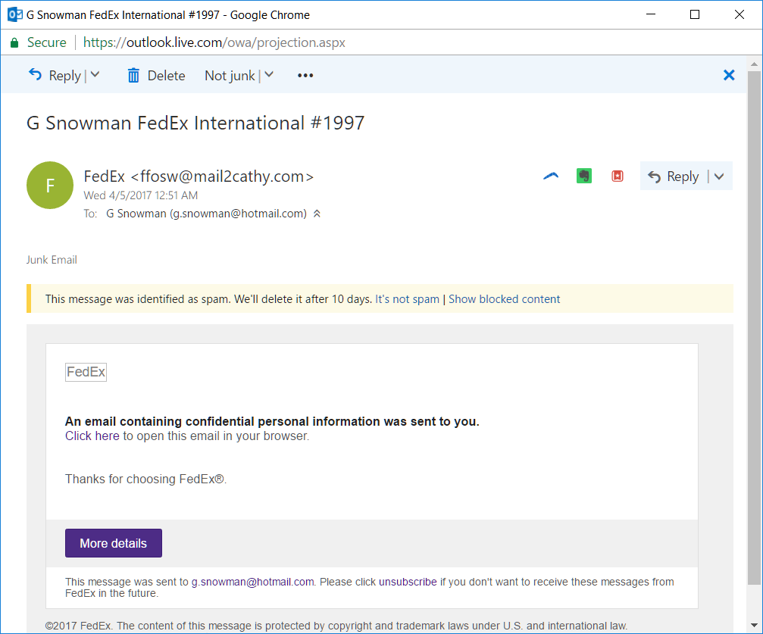
Phishing

Slide 9
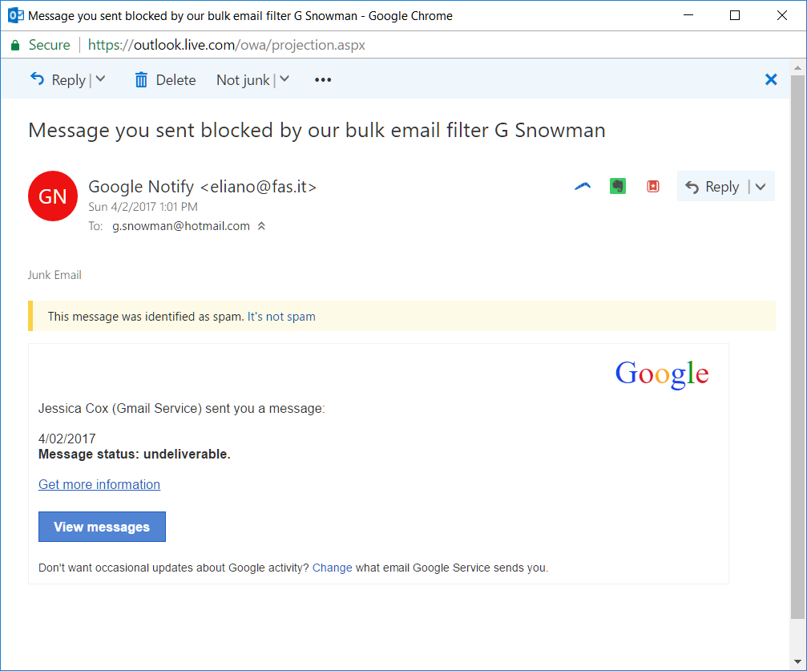
Phishing

Slide 10
Threats
Identity theft
Ransomware

Slide 11
Spear Phishing
Targeted attack that uses information about a specific person to make the attack seem more credible.

Slide 12
Clone Phishing
Copy a legitimate email but change the contents
Malicious URL
Malicious attachment

Slide 13
Phishing Warnings
You receive an email, text or phone call claiming to be from a bank, telecommunications provider or other business you regularly deal with, asking you to update or verify your details.
The email or text message does not address you by your proper name, and may contain typing errors and grammatical mistakes.
The website address does not look like the address you usually use and is requesting details the legitimate site does not normally ask for.
You notice new icons on your computer screen, or your computer is not as fast as it normally is.

Slide 14
Phishing Apparent Sources
Social networks – Facebook / Twitter / Tinder / Grindr
Auction sites – eBay
Banks / Payment processors – Paypal / Venmo
IT Support
Legal subpoena
Complaint (Patient / Ethics Board)

Slide 15
Fake URL
http://www.paypal.someotherurl.com
Bit.ly / Tinyurl
Not always a fake URL. Forward the client to a bank's legitimate website, then to place a popup window requesting credentials on top.

Slide 16
73.7% of online attacks
involve a malicious URL

Slide 17
Phishing by Phone / Skype
Microsoft tech support
Ransomware
Messages from a bank
Please call our fraud department at this number now
Attractive women who friend guys out of the blue on Facebook from accounts created that morning then ask for your Skype ID
Extortion attempts

Slide 18
Phishing by Things
USB Key
Disks

Slide 19
What to do about phishing?
Google is your friend.
Google the exact words from the email to see if a scam warning appears.
Google the bank, get their 800 number, call them.
Google the business, click on their legitimate website.
Don’t click on attachments.

Slide 20
Passwords

Slide 21
Password Sins
Sharing Passwords
Between sites
Between people
Guessable Passwords
Ashley Madison site hack. The top 3 passwords used on the site were 123456, 12345 and password.
Password Lists

Slide 22
Be mindful about what you put in the garbage.

Slide 23
Karim Baratov
Lamborghini Gallardo
BMW
Audi R8
Porsche
Aston Martin
Mercedes

Slide 24
There’s always a teenager
in Sweden who will
think it’s worthwhile.

Slide 25
Yahoo Hack
https://www.nytimes.com/2016/12/14/technology/yahoo-hack.html

Slide 26
What to do about passwords?
Password manager
Lastpass
1Password
Two factor authentication
Fingerprints
Protect your phone

Slide 27
What is your favorite food?
Pizza
(19.7%)

Slide 28
Malware

Slide 29
Malware Terms
Bots
Ransomware
Rootkit
Spyware
Trojan Horse
Virus
Worm

Slide 30
What to do about malware?
Keep stuff up to date.
Use anti-virus.
Secure passwords.
Don’t click on attachments.

Slide 31
Research Project

Slide 32
Learn About One Incident
Research one computer security incident, create a short PowerPoint, and present it to the class

Slide 33
Here are some ideas for things to Google to get you started
Sony Pictures Hack
Target Hack
Yahoo Hack
Ashley Madison Hack
Adobe Hack
JP Morgan Chase Hack
OPM Hack
Aramco Hack
List of Cyber Attacks
Stuxnet
Kevin Mitnick
Edward Snowden
Karim Baratov
Anonymous
Phishing
Malicious URL
OWASP Top 10
SQL Injection
Identity Theft
Ransomware

