Slide 1
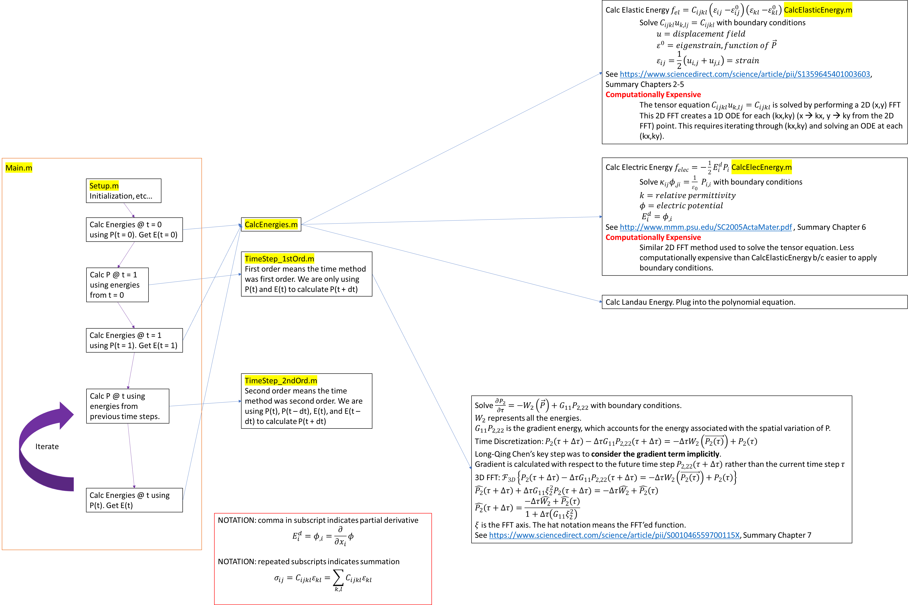

Slide 2
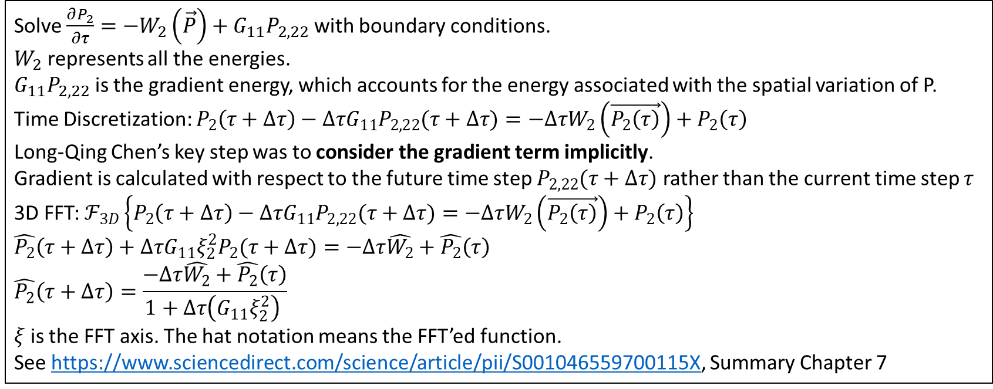
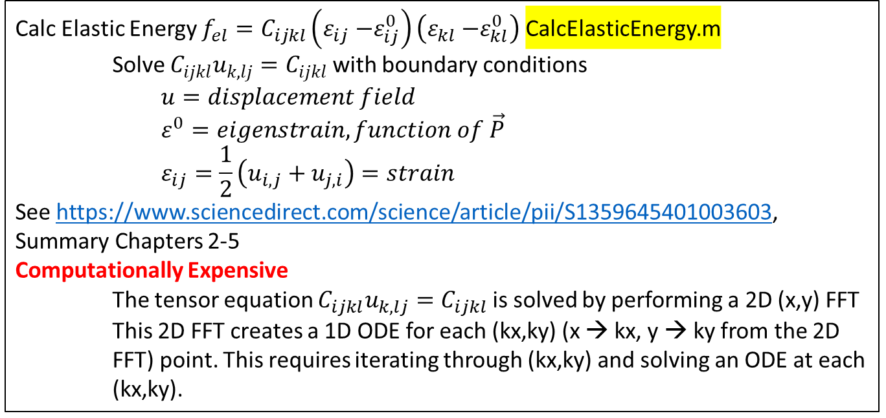
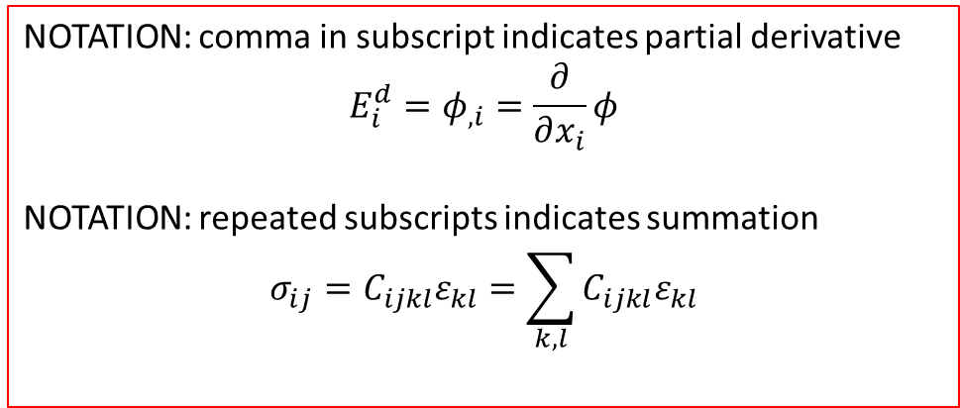
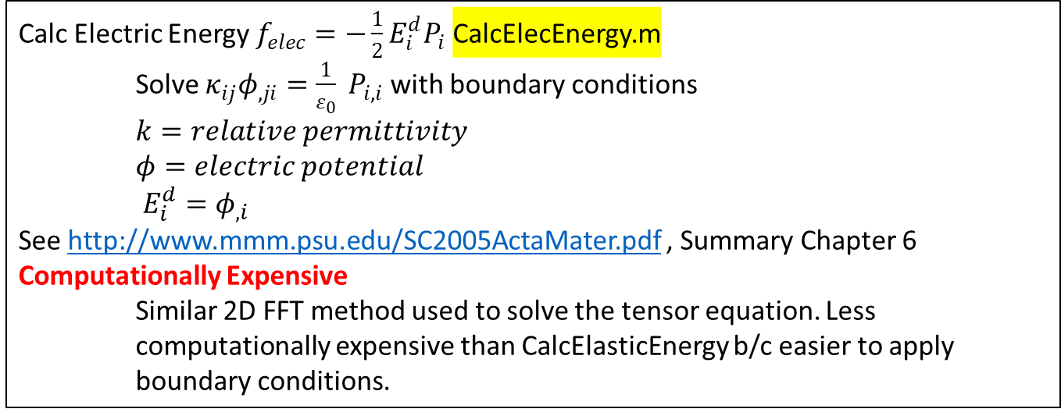
Calc Elastic Energy $f_{el}=C_{ijkl}\left(ε_{ij}{−ε}_{ij}^{0}\right)\left(ε_{kl}{−ε}_{kl}^{0}\right)$ CalcElasticEnergy.m
Solve $C_{ijkl}u_{k,lj}=C_{ijkl}$ with boundary conditions
$$u=displacement field$$
$$ε^{0}=eigenstrain, function of \vec{P}$$
$$ε_{ij}=\frac{1}{2}\left(u_{i,j}+u_{j,i}\right)=strain$$
See https://www.sciencedirect.com/science/article/pii/S1359645401003603, Summary Chapters 2-5
Computationally Expensive
The tensor equation $C_{ijkl}u_{k,lj}=C_{ijkl}$ is solved by performing a 2D (x,y) FFT
This 2D FFT creates a 1D ODE for each (kx,ky) (x → kx, y → ky from the 2D FFT) point. This requires iterating through (kx,ky) and solving an ODE at each (kx,ky).
Main.m
Calc Electric Energy $f_{elec}=−\frac{1}{2}E_{i}^{d}P_{i}$ CalcElecEnergy.m
Solve $κ_{ij}φ_{,ji}=\frac{1}{ε_{0}} P_{i,i}$ with boundary conditions
$k=relative permittivity$
$φ=electric potential$
$E_{i}^{d}=φ_{,i}$
See http://www.mmm.psu.edu/SC2005ActaMater.pdf , Summary Chapter 6
Computationally Expensive
Similar 2D FFT method used to solve the tensor equation. Less computationally expensive than CalcElasticEnergy b/c easier to apply boundary conditions.
Setup.m
Initialization, etc…
Calc Energies @ t = 0 using P(t = 0). Get E(t = 0)
CalcEnergies.m
TimeStep_1stOrd.m
First order means the time method was first order. We are only using P(t) and E(t) to calculate P(t + dt)
Calc P @ t = 1 using energies from t = 0
Calc Landau Energy. Plug into the polynomial equation.
Calc Energies @ t = 1 using P(t = 1). Get E(t = 1)
TimeStep_2ndOrd.m
Second order means the time method was second order. We are using P(t), P(t – dt), E(t), and E(t – dt) to calculate P(t + dt)
Calc P @ t using energies from previous time steps.
Solve $\frac{∂P_{2}}{∂τ}=−W_{2}\left(\vec{P}\right)+G_{11}P_{2,22}$ with boundary conditions.
$W_{2}$ represents all the energies.
$G_{11}P_{2,22}$ is the gradient energy, which accounts for the energy associated with the spatial variation of P.
Time Discretization: $P_{2}\left(τ+Δτ\right)−ΔτG_{11}P_{2,22}(τ+Δτ)=−ΔτW_{2}\left(\vec{P_{2}\left(τ\right)}\right)+P_{2}\left(τ\right)$
Long-Qing Chen’s key step was to consider the gradient term implicitly.
Gradient is calculated with respect to the future time step $P_{2,22}(τ+Δτ)$ rather than the current time step $τ$
3D FFT: $ℱ_{3D}\left\{P_{2}\left(τ+Δτ\right)−ΔτG_{11}P_{2,22}(τ+Δτ)=−ΔτW_{2}\left(\vec{P_{2}\left(τ\right)}\right)+P_{2}\left(τ\right)\right\}$
$$\hat{P_{2}}\left(τ+Δτ\right)+ΔτG_{11}ξ_{2}^{2}P_{2}(τ+Δτ)=−Δτ\hat{W_{2}}+\hat{P_{2}}\left(τ\right)$$
$$\hat{P_{2}}\left(τ+Δτ\right)=\frac{−Δτ\hat{W_{2}}+\hat{P_{2}}\left(τ\right)}{1+Δτ\left(G_{11}ξ_{2}^{2}\right) }$$
$ξ$ is the FFT axis. The hat notation means the FFT’ed function.
See https://www.sciencedirect.com/science/article/pii/S001046559700115X, Summary Chapter 7
Iterate
Calc Energies @ t using P(t). Get E(t)
NOTATION: comma in subscript indicates partial derivative
$$E_{i}^{d}=φ_{,i}=\frac{∂}{∂x_{i}}φ$$
NOTATION: repeated subscripts indicates summation
$$σ_{ij}=C_{ijkl}ε_{kl}=\sum_{k,l}{C_{ijkl}ε_{kl}}$$

