Slide 1
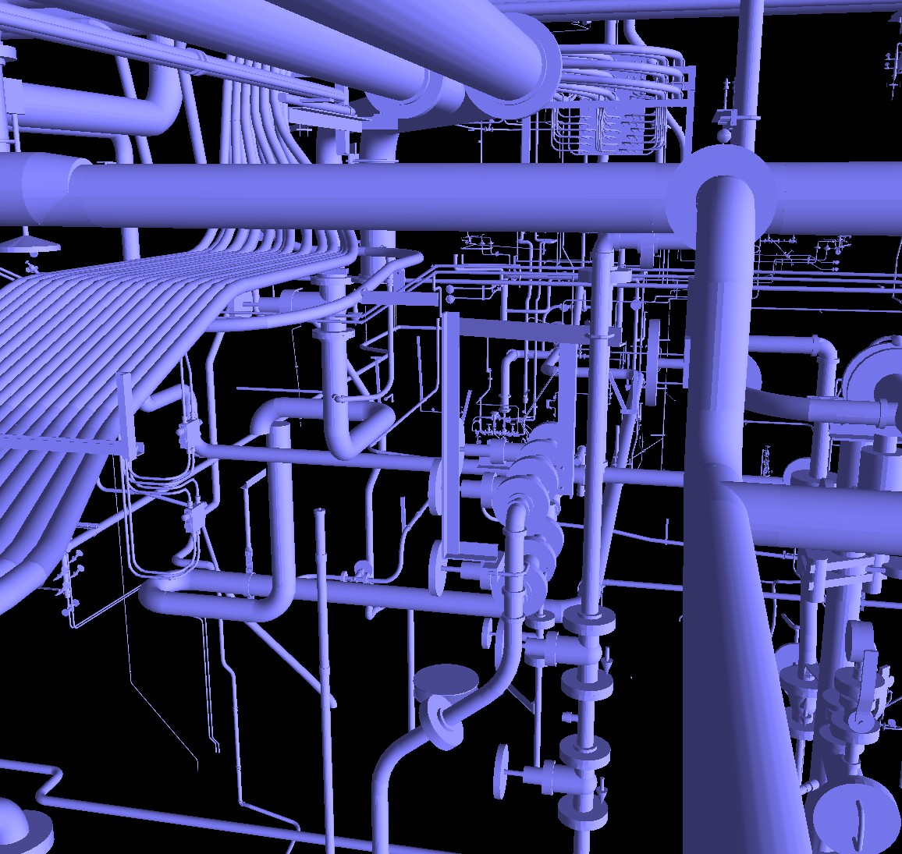
plumber
by
Geofrey Sanders
Clinton Myhre
Seth Long

Slide 2
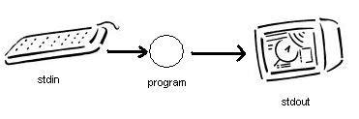
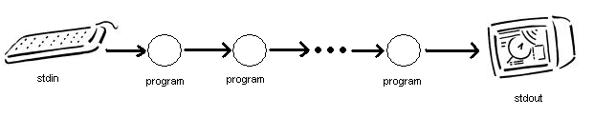
What is a unix pipe ( | )?
Unix “pipe” concept |
  Redirect of stdin, stdout

Slide 3
So what is plumber?
Allows directed graph of connections, instead of sequential list of connections

Slide 4
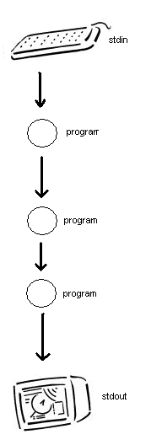
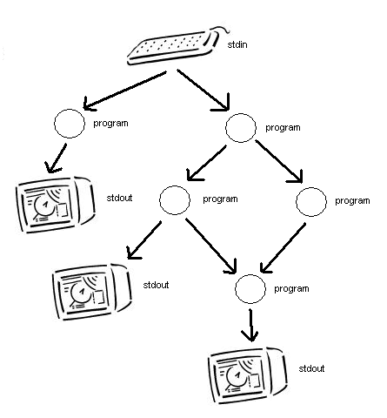
pipe
plumber

Slide 5
Design
Parse input, make Adj. Matrix
Spreader
Collector
Fork, Link, and Exec

Slide 6
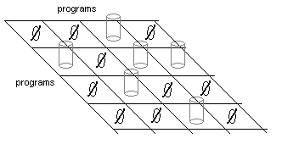
Parse input, make Adj. Matrix
Standard input:
  plumber 1:”program name” 2:”program” … -e 1,2 1,3 …
Row = program output
Column = program input

Slide 7
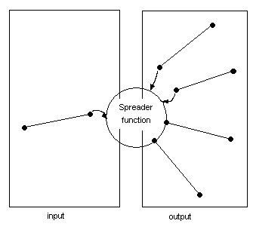
Spreader
Write everything read from the input to each of the outputs
When input closes and is empty, close the outputs

Slide 8
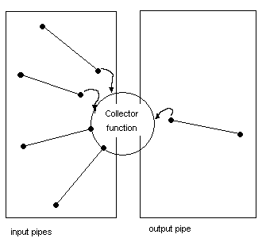
Collector
Read from one input at a time and write to the output
When all inputs are closed and empty, close the output

Slide 9
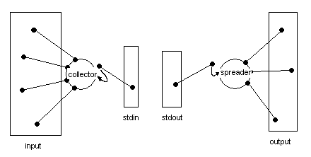
Fork and Link
Create two pipes, one from stdin to the output of a Collector, and the other from stdout to the input of a Spreader.

Slide 10
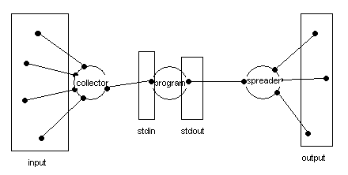
Exec
Run the program

Slide 11
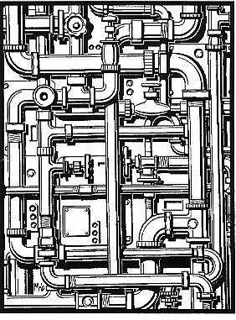
end
No third party software
Development tools:
  CVS
  gcc
  PyQt
  Python
  Gdb
  nroff
.

