Slide 1
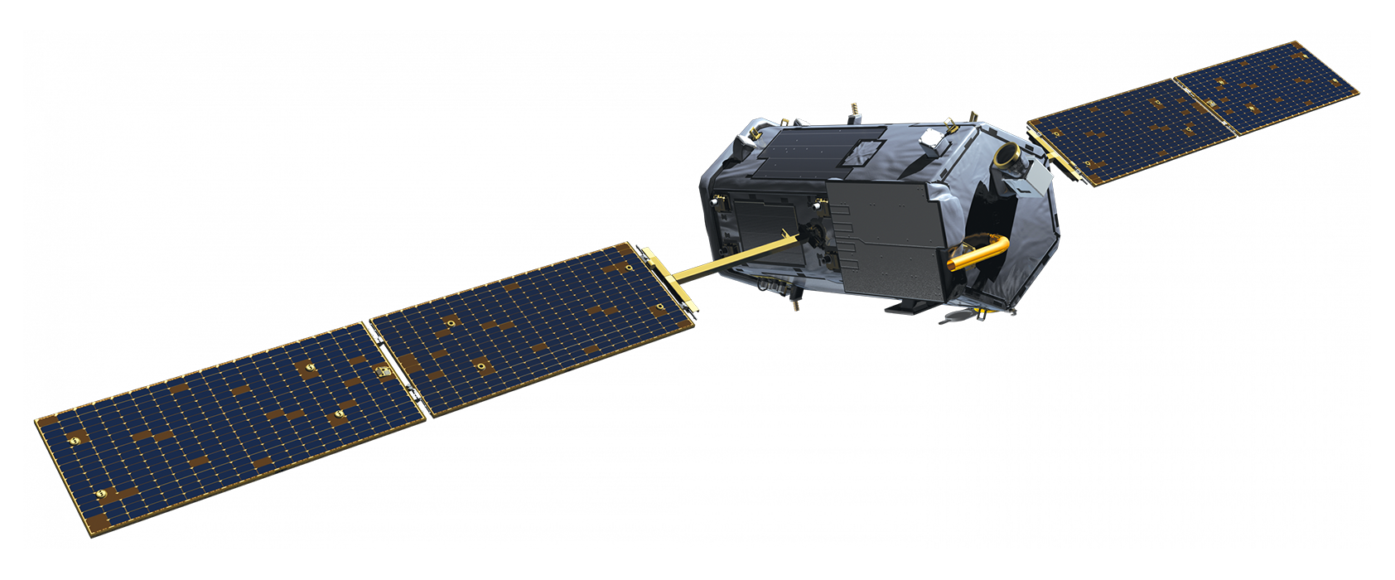
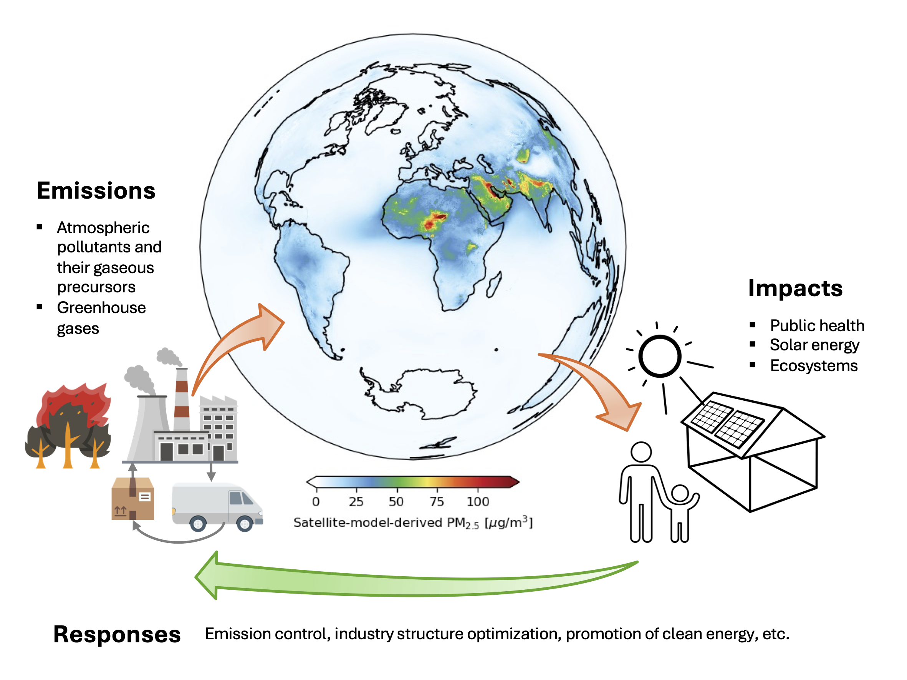


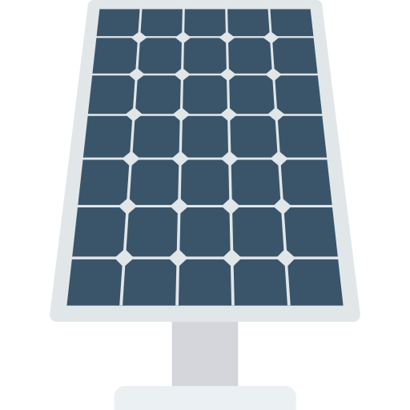
E5 Nexus Lab @ XXX
Energy-Environment-Epidemiology-Economy-Ecosystem
Atmospheric Column
Earth
Observation
Process
Modelling
Data
Assimilation
Artificial
Intelligence

Slide 2
Paper title
Paper title continued
XXX et al., Journal title, Volume(Issue), Page(s), Year
Graphical Abstract or similar
Profile Photo
Name (姓名）
Position
E5 Nexus Lab @ XXX Logo

