Slide 1

Bike Sharing Geospatial Data Analysis During COVID-19
By Yarong Chen

Slide 2
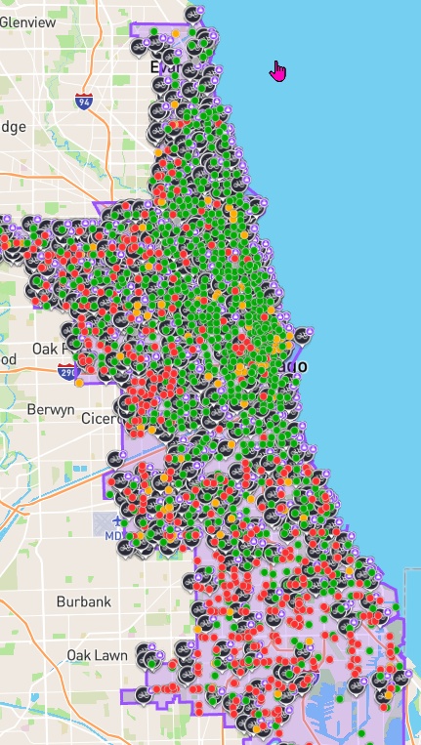
INTRODUCTION
Divvy is the bicycle sharing system in the Chicago metropolitan area, which currently is serving the cities of Chicago and Evanston. The system is owned by the Chicago Department of Transportation and currently is operated by Lyft since 2019. As of July 2019, Divvy operated 5,800 bicycles and 608 stations, covering almost majority of the city. I found its data has been shared on Chicago Data Portal site (https://data.cityofchicago.org/Transportation/Divvy-Trips/fg6s-gzvg) and thought it’s a great geospatial data source for my geo-programming course project. I wonder how the bike sharing system has been changed since COVID-19 hit in early 2020.

Slide 3
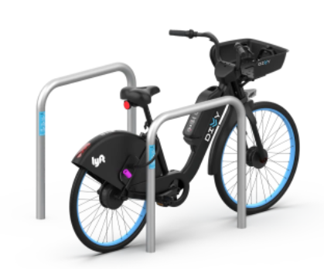
GOAL
The overall project goal is to explore how the bike sharing pattern and volume have been changed since COVID-19.

Slide 4
SPECIFIC OBJECTIVES AND QUESTIONS
What are major monthly and yearly differences on bike sharing volume between 2019 and 2022?
How the duration time for the overall bike sharing rides has been changed?
What is the daily bike sharing volume differences by ride types?
What has changed on daily time series data by membership type during COVID-19?
How does weekly bike-sharing changes during COVID-19?
Where is the hot spot for the ride start point? Where needs more bikes?
Where are the locations that bike-sharing customer tends to use bike longer?

Slide 5
DATA COLLECTION AND DESCRIPTIVE STATISTICS
The main data sets are described as below:
The bike sharing data is downloaded from Chicago Data Portal (https://data.cityofchicago.org/Transportation/Divvy-Trips/fg6s-gzvg).
Bike sharing data of 2019. There are 3,818,795 rows and 16 columns. No latitude and longitude. No boundary type of data column included.
Bike sharing data between 2020 until the April of 2022. There are 27,282,580 rows and 22 columns. It contains start point and end point latitude and longitude. No boundary type of data column included.
The Data for each trip is anonymized and includes:
Trip start day and time
Trip end day and time
Trip start station
Trip end station
Rider type (Member, Single Ride, and Day Pass)
Latitude
Longitude
The combined dataset is huge! There are 37,253,960 rows for the data from 2019 and 27,282,580 from 2020 to 2022. It is not an idea way to analyze spatial data using individual ride geospatial points. My solutions to reduce computation power is aggregating data points to hexagon and the convert to polygon.

Slide 6
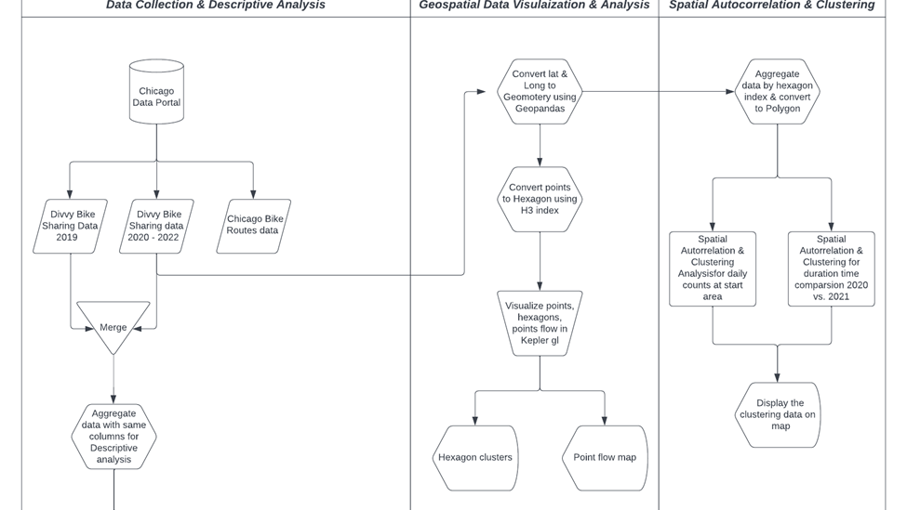
MODIFIED WORKFLOW MODEL

Slide 7
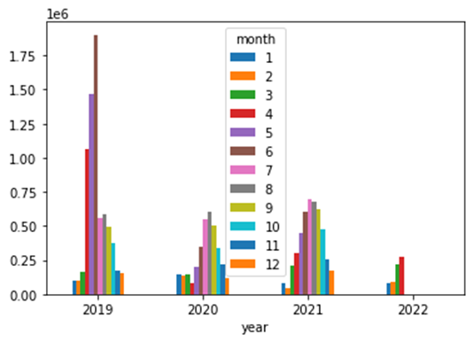
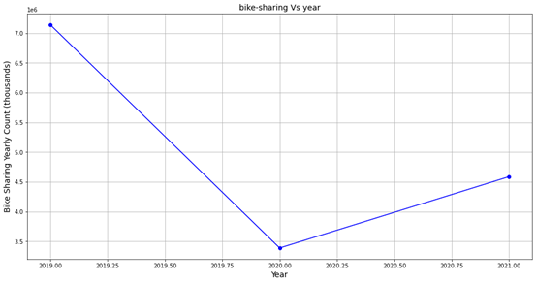
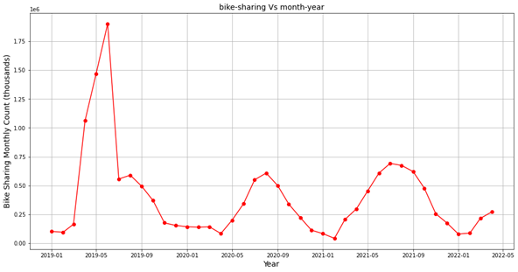
FINDINGS
What are major monthly and yearly differences on bike sharing volume between 2019 and 2022?
Notes:
Overall bike sharing volume is much higher before COVID-19 hit in 2019 compared with 2020 and 2021. The bike sharing in April and March of this year is higher than the same month in 2020, 2021, which showing some recovery signals.
The bike sharing volume shows seasonality. There are not many bikes sharing demand in winter but more demand in summertime.
Before covid hits, in 2019, the bike sharing volume is significantly higher than those in covid years.
The bike sharing significantly decreased in April of 2020 right after the Covid began, whereas it usually increases in April in other years.
The bike sharing volume is higher in 2021 compared with 2020.
The bike sharing in April and March of this year is higher than the same month in 2020, 2021, which showing some recovery signals.

Slide 8
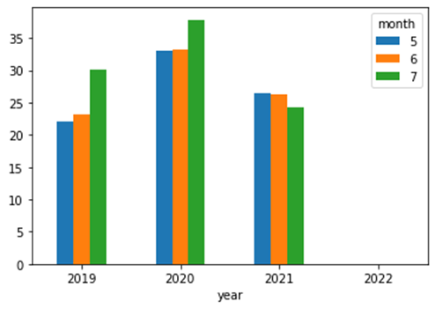
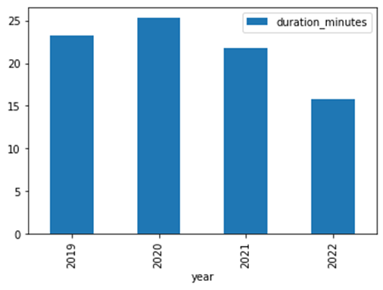
FINDINGS
How the duration time for the overall bike sharing rides has been changed?
Notes:
Average bike sharing duration in minutes dropped since COVID-19 began in 2020.
Average bike sharing show overall decrease in 2021 compare with 2020.

Slide 9
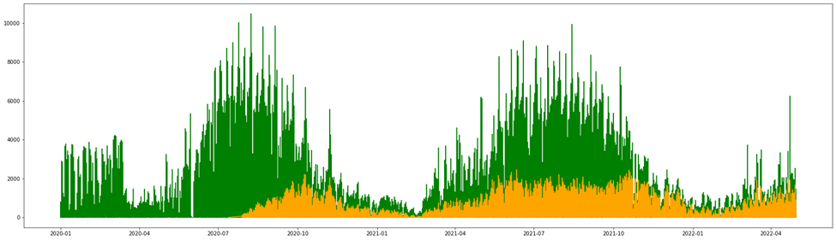
FINDINGS
What is the daily bike sharing volume differences by ride types?
Notes:
It shows strong seasonality: more in summer, less in winter
Electric bike is the new riding type since July of 2020. It shows more flat seasonality compared with traditional bike. (Green below is traditional bike, orange is electric bike)
Bike sharing in winter is much higher before COVID hits, which remains low in the past two years.

Slide 10
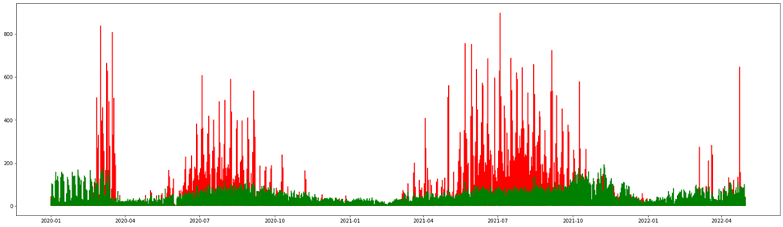
FINDINGS
What has changed on daily time series data by membership type during COVID-19?
Notes:
Green above is with memberships, red is casual. Bike sharing with membership with less variability.
Bike sharing with casual visit showing more demand than member demand during the summertime.
It's interesting to see the peek for red, is the bottom for green, the same is true for green. Which makes sense that more causal visit during the weekend but more demand for weekdays for memberships.
Bike sharing demand for winter is much lower for member after COVID hits in green.
Casual demand in read is much lower in 2020 than 2021 in the summer.

Slide 11
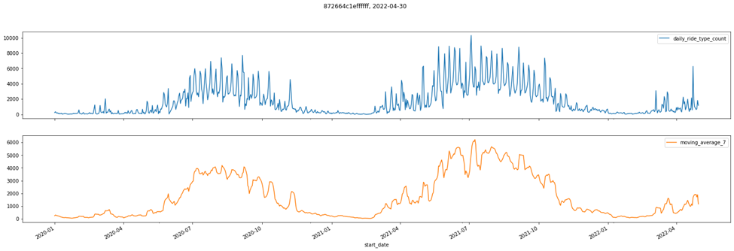
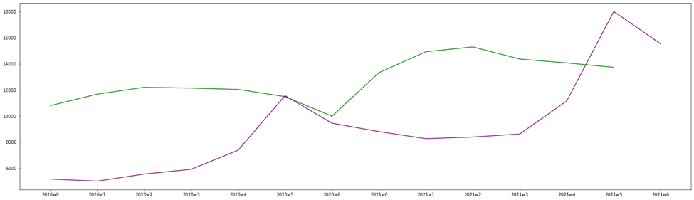
FINDINGS
How does weekly bike-sharing change during COVID-19?
Notes:
The individual hexagon follows the overall time series pattern with trend and seasonality (both weekly and monthly).
It shows more stable demand for memberships (in green) than casual type (in purple), especially in winter to sprint time.
Overall, it has higher demand during weekdays, especially on Tuesdays, Wednesdays, and Fridays.
Weekly demand is much higher in 2021 than 2020.
the member and casual bike sharing demand in a week is trending in an opposite way. For member bike sharing, the demand is mostly during the weekdays, the demand for casual bike sharing is mostly during the weekend and the peek is Fridays.

Slide 12
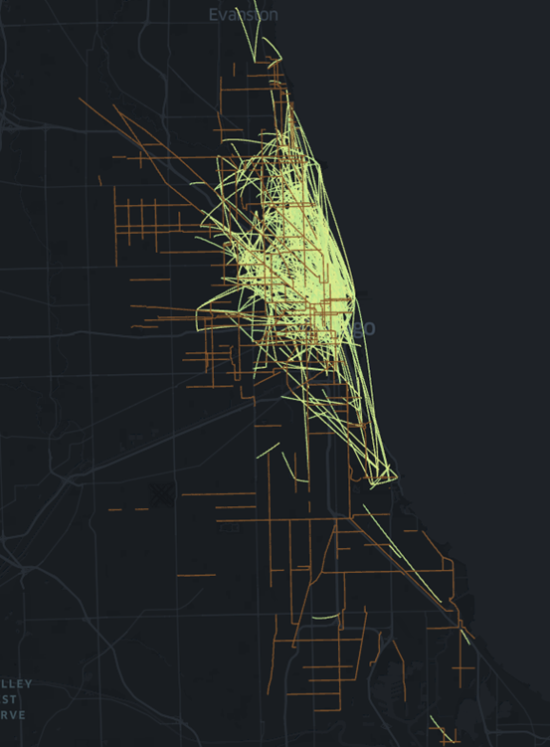
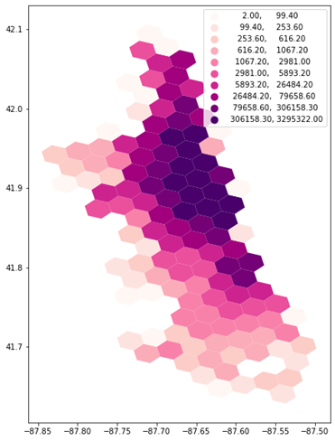
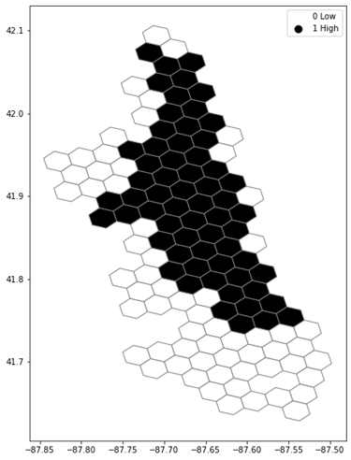
FINDINGS
Spatial Autocorrelation & Hot/Cold Spot clustering analysis for average daily counts by individual hexagon. (Where is the hot spot for the ride start point? Where needs more bikes?)
Notes:
The above sample (only contains 1,000 rides) start-point to end-point visualization is generated using kepler gl. It shows in some areas are busier that others. But it needs to be further analyzed.
Casual demand in read is much lower in 2020 than 2021 in the summer.

Slide 13
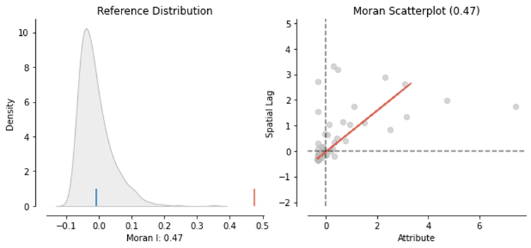
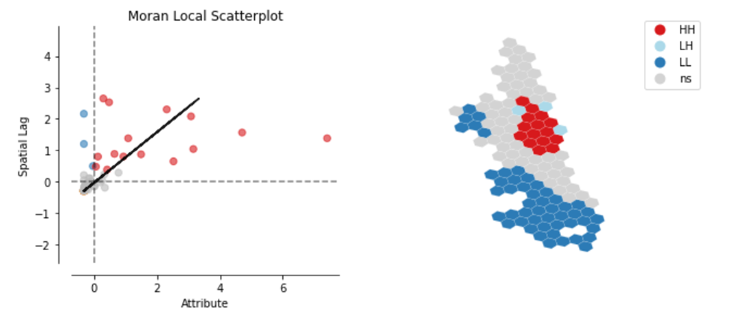
FINDINGS
Spatial Autocorrelation & Hot/Cold Spot clustering analysis for average daily counts by individual hexagon. (Where is the hot spot for the ride start point? Where needs more bikes?)
Notes:
The Moran’s I analysis shows significant autocorrelation with correlation value of 0.47 and p-value=0.001
The red shows hot pot and blue shows cold spot. The hot spot areas on the real map shows a lot of attraction spots such as navel pier, Willis tower, field museum, which makes hot spot meaningful and making sense.

Slide 14
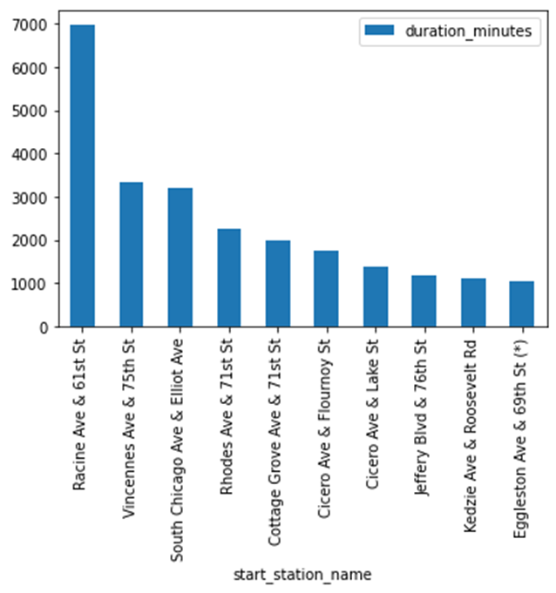
FINDINGS
Spatial Autocorrelation & Hot/Cold Spot clustering analysis for median duration in minute by individual hexagon. (Where is the hot spot for the ride start point? Where needs more bikes?)

Slide 15
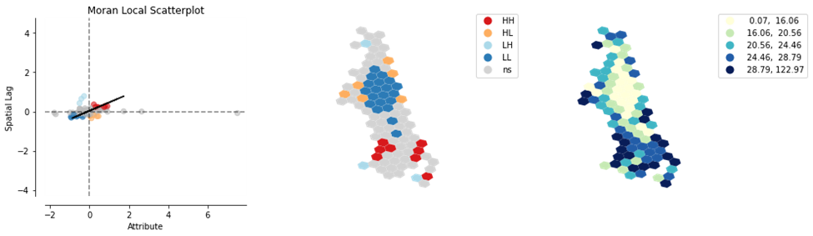
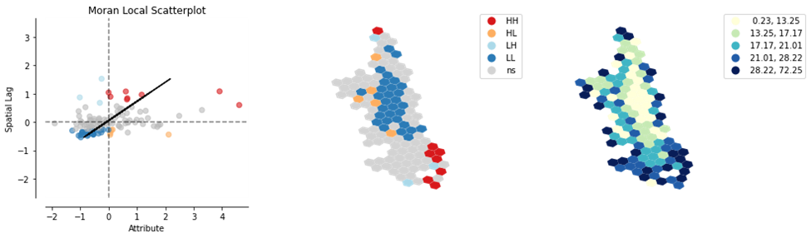
FINDINGS
2020
Spatial Autocorrelation & Hot/Cold Spot clustering analysis for median duration in minute by individual hexagon. (Where is the hot spot for the ride start point? Where needs more bikes?)
​2021
Notes:
Comparing the clustering differences, I see the hot spot locations have changed in 2021. One big hot spot on the left disappeared in 2021. The cold spots remain similar pattern in 2021.
Comparing the quantile values between 2020 and 2021 for median time duration, we can see that overall, it’s higher in 2020 than 2021. It could relates to the electric bike became available later 2020, which can largely reduce the bike-sharing duration time.

Slide 16
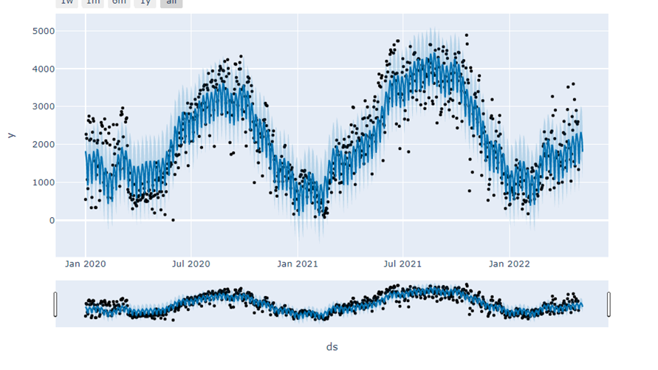
Bike-sharing demand time series forecasting at start area – Experimental analysis

Slide 17
CONCLUSION
Since COVID-19 began, overall, yearly, monthly, weekly bike-sharing volume has decreased compared with 2019. 2021 shows certain level of recovery trend but still not as good as 2019.
Overall ride duration time has reduced. My inference is that electric bike largely reduced the duration time but could also be due to other factors, such as lower demand for tourists. The median of bike duration time shows significant spatial autocorrelations. The clustering for hot/cold spots changed between 2020 and 2021.
The mean of daily bike-sharing shows significant spatial autocorrelation and clustering trends, using this type of information can help the company who manages the bike-sharing to optimize the bikes into different locations.

Slide 18
LIMITATIONS
The bike-sharing points data is aggregated on hexagon level. It may lose some good information in this process.
The spatial autocorrelation and clustering analysis are also limited because many other factors can impact on the overall clustering patterns. It needs future analysis to have more holistic view of the changes.

Slide 19
REFERENCES
Bike share responses to COVID-19: https://www.sciencedirect.com/science/article/pii/S2590198221000609
H3: Uber’s Hexagonal Hierarchical Spatial Index: https://eng.uber.com/h3/
Pysal spatial autocorrelation: https://pysal.org/notebooks/viz/splot/esda_morans_viz.html

