Slide 1

INDIAN PREMIER LEAGUE • DATA INTELLIGENCE
IPL ANALYTICS
SEASONS 2008 – 2022
Business Intelligence & Performance Presentation
Power BI
DAX
Star Schema
225K+ Deliveries

Slide 2





ABOUT THE TOURNAMENT
02
What is the IPL?
The world's biggest Twenty20 cricket league
The Indian Premier League (IPL) is a professional Twenty20 (T20) cricket league launched by the BCCI in 2008. Across 19 seasons through 2026 it has become the world's most-watched T20 tournament, its 10 city-based franchises drawing elite global talent through high-profile annual auctions — with Chennai Super Kings and Mumbai Indians the most successful, on five titles each.
2008
19
10
5
LAUNCHED BY BCCI
SEASONS, 2008–26
TEAMS IN 2026
TITLES: CSK & MI

Slide 3




WHY THIS PROJECT
03
Project Topic
THE PROJECT APPLIES
Turning Cricket Data Into Decisions
Power BI
Cricket is one of the most popular sports in India, and the IPL generates a massive amount of data from every match, player, team and season. This project was selected to explore how data analytics can transform raw cricket statistics into meaningful insight.
As a sports enthusiast and data analyst, IPL Analytics is a chance to apply Power BI, DAX and data modeling to a real-world dataset — building an interactive and visually engaging dashboard.
Interactive, visually engaging reporting dashboards.
DAX
Custom measures and high-performance calculations.
Data Modeling
A clean star schema over a real-world dataset.

Slide 4




WHY IT MATTERS
04
Relevance & Real-World Impact
RELEVANCE OF SPORTS ANALYTICS
Data-driven strategies are now vital for player acquisitions, roster building and on-field team game plans.
REAL-WORLD BUSINESS CASES
Player Auction Valuation
Tactical Game Strategy
Performance Recognition
Estimate market bids using historical match-up advantage and player statistics.
Assess venue patterns to make data-backed batting and fielding decisions.
Isolate the MVP match-winners who consistently deliver under pressure.

Slide 5





USE CASE 01 · IN DETAIL
05
Player Auction Valuation
How season data and match-up history convert into a disciplined bid ceiling.
VALUATION DRIVERS relative weighting
Recent form
85
Consistency
70
Match-up edge
80
Role & scarcity
55
Fair value
Bid ceiling
DISCIPLINED BID CEILING
SMART BID ZONE
OVERPAY
low ₹
Base price
higher price →
Bid up to the ceiling — then walk away.

Slide 6





USE CASE 02 · IN DETAIL
06
Tactical Game Strategy
Turning venue history and the toss into a bat-or-field call and field settings.
Toss Outcome
Venue & Conditions
Bat or Field?
Field & Match-ups
Won or lost
1st-inns avg · chasing win % · pitch & dew
data-backed call
set placements & bowling plans
Field first when chasing is favoured — high chase win %, dew expected.
Bat first when defending holds up — big first-innings scores at the venue.

Slide 7

USE CASE 03 · IN DETAIL
07
Performance Recognition
Weighting raw output by context to surface the players who actually win matches.
All Performances
WHY IT MATTERS
runs · wickets · strike & economy rates
Raw totals reward volume, not impact.
Context Weighting
match importance · pressure · innings phase
Context exposes clutch contributions others miss.
True Match-Winners
Pinpoints who to retain, reward and promote.
clutch POTM & finishers

Slide 8


WHAT WE WORKED WITH
08
Dataset Description & Structure
15
225K+
950
SEASONS (2008–2022)
BALL-BY-BALL DELIVERIES
COMPLETED MATCHES
Delivery Facts
Match & Franchise Dims
Player Details
Fact_ball_by_ball
Dim_Matches · Franchise
IPL Player Details
225,000+ deliveries tracking overs, runs, wickets, plus batter and bowler names.
950 matches with venue, margins, toss & POTM — plus franchise colors, owners and home grounds.
Player statistics enriched with high-resolution Base64 circular portraits.

Slide 9
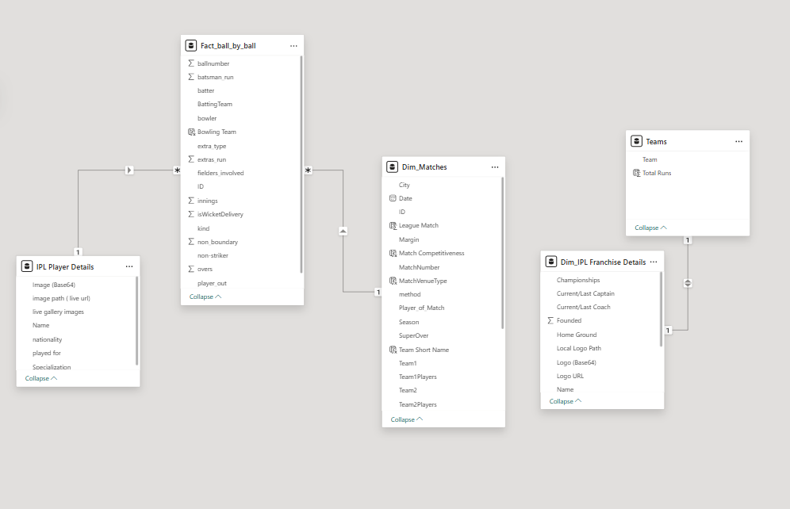



HOW IT FITS TOGETHER
09
Data Model Overview — Star Schema
Star Schema Design
Configured for efficient filtering, fast DAX calculations and high-performance reporting in Power BI.
Core Fact Relationship
Dim_Matches[ID] → Fact_ball_by_ball[ID] (1-to-Many) — links match-level info to ball-by-ball data.
Player Mapping
IPL Player Details[Name] → Fact_ball_by_ball[batter] (1-to-Many) — maps player info and images.
Franchise Link
Franchise Details[Name] ↔ Teams[Team] (1-to-1) — connects logos, captain, coach & titles.
Power BI model view

Slide 10
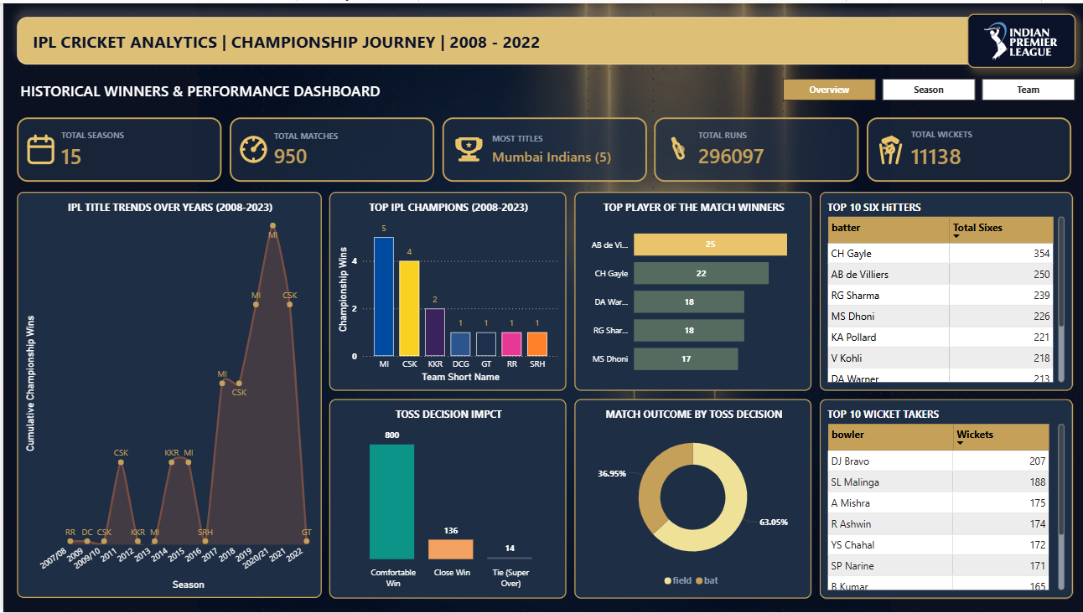


ANALYTICS PAGE 1
10
Overview Dashboard
Core KPIs
15 seasons · 950 matches · 296K+ runs · 11K+ wickets.
Toss Strategy
Field-first wins 63% of tosses — a clear chasing advantage.
POTM Leaders
AB de Villiers leads with 25 (Gayle 22, Rohit 18).
Performance Tables
Top batters by sixes and bowlers by wickets ranked.

Slide 11

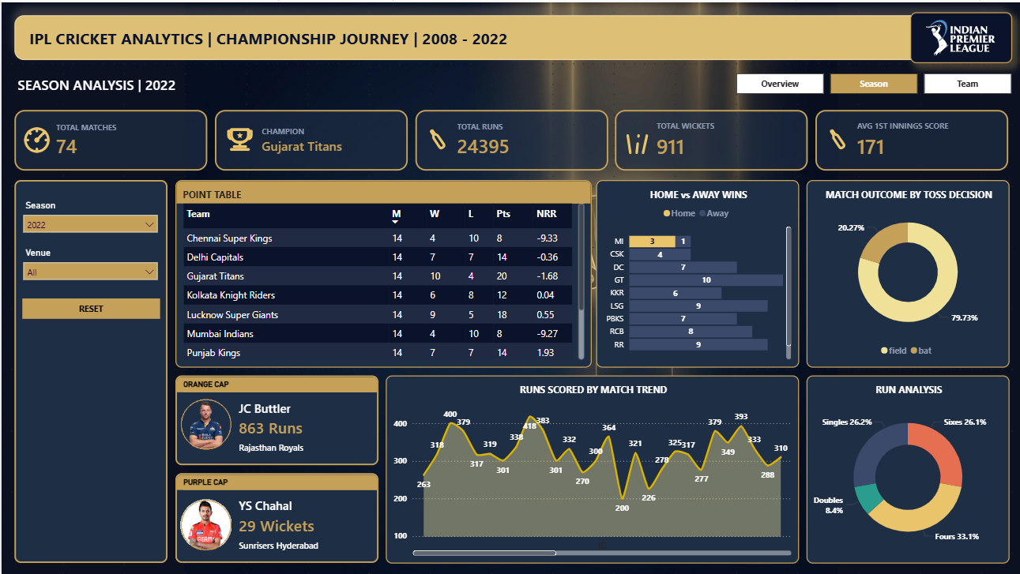

ANALYTICS PAGE 2
11
Season Performance
Points Table
Interactive standings: Played, W, L, Points and Net Run Rate.
Home vs Away
Bar chart compares success at home grounds vs away.
Cap Winners
Season Orange Cap (batter) and Purple Cap (bowler).
Runs Breakdown
Donut splits runs by singles, doubles, fours and sixes.

Slide 12

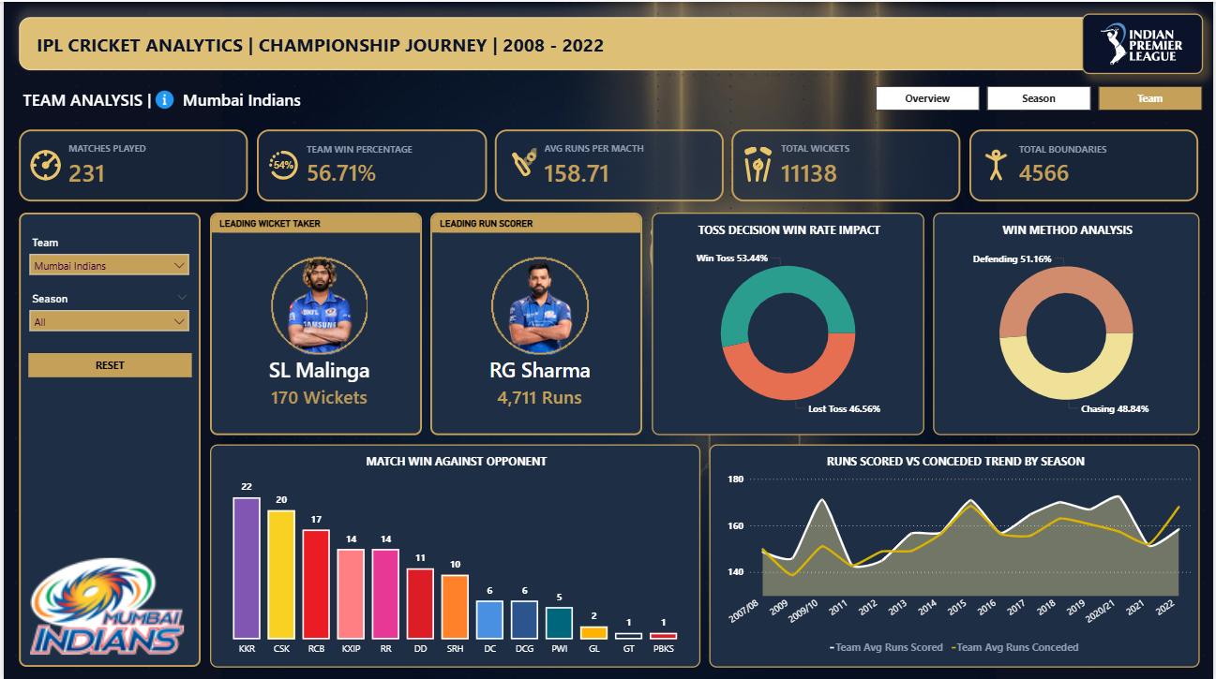

ANALYTICS PAGE 3
12
Team Performance
Team KPIs
Slicer-driven Win %, matches, boundaries, top batter & bowler.
Scoring Trends
Area chart of runs scored vs conceded across seasons.
Victory Conditions
Wins by chasing vs defending and by toss outcome.
Head-to-Head
Wins detailed against each opponent franchise.

Slide 13

WHAT THE DATA TELLS US
13
Insights & Recommendations
KEY INSIGHTS
RECOMMENDATIONS
Team performance varies significantly across IPL seasons.
Maintain balanced squads with strong batting and bowling units.
Several franchises sustain consistent performance over many years.
Study winning seasons to surface the strategies that worked.
Championship teams show strong win % and balanced squads.
Use historical trends to guide planning and decision-making.
Team-wise analysis reveals batting, bowling & match-winning gaps.
Monitor strengths and weaknesses across seasons continuously.
Season trends expose shifting rankings and success rates over time.
Leverage data to optimize composition and match strategy.

Slide 14






WRAPPING UP
14
Conclusion & Future Exploration
This project shows how sports data drives decision-making, performance evaluation and strategic planning. Applying analytics to IPL data produced valuable insight for teams, players and cricket enthusiasts alike.
FUTURE ENHANCEMENTS
Live IPL Data
Predictive Analytics
ML Valuation
Integrate APIs for real-time analysis and reporting.
Forecast match outcomes and player performances.
Model player value and auction bidding strategy.
Player Comparison
Expanded Dashboards
Richer Visuals
Advanced benchmarking and player-vs-player views.
Venue, partnership and opposition-based insights.
Interactive reports to sharpen decision-making.

