Slide 1
Austin Crime Analysis
Comparing 2004 to 2009
Henry Reissig
Geography 5318
April 28, 2010

Slide 2
The years 2004 and 2009
National boom to bust
Population Explosion in Texas and Austin
Population Increase negatives
  Crime Increase

Slide 3
Austin Facts
2004 Population – 692,102
2009 Population – 774,037
Percent Increase – 11.8% Increase
2004 Combined Crime – 135,020
2009 Combined Crime – 160,424
Percent Change – 18.8% Increase

Slide 4
Problem with just facts and the spatial solution
These facts don’t answer:
  Where is crime occurring the most in Austin?
  What areas have increased or decreased in crime from 2004 to 2009?
Solution:
  Spatially analyze the crime density in Austin and find the hot spots where crime has changed between 2004 and 2009.

Slide 5
Crime – what are we counting?
“Data provided represents only calls for police service where a formal, written report was made and does not include other calls for police service that did not result in a written report.” – Austin Police Web Site
Some Examples
  murder
  rape
  robbery
  aggravated assault
  burglary
  theft
  motor vehicle theft
  Arson

Slide 6
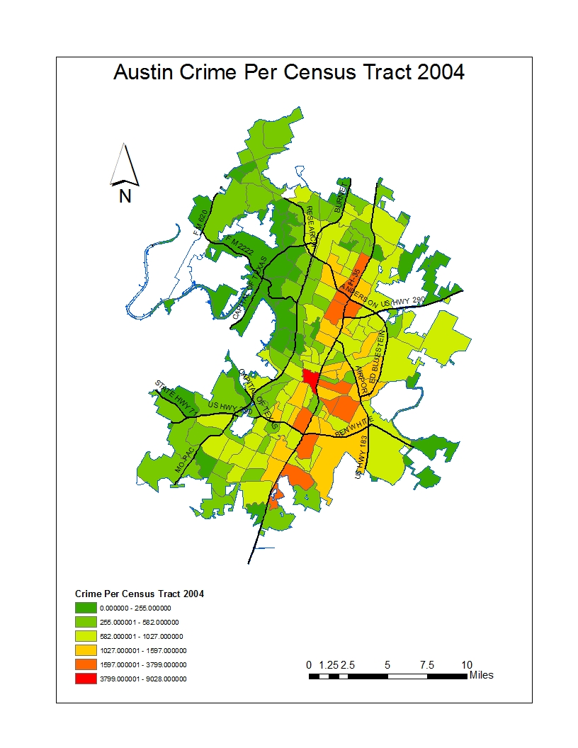

Slide 7
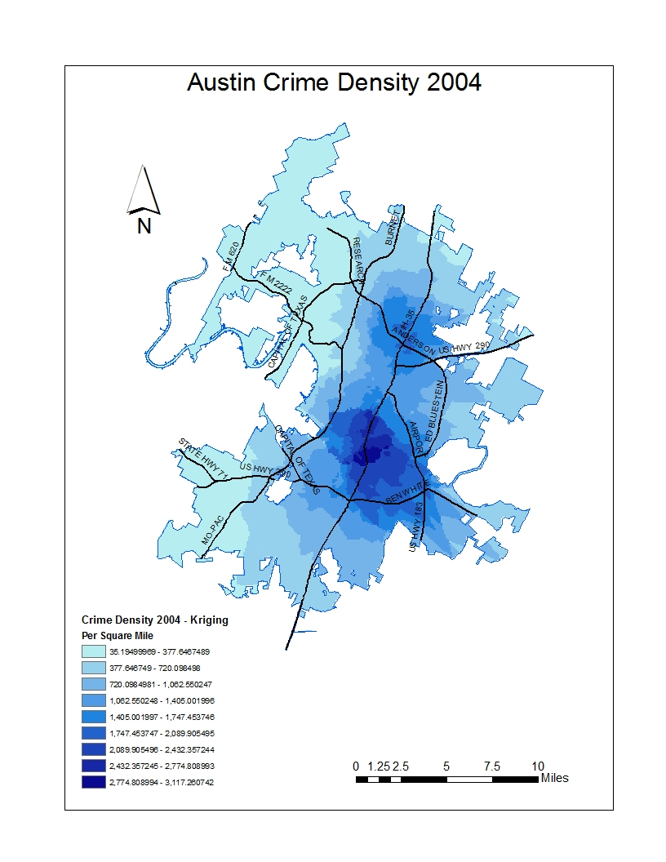

Slide 8
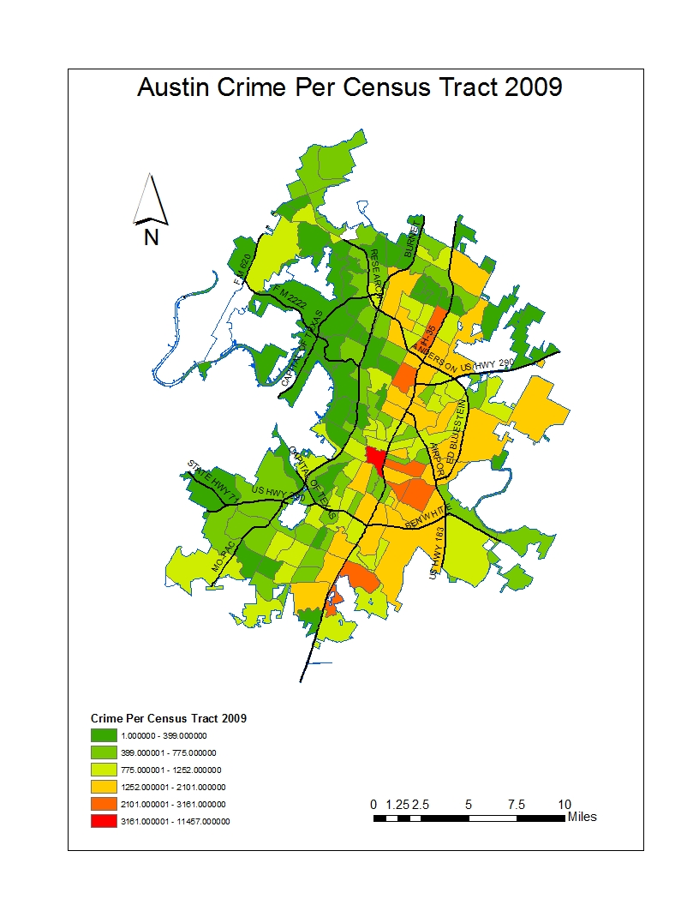

Slide 9


Slide 10
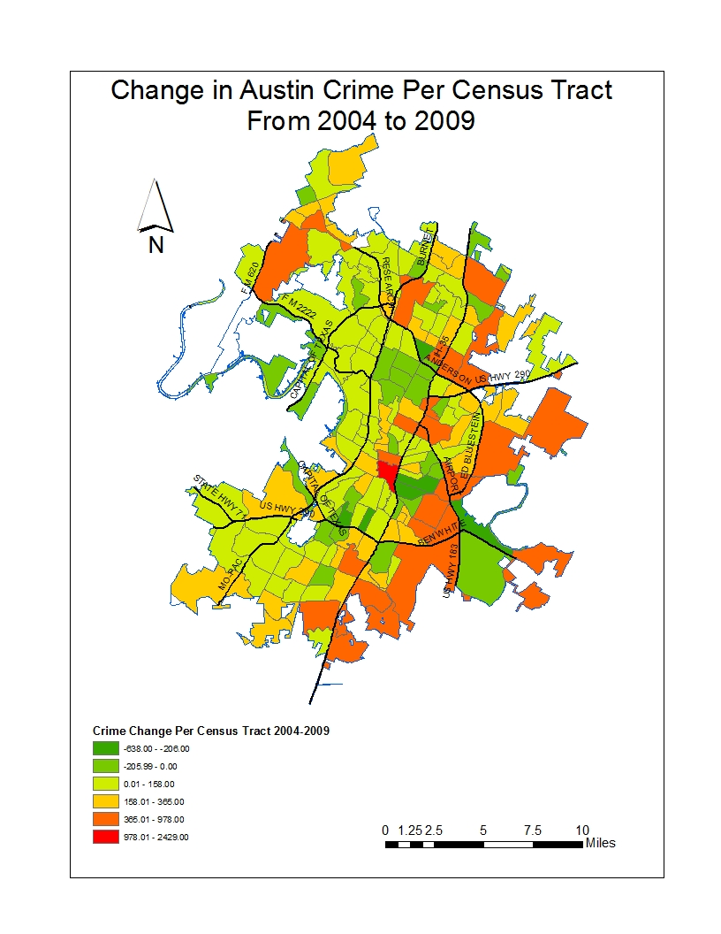

Slide 11
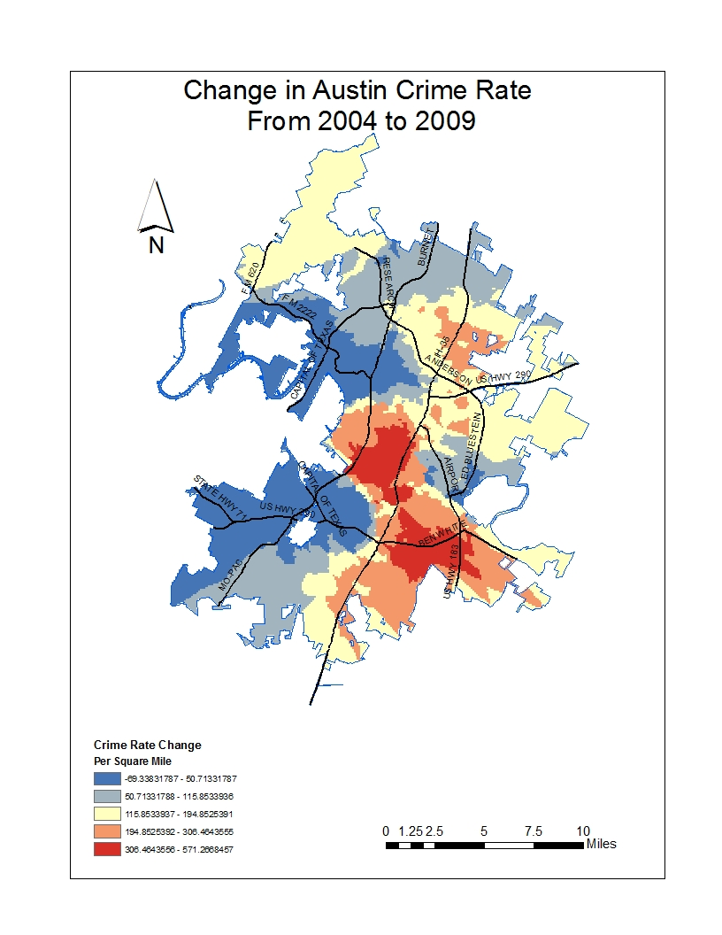

Slide 12
Conclusion
The change in crime is clearly not evenly distributed in Austin
Central, north central and southeast Austin have the highest increases in crime rates
This information can be used by city planners and law enforcement

Slide 13
Steps in Implementing the GIS Model
Gathered crime data from the City of Austin Website the data had total crime with census tract
Census tract maps were gathered from the US census Bureau. The 2000 census tract map was used in this analysis
Crime data was then converted to a database file. The crime by census tract data table was then joined with the 2000 census tract map.

Slide 14
Steps in Implementing the GIS Model (Cont.)
The joined layer was then classified into graduated colors to visualize total crime per census tract for both the 2004 and 2009 data sets.
Before any interpolation analysis was done, the centroids for the all the census block groups were found.

Slide 15
Steps in Implementing the GIS Model (Cont.)
Interpolation was then done on these maps using kriging with a circular semivariogram model and a search radius type as variable and number of points 12. This produced two crime density maps for both years.
The difference between the two kernal density maps was then performed with the raster calculator creating the hot spot map showing the increase in crime rate.

Slide 16
References
Web Site | URL
US Census Bureau | http://www.census.gov/geo/www/cob/tr2000.html
Capital Area Council of Governments | http://www.capcog.org/information-clearinghouse/
City of Austin Police Department | http://www.ci.austin.tx.us/police/censustract/censustract.cfm
Austin City Connection | http://www.ci.austin.tx.us/demographics/

