Slide 1
The Changing Geography of Metropolitan Opportunity: The Segregation of the Poor in U.S. Metropolitan Areas, 1970 to 1990
Presentation
By
Henry Reissig

Slide 2
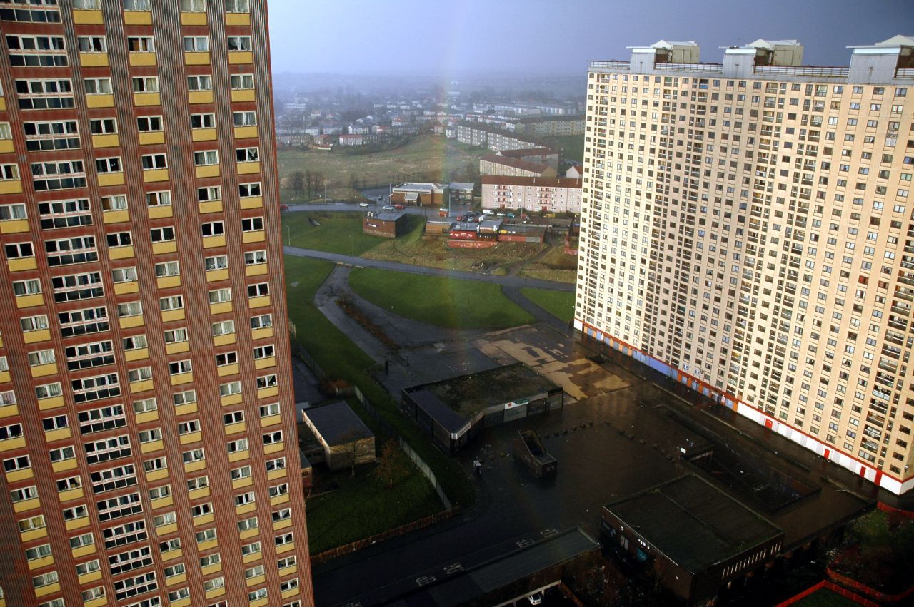
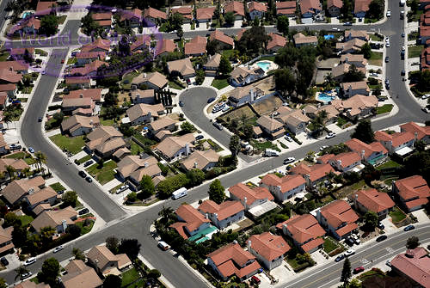
“Poor” and “Rich” Areas
  Colloquially, most or us are aware of what is considered to be a “poor area” or a “rich area”. This article strives to quantify how poor and non poor areas are distributed and isolated.

Slide 3
Why study Segregation of “Rich” and “Poor” Areas
This article analyzes the segregation of the poor in major cities across all parts of the United States and analyzes the trends from 1970-1990.
In this study, the “poor” are defined as persons that are below the poverty line. Note: the poverty line was not defined in this article.
This data can be used by policy makers in decisions regarding funding and can be used as indicators on whether current policies are working or not.

Slide 4
Why study Segregation of “Rich” and “Poor” Areas (cont.)
Separation of poor from the nonpoor has several unfortunate consequences
  Isolates them in distressed areas where the neighborhood effects of living among negative role models may subvert positive individual or family efforts
  Isolated poor communities may be inadequately served by underfunded public institutions that do little help residents break out of distressed neighborhoods.
  Leave them more susceptible to the harmful effects of economic downturn. They have fewer neighborhood resources to call on to relieve dislocations.
  May reinforce negative stereotypes of the poor and weaken the bonds between the poor and nonpoor that allow the two groups to live in relative peace.
  scarcity of positive role models

Slide 5
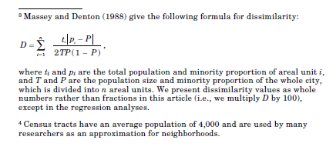
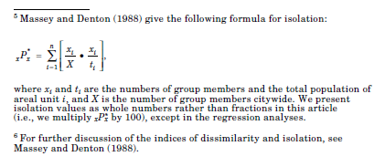
Segregation Indices
The dissimilarity index measures the evenness of the distribution of the poor within a metropolitan area. The dissimilarity index describes the percentage of poor people that would have to move from one census tract to another to achieve an even distribution. A dissimilarity index of 0 means that the poor are perfectly distributed throughout all census tracts. A dissimilarity index of 100 means that 100 percent of all the poor need to move to achieve an even distribution.
The isolation index in this article measures the extent to which the poor are exposed in their neighborhoods to other poor people. This index varies from 0 to 100. Zero indicates someone completely around people other than poor and 100 indicates complete isolation of the poor from everyone else.

Slide 6
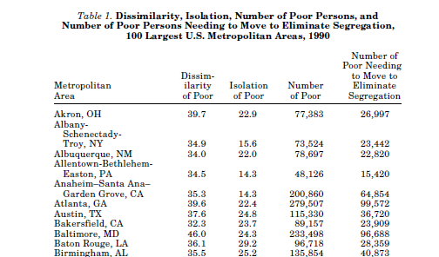
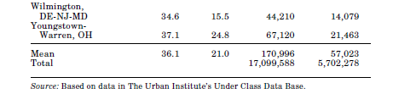
Dissimilarity and Isolation of Poor in Selected Cities
In raw numbers, 36.1 percent in 1990 meant that 5.7 million poor people would have to relocate to different neighborhoods within the same metropolitan area. A value of 21.0 on the isolation index indicates that the neighborhood of an average poor person is 21.0 percent poor.

Slide 7
Indices of Poor as Compared with Black and Hispanic Populations
As seen on the table below, the dissimilarity and isolation of the black population is much larger than the average poor person in the U.S. and the Hispanic population (1990).
Race | Dissimilarity | Isolation
Black | 60.2 | 42.2
Hispanic | 39.1 | 17.2
Average Poor in US | 36.1 | 21.0
    While segregation of the poor increased, the segregation of blacks decreased. The dissimilarity of blacks fell by 7.2 (11 percent). For non whites, the dissimilarity fell by 15.8 (23 percent) from 1970-1990.
    A partial explanation for this is that fair housing laws have permitted blacks and other minorities to move to more integrated suburban areas from poorer areas.

Slide 8
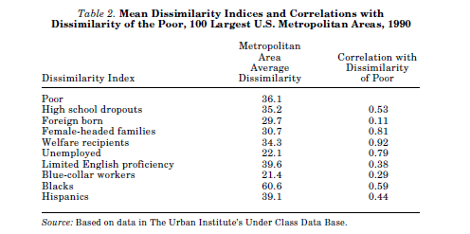
Dissimilarity Indices compared with other known indicators of poorer neighborhoods
One concern that might affect the numbers in this study is what is considered “short term poor”. These are people who are temporarily misplaced because of layoffs or other factors. To alleviate this, the authors compared factors that are considered more permanent indicators of poor such as the number of high school dropouts and Welfare recipients.

Slide 9
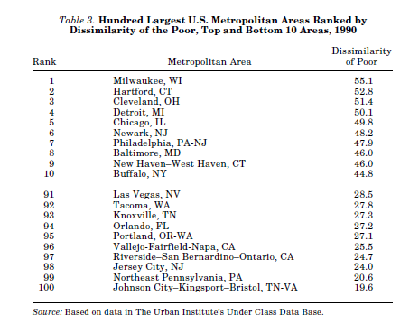
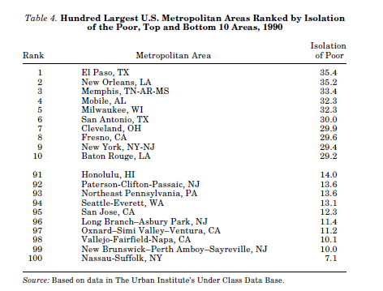
Metro areas with highest Segregation Indices
The segregation indices varied greatly among metropolitan areas. Dissimilarity index range was from 19.6 (Bristol TN-VA) to 55.1 (Milwaukee). The Isolation Index ranged from 7.1 (Nassau-Suffolk, NY) to 35.4 (El Paso, TX).

Slide 10
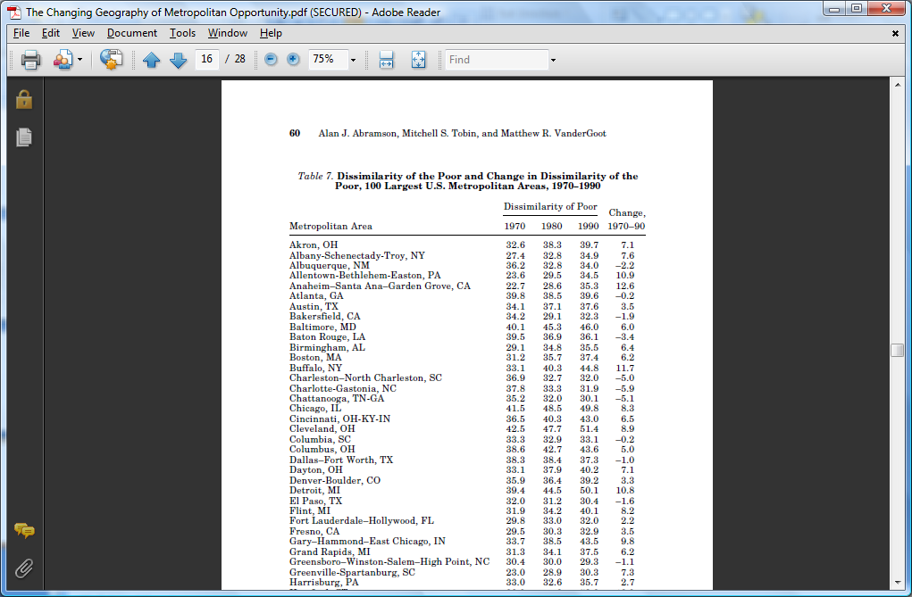
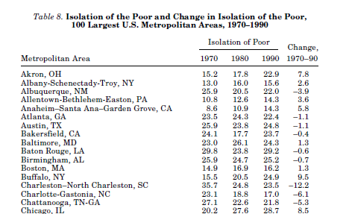
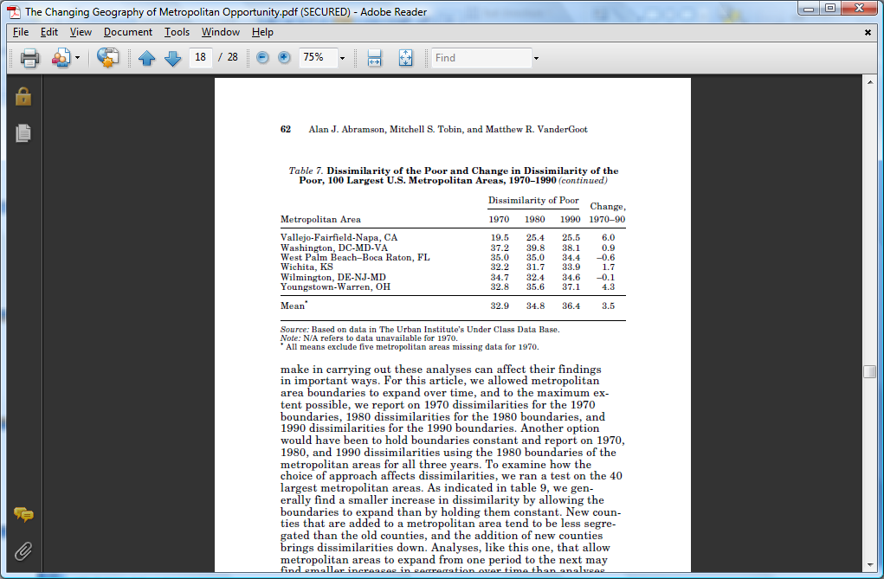
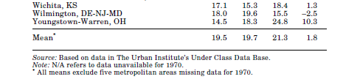
Change in Dissimilarity and Isolation Indices of the Poor for Selected Metro Areas 1970-1990

Slide 11
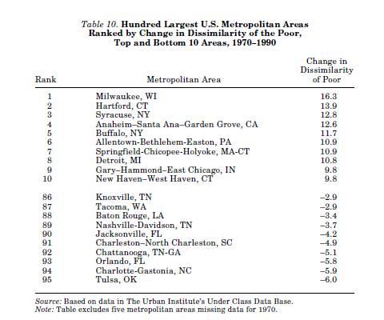
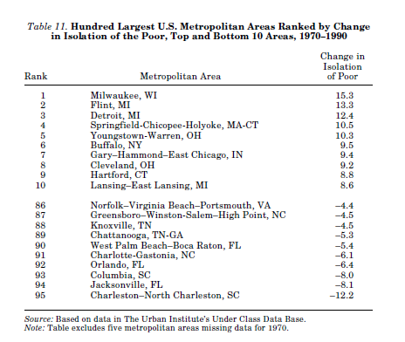
Change in Dissimilarity and Isolation Indices of the Poor for 1970-1990 – Top Metro Areas
Milwaukee experienced the largest increase in the dissimilarity of the poor (16.3) and isolation of the poor (15.3). The largest decrease was Tulsa (-6.0). The largest decrease of isolation was Charleston, SC (-12.2)

Slide 12
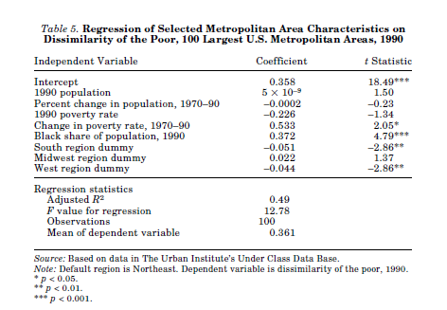
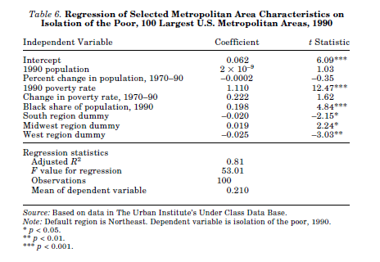
Regression Analysis of Selected Metro Area Characteristics and Dissimilarity of the Poor
The dissimilarity of the poor in 1990 is higher in areas that experienced larger increases in poverty rate.
The poor are more segregated in areas with larger percentages of blacks in the population. Thus the level of black segregation in an area is apt to have some effect on the level of segregation of the poor in the area.
The isolation of the poor in 1990 is significantly related to 1990 poverty rate.
The are poor are significantly more isolated in the Midwest are than the North-east areas.

Slide 13
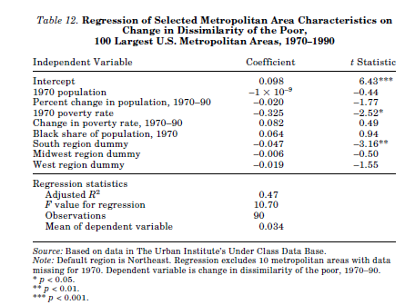
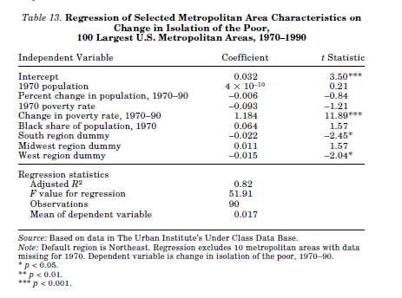
Regression Analysis of Selected Metro Area Characteristics on Change in Dissimilarity or the Poor
Larger increase in the dissimilarity of the poor from 1970-1990 occurred in metropolitan areas with lower 1970 poverty rates (table 12). More mixing of poor and nonpoor occur when the poor start off as a larger share of the population.
Larger increases in the isolation of the poor from 1970-1990 occurred in metropolitan areas that experienced larger 1970-1990 increases in poverty rate (table 13)

Slide 14
Recommended Use of Results
In an effort to decrease the segregation of the poor, the authors recommend a broad range of policy options.
  A set of programs that would attempt to attract the nonpoor into poor neighborhoods through community redevelopment programs.
  Provide transportation assistance to jobs in the suburbs or by finding them housing in nonpoor areas.
  Focus on the overall health of metropolitan-area or regional economies that might eventually affect the level of segregation

Slide 15
Critique
Statistical analysis seems to be very sound for most of the results of this article.
The authors did make their case by approaching the findings in a variety of ways and comparing their results with other studies.
The authors’ results did match their data and was very understandable.
It would have been nice to see other correlations such as crime rate affects the cities with the highest and lowest segregation of the poor.
It would an interesting next step to examine the factors going into why the indices of these cities changed between 1970 and 1990.

Slide 16
Questions?

