Slide 1
TOPS 101
Module 2
Open Tools & Resources

Slide 2
Agenda
10:00 – 10:30
Congratulations! Review Mod 1 and challenges
10:30 – 11:00
Review convening purpose and plan for sessions
11:00 – 12:00
FAIR data, Open Science Data Management Plans
12:00 – 12:30
Open Software, assessment
12:45 – 1:45
Lunch (Chapter IV)
2:00 PM – 3:45 PM
Module 3, Open Data
3:45 PM – 4:00 PM
Closing and next steps

Slide 3
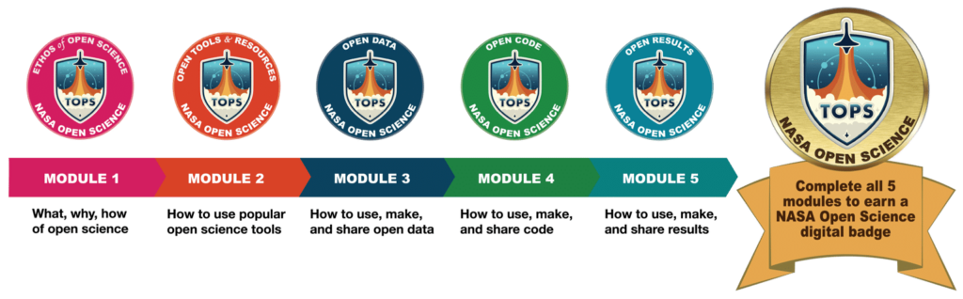
+ put Open Science knowledge to work in a open science research plan or proposal

Slide 4
Review
openscience101.org
ORCHID
progress through modules?

Slide 5
Oppportunities to make an Open Science plan
SUPPORTING CLIMATE RESILIENT COMMUNITIES – Community developed solution using NASA data (for example, pollution early warning) . Due May 2.
DISASTER RISK REDUCTION, RECOVERY, AND RESILIENCE – Use NASA data to inform disaster preparedness decision making. Notice due March 28, Proposal due June 14
CITIZEN SCIENCE FOR EARTH SYSTEMS PROGRAM – Established group to research an issue like climate change. Notice due April 15, proposal due May 14.
Gulf Research Program NAS
  Place-based learning K-8
  Next generation STEM Environmental Justice researchers

Slide 6
Assessment Questions
Open science definition
OSDMP purpose
FAIR
Meta data
Types of software
Repositories, types of respositories, vs archives,
Integrated Development environments Jupyter, Visual studio
Version control
Project registry
Reference Managment system

Slide 7
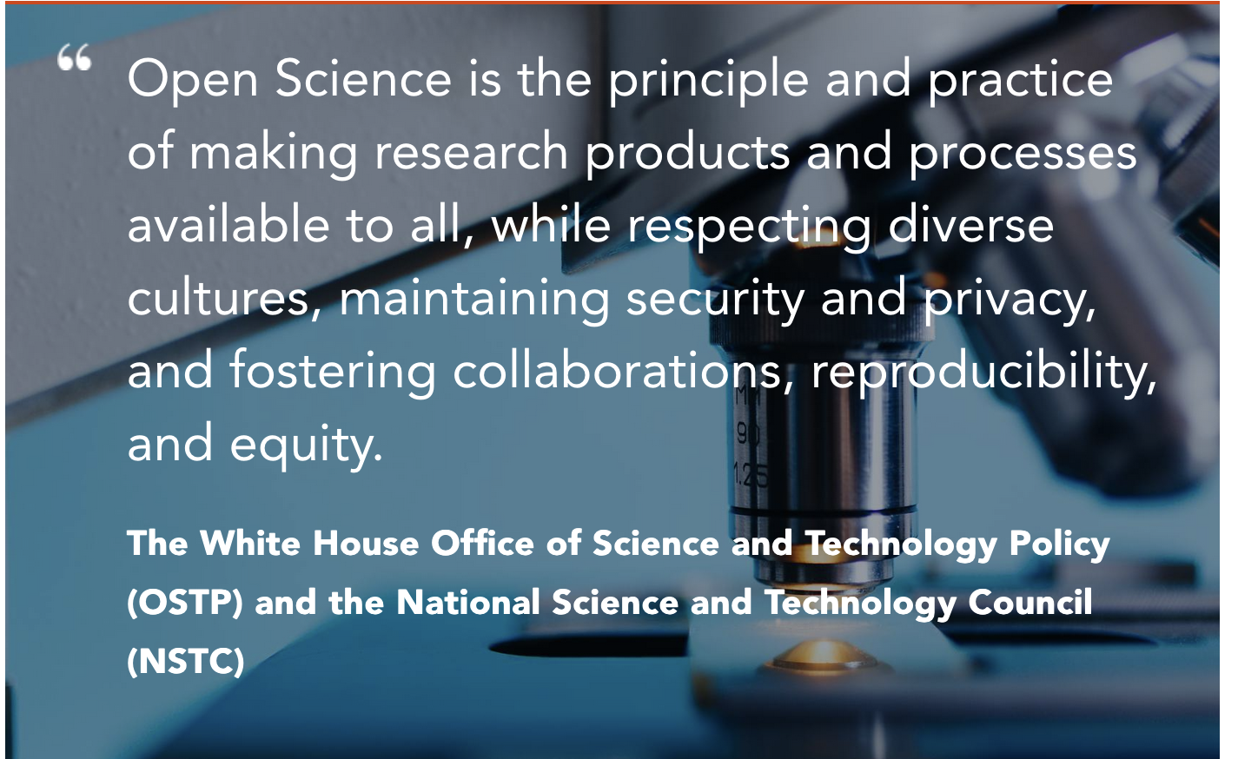
Notes:
What are the main elements? What tools might you need to do this?

Slide 8
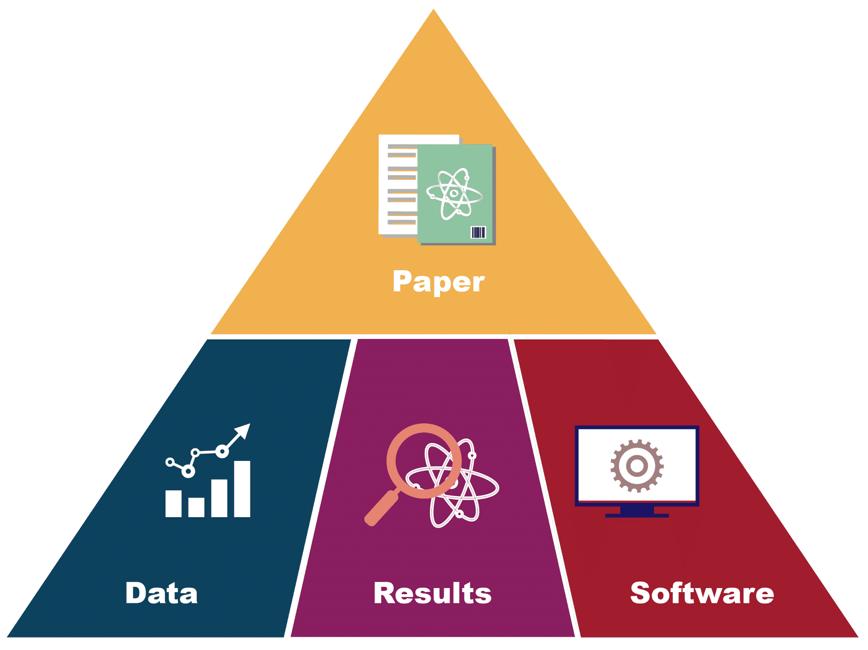
Open Science tools help to share research products:
Notes:
Mod 2 lesson 1 – Research Products

Slide 9
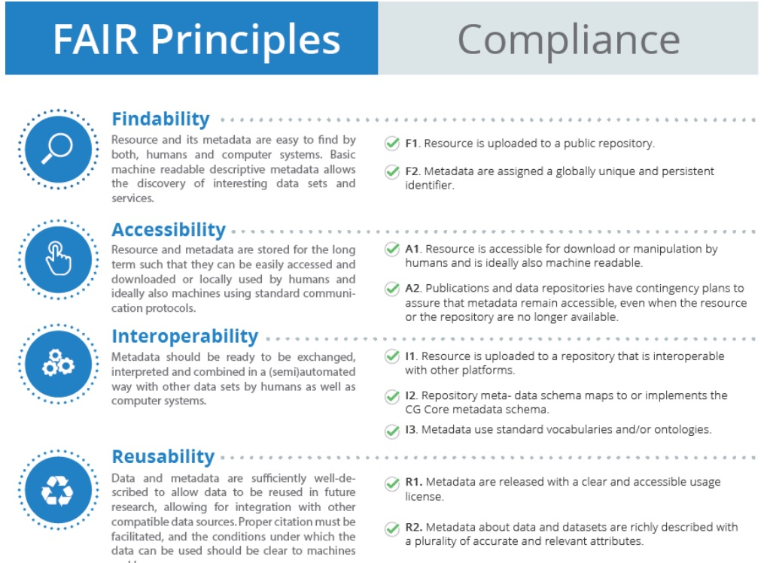
FAIR principles
Notes:
https://aims.fao.org/news/fair-principles-digital-objects-role-metadata

Slide 10
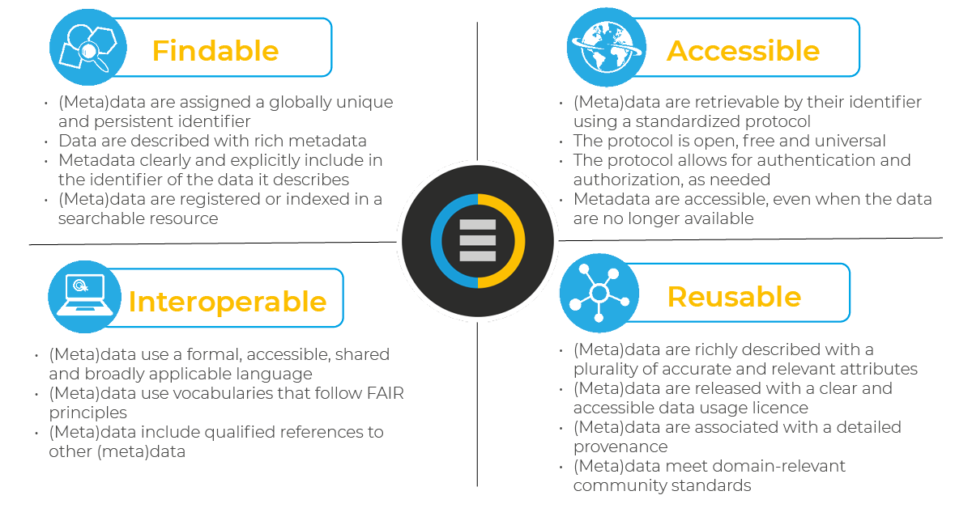
Notes:
https://www.ccdc.cam.ac.uk/solutions/about-the-csd/fair-data-principles/

Slide 11


Digital Persistent Identifiers
long-lasting reference to a digital resource that is machine-readable and uniquely points to a digital entity
ORCHID
  “Open Researcher and Contributor Identifier” (ORCID) provides valid information about a person
DOI – Digital Object Idenntifier
  A DOI is a persistent identifier used to cite data, software, journal articles, and other types of media (including presentation slides, blog posts, videos, logos, etc.).

Slide 12
Demonstrate Zenodo
https://zenodo.org/
General purpose open repository for
Generates an DOI
  research paper
  data set
  document
  anything digital

Slide 13
Metadata
Metadata are data that describe your data
Either accompanying your data as a separate file or embedded in your data file
Enhance searchability by providing standardized, key information about the data

Slide 14

Metadata and FAIR discussion
Look at the metadata for a data set
https://microdata.worldbank.org/index.php/catalog/4571/study-description
Discuss
  What types of information are included in metadata for the data set?
  How does that information help make the data FAIR
    Findable
    Accessible
    Interoperable
    Reusable

Slide 15
Repositories
Storage locations for data, results, code and compiled software
Usually include meta data and assign DOI
General purpose:
  Zenodo -- free
  Dataverse -- Started at Harvard and now distributed
  Datacite – mostly for citing government data
  Dryad – submission fee, curated, mostly to support publications
Institutional – University library, World Bank Data catalogue, NASA
Discipline – Cancer images, environmental data initiative...
Software development – GitHub Repos

Slide 16
Open Science tools in research:
Discovery – finding content and background for your research
Analysis & Visualization
Writing & presenting – data management plans, presentations, pre-prints
Publications – archiving & sharing
Outreach – promoting & applying research

Slide 17
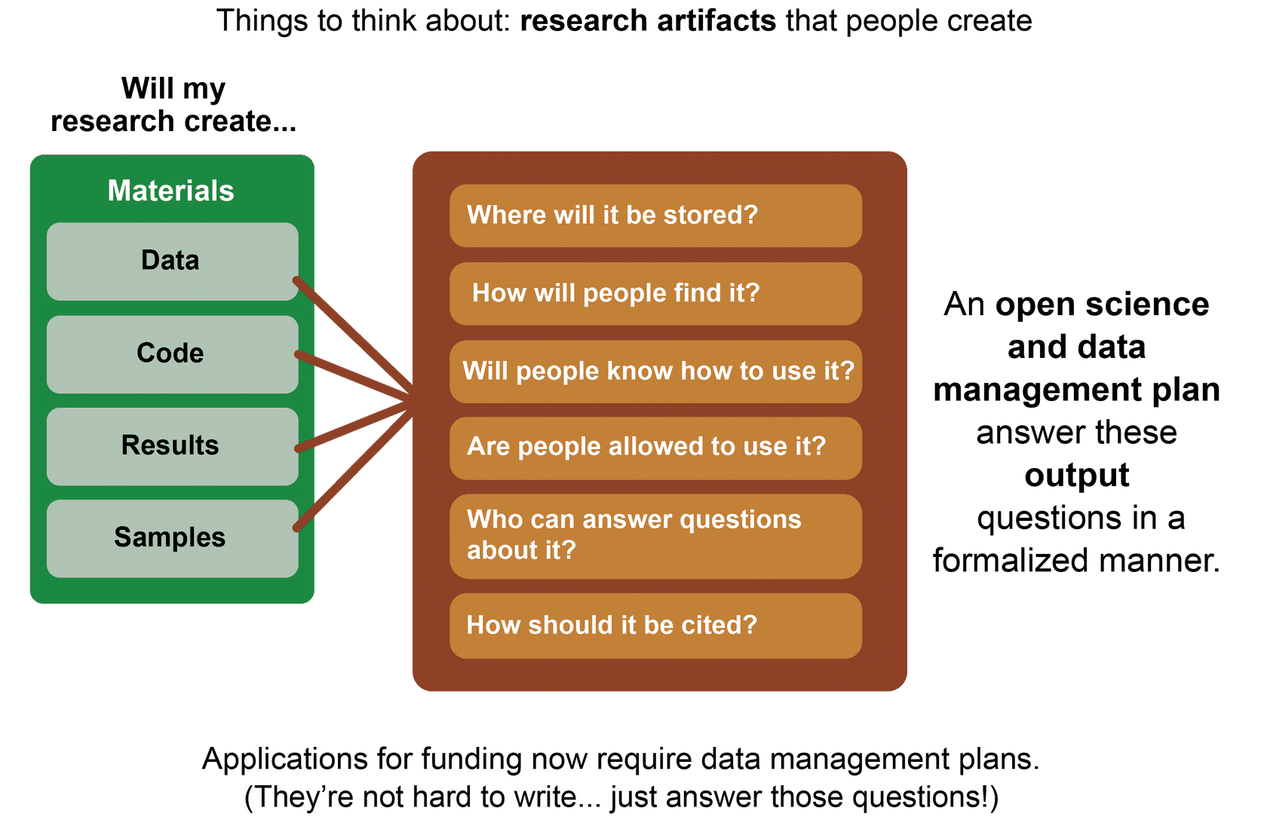

Slide 18

Write your own OSDMP
Example of our OSDMP for this project

Slide 19

Quiz – Lessons 1-3

Slide 20
Tools for Software Development

Slide 21
What software development is needed for data analysis? How can this be Open?
Individual Analyst
  Interactive Development Environments (IDE)
    https://visualstudio.microsoft.com/
  Comuputational note books
    https://youtu.be/H9Iu49E6Mxs?si=WyDb5siKrYAQBs0f
Open source development (commuity of coders/analysts)
  GitHub -- demonstrate
  Version control – most important when multiple coders
Distribute ready to use code or software library
  static code archive

Slide 22
IDE
Visual Studio
Software Repository
GIT
(version control)
Software Archive
Static archive

Slide 23
Quiz – Lesson 4

Slide 24
Other tools

Slide 25

Project registry
Create and update a Project Registry in conjunction with preserving outputs in the form of a spreadsheet or other type of list.
Preserve the Project Registry as a project component.
Include in each registry entry a description of the object, preferred citation, and the persistent identifier, and any other useful information supporting the project
Reference Management systems
What do you use?
zotero demo

Slide 26
Quiz – Lesson 5
Final Assessment

