Slide 1
Mod 3 Open Data
Open Science 101

Slide 2
What are some benefits of open data?

Slide 3

Look at Quiz for Module 3 Lesson 1

Slide 4
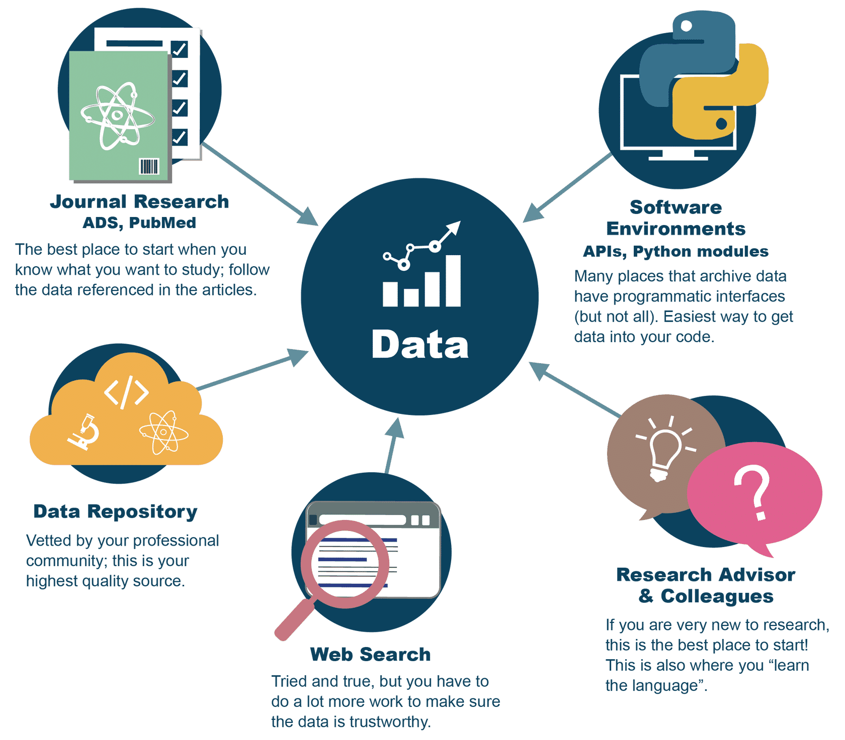
Find open data

Slide 5
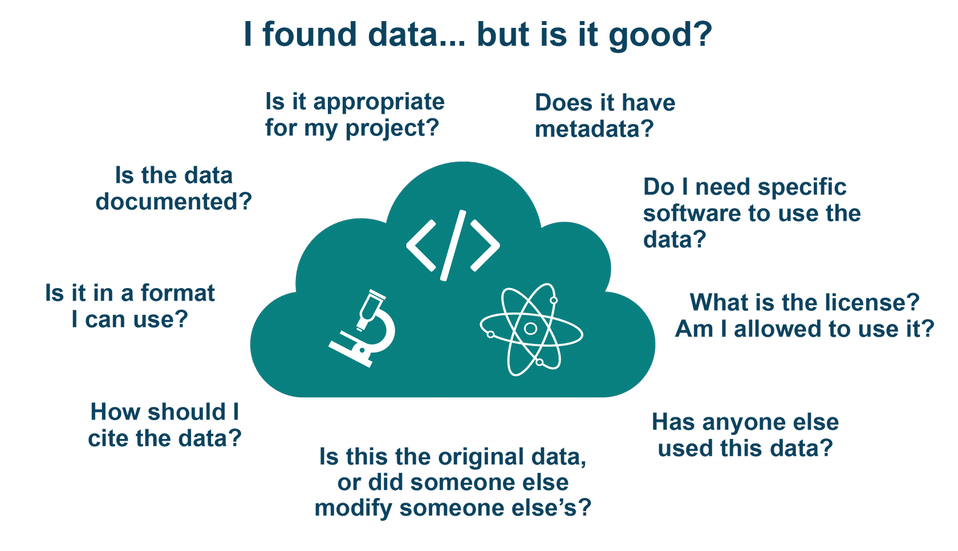

Slide 6

Lesson 2 Quiz

Slide 7
Examples of non-open data formats and open formats
Non-open
Open
?
?

Slide 8
Examples of non-open data formats and open formats
Non-open
Open
.doc, .docx
pdf
cad files, other proprietary formats often used in drafting or built environment
csv
others
  Hierarchical Data Format (HDF)
  Network Common Data Form (NetCDF)
  Common Data Format (CDF)
  Flexible Image Transport System (FITS)

Slide 9
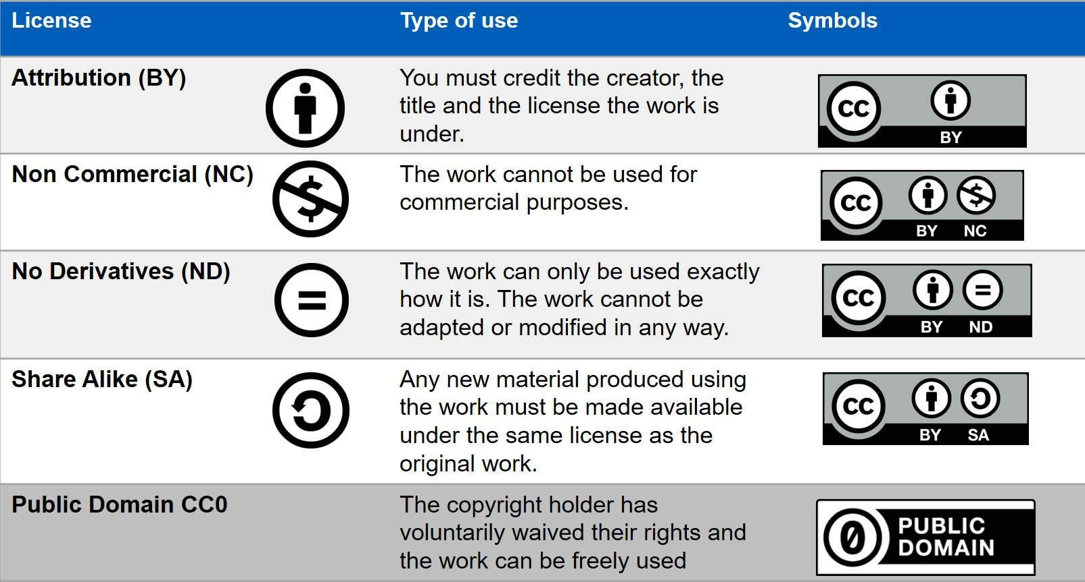

Slide 10
Quiz: Lesson 3

Slide 11
Quiz: Select the option you think is correct to complete the sentence. It is best practice to start working with a repository_____________.
As early as possible
When you have test data ready
After you obtain a DOI
When you are ready to release your data

Slide 12
Open data sharing process
Make sure your data can be shared
Select or identify a repository to host your data
Work with your repository to follow their process and meet their requirements
Make sure your data is findable and accessible through the repository and is maintained and archived
Request a DOI for your data set so that it is easily citable
Choose a data license

Slide 13
Regulations on data sharing
International Traffic in Arms Regulation (ITAR), which regulates the manufacture, sale, distribution, and export of defense-related articles and services.
Export Administration Regulations (EAR), which regulates the manufacture, sale, distribution, and export of commercial and dual- use items, technology, and information not already covered by ITAR.
Health Insurance Portability and Accountability Act (HIPAA), which established standards to protect sensitive patient health information from disclosure.
Controlled Unclassified Information provides standards for handling unclassified information that requires safeguarding or dissemination controls consistent with laws, federal regulations, and policies.
Federal laws and regulations governing classified information or security requirements.

Slide 14
What other data should not be shared or should be highly protected?
Subject to intellectual property, copyright, and licensing concerns
???

Slide 15
In the DMP, answer the following questions:
What: Data formats and (where relevant) standards.
When: When and if to share data.
Where: The intended repositories for archived data.
How: How the plan enables reuse of the data.
Who: Roles and responsibilities of the team members in implementing the DMP.
https://dmptool.org/public_plans

Slide 16

Quiz: Which of the following are roles to consider when sharing data? Select all that apply.
Develop guidance on privacy and cultural sensitivity of the data
Develop the data documentation and metadata
Assign the data a DOI
Verify the integrity of the data, metadata, and documentation transfer

Slide 17
Quiz: What are the three broad categories of getting involved with open data communities discussed in this lesson? Select all that apply.
Engage with repositories
Join standards committees
Write a data management plan (DMP)
Volunteer and participate in conferences, workshops, and special sessions
Identify data sharing roles and responsibilities on your team

