Slide 1
Open Science 101
module 5 – from theory to practice

Slide 2
Who benefits from scientific results?
Conventional research model:
University? Profs?
Industry?
Military?
Open Science
?

Slide 3
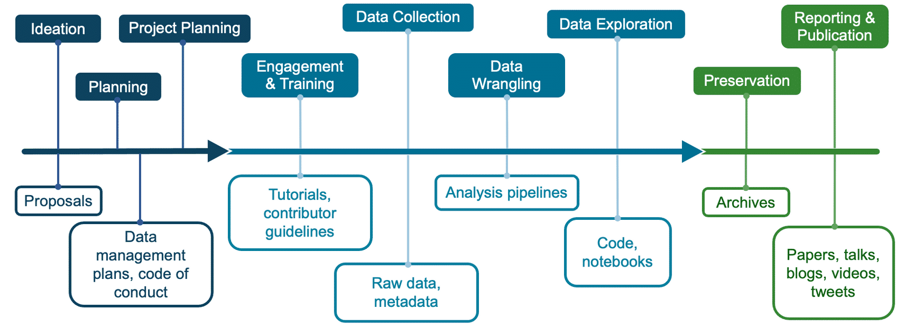

Slide 4
wider range of results of science
Open access peer-reviewed articles
Technical reports
Computational notebooks
Code of conduct, contributor guidelines, publication policies
Blog posts
Short form videos and podcasts
Social media posts
Conference abstracts and presentations
Forum discussions

Slide 5
How does broader definition and more open results address the ‘reproducibility crisis’
?

Slide 6
Where to look for open results
Google search
Google Scholar
Library
ADS
Scopus
Web of Knowledge
ResearchGate
other?

Slide 7
Where do EJ communities find results?
GitHub
LinkedIn
YouTube
Google/Bing
Conference websites
X, formally known as Twitter
Facebook
Medium
Substack
Stack Overflow
Reddit
Mastodon

Slide 8
Questions of quality
Is the material associated with a peer-reviewed publication?
Are the primary data associated with the results also open-source?
Is code used to generate the Open Results materials also open-source?
Are all fields and parameters clearly defined?
Is the derivation of measurement uncertainties clearly described?
Were any data or results excluded, and if so, were criteria provided?
Does the host website's URL end in .edu, .gov or (if managed by a non-profit organization) in .org?
Does the host website provide contact information of the author and/or organization?
Is the host website updated on a frequent basis?
Is the host website free of advertisements and/or sponsored content, the presence of which could indicate bias?
Is the result reproducible? Can you interact with the data and results? Have others reported being able to reproduce the results?
Is the author reliable? Have you seen them publish or share results in other forums?
Is the result from only a single author/voice or includes contributions from a broader community?
Does the post have a significant amount of likes/views and public comments? The value of a blog post with no comments or responses can be difficult to assess. Conversely, a thorough github discussion forum with multiple views shared indicated a robust post.

Slide 9
Contributing on Git Hub vs email
Pro: The feedback is open and other community members can see ongoing issues that are being addressed.
Pro: Contribution is archived and logged on GitHub.
Con: the feedback is closed. The information is generally not propagated back to the community unless the creator creates a new version.
Con: No way of tracking credit.

Slide 10
making open results
1) making all types of research outputs;
2) recognizing all contributors; and
3) combining outputs for scientific reporting and publications.

Slide 11
How do you communicate about your interests, activitism and work? Is there are role for open science?
Social media
  ?
Blogs?
Videos?
Forums – specific to a group or conference?

Slide 12
Make clear how different people will be recognized
contributor -- A contributor is anyone who has done any activity that made it possible for the research to happen and results to be created, published or shared.
author -- An author of an open result is a contributor who has given a substantial contribution to the conception or design of the work or the acquisition, analysis, or interpretation of the data for the published work.

Slide 13
What credit should be given to those involved in community engaged research? Others?
Conceptualization
Data curation
Formal Analysis
Funding acquisition
Investigation
Methodology
Project administration
Resources
Software
Supervision
Validation
Visualization
Writing – original draft
Writing – review & editing

Slide 14

Lesson 1,2,& 3 Quiz

Slide 15
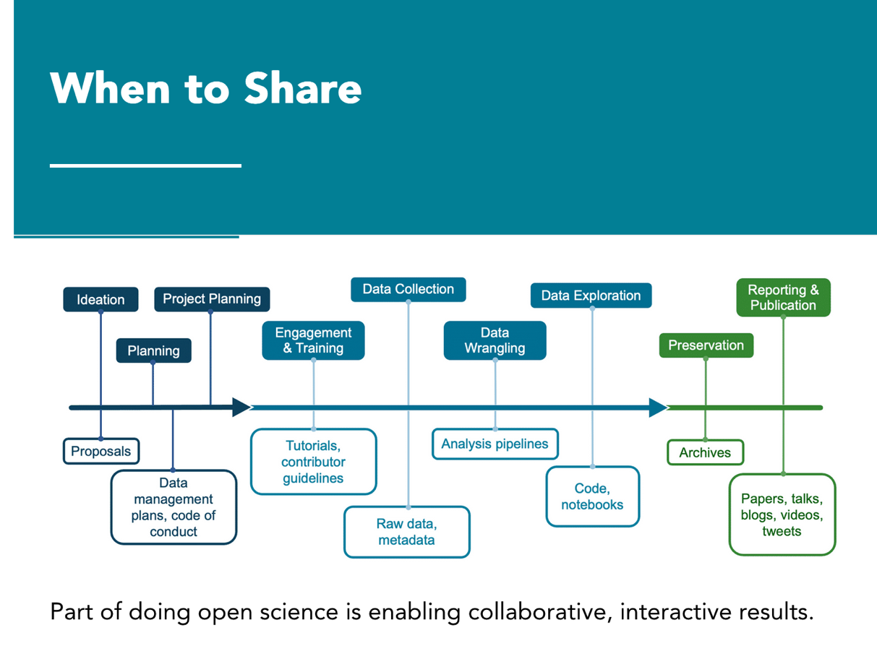

Slide 16

open access publishing
Consider your liscense – CC-BY and others
Open access types
  Gold Open Access Publishing, authors pay an Article Processing Charge (APC) to a journal so that they publish the final version of your article under an open access license, which is then permanently and freely available online for anyone. The author will retain the copyright of their article, usually via a Creative Commons license
  Green Open Access is the process of self-archiving.
  Diamond Open Access are publications where there is neither a cost for reading the article or publishing an article.

Slide 17
Predatory publishers?
spam email and scams

Slide 18
Let’s complete an OSDMP for one of our projects

Slide 19
Using AI
Literature reviews
searching for data sets
translation
Possible drawbacks when using these tools include:
  Potential introduction of biases
  Insufficient contextual understanding or interpretation
  Possible inability to handle complex technical language
  Incorrectly identifying key points

Slide 20
Lesson 4 & 5 Quiz

