Slide 1

R.E.M: Do Now. In silence.
Date:
[1]
[1]
Name the storm that flooded Carlisle in December 2015.
Name one upland area of the UK.
Last Lesson
Last Term
[1]
[2]
What is erosion?
Why might a river flood after many days of heavy rain?
Last Year
Stretch & Challenge
R.E.M
Enquiry
Modelling
Guided Practice
Independent Practice
Assessment & Feedback
Notes:
Students walk in and start in silence. 7 minutes including answers. Last lesson = Session 4 (Storm Desmond). Last term = UK physical geography (L1). Last year = Year 10 Distinctive Landscapes.

Slide 2
R.E.M: check your answers in green
Name the storm that flooded Carlisle in December 2015.
Name one upland area of the UK.
Storm Desmond
Any one: the Pennines, the Lake District, the Scottish Highlands, Snowdonia.
What is erosion?
Why might a river flood after many days of heavy rain?
The wearing away of rock and soil, which is then carried away (by water, wind or ice).
The ground is saturated (full of water) (1), so rain runs straight off the surface into the river, and it rises fast (1).
R.E.M
Enquiry
Modelling
Guided Practice
Independent Practice
Assessment & Feedback
Notes:
Green pen. Cold call the Stretch & Challenge: this is the idea that drives the whole flooding story on the Eden.

Slide 3
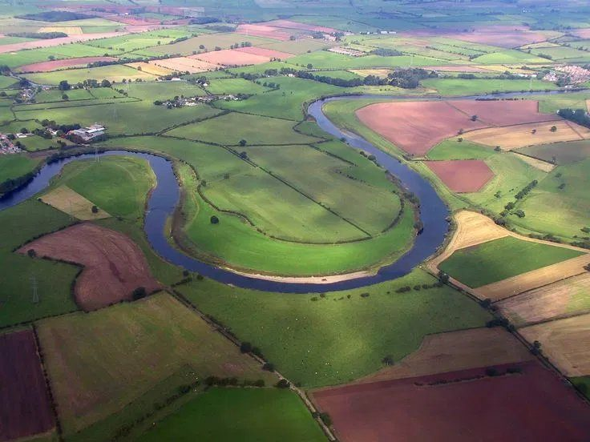
Back to basics: the Eden's landscape
Lesson 1 of 2
The words of a river basin
watershed, source, tributary, confluence, mouth
1
Three geomorphic processes
erosion, transportation, deposition, with an Eden example for each
2
Two landforms, step by step
the waterfall at Hell Gill Force and the meanders at Salkeld
3
Meanders on the Eden near Salkeld
R.E.M
Enquiry
Modelling
Guided Practice
Independent Practice
Assessment & Feedback
Notes:
3 minutes. Frame it honestly: yesterday showed we skipped the foundations. Today is the foundations, all on the Eden. Next lesson is every way OCR can ask about it.

Slide 4
Look closely: what has the water done here?
3 min
Think, pair, share
This is the River Eden near Salkeld, in Cumbria.
1. Why is the river not straight?
2. Which bank do you think the water is cutting into?
3. Where might sand and pebbles be dropped?
R.E.M
Enquiry
Modelling
Guided Practice
Independent Practice
Assessment & Feedback
Notes:
Think, pair, share. Take answers without correcting yet: 'it bends', 'it has cut the bank', 'sand on the inside'. Every one of those is a geomorphic process, and by the end of the lesson they will have the words for them.

Slide 5
The words of a river basin
Modelling
MOUTH
Solway Firth: where the Eden meets the sea
Sea
CONFLUENCE
Carlisle: the Caldew and Petteril join the Eden
TRIBUTARY
A smaller river joining the Eden, e.g. the Eamont
WATERSHED
The high ground at the edge: Pennines and Lake District fells
SOURCE
Where the Eden starts: Pennines near Kirkby Stephen
RIVER BASIN
All the land drained by the Eden and its tributaries
Simplified Eden basin, not to scale
R.E.M
Enquiry
Modelling
Guided Practice
Independent Practice
Assessment & Feedback
Notes:
I do. Point to each label in turn and say the word with the class. Simplified, not to scale. Hammer two words: WATERSHED (the edge: high ground that decides which way rain flows) and TRIBUTARY (a smaller river that joins the main one). Ask: 'If rain lands just over the watershed, which river does it go to?' (a different one).

Slide 6
Watch: the parts of a drainage basin
Modelling
TIME FOR GEOGRAPHY
Anatomy of a drainage basin
Click to play. Opens in your browser.
Then, in your booklet
Find the table of river basin words.
Read the On the Eden column with your partner.
One of you says the word. The other says the Eden example without looking.
While you watch: tick each word when you hear it
☐ watershed (the video also calls it the drainage divide)
☐ source
☐ tributary
☐ confluence
☐ mouth
R.E.M
Enquiry
Modelling
Guided Practice
Independent Practice
Assessment & Feedback
Notes:
Time for Geography Knowledge Booster, 'Anatomy of a drainage basin'. The page lists the drainage divide (watershed), sources, tributaries, confluences and the mouth, so the tick-list matches what the video covers. Check the clip length before the lesson and play it full screen from the browser. If the school network blocks it, TfG has a support page on unblocking.

Slide 7
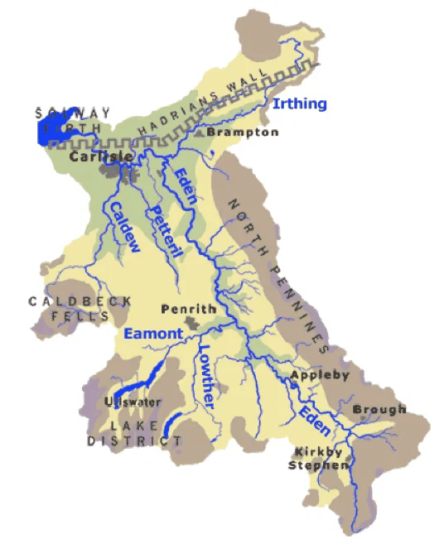
Find it on the Eden
We do
Whiteboards up after each one
1. Where is the source of the Eden?
2. Name two tributaries of the Eden.
3. Which city is built at a confluence?
4. Where is the mouth of the Eden?
5. Trace the watershed with your finger. Which high ground does it follow on the east?
R.E.M
Enquiry
Modelling
Guided Practice
Independent Practice
Assessment & Feedback
Notes:
We do, on mini whiteboards. Answers: 1) south-east, in the Pennines near Kirkby Stephen. 2) any two of Eamont, Lowther, Caldew, Petteril, Irthing. 3) Carlisle (Caldew and Petteril join the Eden; the Irthing joins just upstream). 4) Solway Firth. 5) The edge of the shaded area: the North Pennines on the east, the Lake District fells on the west. Point out that Ullswater drains into the Eamont, so it is in the Eden basin too.

Slide 8
Check: show me A, B, C or D
We do
1. What is a tributary?
2. The mouth of the Eden is at...
A the edge of a river basin
B a smaller river that joins the main river
C where a river meets the sea
D where a river starts
A Kirkby Stephen
B Penrith
C Carlisle
D the Solway Firth
3. What is the watershed?
4. Where the Caldew joins the Eden at Carlisle is a...
A the high ground at the edge of a river basin
B a lake behind a dam
C a river in flood
D where two rivers meet
A source
B mouth
C confluence
D meander
R.E.M
Enquiry
Modelling
Guided Practice
Independent Practice
Assessment & Feedback
Notes:
Hinge check. Fingers or boards, all at once on 3. If more than a quarter miss one, reteach that word with the diagram before moving on.

Slide 9
Check: answers
We do
1. What is a tributary?
2. The mouth of the Eden is at...
A the edge of a river basin
B a smaller river that joins the main river
C where a river meets the sea
D where a river starts
A Kirkby Stephen
B Penrith
C Carlisle
D the Solway Firth
3. What is the watershed?
4. Where the Caldew joins the Eden at Carlisle is a...
A the high ground at the edge of a river basin
B a lake behind a dam
C a river in flood
D where two rivers meet
A source
B mouth
C confluence
D meander
R.E.M
Enquiry
Modelling
Guided Practice
Independent Practice
Assessment & Feedback
Notes:
Anyone who got one wrong: say the right definition out loud, then write it on the board.

Slide 10
Geomorphic processes shape the land
Modelling
geo = Earth morph = shape
1 EROSION
2 TRANSPORTATION
3 DEPOSITION
The river wears away rock from its bed and banks.
Eden: the soft sandstone under Hell Gill Force is worn away.
The river carries the worn-away material downstream.
Eden: the floodwater in Carlisle in 2015 was brown with mud.
The river drops what it is carrying when it slows down.
Eden: sand is dropped on the inside of the bends at Salkeld.
Also geomorphic: weathering breaks rock down where it is, and mass movement slides it downhill into the river.
R.E.M
Enquiry
Modelling
Guided Practice
Independent Practice
Assessment & Feedback
Notes:
Break the word down: geo = Earth, morph = shape. Then the three verbs. Use your hands: scrape (erode), carry (transport), drop (deposit). OCR uses 'geomorphic processes' in the case study questions, and students who don't know the phrase freeze. Mention that weathering and mass movement are geomorphic processes too: they feed loose rock into the river.

Slide 11
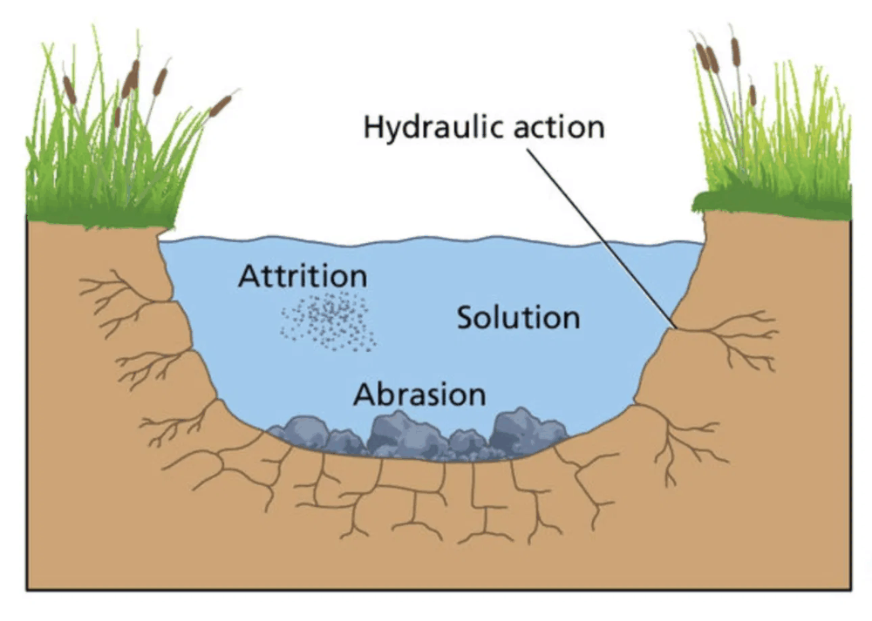
Erosion: four ways the river wears rock away
Modelling
Hydraulic action
The force of the water hits the banks and forces air into cracks.
Eden: at the foot of Hell Gill Force
Abrasion
Stones carried by the river scrape the bed and banks, like sandpaper.
Eden: the outside bank of the bends at Salkeld
Attrition
Stones knock together and become smaller and rounder.
Eden: stones get rounder on the way to Carlisle
Solution
The water dissolves soluble rock, such as limestone.
Eden: the limestone in the upper Eden
R.E.M
Enquiry
Modelling
Guided Practice
Independent Practice
Assessment & Feedback
Notes:
I do. Four processes, each tied to a place on the Eden. Trap to name now: attrition wears down the STONES, not the channel. OCR's 2022 mark scheme gave no credit for attrition in a V-shaped valley answer. Diagram from the revision app.

Slide 12
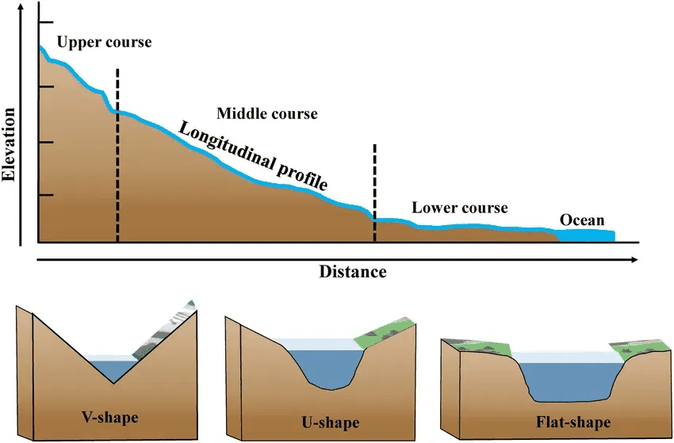
Vertical or lateral: where does it erode?
Modelling
Upper Eden: VERTICAL erosion
Steep, so the river cuts down.
This makes a steep V-shaped valley.
Eden: near the source, around Kirkby Stephen.
Middle Eden: LATERAL erosion
Gentler, so the river cuts sideways.
This makes the valley wider and the bends grow into meanders.
Eden: at Salkeld, on soft red sandstone.
R.E.M
Enquiry
Modelling
Guided Practice
Independent Practice
Assessment & Feedback
Notes:
Long profile from the app. Upper course: steep, so the energy goes downwards (vertical erosion) and cuts a V-shaped valley. Middle course: gentler, so the energy goes sideways (lateral erosion), which makes the valley wider and the bends bigger. On the Eden, the soft red sandstone in the middle course makes lateral erosion easy.

Slide 13
Watch: river erosion processes
Modelling
TIME FOR GEOGRAPHY
River erosion processes
Click to play. Opens in your browser.
After the clip: say it back
Turn to your partner. Partner A explains hydraulic action and abrasion. Partner B explains attrition and solution.
Each explanation must finish with a place on the Eden.
R.E.M
Enquiry
Modelling
Guided Practice
Independent Practice
Assessment & Feedback
Notes:
Time for Geography Knowledge Booster, 'River erosion processes'. Check the length beforehand. If time is tight, stop after the four processes.

Slide 14
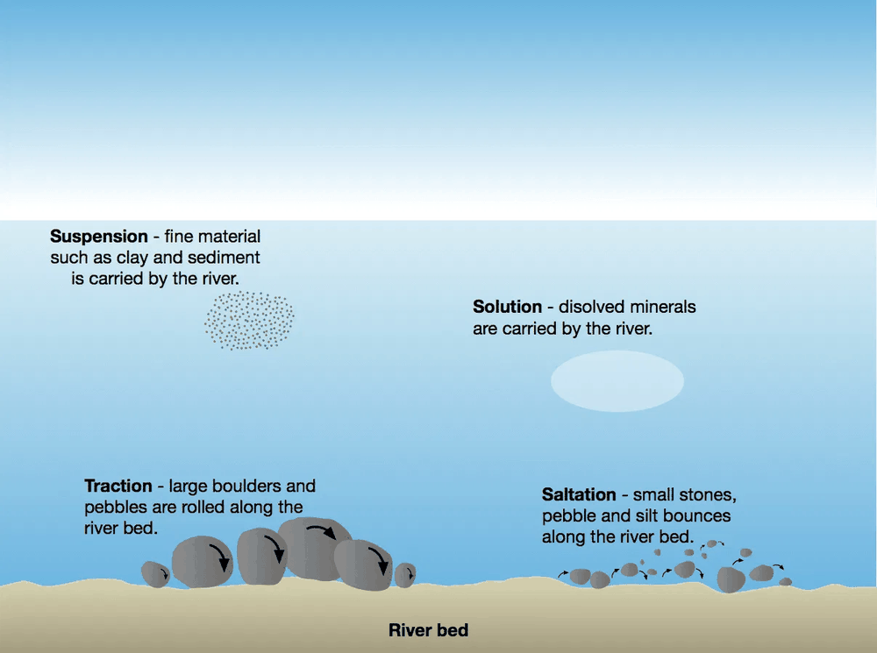
Transportation: four ways the river carries its load
Modelling
Traction
Large boulders are rolled along the bed.
Eden: in floods in the steep upper Eden
Saltation
Small pebbles and sand bounce along the bed.
Eden: along the bed in the middle course
Suspension
Fine silt and clay float in the water.
Eden: brown floodwater in Carlisle, 2015
Solution
Dissolved minerals are carried in the water.
Eden: dissolved limestone from the upper Eden
R.E.M
Enquiry
Modelling
Guided Practice
Independent Practice
Assessment & Feedback
Notes:
I do. Biggest to smallest: rolls, bounces, floats, dissolved. Solution appears twice in the spec: as erosion (dissolving the rock) and as transport (carrying the dissolved minerals). Optional clip: Time for Geography 'River transport processes' (link on the next slide).

Slide 15
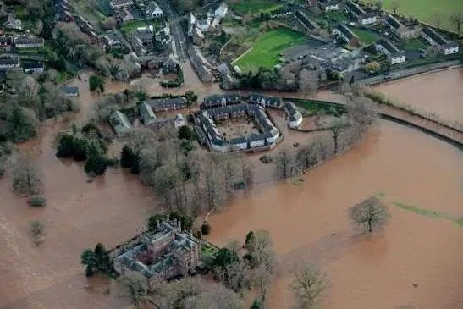
Deposition: when and where the Eden drops its load
Modelling
When? When the river loses energy
It slows down, gets shallower, or spills over its banks in a flood.
The heaviest material is dropped first.
Where on the Eden?
Salkeld: sand and shingle on the inside of each bend.
Carlisle: silt spread over the floodplain every time the river floods.
Solway Firth: mud and sand dropped where the river meets the sea.
Carlisle, December 2015: the brown colour is silt in suspension
OPTIONAL TIME FOR GEOGRAPHY CLIPS
▶ River transport processes
▶ Floodplains
R.E.M
Enquiry
Modelling
Guided Practice
Independent Practice
Assessment & Feedback
Notes:
Key idea: the river drops its load when it loses energy. Heaviest first. Optional clips for homework or if time allows: 'River transport processes' and 'Floodplains' on Time for Geography (both linked on this slide).

Slide 16
E, T or D? Erosion, transportation or deposition
We do
a) The floodwater in Carlisle in 2015 was brown with mud.
?
b) Sand piles up on the inside of a bend at Salkeld.
?
c) The plunge pool under Hell Gill Force gets deeper.
?
d) Pebbles bounce along the bed of the Eden.
?
e) After a flood, a layer of silt covers the fields around Carlisle.
?
f) The outside bank of a bend at Salkeld is cut back.
?
R.E.M
Enquiry
Modelling
Guided Practice
Independent Practice
Assessment & Feedback
Notes:
Whiteboards: write E, T or D for each, all at once on 3. Push for the named process too: e.g. the plunge pool = abrasion and hydraulic action.

Slide 17
E, T or D? Answers
We do
a) The floodwater in Carlisle in 2015 was brown with mud.
T
b) Sand piles up on the inside of a bend at Salkeld.
D
c) The plunge pool under Hell Gill Force gets deeper.
E
d) Pebbles bounce along the bed of the Eden.
T
e) After a flood, a layer of silt covers the fields around Carlisle.
D
f) The outside bank of a bend at Salkeld is cut back.
E
R.E.M
Enquiry
Modelling
Guided Practice
Independent Practice
Assessment & Feedback
Notes:
If they mixed up E and D on the meander, go straight back to the deposition slide: fast outside = erosion, slow inside = deposition.

Slide 18
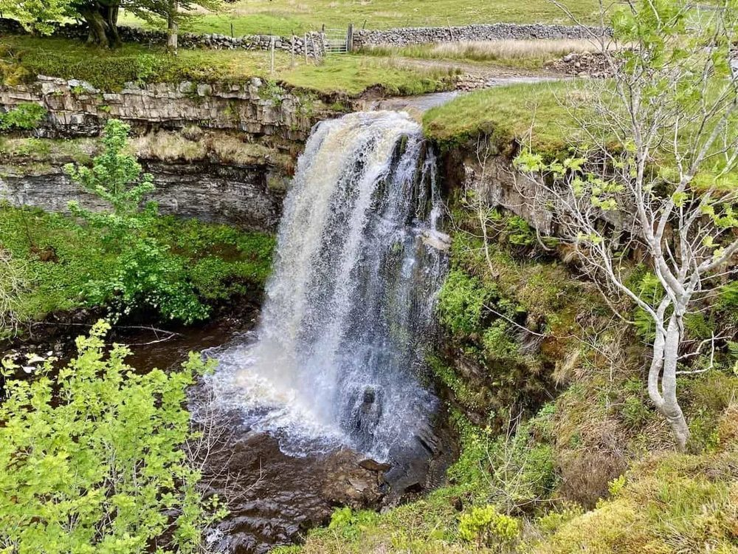
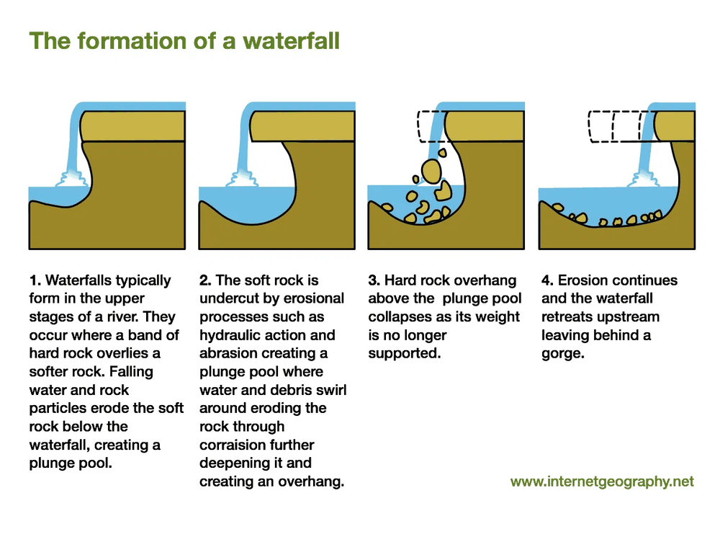
Landform 1: the waterfall at Hell Gill Force
I do
Hell Gill Force, near the source of the Eden
corrasion = abrasion: always write abrasion
R.E.M
Enquiry
Modelling
Guided Practice
Independent Practice
Assessment & Feedback
Notes:
Hell Gill Force is near the source of the Eden: harder limestone on top of softer sandstone. The diagram is from Internet Geography, via the app. Where it says 'corrasion', the exam word is ABRASION. Say it every time.

Slide 19
How Hell Gill Force formed: the chain
I do
Hard rock on soft rock. At Hell Gill Force, harder limestone lies on top of softer sandstone.
1
The soft sandstone is eroded faster by hydraulic action and abrasion, so the limestone is undercut.
2
This leaves an overhang. Swirling water and rocks erode a deep plunge pool by abrasion.
3
The overhang is no longer supported, so it collapses into the plunge pool.
4
This repeats, so the waterfall retreats upstream, leaving a steep-sided gorge: Hell Gill.
5
R.E.M
Enquiry
Modelling
Guided Practice
Independent Practice
Assessment & Feedback
Notes:
I do. Read each link aloud, then the class repeats the bold words. Every link starts with a cause and ends with a result. This exact chain is the core of Q1 next lesson.

Slide 20
Watch: formation of a waterfall and gorge
Modelling
TIME FOR GEOGRAPHY
Formation of a waterfall and gorge
Click to play. Opens in your browser.
While you watch
Hold up 1, 2, 3, 4 or 5 fingers each time the video reaches a link in our chain.
Listen for one word the video uses that is not in our chain. Write it in your booklet.
R.E.M
Enquiry
Modelling
Guided Practice
Independent Practice
Assessment & Feedback
Notes:
Time for Geography Knowledge Booster, 'Formation of a waterfall and gorge'. Students hold up fingers 1 to 5 as each link in the chain appears.

Slide 21
We do: put the waterfall back in order
We do
A The overhang collapses into the plunge pool.
Write the order
1 ___
2 ___
3 ___
4 ___
5 ___
B The soft sandstone is eroded faster, so the limestone is undercut.
C The waterfall retreats upstream, leaving a gorge.
D Harder limestone lies on top of softer sandstone.
E An overhang is left and abrasion deepens the plunge pool.
Whiteboards: the five letters in order.
R.E.M
Enquiry
Modelling
Guided Practice
Independent Practice
Assessment & Feedback
Notes:
Answer: D, B, E, A, C. Then cover the chain slide and ask a student to say all five links from memory.

Slide 22
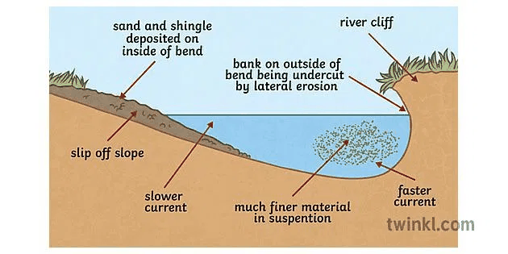
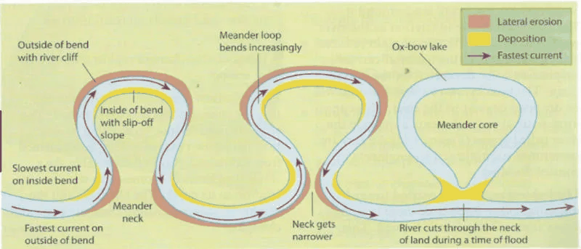
Landform 2: the meanders at Salkeld
I do
Seen from above: the bend grows, then becomes an ox-bow lake
Cross-section through one bend
OUTSIDE of the bend
INSIDE of the bend
Fastest, deepest water, so erosion.
Makes a steep river cliff.
Slowest, shallowest water, so deposition.
Makes a gentle slip-off slope.
R.E.M
Enquiry
Modelling
Guided Practice
Independent Practice
Assessment & Feedback
Notes:
Fast water on the OUTSIDE of the bend erodes (river cliff). Slow water on the INSIDE deposits (slip-off slope). That is the whole meander in one sentence. There is no Time for Geography clip for meanders, so the diagrams carry it. Ox-bow lake: there is one near Salkeld, where Briggle Beck joins the Eden.

Slide 23
How the Salkeld meanders formed: the chain
I do
Water flows fastest on the outside of the bend, where it is deepest.
1
Lateral erosion by hydraulic action and abrasion cuts into the outside bank, making a river cliff.
2
Water flows slowest on the inside, so it loses energy and deposits sand and shingle: a slip-off slope.
3
Erosion on the outside and deposition on the inside make the bend grow and move across the valley.
4
At Salkeld the rock is soft red sandstone, so lateral erosion is easy and the bends are large.
5
R.E.M
Enquiry
Modelling
Guided Practice
Independent Practice
Assessment & Feedback
Notes:
I do. Same routine as the waterfall: read, class repeats the bold words. Link 5 is the place-specific link (PLC) that lifts an answer to Level 3 next lesson.

Slide 24
We do: label the bend
We do
INSIDE of bend
OUTSIDE of bend
Which letter?
river cliff
slip-off slope
fastest, deepest water
slowest, shallow water
D
A
B
C
Not to scale
R.E.M
Enquiry
Modelling
Guided Practice
Independent Practice
Assessment & Feedback
Notes:
Answers: A river cliff (erosion). B slip-off slope (deposition). C fastest, deepest water. D slowest, shallow water. Booklet: the meander labelling box. Ask: which letters show erosion, which show deposition?

Slide 25
You do: your booklet, on your own
20 min
Task 1
Which process? Match each Eden example to its process.
4 min
Task 2
The waterfall chain: fill the gaps.
3 min
Task 3
The meander chain: fill the gaps.
3 min
Task 4
OCR June 2022: waterfall retreat calculation [2]
3 min
Task 5
OCR June 2022: explain the formation of a V-shaped valley [3]
3 min
Task 6
Explain the formation of a meander [3]
4 min
R.E.M
Enquiry
Modelling
Guided Practice
Independent Practice
Assessment & Feedback
Notes:
At least 20 minutes, in silence for the first 10. Circulate to Task 3 first: the meander chain is where yesterday's gaps showed. Tasks 4 and 5 are real OCR questions (June 2022, Paper 1). Task 6 is written by Claude in the OCR style and is labelled in the booklet.

Slide 26
Mark it in green: Tasks 4, 5 and 6
Feedback
Task 4 [2]
Task 5 [3]
Task 6 [3]
Working: 48.5 ÷ 10 (1)
Answer: 4.85 cm per year (4.9 accepted) (1)
1 mark is reserved for vertical (downward) erosion.
Sides become deeper, steeper, unstable.
Names abrasion, solution or hydraulic action.
Weathering loosens the slopes; mass movement moves it down.
Attrition gets no credit.
Fastest flow on the outside causes lateral erosion (1)
by hydraulic action or abrasion, forming a river cliff (1)
Slower flow on the inside causes deposition: a slip-off slope (1)
The bend grows / migrates (1)
R.E.M
Enquiry
Modelling
Guided Practice
Independent Practice
Assessment & Feedback
Notes:
Mark schemes for Tasks 4 and 5 are OCR's (June 2022 P1 Q2(a) and Q2(b)). Task 6 is a Claude-written question, so its mark points are Claude's, built in the same point-marked style (1 mark per valid linked point).

Slide 27
Exit ticket: three in three minutes
3 min
1. What is the name for the high ground at the edge of a river basin?
2. Which erosion process only wears down the stones, not the channel?
3. Why does Hell Gill Force move upstream over time?
R.E.M
Enquiry
Modelling
Guided Practice
Independent Practice
Assessment & Feedback
Notes:
Answers: 1) watershed. 2) attrition. 3) the soft rock underneath is eroded faster, so the hard rock is undercut, the overhang collapses, and this repeats. Next lesson: every question OCR can ask about the Eden, broken down step by step.

