Slide 1
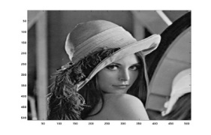
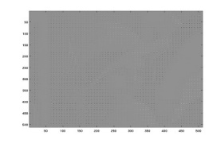

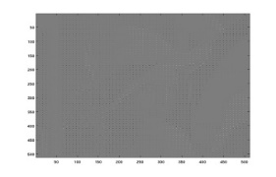
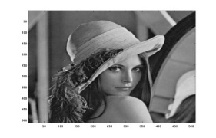
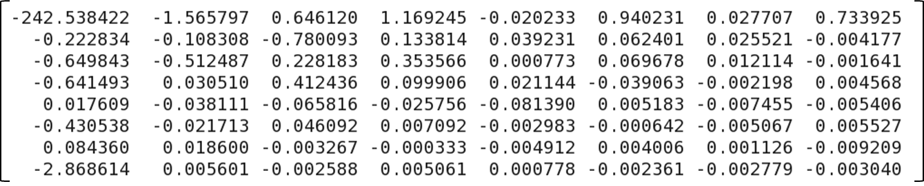
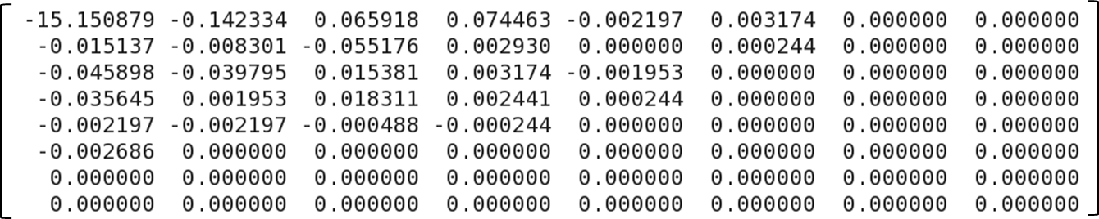
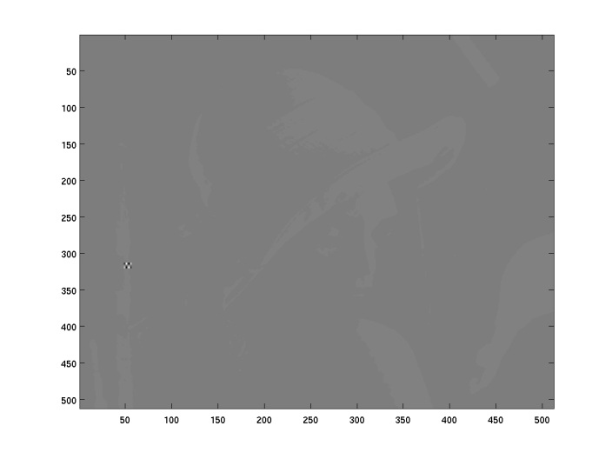
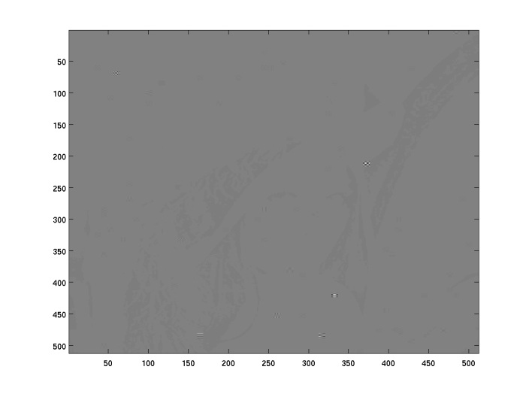
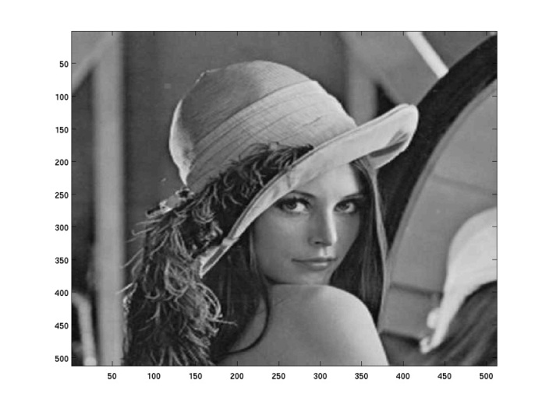


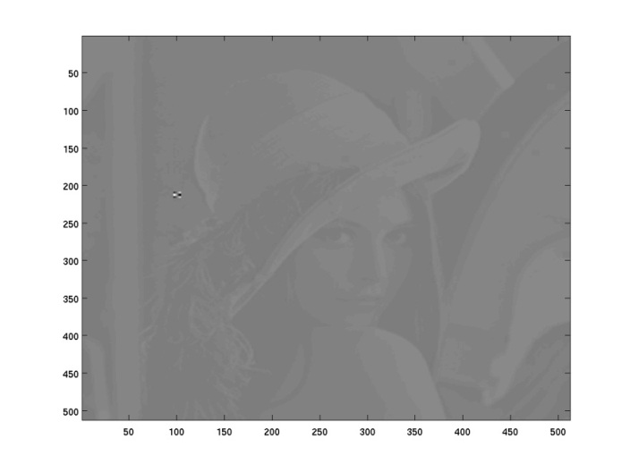
IP4-15: A Low Overhead Error Confinement Method based on Application Statistical Characteristics
Statistical Error Confinement
Memories are usually protected by ECC
Large overhead for error detection / correction
Prevalent SECDED code only correct single bit error
Alternative: applications with statistical properties
DSP applications e.g. JPEG
Statistical error confinement
Simple parity bit for error detection
Substitute erroneous value by statistical mean
Confine error effects with low overheads
Limit error effects for multiple bit-flip errors
Architecture support
Programming model for generic algorithms
Custom instructions for RISC style processor
Synthesizable processor architecture
DCT
Quantization
De-quantization
IDCT
Statistical mean matrix (8 X 8 elements)
of DCT coefficients
Statistical mean matrix (8 X 8 elements)
of quantization coefficients
Custom instructions | Functionalities
set_data @{start} @{size} @{lut_start} @{lut_size} | Register protected data array and the LUT of statistic data
enable_parity | Turn on store protection
disable_parity | Turn off store protection
chk_ld @{dst} @{src} @{offset} | Return statistical data in @{dst} if an error is detected in @{src}
int imageEx[SIZE][SIZE];
int imageData[ROW_SIZE][COL_SIZE];
int imageExtended[ROW_SIZE][COL_SIZE];
// reference LUT containing generalized data
int lut_imageEx[8][8]={{780, -1, 0, 1, 0, 0, 0, 0 },
{ 0, 0, 0, 0, 0, 0, 0, 0 },
{ 0, 0, 0, 0, 0, 0, 0, 0 },
{ 0, 0, 0, 0, 0, 0, 0, 0 },
{ 0, 0, 0, 0, 0, 0, 0, 0 },
{ 0, 0, 0, 0, 0, 0, 0, 0 },
{ 0, 0, 0, 0, 0, 0, 0, 0 },
{ -2, 0, 0, 0, 0, 0, 0, 0 }};
int DiscreteCosine(int imageData[SIZE][SIZE], int imageEx[SIZE][SIZE])
{ ......
asm("enable_parity"); // turn on store protection
imageEx[i1][j1]= (int)sum;
asm("disable_parity"); // turn off store protection
.......
}
int Quantization(int imageEx[SIZE][SIZE], int imageExtended[SIZE][SIZE])
{ ......
int src = imageEx[i1][j1];
int dst;
asm("check_value @dst, @src, index"); // automatic correction
imageExtended[i1][j1]= (dst/quant[i][j]);
......
}
int main()
{ ......
// register range of protected data using reference LUT
asm("set_data @imageEx, 262144, @lut_imageEx, 64");
DiscreteCosine(imageData, imageEx);
Quantization(imageEx, imageExtended);
......
}
Data flow
REGISTER FILE
Architecture Extension
SEC_REG
DC
EX
MEM
WB
ALU_DC
ALU_EX
LDST
MEM
FETCH
BRA_DC
CTRL_DC
LDST_EX
MEMORY
ACCESS
WRITE
BACK
FE_DC
DC_EX
EX_MEM
MEM_WB
TRAP_DC
Gen_parity
PRE
/FE
LDST_DC
BRA_EX
SEC_WB
SEC_DC
SEC_EX
SEC_MEM
PROG
MEM
DATA
MEM
MEMORY INTERFACE
Architecture extension for RISC processor
Programming example for JPEG application
(a) 1 error
PSNR -0.03 dB
No protection
(b) 100 errors
PSNR -89.94 dB
No protection
(c) 100 errors
PSNR 39.12 dB
Protected
(a)
(b)
Example: JPEG application
(d) 500 errors
PSNR 38.51 dB
Protected
(e) 800 errors
PSNR 36.24 dB
Protected
(f) 1000 errors
PSNR 23.68 dB
Protected
(c)
(d)
Fault injection experiment (single bit-flip errors)
Error resiliency and performance overheads
M. Sc. Zheng Wang (wangz@ntu.edu.sg) ▪ Dr.-Ing. Anupam Chattopadhyay (anupam@ntu.edu.sg) ▪ Dr. Georgios Karakonstantis (G.Karakonstantis@qub.ac.uk)

