Slide 1

IP4-15: A Low Overhead Error Confinement Method based on Application Statistical Characteristics
M. Sc. Zheng Wang
Dr. -Ing Anupam Chattopadhyay
Dr. Georgios Karakonstantis Queen University Belfast

Slide 2
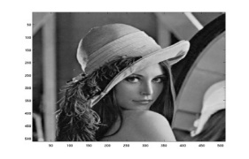
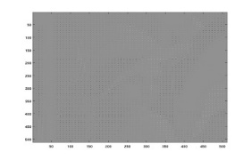

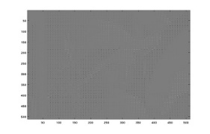
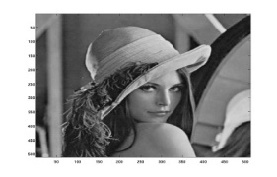
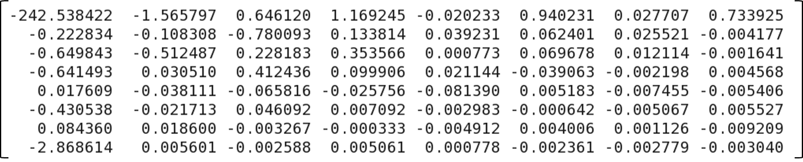
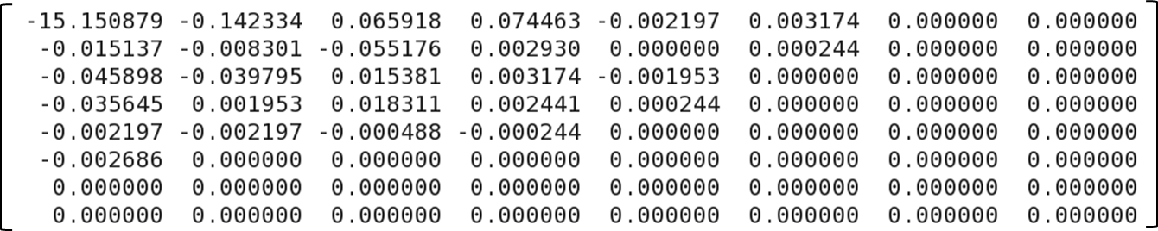
Statistical Error Confinement
Memories are usually protected by ECC
Large overhead in size and power for error detection/correction
Prevalent code can only correct single bit error
Applications existing statistical data distributions
DSP applications e.g. JPEG
Simple parity bit for error detection
Substitute erroneous value by statistical data in LUT
Able to confine errors (single and multiple bit errors)
DCT
Quantization
De-quantization
IDCT
Statistical mean matrix of DCT coefficients
Statistical mean matrix of quantization coefficients

Slide 3
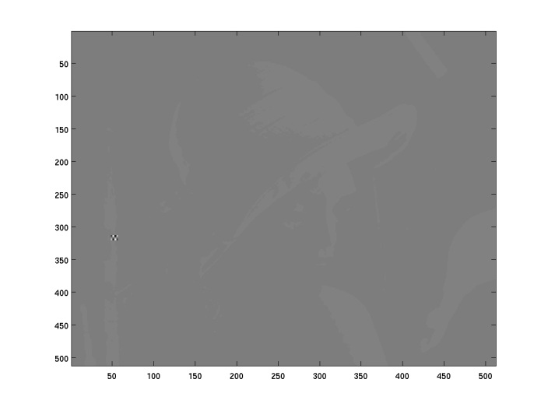
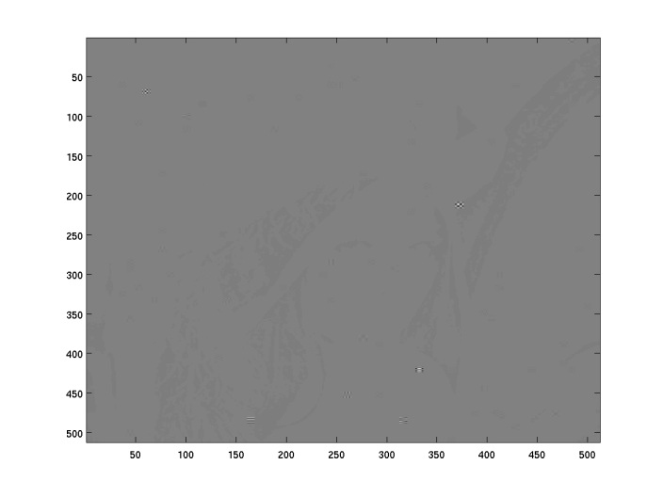
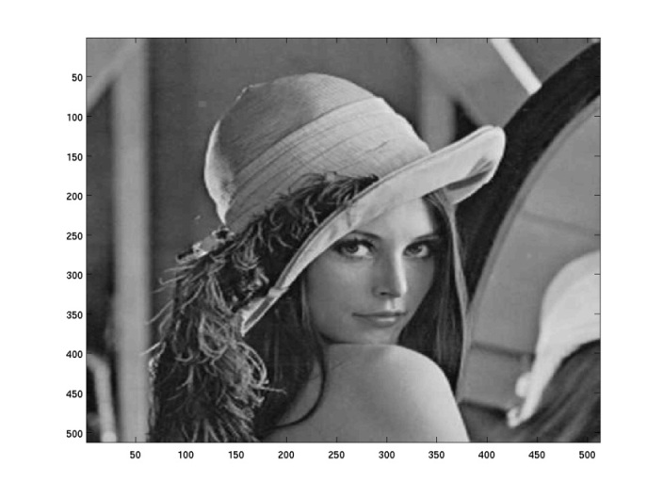


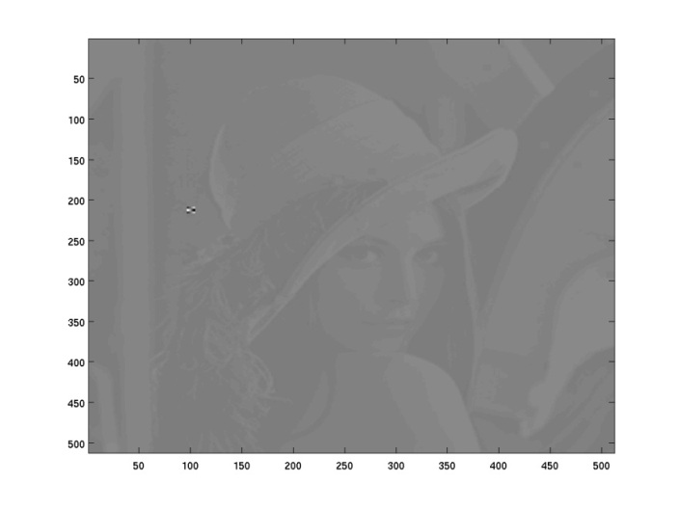
Statistical Error Confinement – Experiments
(a) 1 error
PSNR -0.03 dB
No protection
(b) 100 errors
PSNR -89.94 dB
No protection
(c) 100 errors
PSNR 39.12 dB
Protected
(d) 500 errors
PSNR 38.51 dB
Protected
(e) 800 errors
PSNR 36.24 dB
Protected
(f) 1000 errors
PSNR 23.68 dB
Protected
Refer to paper/poster for benchmarking with ECC protection

Slide 4
Statistical Error Confinement – ASIP
Custom instructions | Functionalities
set_data @{start} @{size} @{lut_start} @{lut_size} | Register protected data array and the LUT of statistic data
enable_parity | Turn on store protection
disable_parity | Turn off store protection
chk_ld @{dst} @{src} @{offset} | Return statistical data in @{dst} if an error is detected in @{src}
Data flow
REGISTER FILE
SEC_REG
DC
EX
MEM
WB
ALU_DC
ALU_EX
LDST
MEM
BRANCH_DC
FETCH
BYPASS_DC
LDST_EX
MEMORY
ACCESS
WRITE
BACK
FE_DC
DC_EX
EX_MEM
MEM_WB
TRAP_DC
Gen_parity
LDST_DC
BRANCH_EX
PRE/FE
SEC_DC
SEC_EX
SEC_MEM
SEC_WB
PROG
MEM
DATA
MEM
MEMORY INTERFACE
Architecture extension on RISC processor

