Slide 1
Deep Learning: Autoencoder and Restricted Boltzmann Machine
Bo Peng

Slide 2
Definition
Deep learning means using a neural network with several layers of nodes between inputs and outputs
The series of layers between input & output do feature identification and processing in a series of stages, just as our brains seem to.
Shallow vs Deep
Representation of functions of inputs
Compact representation: a function can be compactly represented by a deep architecture, it might need a very large architecture to be represented by an insufficient deep one. (Bengio, 2009)

Slide 3

Breakthroughs
Problem of multiple-layer neural network
Hard to train with too many parameters
SGD highly relies on “good” initial weights
Large initial weights: pool local minima
Small initial weights: gradients are tiny
Unsupervised learning?
Breakthroughs
Deep Belief Network (DBN)
Hinton, G.E, Osindero, S., and Teh, Y.W. (2006).
A fast learning algorithm for deep belief nets.
Autoencoders
Bengio, Y., Lamblin, P., Popovici, P., Larochelle, H. (2007)
Greedy Layer-Wise Training of Deep Networks.

Slide 4
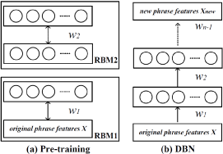
Intuitive Idea
What did Hinton and Bengio do?
Model a two-layer network at a time
Pretraining procedure for initial weights
Global fine tuning stage
Backpropagation

Slide 5

Autoencoder
What?
Deterministic artificial neural network
Learn a compressed distributed representation (encoding) for a set of data
Dimension reduction
How?
Feed-forward pass to compute activation at all hidden layers
Encode: $y=s\left(Wx+b\right)$ where $s$ is sigmoid or hyperbolic tangent
Measure the deviation of output from the input (MSE)
Decode: $z=s\left(W^{′}y+b′\right)$ with $W^{′}=W^{T}$
Reconstruction error: $L\left(xz\right)=||x−z||^{2}$ or $L\left(xz\right)=−\sum_{k=1}^{d}{[x_{k}\log{z_{k}}+\left(1−x_{k}\right)log(1−z_{k})]}$
Backpropagate the error through the net for weights updating

Slide 6

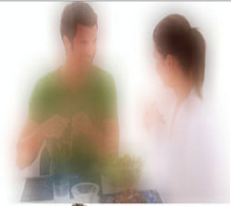
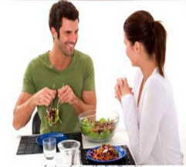
Stacked Autoencoder
Decoder
Fine Tuning
Autoencoder
30
500
2000
2000
Autoencoder
500
1000
1000
1000
500
500
Autoencoder
Encoder
1000
30
30
500
500
2000
1000
1000
2000
2000
2000

Slide 7
Some issues
Pretraining
Unsupervised initialization in a greedy layer-wise fashion will put the parameters in a region of parameters space from which a good local optimum can be achieved by local descent
Fine tune
Supervised learning: Classification
Unsupervised learning: Dimension reduction
Denoising
Robust feature extraction and avoid simple copy
Input corruption

Slide 8

Restricted Boltzmann Machine
What?
Stochastic artificial neural network
Learn a probability distribution over a set of inputs
Dimension reduction and classification
Energy-Based Models (EBM)
$p\left(x\right)=\frac{e^{−E(x)}}{Z}$ where $Z=\sum_{x}{e^{−E(x)}}$
Hidden Units
$$P\left(x\right)=\sum_{h}{P\left(x,h\right)=\sum_{h}{\frac{e^{−E(x)}}{Z}}}$$
Set free energy $F\left(x\right)=−\log{\sum_{h}{e^{−E(x)}}}$, we have $P\left(x\right)=\frac{e^{−E(x)}}{Z}$
Gradient
$$−\frac{∂\log{p\left(x\right)}}{∂θ}=\frac{∂F\left(x\right)}{∂θ}−\sum_{\tilde{x}}{p(\tilde{x})\frac{∂F\left(\tilde{x}\right)}{∂θ}}$$

Slide 9
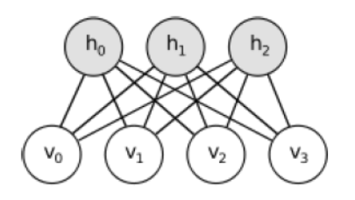
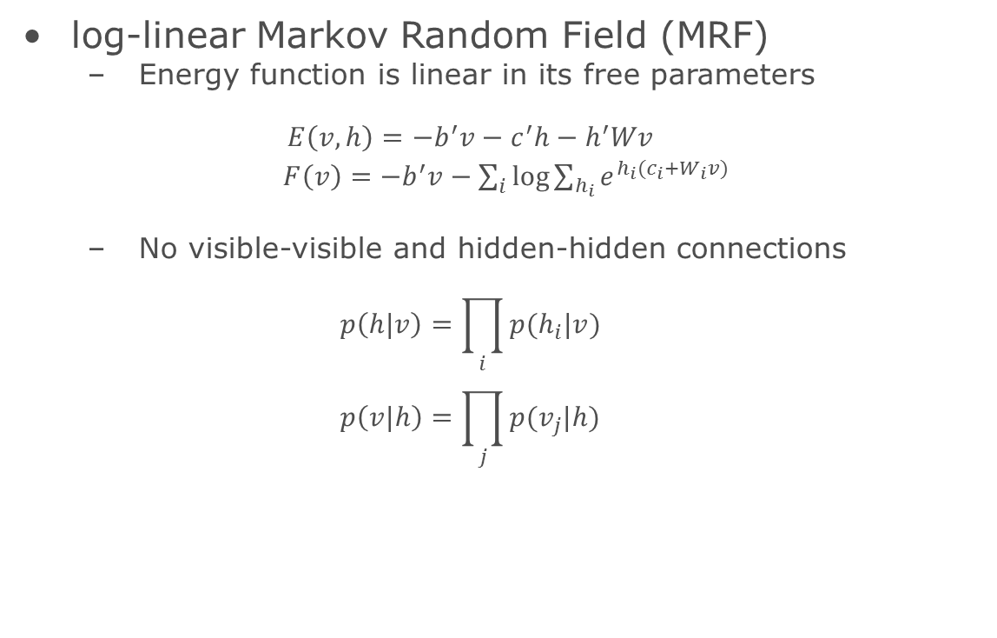
Restricted Boltzmann Machine
log-linear Markov Random Field (MRF)
Energy function is linear in its free parameters
$$E\left(v,h\right)=−b^{′}v−c^{′}h−h^{′}Wv$$
$F\left(v\right)=−b^{′}v−\sum_{i}{\log{\sum_{h_{i}}{e^{h_{i}(c_{i}+W_{i}v)}}}}$
No visible-visible and hidden-hidden connections
$$p\left(h|v\right)=\prod_{i}{p(h_{i}|v)}$$
$$p\left(v|h\right)=\prod_{j}{p(v_{j}|h)}$$

Slide 10
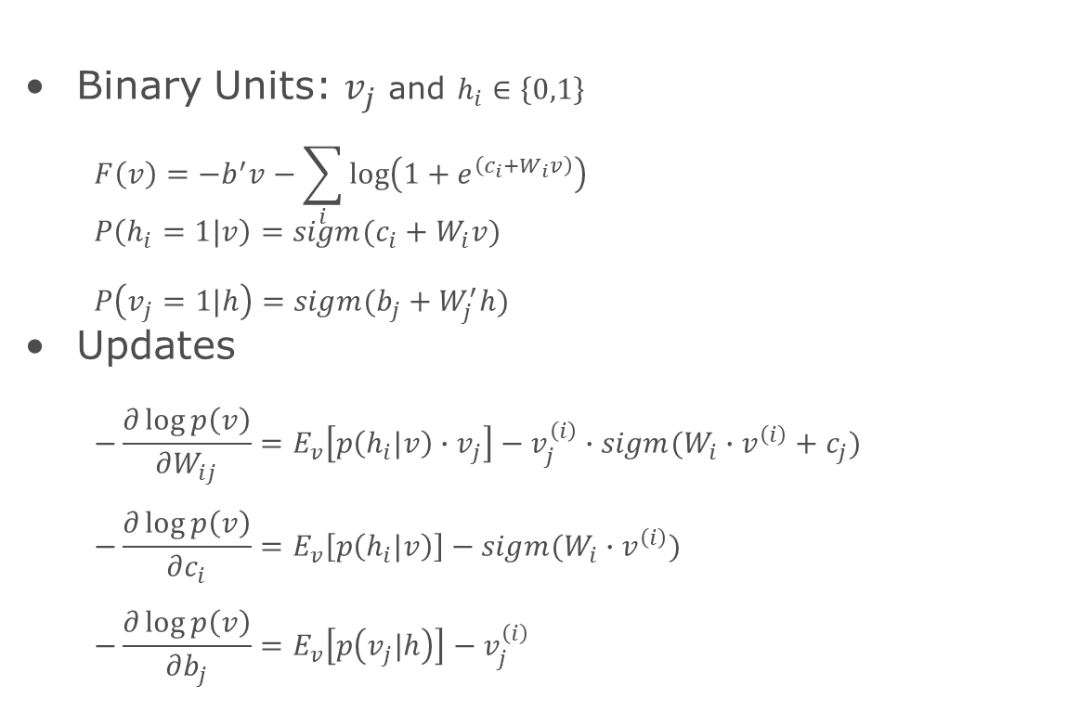
Restricted Boltzmann Machine
Binary Units: $v_{j}$ and $h_{i}∈\left\{0,1\right\}$
$$F\left(v\right)=−b^{′}v−\sum_{i}{\log\left(1+e^{\left(c_{i}+W_{i}v\right)}\right)}$$
$$P\left(h_{i}=1|v\right)=sigm(c_{i}+W_{i}v)$$
$$P\left(v_{j}=1|h\right)=sigm(b_{j}+W_{j}^{′}h)$$
Updates
$$−\frac{∂\log{p\left(v\right)}}{∂W_{ij}}=E_{v}\left[p\left(h_{i}|v\right)∙v_{j}\right]−v_{j}^{\left(i\right)}∙sigm(W_{i}∙v^{\left(i\right)}+c_{j})$$
$$−\frac{∂\log{p\left(v\right)}}{∂c_{i}}=E_{v}\left[p\left(h_{i}|v\right)\right]−sigm(W_{i}∙v^{\left(i\right)})$$
$$−\frac{∂\log{p\left(v\right)}}{∂b_{j}}=E_{v}\left[p\left(v_{j}|h\right)\right]−v_{j}^{\left(i\right)}$$

Slide 11
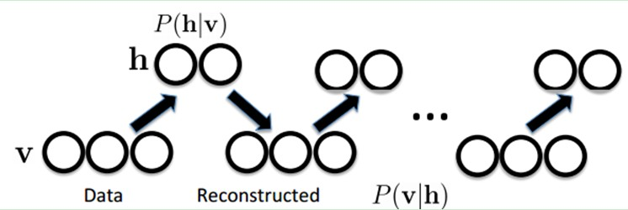

Restricted Boltzmann Machine
Gibbs sampling
$$h^{(n+1)}\sim sigm(W^{′}v^{\left(n\right)}+c)$$
$$v^{(n+1)}\sim sigm(Wh^{\left(n+1\right)}+b)$$

Slide 12
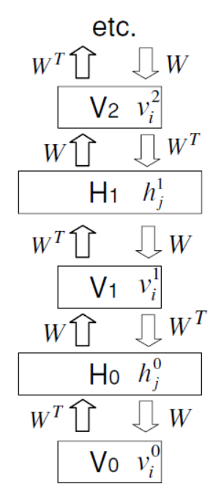
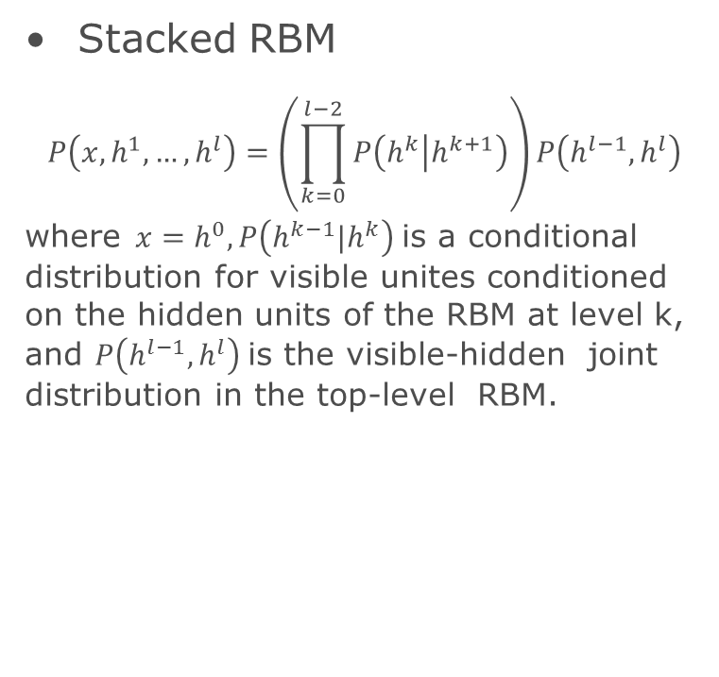
Deep Belief Networks
Stacked RBM
$$P\left(x, h^{1},…,h^{l}\right)=\left(\prod_{k=0}^{l−2}{P\left(h^{k} | h^{k+1}\right)}\right)P\left(h^{l−1},h^{l}\right)$$
where $x=h^{0},P\left(h^{k−1}|h^{k}\right)$ is a conditional distribution for visible unites conditioned on the hidden units of the RBM at level k, and $P\left(h^{l−1},h^{l}\right)$ is the visible-hidden joint distribution in the top-level RBM.

Slide 13
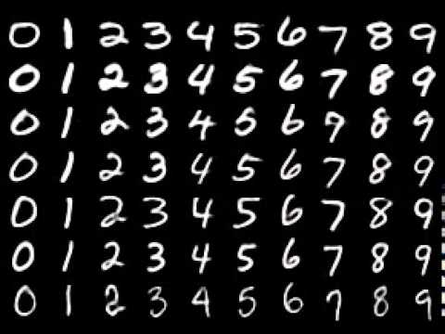
Example
Data description
MNIST database of handwritten digits
28x28=784 pixels for each image
Training set 60,000 images and tesing set 10,000 images
Python
Deep learning library (Bengio): Theano
dA, sda, rbm, DBN (http://deeplearning.net/tutorial/)

Slide 14








Results(More nodes)
Autoencoder
RBM
Layer: 30 MSE: 0.05074
Layer: 30 MSE: 0.06213
Layer: 100 MSE: 0.02686
Layer: 100 MSE: 0.02350
Layer: 500 MSE: 0.00786
Layer: 500 MSE: 0.00977
Layer: 1000 MSE: 0.00941
Layer: 1000 MSE: 0.00973

Slide 15






Results(More layers)
Autoencoder
RBM
Layer: 30 MSE: 0.05074
Layer: 30 MSE: 0.06213
Layer: 250-30 MSE: 0.05450
Layer: 250-30 MSE: 0.04957
Layer: 500-250-30 MSE: 0.04632
Layer: 500-250-30 MSE: 0.03741
Layer: 1000-500-250-30 MSE: 0.05012
Layer: 1000-500-250-30 MSE: 0.0476

Slide 16
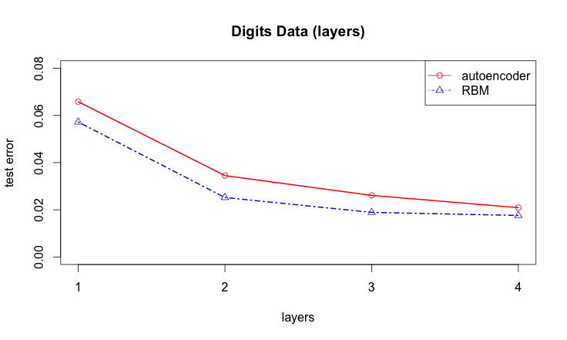
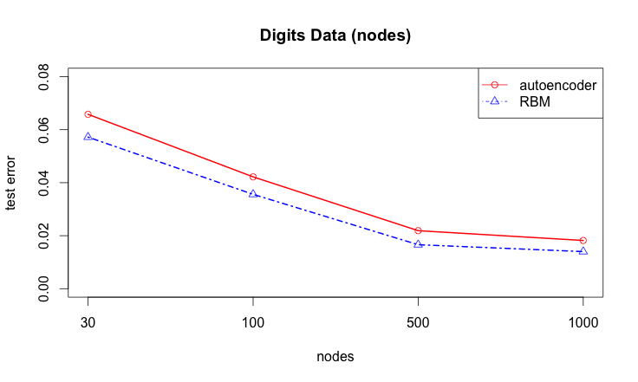
Results(Classification)
RBM performs better on classification than autoencoder
Test error decreases as layers and nodes size increase

Slide 17
Reference
Reducing the dimensionality of data with Neural networks. (Hinton and Salakhutdinov, 2006)
A fast learning algorithm for deep belief nets. (Hinton, Osindero and Teh, 2006)
Learning deep architectures for AI. (Bengio, 2009)

