Slide 1
Keeping your SQL Code safe
An introduction to GIT and SSDT for DB professionals

Slide 2




Geovanny Hernandez
DB Engineer / MCT
Database Engineer and Microsoft Certified Trainer, passionate for performance tuning in MS SQL Server, CI/CD, Unit Testing and Python. Looking for opportunities to growing as professional and consultant.
DB Engineer – Microsoft Certified Trainer
PASS Volunteer / Data enthusiast
Originally from Nicaragua(central America) lives in Malaga, Spain with his wife and kids. Volunteer in the chapter of PASS Malaga, active member in MSDN forums and enjoys the beautiful beaches in La Costa del Sol.
https://www.geohernandez.net/
me@geohernandez.net
Notes:
[Moderator Part]
This PASS Marathon session is presented by Geovanny Hernandez. Geovanny is a passionate about databases and teaching. He is a Database Engineer and Microsoft Certified Trainer and has more than 12 years experience in the software development. He has been working in different industries such as online games, publishing and banks, involved in migration projects, upgrades and performance tuning on MS SQL Server solutions. Geovanny is also very involved with the SQL Server community specially with the PASS Malaga Local Group in Spain and other virtual events for students and professionals in Universities from Nicaragua (Central America).
[move to next slide]

Slide 3
AGENDA
Introduction to SSDT – A road to DB DevOps
GIT and keeping your DB code under control

Slide 4
Introduction to SSDT A road to Database DevOps

Slide 5
Why do you must apply DevOps for the Database?
“Our highest priority is to satisfy the customer through early and continuous delivery of valuable software”.
1st principle behind agile manifesto
Notes:
Answer with three key aspect : Faster, better, cheaper which finally give us stability speed stability spped

Slide 6

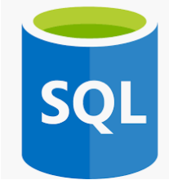

Tools for starting to work:
https://docs.microsoft.com/es-es/sql/ssdt/download-sql-server-data-tools-ssdt?view=sql-server-2017#changes-in-ssdt-for-visual-studio-2019
https://www.microsoft.com/en-us/sql-server/sql-server-downloads
https://www.microsoft.com/en-us/sql-server/sql-server-downloads
Notes:
Since VS 2019 only requires that you installa an extensión and not download a separate package for SSDT

Slide 7
Source Code control and automated changes
SQL Server Data Tool (SSDT)
Notes:
Mention that SSDT is an integrated component which is part of Visual Studio ecosystem and help us to manage the lifecycle for DB Projects
SQL Server Data Tools (SSDT) is a toolset that allows professional database and application developers to carry out all their database design work for SQL Server and SQL Azure within Visual Studio
The SSDT project system allows developers to have a fully representative source-code backed model of their database for offline development. SSDT Database Projects also enable the database schema to be version controlled using database snapshots and other source code control mechanisms.

Slide 8
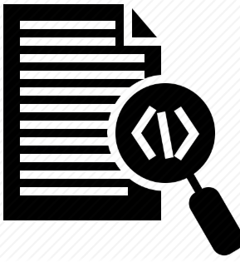
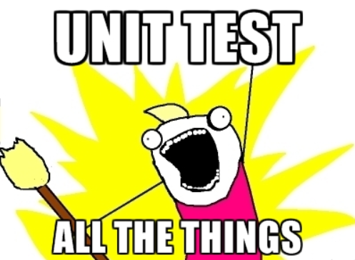
Some benefits of using SSDT
Artifact (DACPAC)
Notes:
Answer with three key aspect : Faster, better, cheaper which finally give us stability speed stability speed
Code integrated into a project
Compile time checking – No artefact is generated if you have error in your SSDT project
A release is a collection of artifacts in your DevOps CI/CD processes. An artifact is a deployable component of your application. DACPAC will be a tangible component use to deploy our DB Changes> new tables, new sp, new data

Slide 9
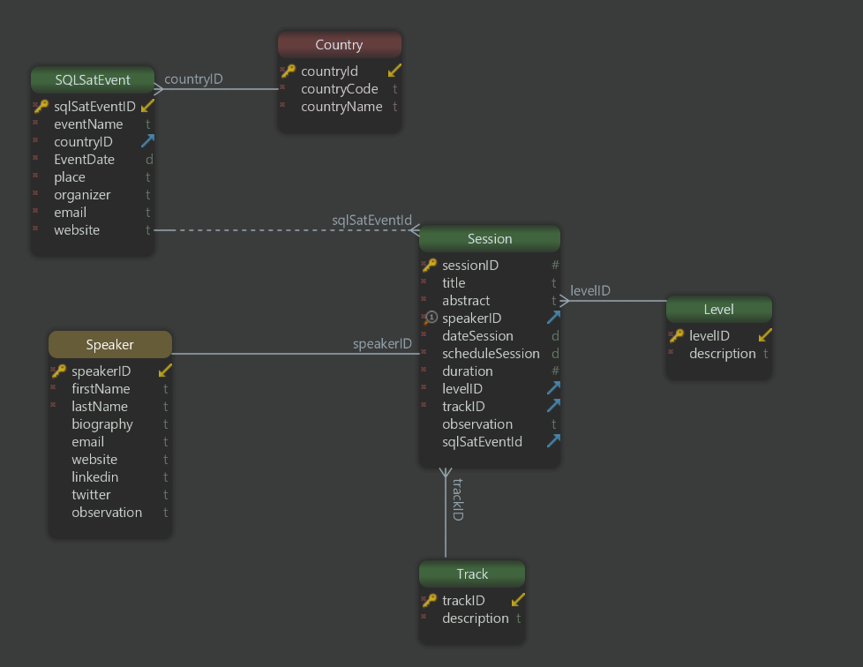
Notes:
SQLSaturday DB

Slide 10
Importing an existing DB SSDT in action

Slide 11
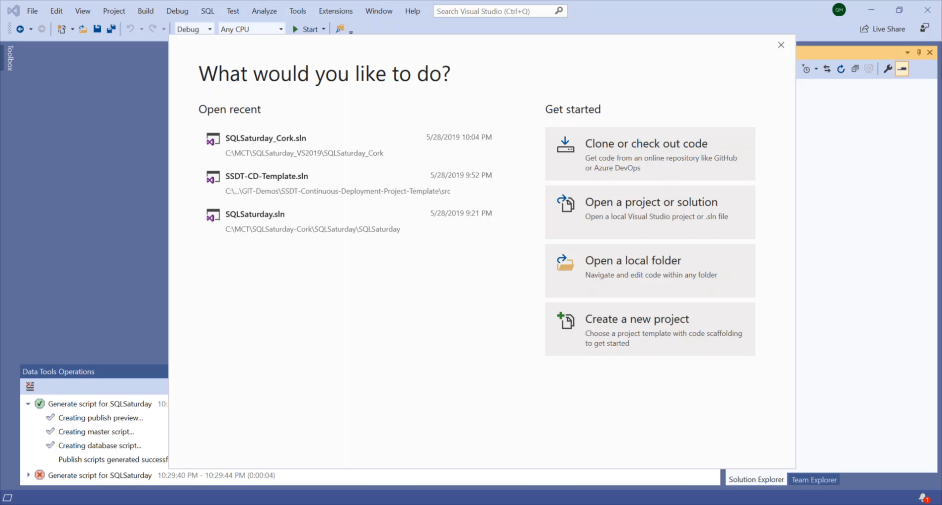
Notes:
SQLSaturday DB

Slide 12
Interacting with our Project SSDT in action
Notes:
You should start to modify and compare schema-publish script and show how great is …but how the manual intervention can have a negative impact.

Slide 13
Why is important to have an Artifact (DACPAC)?
Notes:
Answer with three key aspect : Faster, better, cheaper which finally give us stability speed stability spped

Slide 14
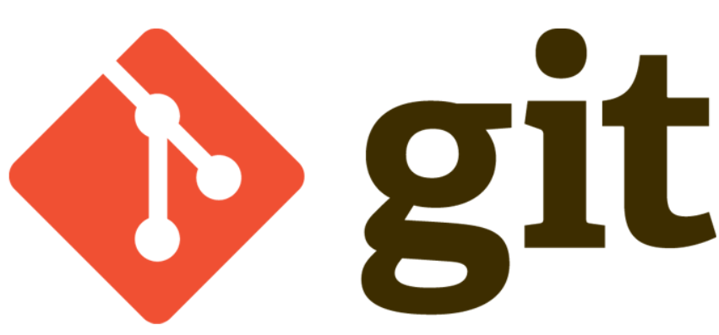
Why do we need a Source Control System?
Notes:
Why GIT – The most used source control in the programming world, every computer is a Server of the code, remember, the develop branch is forced and branch to be sync before to push changes. GIT is a distributed versioning or change tracking system. Every copy of a repository contains the entire history of changes

Slide 15
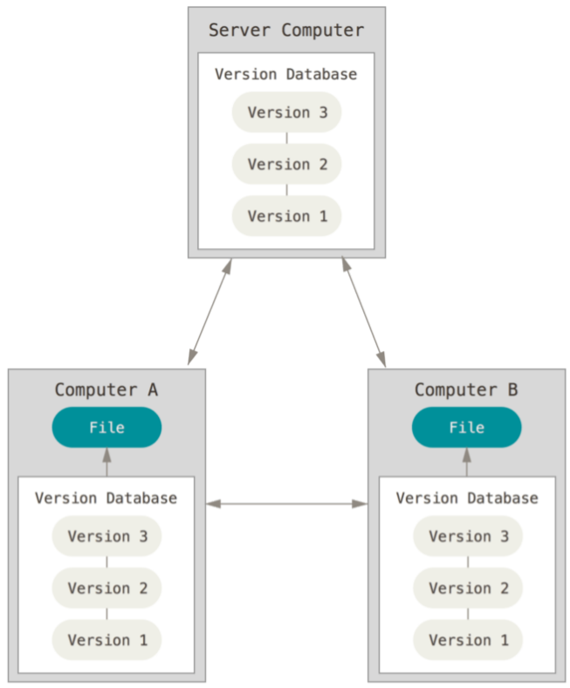
Distributed version control . Credits: Pro GIT – Scott Chacon and Ben Straub
Notes:
What exactly it means? Every computer updated keep the history of every version, it means that if the Server Computer collapse, we can easy restore it taking the project from any available sync computer.

Slide 16
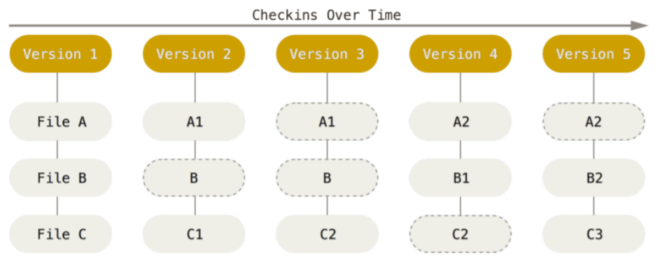
Storing changes as stream of snapshots. Credits: Pro GIT – Scott Chacon and Ben Straub
Notes:
GIT do a checksum before to store anything, everything happen in the repo GIT realizes, the SHA-1 hash algorithm, GIT doesn’t store name, use the hash value of its contents

Slide 17
Set up our Project into a repository GIT in action
Notes:
Open your Azure account and show the process of creating a new empty repository (called SQL Saturday) – Check if it is possible to omit the process of creating and only showing the link for a new simple article about it

Slide 18
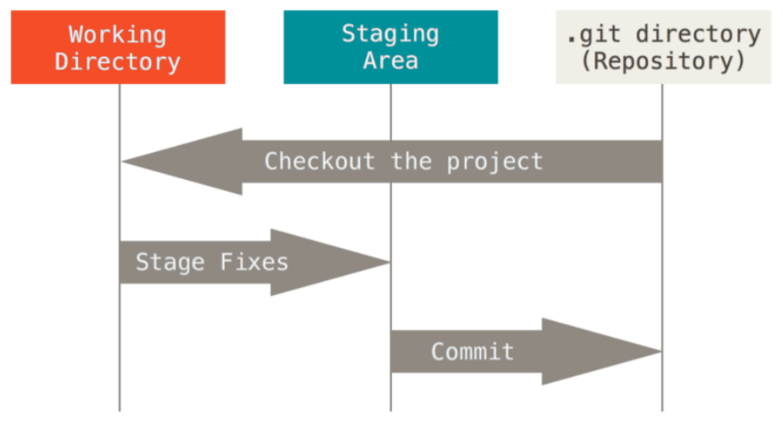
GIT Workflow -- Working tree, staging area, and Git directory. Credits: Pro GIT – Scott Chacon and Ben Straub
Notes:
You modify files in your working tree.
You selectively stage just those changes you want to be part of your next commit, which adds only those changes to the staging area.
You do a commit, which takes the files as they are in the staging area and stores that snapshot permanently to your Git directory.

Slide 19
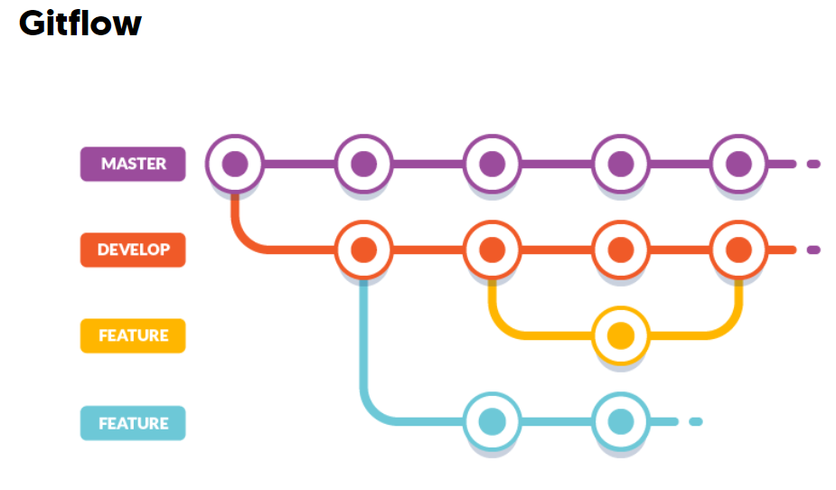
Notes:
Mention the importance

Slide 20
“Pull request… Learning in action
Notes:
A pull request (PR) is a request submitted to a GitHub/AzureDevops/Jira, etc repository to merge code into that project

Slide 21

Why do you should open a Pull Request before to merge?
Team Learning

Slide 22
A recap
DevOps on Database
An artifact
Source Control
Team working – Pull request

Slide 23
Thank you for attending

