Slide 1
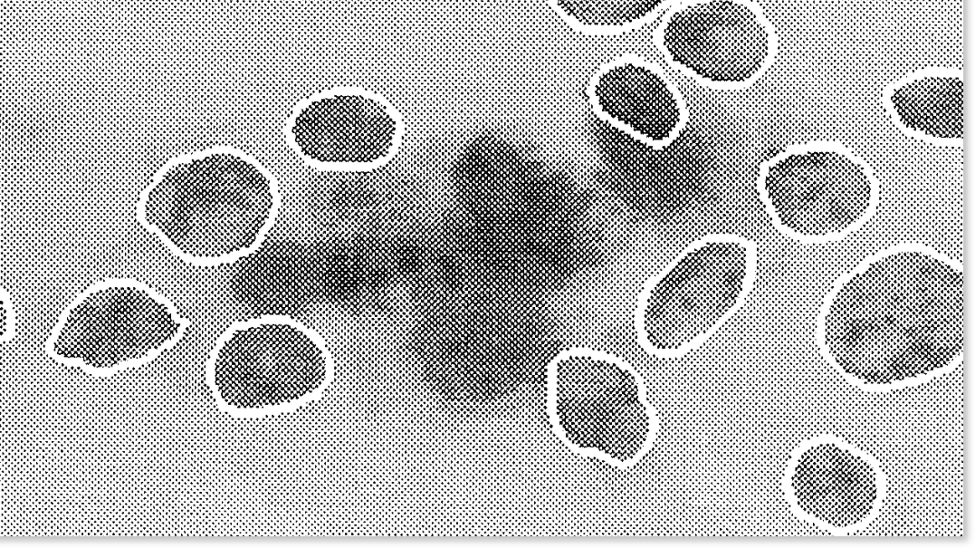
Updated Random Forest Model for Breast Cancer Diagnosis
Georgia Jenkins, MPH
Springboard Capstone Project

Slide 2
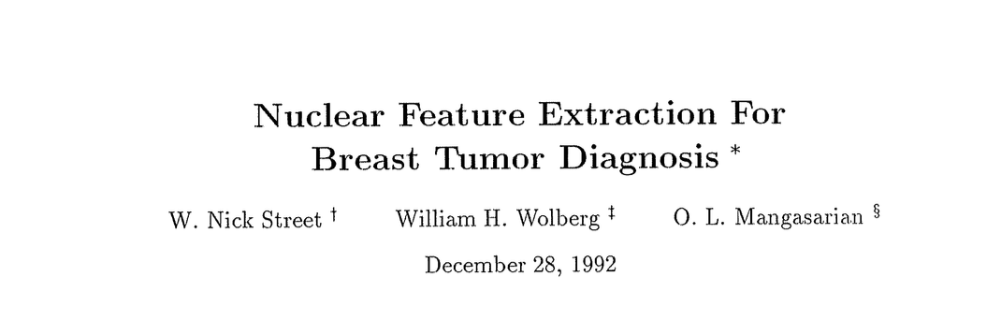
Background
Fine Needle Aspiration (FNA) is a minimally invasive way to sample breast mass tissue
FNA yields many (10) nuclear features, making diagnosis difficult
In 1992, Street et. Al built a multi-surface method tree (MSM-Tree) to predict diagnosis
97.3% accuracy, 90% sensitivity, 86% specificity
Street, Nick & Wolberg, William & Mangasarian, O. (1999). Nuclear Feature Extraction For Breast Tumor Diagnosis. Proc. Soc. Photo-Opt. Inst. Eng.. 1993. 10.1117/12.148698.

Slide 3
Why update the model?
Random Forests first described in 1995, after the paper was published
Potential to increase sensitivity & specificity for diagnosis of a life-threatening disease
Tin Kam Ho, "Random decision forests," Proceedings of 3rd International Conference on Document Analysis and Recognition, Montreal, QC, Canada, 1995, pp. 278-282 vol.1, doi: 10.1109/ICDAR.1995.598994.

Slide 4
Dataset Profile
Diagnostic Breast Cancer Wisconsin Database
569 instances each representing 1 patient & 1 breast mass
3 categories of 10 nuclear features to describe cell nuclei in the FNA image
Target: Diagnosis
Benign, 63% (357/569)
Malignant, 37% (212/569)
Nuclear Features
Radius
Concavity
Perimeter
Concave points
Area
Symmetry
Compactness
Fractal dimension
Smoothness
Texture
Mean, Worst, & Standard Error
Wolberg, W., Mangasarian, O., Street, N., & Street, W. (1993). Breast Cancer Wisconsin (Diagnostic) [Dataset]. UCI Machine Learning Repository. https://doi.org/10.24432/C5DW2B.

Slide 5
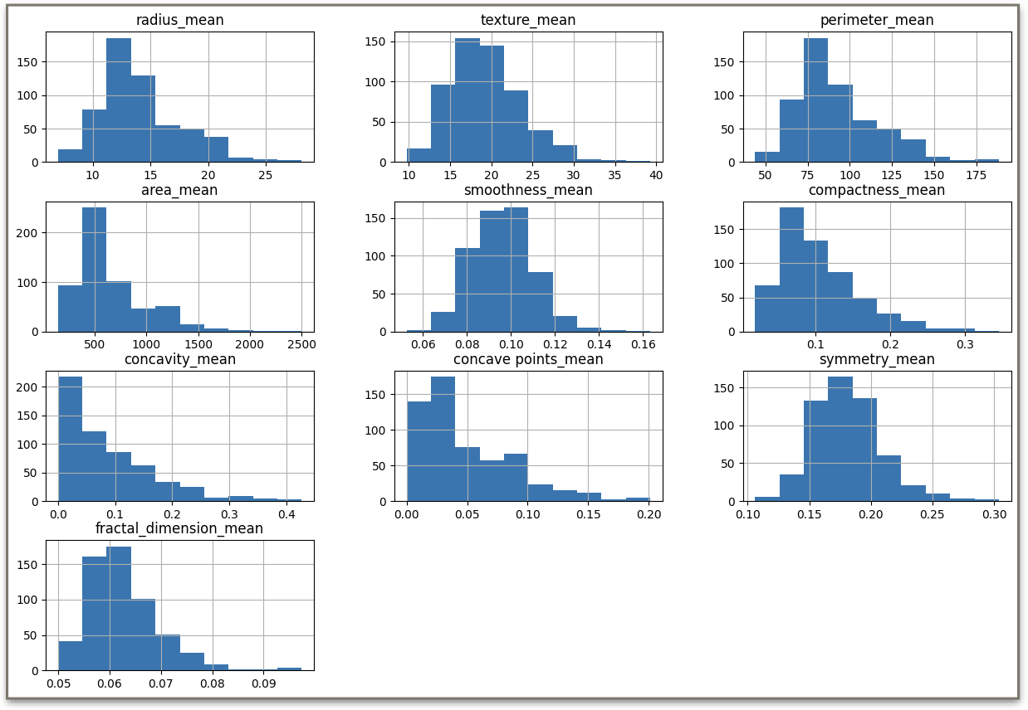
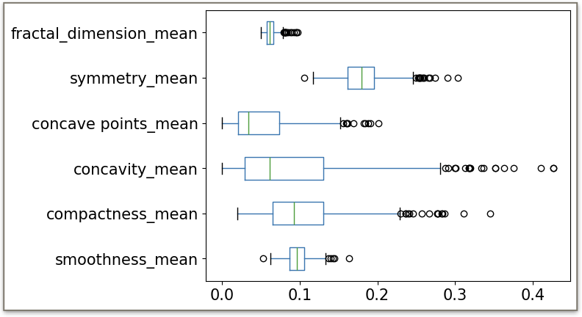
EDA: Right skewed data with outliers

Slide 6
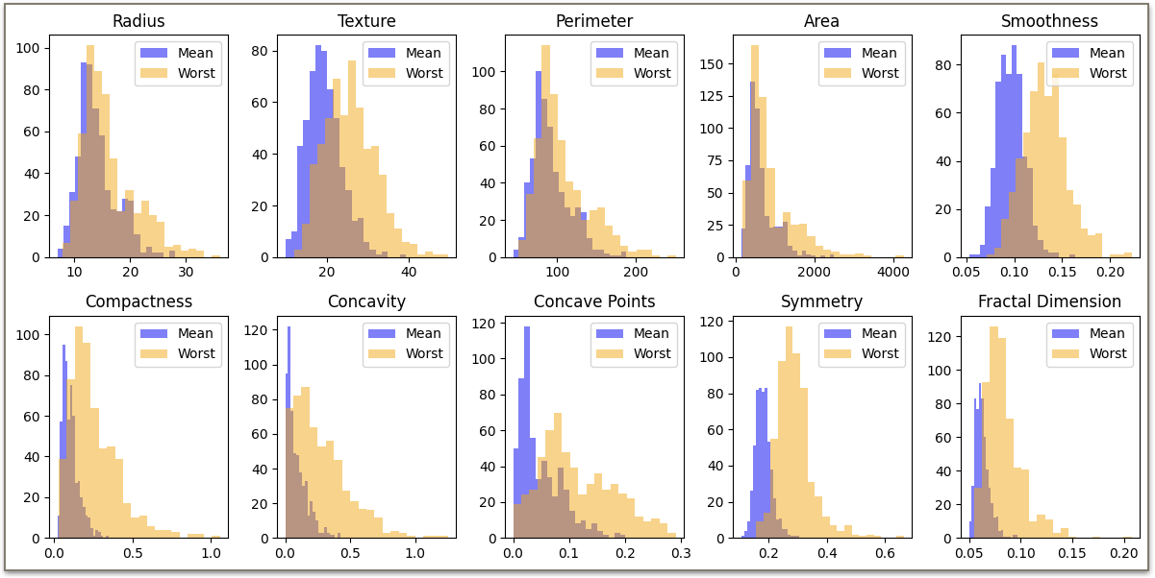
EDA: “Worst” = the largest measurement taken

Slide 7
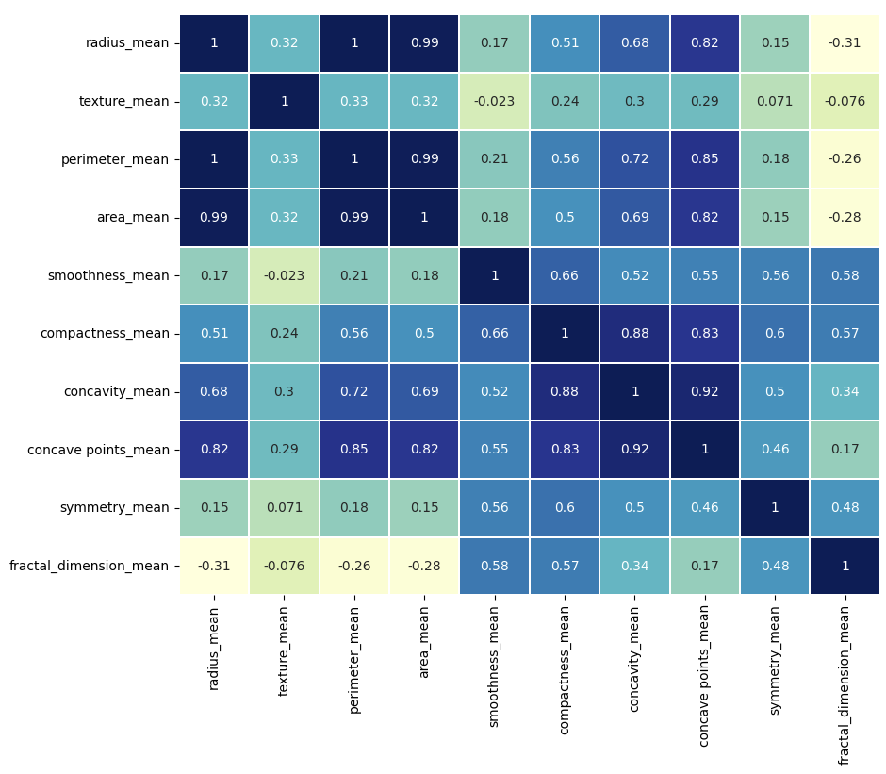
Relationships
*
*
*
Strong correlation between size features*
Strong correlation between concavity, concave_points, & compactness
Moderate correlation between smoothness, compactness, symmetry, & fractal dimension

Slide 8
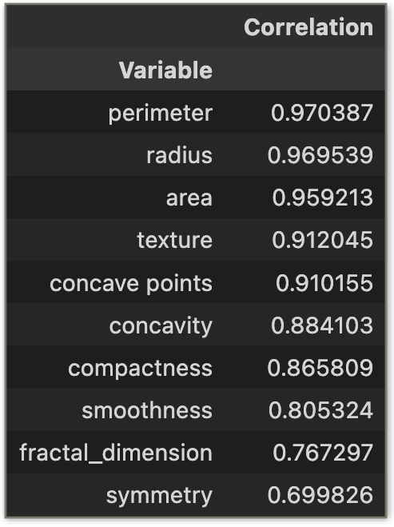
Relationships across the 3 categories
I.e., how correlated are perimeter_mean, perimeter_worst, & perimeter_se?
All features are correlated with their matching features in other categories

Slide 9
Feature Selection Guiding Principles
Goal: select features to minimize bias in the model
Criteria
Don’t include matching features from other categories
I.e., must choose ONE from symmetry_mean, symmetry_worst, & symmetry_se
Don’t include highly correlated variables
I.e., must choose ONE from radius, area, & perimeter

Slide 10
Feature Selection Methods
Attempt 1:
Loop through all possible combinations and test on a basic RandomForestClassifier
Find combo that yielded highest accuracy
Use radius as size feature.
Too computationally expensive
Attempt 2:
Loop through set number of random combinations to limit computational load.
If accuracy scores are similar, no need to test them all.
Accuracy scores were different

Slide 11
Feature Selection Methods, cont.
Attempt 3:
Revisit paper and see they used area instead of radius & no standard error features
Avoid all standard error features and swap radius with area
Reasonable computation time & high accuracy (99.12%)
Features Moving to Modeling Phase
area_worst
compactness_mean
concavity_mean
fractal_dimension_mean
smoothness_worst
symmetry_mean
texture_mean

Slide 12
Random Forest Modeling Setup
Recall that diagnosis is an imbalanced target with 63% benign and 37% malignant
Use StratifiedKFold cross-validation with 5 splits
Stratify y in train_test_split(test_size=0.2)

Slide 13
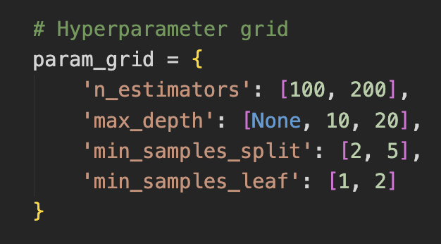
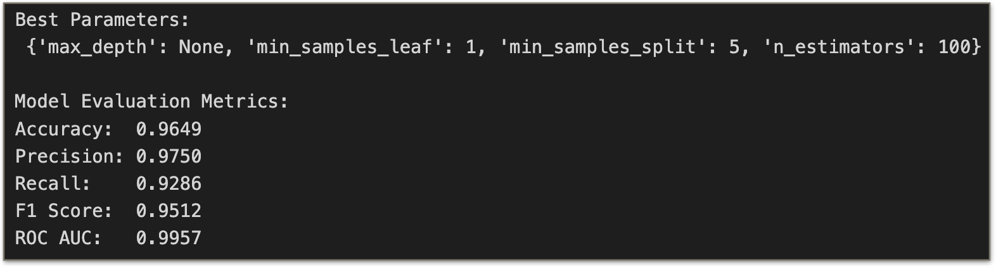
GridSearch to find the best hyperparameters

Slide 14
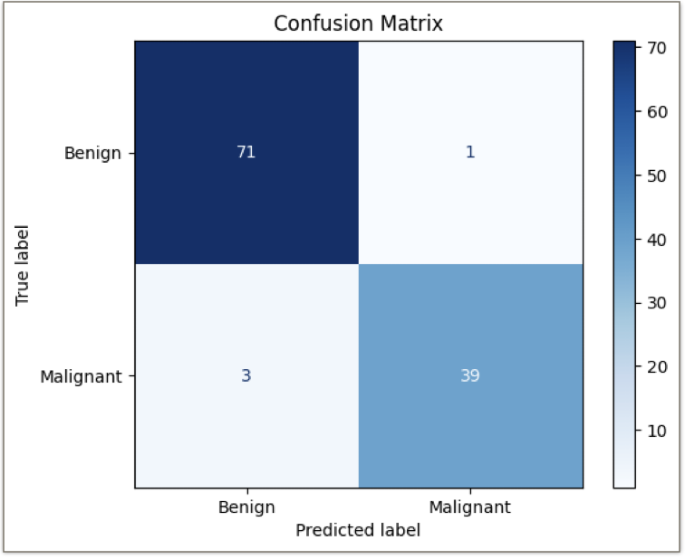
Initial Results
This is a strong start, and we could probably stop here
But can we improve the sensitivity to prevent false negatives?

Slide 15
Maximizing Recall / Sensitivity
Attempt 1:
Emphasize recall in GridSearchCV instead of the F1 score
Assign class_weight = ‘balanced’ in the RandomForestClassifier
Failed to reduce false negatives

Slide 16
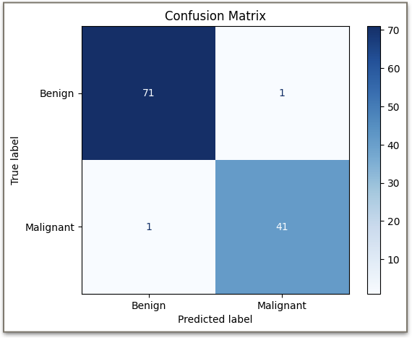
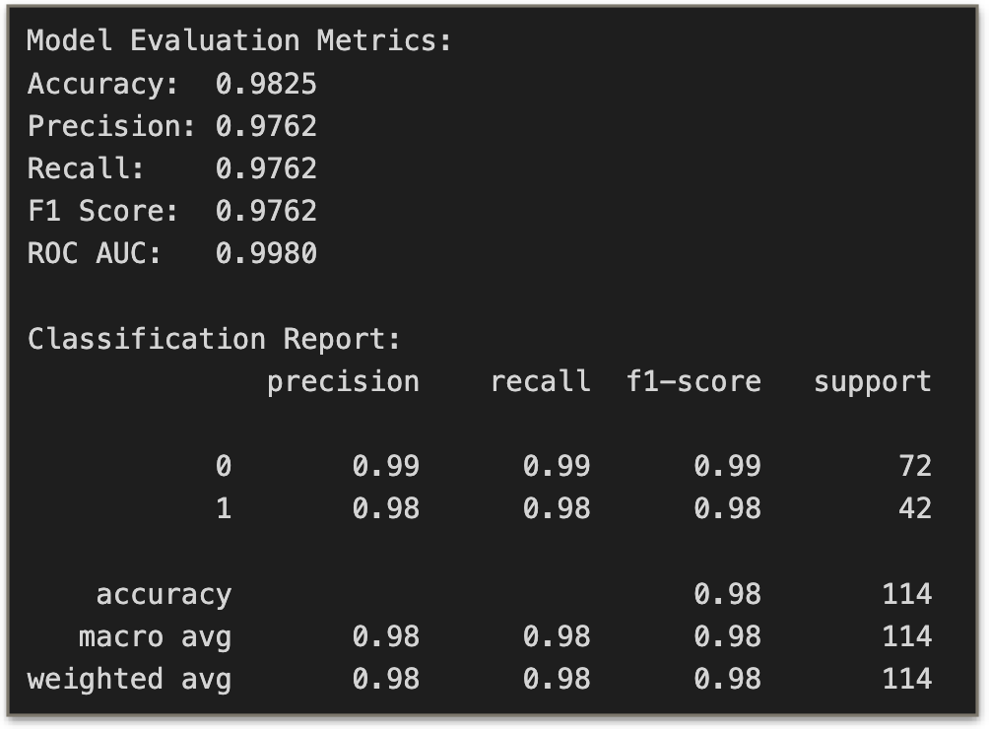
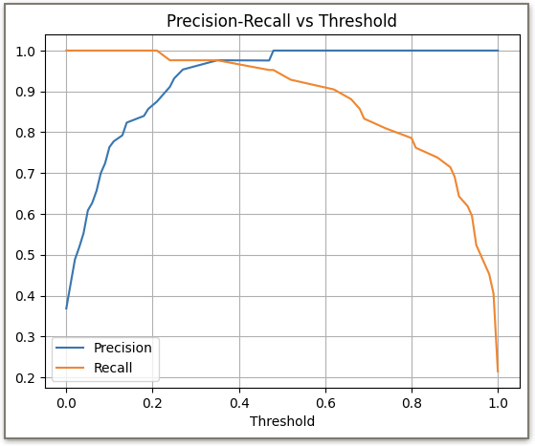
Maximizing Recall
Attempt 2: Manually reduce probability threshold from 0.5 to 0.3
Lowered false negatives without increasing false positives
Better overall accuracy, sensitivity, and specificity than original MSM-Tree model
Note: deep learning methods may be more appropriate in practice, and we’ll learn about this in the next unit

Slide 17
Final Model Summary
Train test split with 80/20 ratio and stratified target variable.
Random forest classifier with n_estimators=100, max_depth=None, min_samples_split=2, min_samples_leaf=1, class_weight=‘balanced'.
Threshold > 0.3
For reproducibility, random_state=42 was used throughout this report.

Slide 18
References & Acknowledgements
Street, Nick & Wolberg, William & Mangasarian, O. (1999). Nuclear Feature Extraction For Breast Tumor Diagnosis. Proc. Soc. Photo-Opt. Inst. Eng.. 1993. 10.1117/12.148698.
Tin Kam Ho, "Random decision forests," Proceedings of 3rd International Conference on Document Analysis and Recognition, Montreal, QC, Canada, 1995, pp. 278-282 vol.1, doi: 10.1109/ICDAR.1995.598994.
Wolberg, W., Mangasarian, O., Street, N., & Street, W. (1993). Breast Cancer Wisconsin (Diagnostic) [Dataset]. UCI Machine Learning Repository. https://doi.org/10.24432/C5DW2B.
Special thanks to Springboard and especially my advisor, Aditya Bhattacharya, for his guidance throughout this project!

