Slide 1
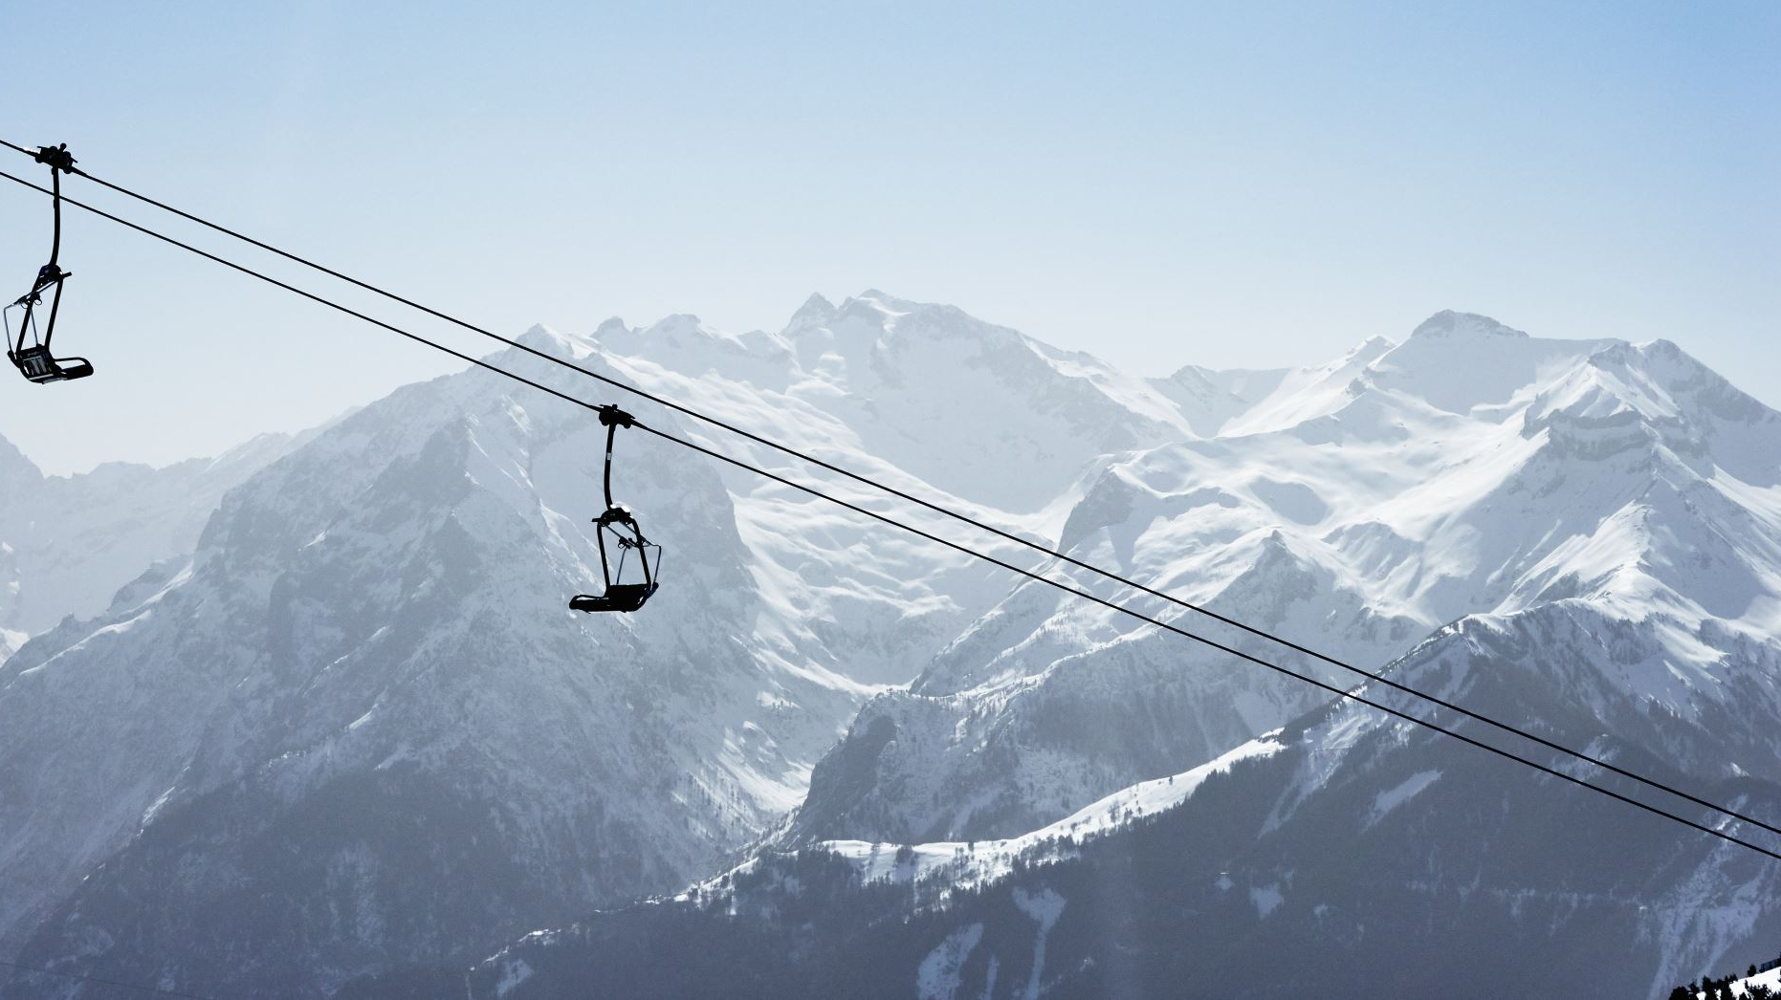
Big Mountain Resort Pricing Strategy (2025)
Georgia Jenkins, Analyst

Slide 2
Problem
Big Mountain is a top US resort
350,000 customers/year
2,353 ft vertical drop, 3K acres skiable terrain
105 runs,14 total chairs, 3 fast quads
600 snow making acres
Current pricing strategy fails to capitalize
Charges premium above avg. market price
Does not account for value of features offered
Four strategies were proposed to increase revenue, but need a data-driven decision

Slide 3

Recommendation
Adopt Random Forest Model to account for the most important features in pricing
Current price: $81
Modeled price: $95.87 [$85.49, $106.26]
Deploy proposed strategy #2
Add lower run to increase vertical drop
Install chair lift to bring skiers back up
After modelled adjustment, strategy #2 supports a $1.99 price increase
$1.99 increase = additional $3.47M
Covers cost of new chair lift ($1.54M)

Slide 4
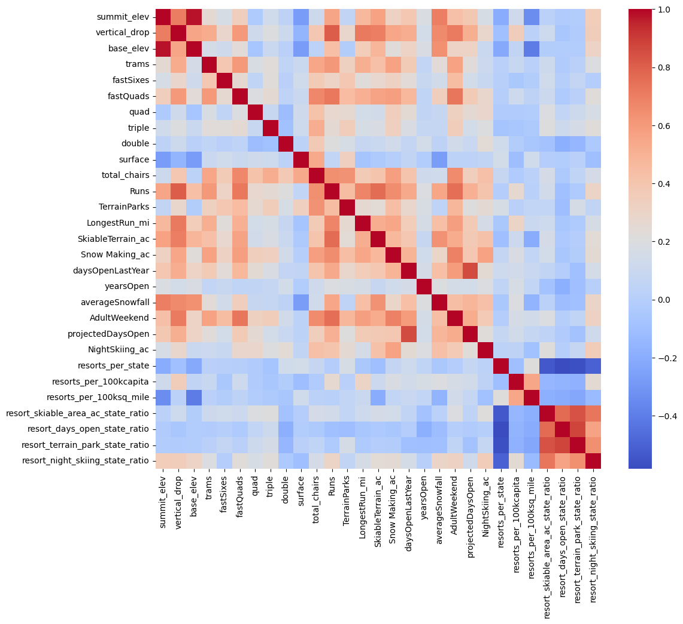
Analysis
Explored data from 330 resorts
Most important features*
Vertical drop
# of fastQuads
# of runs
Total # of chairs
Snow making acreage
*Aligned across two different models (linear & random forest)

Slide 5
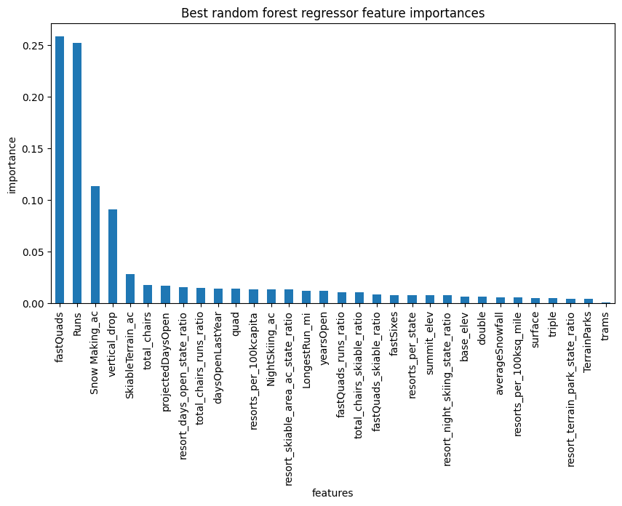
Modeling
Random forest model
Stronger than linear model & simply using the mean price as a baseline
Had the least variability & lowest cross-validation mean absolute error
Unlike mean price, accounts for the importance of the features offered

Slide 6
Model Testing Results
Trained/tested model with a 70/30 data split
Modeled ticket price: $95.87 [$85.49, $106.26]
Current price ($81) is outside margin, suggests undercharging
Recommendation: raise ticket price within these margins
Discussion: will raising the price too much deter customers?
Assuming 350K customers, raising ticket price to just $85.49 will lead to a >$1.5M revenue increase which covers the recent chair lift addition
Drastic increases may deter Montana customers
Big Mountain is currently the most expensive in Montana
Less impact is expected for non-local customers
Consider local/non-local customer split

Slide 7
Testing four scenarios
Permanently close up to 10 of the least used runs
Increase the vertical drop by adding a run to a point 150 feet lower down but requiring the installation of an additional chair lift to bring skiers back up
Same as number 2, but adding 2 acres of snow making cover
Increase the longest run by 0.2 mile, requiring an additional snow making coverage of 4 acres
Increasing the vertical drop by 150ft & adding a lift increases the modeled price by $1.99
New modeled price + this scenario increases projected revenue by $3.47M per season
The other scenarios had either no positive effect on revenue or even a potential negative effect in the case of closing runs

Slide 8
Summary
Analysis of 330 US resorts yielded a stronger pricing model based on feature importance
01
The model suggests repricing tickets at $95.87 [$85.49, $106.26]
02
Scenario #2 would support an additional increase of $1.99 per ticket
03
Combined, the changes increase projected revenue by $3.47M
04

