Slide 1

NLP Model to Identify Math Student Misconceptions
Georgia Jenkins, MPH
Springboard Capstone Project

Slide 2
Background
Students’ written explanations of their mathematical reasoning provide insight into their thinking and reveal misconceptions
1
Tagging misconceptions by hand is useful but labor-intensive and difficult to scale
2
The Misconception Annotation Project (MAP) was designed to address this challenge by using NLP models to ID misconceptions across diverse math problems
3
Goal: Predict when a student’s answer contains a misconception, and what type of misconception it is
4

Slide 3
Dataset Profile
Misconception Annotation Project (MAP) dataset
36,696 instances each representing 1 answer to a multiple-choice math problem
6 variables

Slide 4
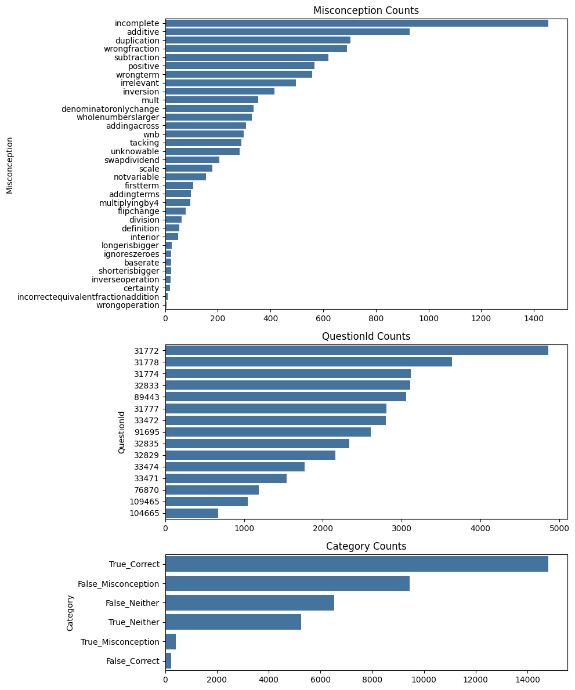
EDA: class imbalance

Slide 5
EDA: class imbalance & too many classes

Slide 6
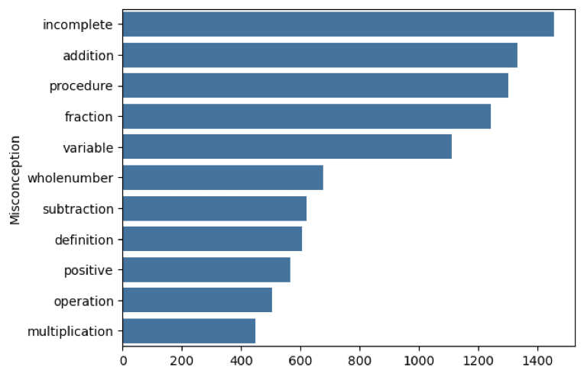
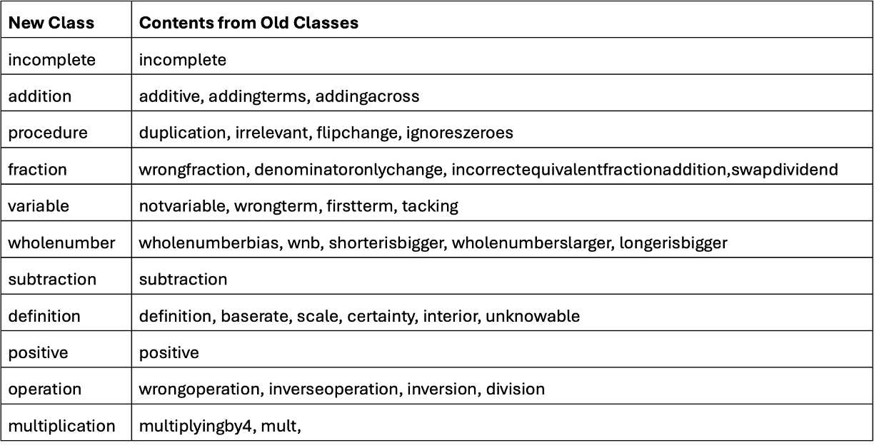
Logically combine 36 target classes into 11

Slide 7
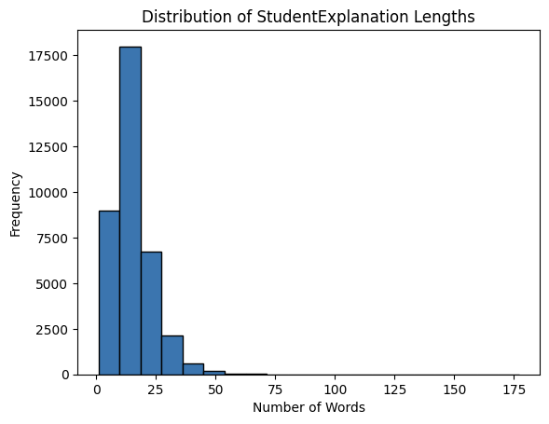
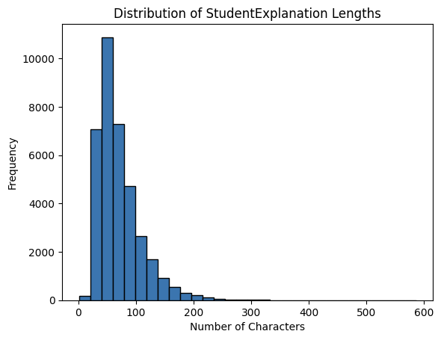
Explore and Clean Student Explanations
Set all to lower
Remove accents
Expand contractions
Remove repeated words
Remove English stop words
Remove special characters and numbers

Slide 8
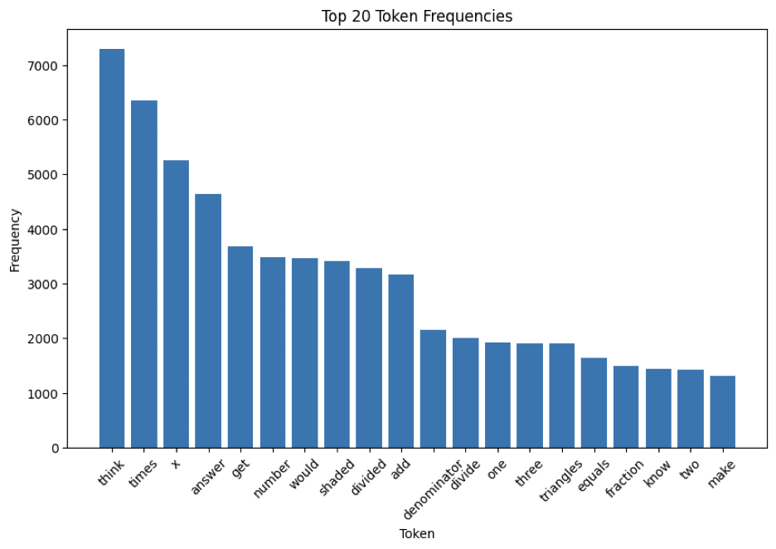
Tokenize Cleaned Student Explanation

Slide 9
Initial Modeling Strategy
Two modeling stages:
Stage 1 – Predict if explanation is Correct / Misconception / Neither.
Stage 2 – Predict type of misconception (if present).
Baseline: Multinomial Naive Bayes with TF-IDF + TokTokTokenizer.

Slide 10
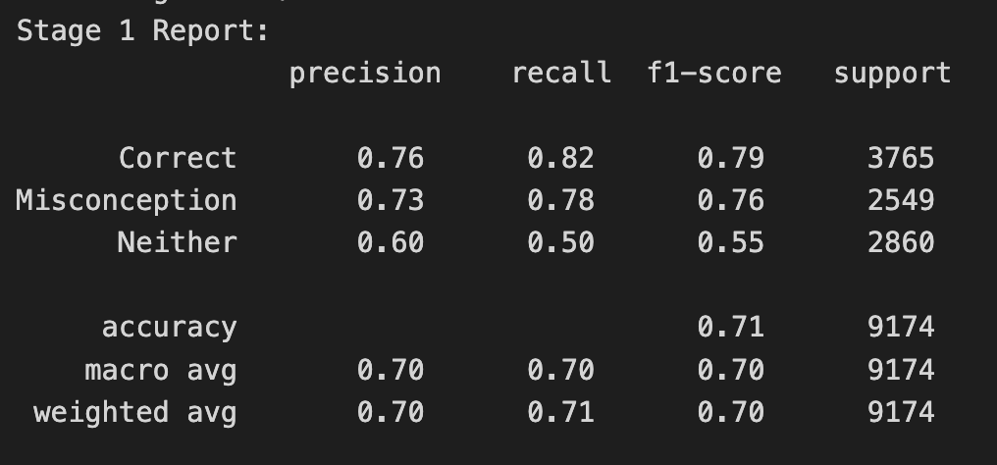
Two-Step Categorization: Naive Bayes
Stage 1: Fair performance with RandomOverSampler to address imbalance.
Stage 2: Poor F1 (0.00) when predicting misconception type only on subset.
Using full dataset yielded inflated results (F1 = 0.80) – not realistic.

Slide 11
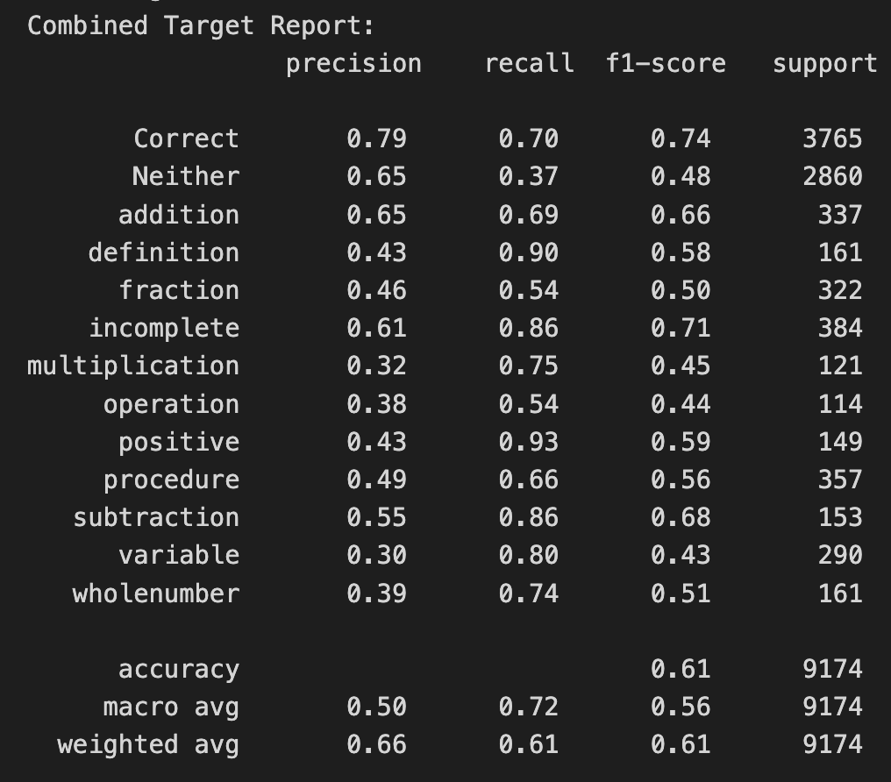
Combined Target Categorization: Naive Bayes
CombinedTarget merges Correct/Neither with specific misconception types.
13 total classes → single multiclass prediction task.
Improved and more realistic performance.

Slide 12
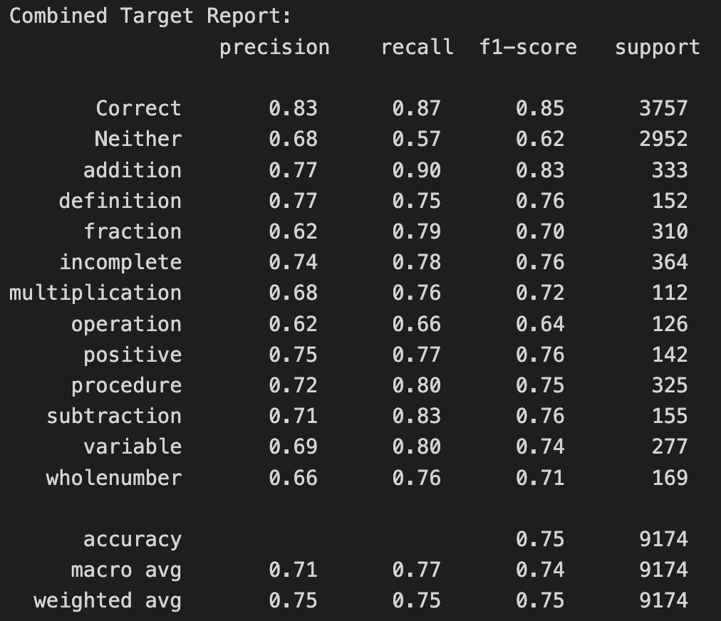
LightGBM Model
Light Gradient-Boosting Machine outperformed Naive Bayes.
Tuned with Optuna hyperparameter optimization.
Final parameters:
TF-IDF ngram_range=(1,3)
Encoded QuestionID + is_correct (CSR matrix)
F1 = 0.75 | Recall = 0.77 | Precision = 0.75.

Slide 13
Final Model Summary
1. 75/25 stratified train-test split.
2. Text preprocessing with TF-IDF + TokTokTokenizer.
3. Label encoding for QuestionId; binary is_correct.
4. RandomOverSampler to balance classes.
5. LightGBM multiclass classifier (class_weight=balanced).
6. Random state = 42 for reproducibility.

Slide 14
Conclusion and Impact
NLP can effectively identify and categorize student misconceptions.
Automates diagnostic feedback for educators.
LightGBM model achieved strong, interpretable performance.
Potential to integrate with educational platforms like Eedi.
Future work: test transformer models, expand dataset coverage.

Slide 15
References & Acknowledgements
Jules King, Kennedy Smith, L Burleigh, Scott Crossley, Maggie Demkin, and Walter Reade. MAP - Charting Student Math Misunderstandings. https://kaggle.com/competitions/map-charting-student-math-misunderstandings, 2025. Kaggle.
Special thanks to Springboard and especially my advisor, Aditya Bhattacharya, for his guidance throughout this project!

