Slide 1
Scenario
The leadership of the Health Fund is working closely with a partner clinic in Manhattan to improve outcomes and reduce costs for certain common procedures. Prior to assessing outcomes, the leadership has asked me to form a list of top 10 referral providers based on cost and volume, in the immediate vicinity of the clinic, for colonoscopy procedures. I’ll be working with a dataset containing a set of claims that encompass all colonoscopies in the clinic catchment area.
Audience: Technical leaders of the health fund data team (not C-suite)
Source: Health Fund at 32BJ SEIU

Slide 2
Questions from the Leadership
What was the total volume of colonoscopy procedures in 2020? What was the total volume by provider for the top 10 providers, by volume?
What are the mean and median costs per procedure for each of the top 10 providers, by volume?
Are the costs per procedure statistically different between the top 3 providers by volume?
What recommendations would you make to the clinic, based on this data, about which providers should be preferred for colonoscopy procedure?

Slide 3
Methods: Data Cleaning
Purpose | Actions Taken
Remove data irrelevant to the assignment | Filtered out endoscopy CPT codes (43200, 43235, 43239). Filtered out procedures that started/ended in any year other than 2020. Confirmed that all provider zip codes were near UHC.
Remove duplicates | Identified claims where claim number, provider, start date, end date, and CPT code were duplicated. 12 duplicate sets (24 claims) were identified. Each set contained one claim with paid amount > 0 and one = 0. Filtered out the 12 duplicates where paid amount = 0.
Remove invalid data | Invalid date, 2/29/2019 was removed during filtering year to 2020. Checked for NA values throughout the data set. None were present in the key variables, just reject codes, modifiers, and additional ICD codes after the primary code. Filtered out 4 claims where payment value = 999999. Assumed this represented an error. Did notice a pattern with the ICD codes, but that didn’t adequately explain 999999.
Notes:
The first step is to orient myself to the data. For me, the best way to do this is to perform one cleaning step at a time, then immediately see how this affected the dataset. Lots of summary functions and viewing subsets of the data based on the whatever just changed. Rinse and repeat!

Slide 4
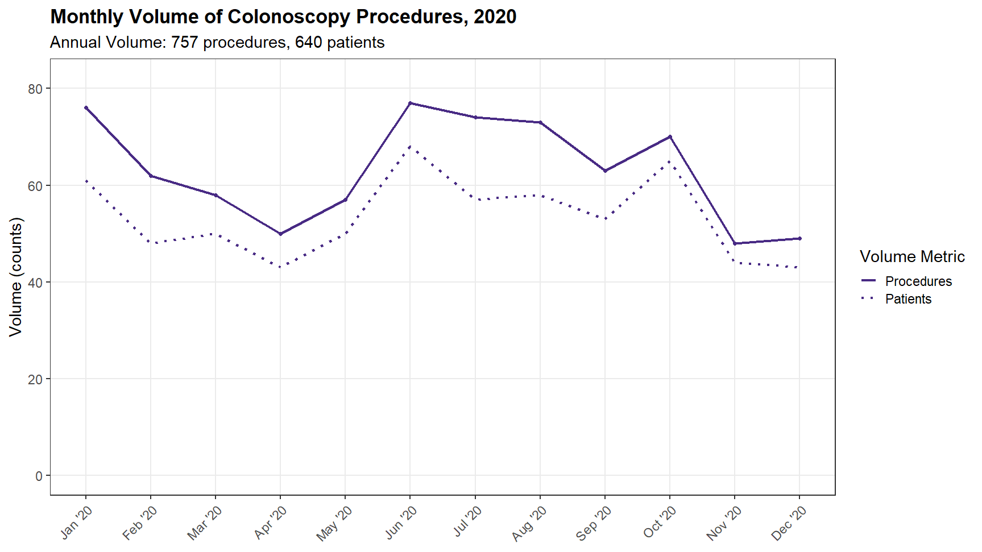
Notes:
I decided to show volume over time in case there were any seasonal variations to note. There is a dip in volume in the Spring of 2020, most likely related to the reduction in not-emergency procedures at the beginning of the COVID-19 pandemic lockdowns. There is also a dip in Nov/Dec, maybe related to the holidays or a spike in COVID-19 cases. Running the same plot over a more recent year could tell us more, if needed.
I modelled this plot after a figure in “Impact of the COVID-19 Pandemic on Utilization of EGD and Colonoscopy in the United States: An Analysis of the GIQuIC Registry” (Calderwood et. al, 2021), but for a more patient centered visualization, I included the number of patients in addition to the number of procedures.

Slide 5
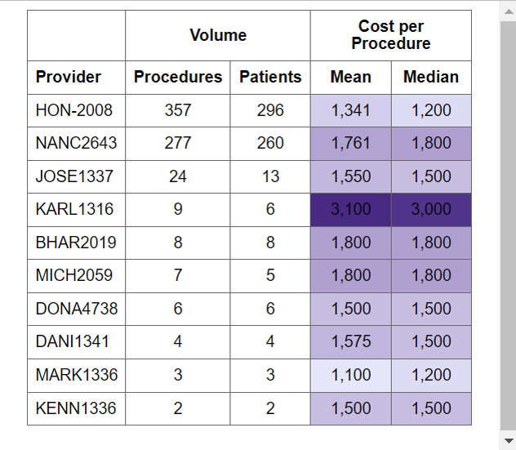
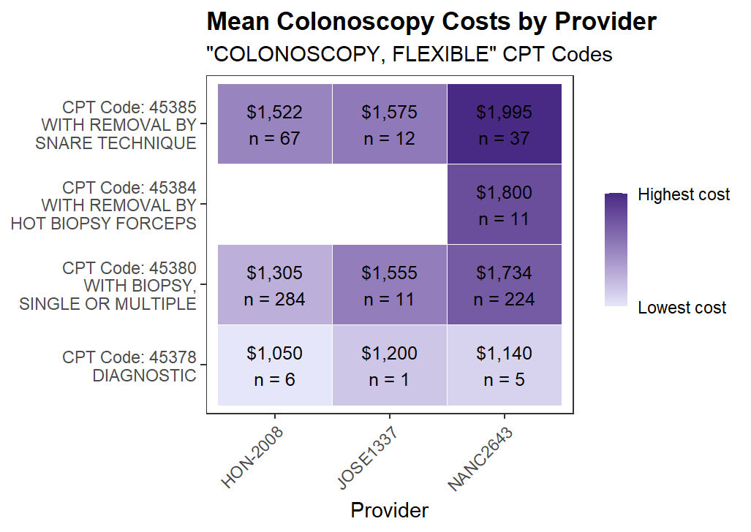
91% of procedures
performed by top 2 providers
Only 1 of the top 3 performed removal by hot biopsy forceps
Notes:
For the left figure and all figures that follow it, I filtered out rejected claims.
HON-2008: 32/389 (8%) rejected
NANC2642: 12/289 (4%) rejected
Reasoning:
Rejected claims have a payment of $0, which could make costs seem lower for providers with many rejected claims
One provider, MICH1336, had all claims rejected (n = 4). That provider was removed from the table, since mean and median cost were NA.
After removing that provider, I decided it was only fair to be consistent across all providers in the top 10
I made the figure on the right because I wanted a more detailed breakdown of the specific procedures and costs for the top 3 providers. Interestingly, one procedure was performed by only one provider in the top 3. NANC2643 has the highest costs, but maybe that’s to offset the cost of a recommended procedure. We should understand the costs/benefits of offering/not offering hot biopsy before totally ruling out a partnership with NANC2643.

Slide 6
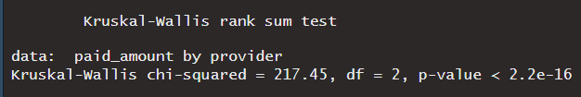


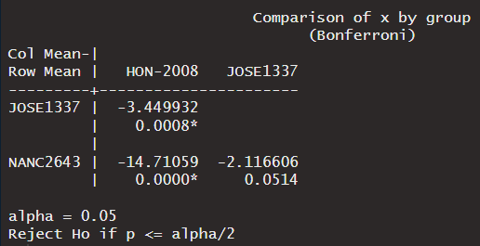
Cost differences between top 3 providers
Step 1: Determine if there are statistically significant differences
ANOVA assumptions
Independent observations
Normal distribution
Homogeneity of variances
Kruskal-Wallis Test p ≈ 0
Significant differences exist!
Step 2: which pairs have differences?
Dunn’s test of multiple comparisons, Bonferroni adjustment
HON-2008 & JOSE1337 p < 0.001
HON-2008 & NANC2643 p ≈ 0
Notes:
Distributions were clustered with outliers. Ran a Shapiro-Wilk test on paid amounts for each provider. p ≈ 0 for all 3 providers.
Variances were 20869, 76586, and 133474
Bonferroni adjustment to adjust p-values for multiple comparisons

Slide 7
Summary & Recommendations
Provider | Summary
HON- 2008 | Lowest prices (p < 0.001) Highest volume No hot forceps biopsy Had 8% of claims rejected
JOSE 1337 | Volume much lower than NANC & HON No hot forceps biopsy No rejected claims
NANC 2863 | Highest prices (sig. different from HON-2008 but not from JOSE1337) 2nd highest volume Only provider who performed removals with hot biopsy forceps Had 4% of claims rejected
BEST VALUE
Caveat: high volume may mean longer wait times to get an appointment
Mid-tier value, lower patient volume
May be able to take more patients
Not recommended due to high cost

