Slide 1

Map Service Reader:
Using Python to download data
by
Silas Toms
silas@loki.mobi
@loki_president

Slide 2




Who am I?
Author of three books on Python programming for GIS:
  ArcPy and ArcGIS: Geospatial Analysis with Python
  ArcPy and ArcGIS: Second Edition
  Mastering Geospatial Analysis with Python
Created GIS for Super Bowl 50
Started Loki Intelligent, a geospatial software and consulting firm
Now working onsite at NIO, an electric car company
Co-Host of The Mappyist Hour, a geospatial podcast

Slide 3
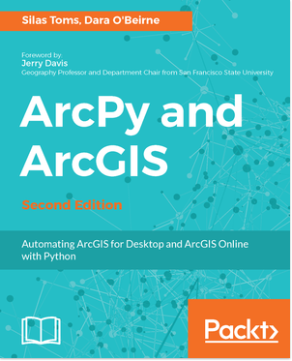

Books are good! Read more books

Slide 4
Topics to be covered
The importance of data
  Who creates it?
  How can we get it for our own uses?
How data is shared and used
  Files vs services
  Open data portals
  What if the data isn't shared on a portal?
Adding services
  to ArcMap
  to QGIS
Feature Servers vs Map Servers
How to query REST services directly
  Online service query interface
Downloading the data using Python
How & why the code is organized
How to pass arguments
Where to find the code

Slide 5
Data is the heart of GIS
The old saying: Garbage in, Garbage out
If you don't have good data, you don't have a GIS
Data sources are varied in accuracy, quality, and accessibility
While some open data portals exist, lots of times you have to use web scraping and downloading to get the data you need
There's a lot of it – big data is real – but it's all over the place

Slide 6
Types of data: Shapefiles
Advantages
  Open Standard
  Widely supported
  Support for all coordinate systems
Disadvantages:
  Made up of multiple files (not convenient)
  Field names limited to 12 characters
  No topology
They're not going away. Sorry. Learn to live with the humble SHP

Slide 7
Types of data: GeoJSON
Advantages
  Open standard
  Becoming widely supported
  Written to be human and machine readable
  Written in the native language of the web: Javascript
Disadvantages:
  Can be large files
  No topology
  Support for only one coordinate system
  Less useful for analysis
Best for web maps and data exchange

Slide 8
Types of data: Data web services
Advantages:
  Publish data from one source, share everywhere
  Instant data updates/dynamic data
  Share with the web and desktop machines
  Pushes data as JSON (GeoJSON or EsriJSON)
Disadvantages
  Can be slow
  Sometimes tiled to be shared
  Limited results for requests (~1000 per request)

Slide 9
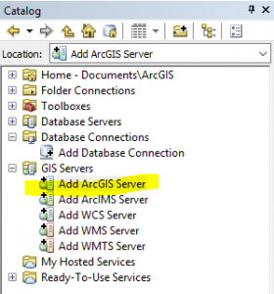
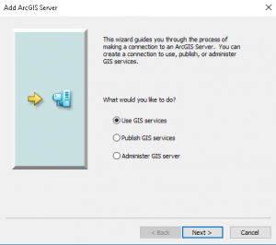
Adding Services to ArcMap
Straightforward to add data services
These services can be added to maps
  Web Maps
  ArcMap/Pro
Not for analysis

Slide 10
Two main types of data services
MapServer services
  Published as image files
  Slower to update do to caching
FeatureServer services
  Published as vector data
  Fast updating

Slide 11
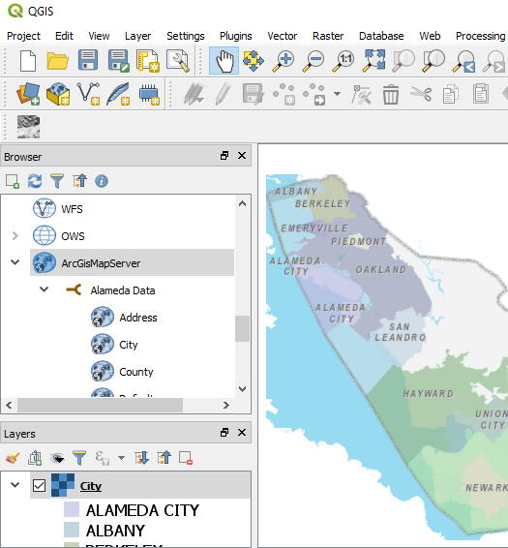
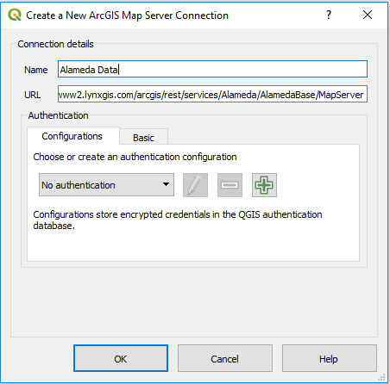
Adding Services to QGIS

Slide 12
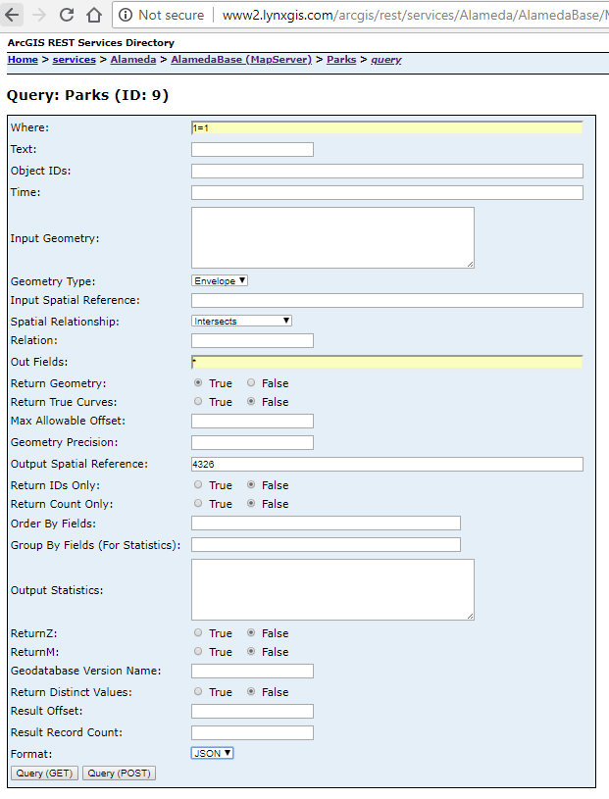
REST Interface Queries
REpresentative State Transfer (REST)
Pass parameters to the service endpoint, get back specified data
Can even do intersects
These requests can be automated

Slide 13
Problem: downloading data from web services
Why download?
  Data request limits
  Data is shared in raster format
  Data is needed locally for analysis
  Data is in wrong coordinate system
I want it. Give it to me. Gimme gimme gimme

Slide 14
Solution: Python
Python makes automation easy
No need for ArcPy/ ArcGIS license
Built-in modules
  The basic tools that make Python powerful
  Handle web requests and JSON returns
Third party modules
  Built on standard tools
  Add ability to read/write/edit shapefiles
  Thousands of these exist, for any data type

Slide 15
Built-in modules used
urllib
requests
json
datetime
csv
sys
os
argparse

Slide 16
PySHP
Pure Python shapefile reading, writing, editing
Install for use
  pip install pyshp
  A local copy is already included in my module
Import in script
  import shapefile
New version (2.0) just released last week
  Breaks my code :)

Slide 17
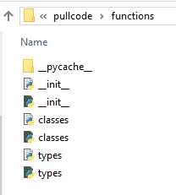
Create our own modules
Our code can be organized into modules
Create a folder and add __init__.py script
This makes the module importable in another script
Place next to script or in module repository
  C:\Python\Lib\site-packages

Slide 18
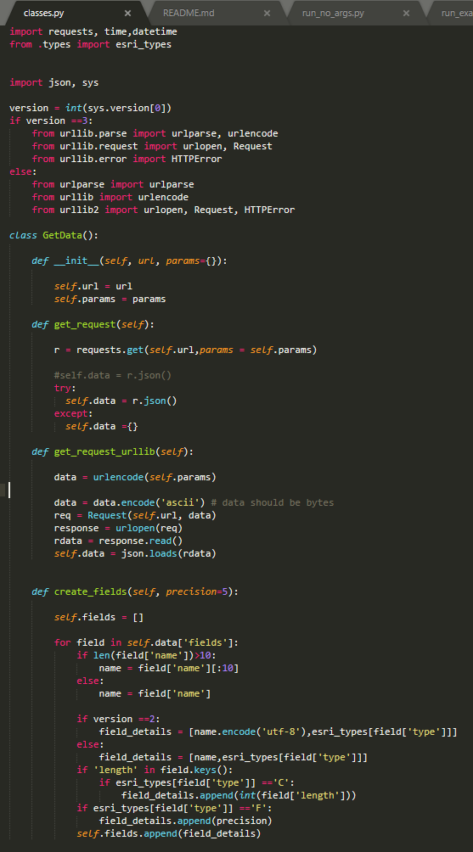
Using Classes
Organizing code in classes makes it easy to create “objects” with built in functions
These objects are instantiated
  object = Object()
The functions of the class are available to the new object
Makes code cleaner and smarter

Slide 19
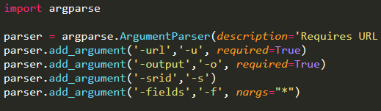
Command Line Arguments
Python allows for custom command line arguments
argparse module is built-in
Arguments are passed to the script when run

Slide 20
How it works
Accepts arguments (URL and output name)
Sends one call to URL to get all Object Ids
Finds total # of features
Sends second call to URL
Determines field names and types
Creates shapefile with fields in memory
Sends calls for data on specific features
  500 at a time
Saves output named shapefile, writing to disk

Slide 21

Example of running the script
Starts with Python executable (must be in “PATH” variable)
Then script is passed to python (python run.py
Then the arguments are passed: -u for URL, -o for output file
Example:
C:\Code\mapservicereader> python run.py -u http://www2.lynxgis.com/arcgis/rest/services/Alameda/AlamedaBase/MapServer/8/query
-o Streets

Slide 22
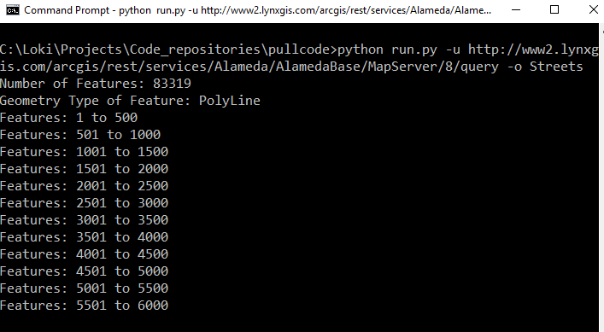
Running the script

Slide 23
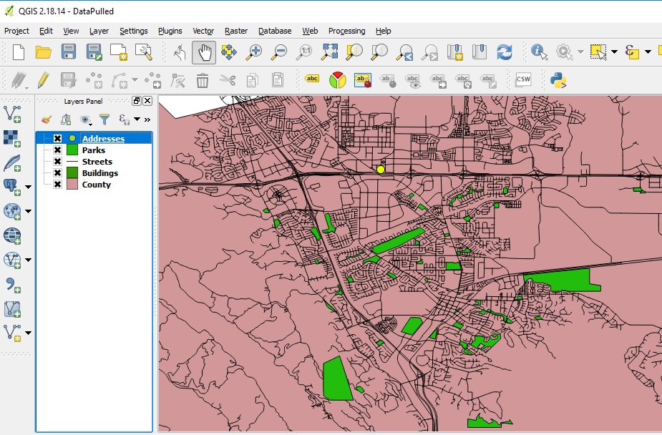
Looking at the Data

Slide 24
To Do (for me!)
Add support for GeoJSON
Add support for CSV
Fix Python 2.7 field issue
Automate for all available services on a server

Slide 25
To Do (for you!)
Download the code
  Use Git and GitHub
  Download as a zip file
Get comfortable with how the various parts work
Improve the code! There's lots of ways to make it better
Have fun with Python

Slide 26
Thanks to:
Annijke Wade and GeoCorps
Anna Wegbreit, author of article
  https://sites.temple.edu/psmgis/2018/08/02/arcgis-server-connections-for-digital-hoarders/
Joel Lawson, author of PySHP module
My mentors and inspirations: Bill Voigt, Beth Stone, Gabriel Paun, Greg Braswell, Todd Barr, Anita Graser, and many more

