Slide 1
Oscar Gonzalez’ ERT skills assessment. August 5th 2022
I am an experienced Scientific Programmer, with a strong background and formal education in Math and Physics. I have used many programming languages, and even created my own GLS Scripting Language with Operator Overloading to process math on LAS petrophysical files. This ERT assessment allows me to show you all, some of my skills on these areas:
Algorithm + System design (The boxes problem)
Applied Math and optimization (The boxes problem), and of course basic Physics to understand the IRI statement.
Programming Languages: (and I handle much more than those)
Java
Groovy
Bash Shell
Fortran
C
PHP
JavaScript
Tools and Web:
Linux make, egrep, vim, etc.
HTML (Handwritten: without edition software)
CSS (Handwritten: without edition software)
Seven programming languages used for ERT
Time line:
Monday July 25: Ye Men interview
Tuesday 26: Desktop computer still dead ☹
Wednesday 27: Desktop computer still dead ☹
Thursday 28: Start with The boxes assessment
Friday 29: The boxes assessment
Week-end, some rest, but less than I needed ☺
Monday: End with the boxes assessment
Tuesday: Start with the IRI assessment
Wednesday: End with the IRI assessment
Thursday: HTML, CSS, JavaScript assessment
Friday August 5th: This results seminar ☺
I could only fit an effective allowance of 6 days, and still I am working with JavaScript.
Overall I fell OK with my results.

Slide 2
Assessment 7: Pack random boxes into a large container
Optimization (fun problem and open-ended solution)
“You need a fairly optimal way to bunch of small boxes into a big box. It doesn't need to be perfect, as coming up with a provably optimal solution is likely a really hard problem. The input is a text file with a listing of integer volumes(width, length, height). The first line is the container volume, the rest are the volumes of boxes to be placed inside. Place as many as you can. Output the best configuration you find to optimize the number of boxes put into the container, and/or the configuration that most fully utilizes the space within the container.
If you write in a low-level language, you can use a library for basic data structures”
Oscar’s solution: Algorithm and Code Implementation: (it took me three days)
I have moved so many times towing an U-Haul trailer with my house-holdings that I took the problem almost personal. The problem turns even more interesting if instead of different boxes, you pack real irregular 3D solids: You may start packing a table flipped down with its legs up, then put a coach, then the chairs, and below and above each chair seat put boxes with math books and so forth. And don’t forget room for your bike.
The problem statement mentions a word that immediately suggests an approach: “Integer width, length, and heights”. It settles the framework to extend from boxes to full irregular 3D shapes. Dealing with integers (instead of real numbers), immediately allows us to model each irregular 3D body in a 3D grid of cells (or 3D pixels). So each body is just a Set or 3D points (or cells): Body = {(ix,iy,iz)}
Start randomly, or perhaps choosing a large Body1 (Count of pixels {(ix,iy,iz)} is a large integer). Perform random body transforms (6 translations East, West, North, South, Up, Down), and 4^3=64 3D rotations along axis x, y, z. Collocate this body on the floor (z layer=0)
Choose a next Body2 and place it in the container or trailer. If the Set intersection between Body1 and Body2 3D cells is not empty, it means that there is a collision between the two bodies: Reject and remove Body2 from the container. If the intersection is empty accept Body2 placement, and then continue to a next Body_i, and so on.

Slide 3
Software Design Diagram: Use class objects
General 3D Solids: Super Class
Point3D
Shape3D
An atomic 3D cell. All solids are built with a Set of cells.
Sub Classes with inheritance
ContainerBox
Box
A large container Box with void space: Sub Class with inheritance from Shape3D.
It is responsible for packing.
A small Box: Sub Class with inheritance from Shape3D. Its cells are a cartesian product X x Y x Z
Language implementation (fully coded, up and running):
A detailed API was written in Java for the core four classes
A builder was written in Bash shell under Linux. (Far more detailed and general than a Makefile)
The access to the API is done though several JVM interpreted script languages:
Groovy (The one I choose)
Python (Jython)
Ruby (JRuby)
Lisp (Clojure)
Scala
Kotlin

Slide 4
Next Step: Let’s check the implementation code and run alive!

Slide 5
Optimization Algorithm
The assessment statement asks to maximize the amount of boxes. That is an over-simplification. You may fit in your trailer perhaps only two mattresses and one coach, but would you prefer to fit one thousand of cheap pencils or colored crayons instead? We may want to define many objective functions to minimize, like:
O1: The amount of 3D shapes. To minimize, just use instead -1.0 * O1
O2: The void space volume of the container after packaging should be a minimum
O3: Safety first!, compute the center of gravity of the filled container, you want its Z coordinate as close as possible to the floor layer Z=0
Combine all desired optimizations in a single global Optimization, for instance:
Oglobal = w1 * O1 + w2 * O3 + . . . + wn * On
Optimization Strategy: Slow thermal cooling of “temperature”: Oglobal (called Annealing)
It usually works nicely and emulates the real physical world: Perform small random arrangements of the objects, including translations and rotations, entering and removing of objects. For each scenario realization compute Oglobal. Iterate for a maximum allowance of CPU time, then just simply choose, the arrangement 3D solids realization that yields the minimum value for Oglobal, that is, let it cool down the “temperature”.
I have worked on Annealing when studying GeoStatistics at Stanford. I could fully implement the code, that honestly would take weeks or even a couple of months, so it is beyond of the scope of the assessment.

Slide 6
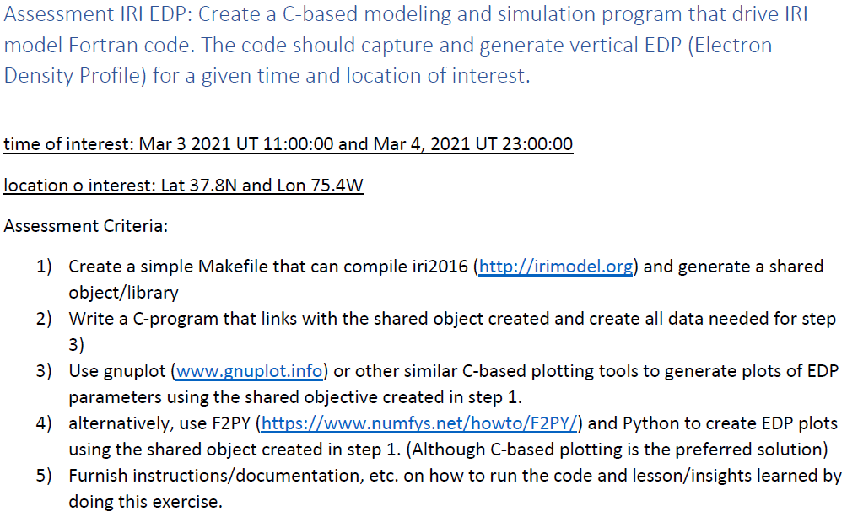
Assessment 1: IRI Electron Density Profile

Slide 7
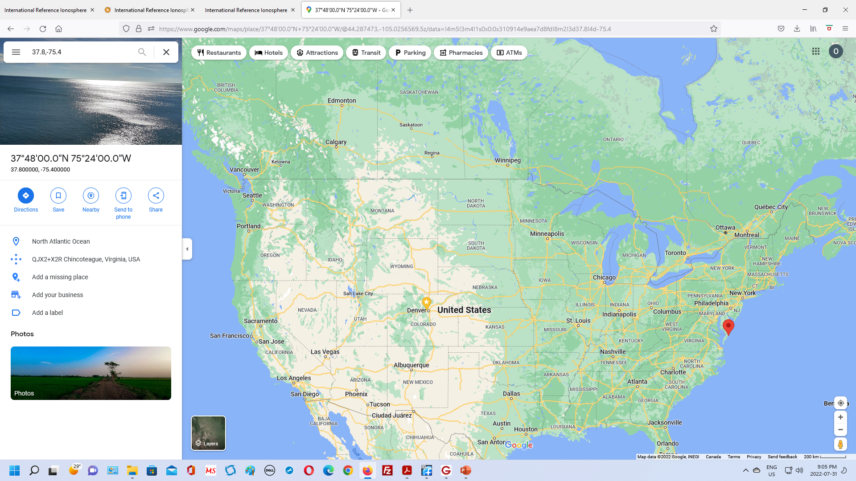
Sexagesimal: degrees and minutes. Not decimal. Enough for the exercise. That’s why it lays on the sea. My mistake.
Oscar is here now
Exercise Location.
Not quite. Why?
You are here

Slide 8
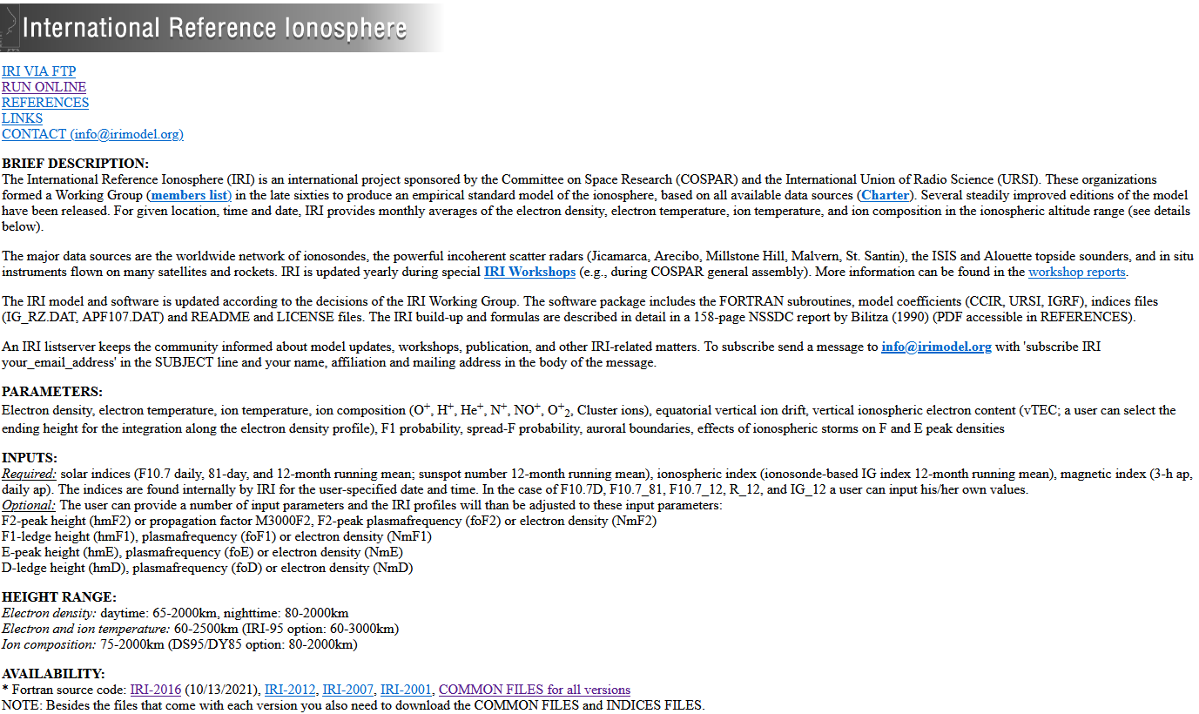

Slide 9
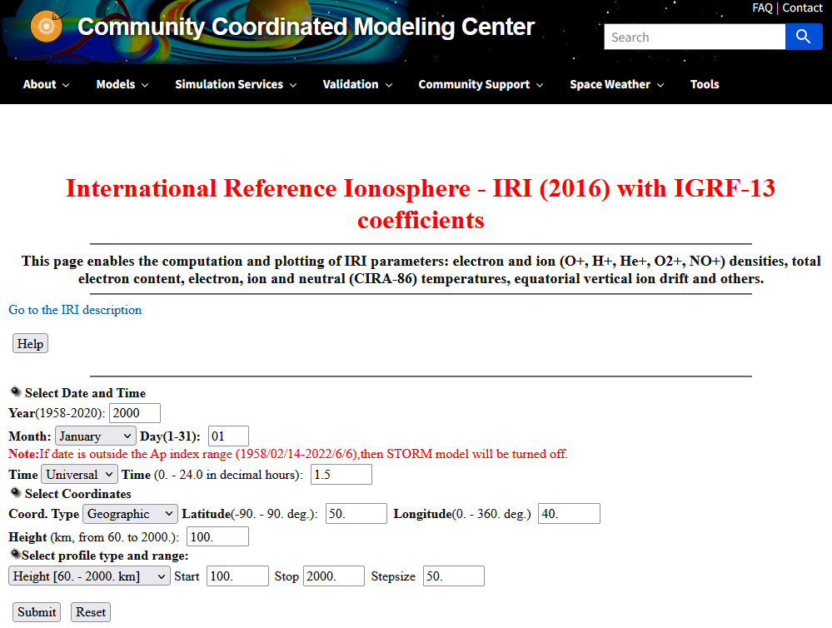

Slide 10
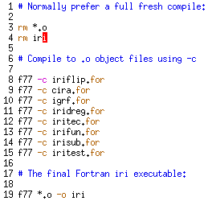
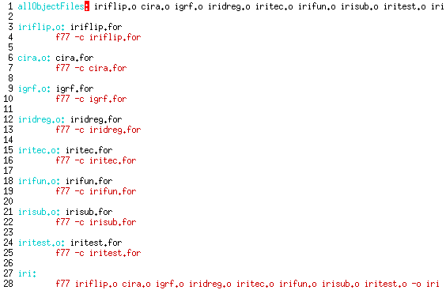
Compile the IRI 2016 Program
Download all the Fortran source code files. Download also all the necessary non-embedded data files.
Install a Linux Fortran compiler. GNU gcc and gfortran makes the work, the create a file soft link “f77” to gfortran in root /bin/
How to compile the code?
Write a .sh Linux Bash script with full control on dates, folders, and more (My recommendation)
Straightforward command line:
Write a Makefile to be run through Linux make:
My opinion: make is a legacy, very old
program with primitive syntaxis, like
using “TAB” character at start of rules.
Check alive the builder-compiler

Slide 11
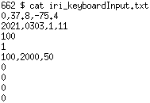
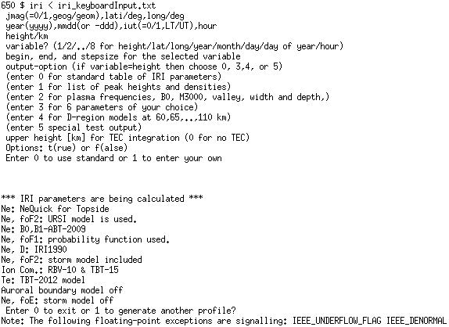
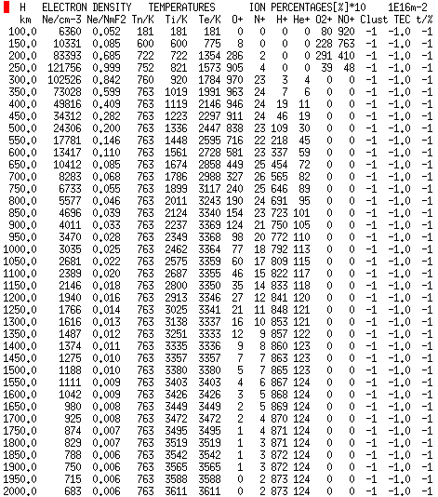
Check alive the ASCII compiled executable
Run it. The source code has unstable numerical underflow IEE floating point number exceptions!, but managed to produce results. Poor math coding?
Create a keyboard input text-file, instead of typing any time you need to run.
Altitude of ionosphere electron density is the classic plot

Slide 12
Write a C program that links for Fortran *.o libraries and drive pre and post processing
Motivation: Certainly we don’t plan to reinvent the wheel. If there is a reliable, reputable, top quality, and fast program already available, don’t touch it unless really necessary. Just write or adapt interfaces in other languages. For a Linux GNU Fortran environment, the natural glue language choices are C and Rust. For quick prototyping then interface the C layer with another layer high level Scripting language, like CPython that may use GNU Fortran and C libraries:
CPython Scripting for XML,& GUI
Rust or C, low level pre, post-processing and fast simulation
IRI-2016
Master math engine
(GNU Fortran)
Interface
Plotting 1D X-Y services & 2D mapping

Slide 13
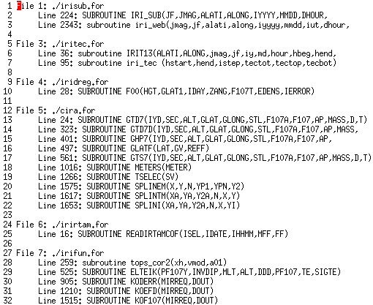
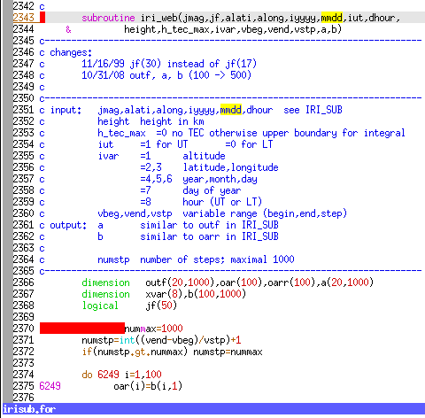
Step 1: Explore the eight Fortran source code files and understand the architecture. Start by searching with Linux egrep the collection of all subroutines and functions:
Both subroutines IRI_SUB and iri_web have suitable entry points to interface with C code driver. Notice how different typing and case styles might reflect the hands of different programmers perhaps along years.
… and much more …
A Linux Bash Shell script that uses egrep

Slide 14
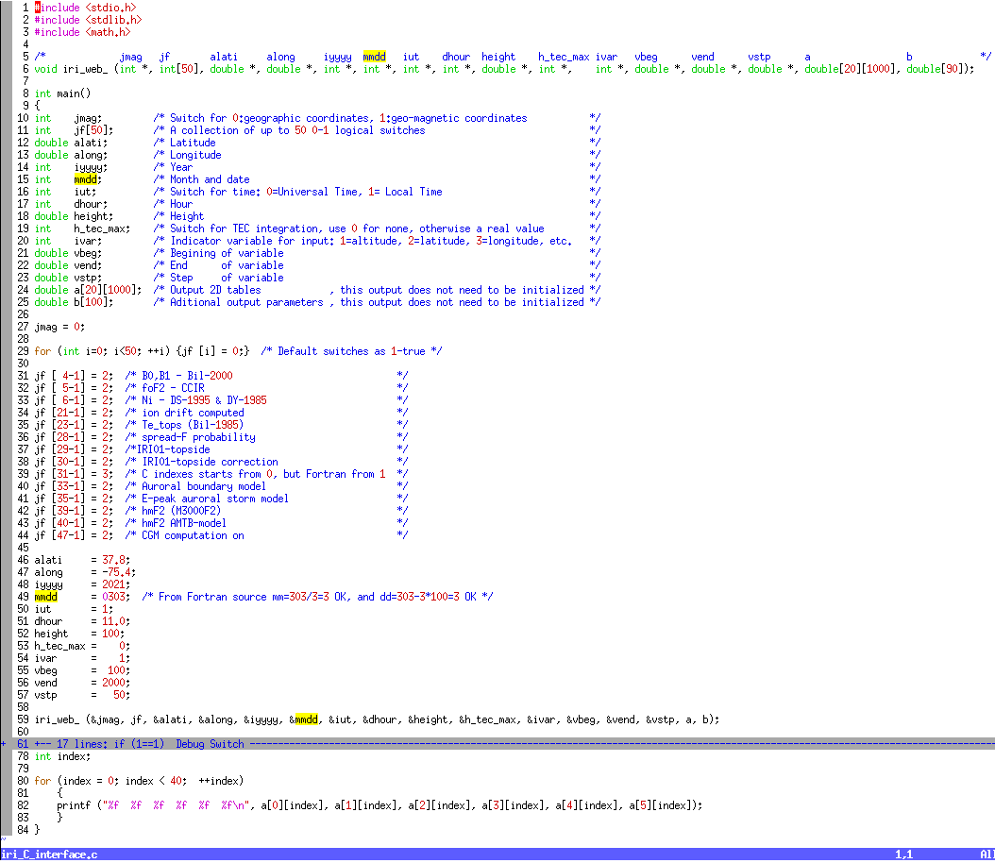
Step 2: Write C interface program. Make sure the Fortran subroutines has an appended underscore “_”. Carefully declare equivalent variable types, and document the source code.
Standard *.h header C files by GNU
Identify and document Fortran variable names, one to one
External C function prototypes equivalent to Fortran
Formally declare variable types, make sure that 1D and 2D arrays have the same dimensions as Fortran source code, even if you don’t like static arrays
Nice: a[][] is the Fortran output subroutine. We have full control for post-processing without reading Fortran text output files.
Override non-default switches. Even better from an outside text file, or an XML file digested by CPython
The exercise geographic location and parameters.
Call to the Fortran engine subroutine
The 2D a[][] output array is captured. You are free to make use of it, pos-processing and crunch numbers.

Slide 15
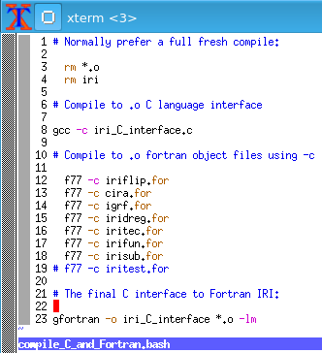
Step 4: Joint Fortran-C compilation. Write a Linux Bash script instead of a MakeFile for full control
I recommend a full fresh compilation
GNU GCC with –c flag creates .o object file
Although gfortran is the GCC Fortran compiler, I wrote a symbolic link for readability in /bin/ directory: ln –s gfortran f77, the check if .bashrc path is OK.
-c flag creates all fortran *.o object files
Link all *.o object files and –lm default libraries
Final “-o” output is the executable file in Linux
Make sure to use gfortran, not gcc here. The reason is that gfortran brings specific fortran defaults and libraries that GCC does not have in C neither C++

Slide 16
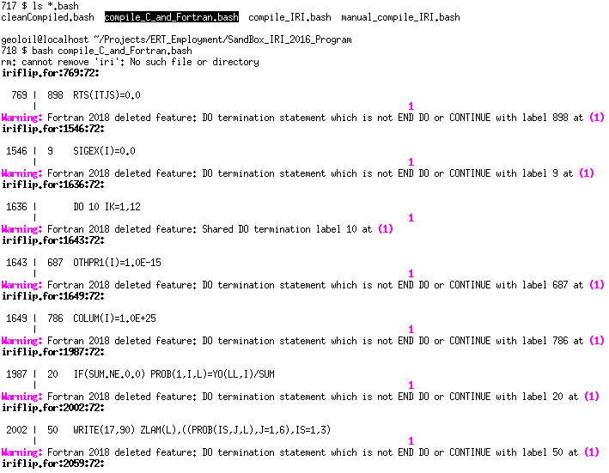
Many Warning compilation messages for the Fortran source codes. The C program interface had no warnings at all.
Ignore most warnings for legacy old Fortran sources, but make sure that your C code is seamless.

Slide 17
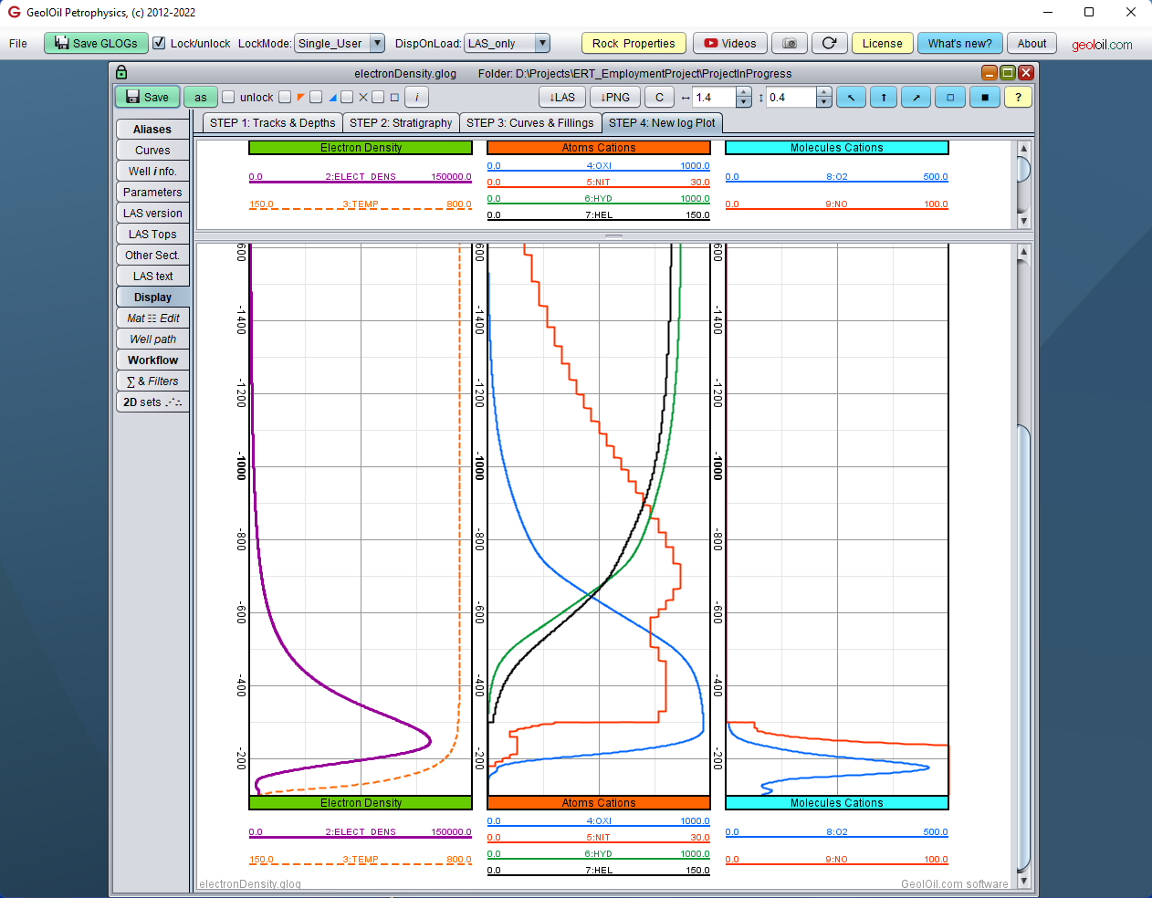
Height Plots of Properties
I used my commercial petrophysics software for the exercise. It is a huge Java package of 150,000+ lines of source code and 200+ classes.
It is used in the Oil & Gas industry for depths, not heights or elevations. That’s why I had to enforce a negative sign on the Z vertical axis.
Staircase type numerical artifacts present in the Fortran library. The C interface post-processing program could easily smooth this behaviour using Kernel functions.

Slide 18
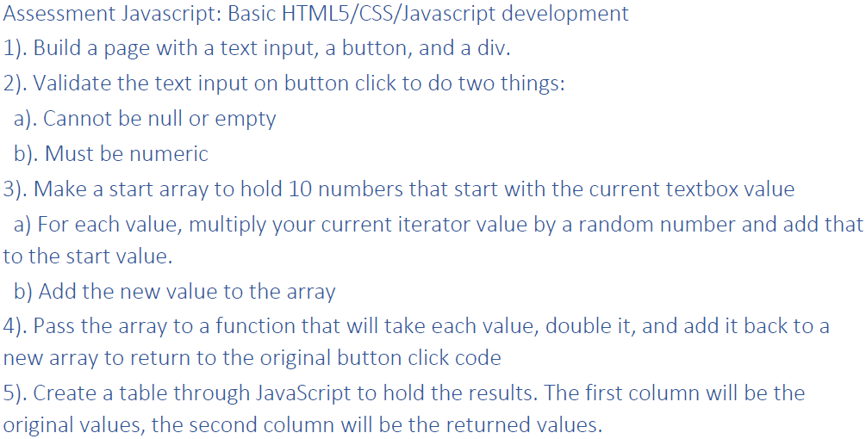
Assessment 5: HTML5/CSS/JavaScript
I wrote basic illustrative code on HTML5, CCS, JavaScript, and even PHP. All of then ASCII Hand-Written, not using Web edition software.
HTML controls the basic structural block of the web page. I put head, example images, input and output boxes, and internal and external links.
CSS control the font types, colors, but more interesting and valuable, I programmed a “Responsive Design”. This is not only nice, but necessary to ensure that the page is readable on any device, from a large Desktop Screen to a tiny Mobile Phone Screen.
JavaScript programmatically validates HTML inputs from the client side, without connecting to the remote server.
PHP receives HTTP POST data from HTML, it is processed (before JavaScript previously validated boxes inputs) on the server side and send results . I used a minimal of PHP features to include common files. Something HTML can’t do.

Slide 19

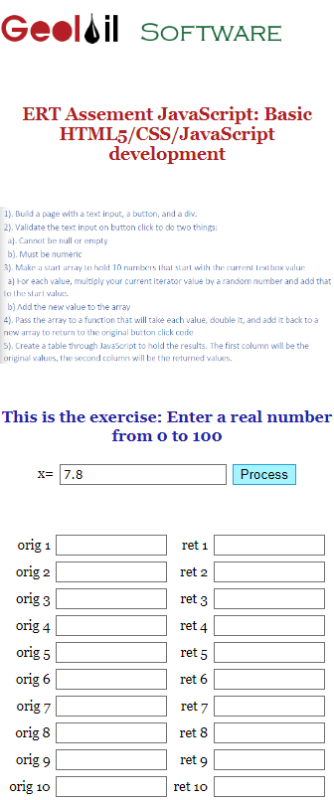

Logo images are gracefully and automatically resized for Desktop, Tablet, or Phone screens
Left: Desktop Screen/Cell Phone Screen: Right
Menu navigation bar on left Desktop does not fit in the phone screen, so CCS relocates it at the bottom of the mobile, instead of disappear.
… to the very bottom of mobile screen…
CSS responsive design ensures an automatic adjustment of font to be readable even on a tiny phone
Clickable image links
Font types & colors controlled by CCS

Slide 20
Next Step: Let’s check the implementation code alive!

Slide 21
That’s all. Thanks for watching!
Oscar Gonzalez
Phone: 303-931.0333
Email: Oscar@geoloil.com
Web-Site: https://geoloil.com

