Slide 1

Addresses
The Findability factor in OpenStreetmap
This document licensed in entirety by Creative Commons CC-by-SA. For specific terms of license, see: http://creativecommons.org/licenses/by-sa/3.0/

Slide 2
Overview
What is an Address and Why Do We Care?
Characteristics of US Addresses
Why We Need to Expand Our Tagging
How to Improve Our Address Tagging Practice
Benefits to the OSM Community

Slide 3
Addresses vs. Address Ranges
Addresses are point features
Uniquely apply to one place (mostly)
1:1 match description to coordinates
May reference a street (or linear feature)
Address ranges are linear features
Describe a sequence of addresses
Associated with a street (or linear feature)
Our concern here is with address points

Slide 4
Why care about addresses?
Addresses are the most granular geographic features
Support routing – E911 & Emergency Services
Support supply chain management – Delivery
Support work order management - Logistics
Support statistics and surveys – Census, Polling
Numerous navigation, wayfinding, and mental maps

Slide 5
Characteristics of US Addressing Practice
US has several street naming schemas:
Quadrant system – base lines dividing city into sections
Coordinate, or Lyman system – Addresses reference numbered streets to provide relative coordinates
Theme/alphabetical – Presidents, natural features, place names, etc. Alphabetical sequencing
Neighborhood Unit – Self-contained neighborhoods with thematic street names (local landmarks, historical events, etc.)
US has numerous property numbering schemas
Frontage intervals
Block intervals
Decimal

Slide 6
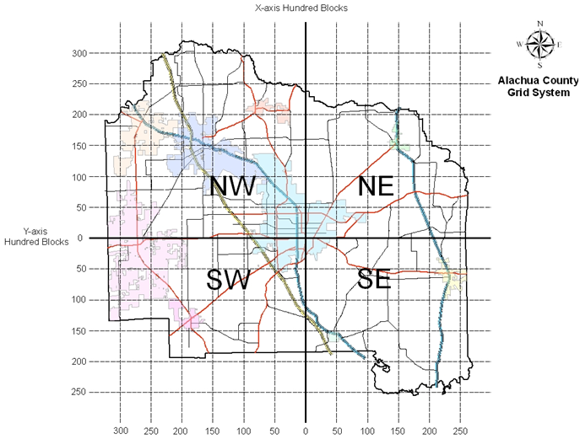
US Street Naming schemas
Quadrant System
Divides city into four quadrants on baseline streets
Streets numbered/ named off of baseline
Image source: Alachua County, FL

Slide 7
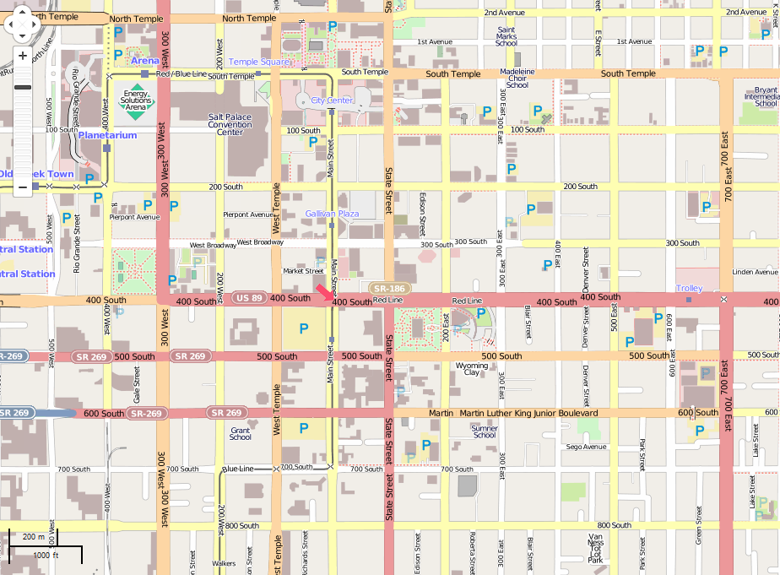
US Street Naming schemas
Lyman, or Coordinate System
Baseline streets on grid
Numbered streets in 100’s
Complicated, but useful without a map

Slide 8
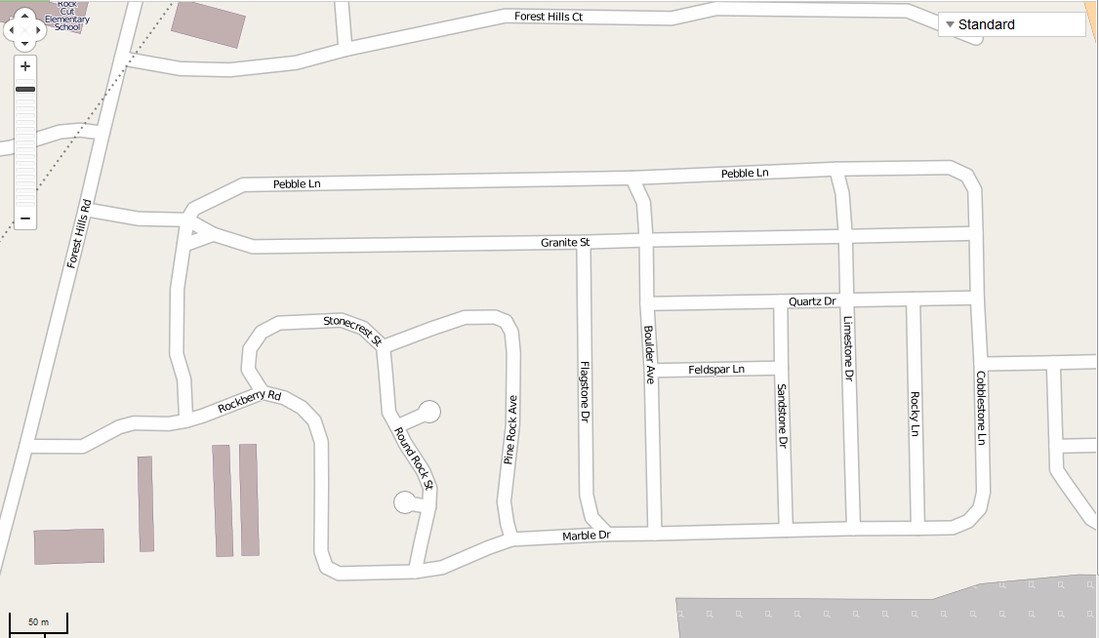
US Street Naming schemas
Neighborhood Unit
Subdivisions, or areas where topography does not lend itself to grid
Local landmarks, historical events, thematic

Slide 9
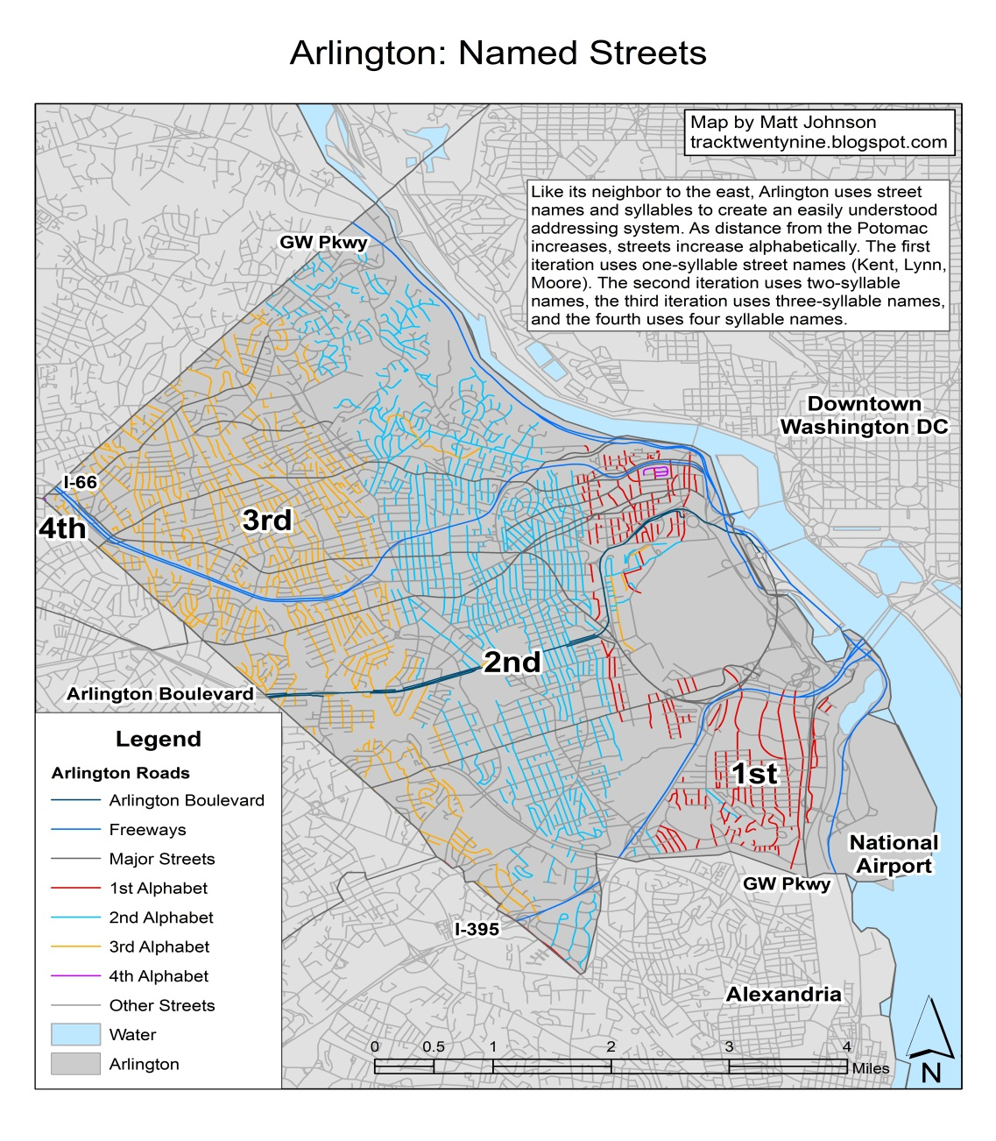
US Street Naming schemas
Alphabetical Sequencing
Alphabetical order
Multiple syllables used to overcome limits of 26 character alphabet
Image source: Matt Johnson @tracktwentynine

Slide 10
Property Numbering: Frontage Intervals
Source: City of Muncie, IN Uniform Numbering Code
SECTION 156.05: AXIS AND PROGRESSION
The first numbers on Walnut Street at Main Street shall be in the 100 series and shall increase to the north and south therefrom but shall not exceed 100 numbers to each block; 16 blocks to the mile, or approximately 330 feet per block. The first numbers on Main Street at Walnut Street shall be in the 100 series and shall increase to the east and west therefrom but shall not exceed 100 numbers to each block; 16 blocks to the mile, or approximately 330 feet per block. Whenever a block is not 330 feet the block series for this segment shall be established at local intervals as the case may require.

Slide 11
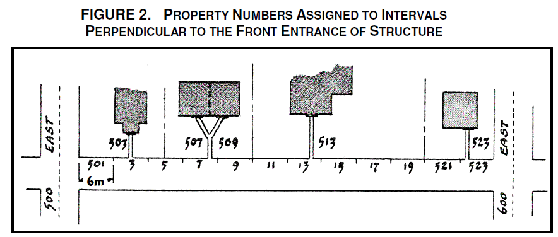
Property Numbering schemas
Century, or Equal Interval System
Image source: Osoyoos Ordinance

Slide 12
Property Numbering: Philadelphia Blocks
Philadelphia blocks, or decimal system
Metric blocks
Image source: Reuben S. Rose-Redwood

Slide 13
What to Conclude?
In the US, there is a high degree of local variation
…in street naming schemas
…in property numbering schemas
There is unlikely to be any US national street naming/property numbering schema
Local control is well-established
US National Grid is too cumbersome for most people
Need the ability to accurately describe any system of addresses

Slide 14
Limitations of Current Practice
Addresses in the US do not increment uniformly by 2
Implications for interpolation
Tag addr:street is overloaded with:
Street Name
Street Type
Directional prefix
Directional suffix

Slide 15
Limitations of Current Schema
Tagging in current (& widespread) usage is unsuitable for variety of address schemas
Not descriptive of local conditions
Cities with Lyman systems (e.g. Salt Lake City), hard to parse street names
Street name and street type combined in one tag
Expand? Or, not expand?
“Saint” vs. “St.” vs. “Street”
“Northwest” vs. “NW”
Ambiguous Street Names
“The Plaza” – Charlotte, NC
“Boulevard” – Richmond, VA

Slide 16
What do we need from an Address Schema?
The premise of a good address schema should be:
Flexible
Descriptive
Understandable
Granular
Reflect local practice

Slide 17
Proposed Tags for Addresses
The addition of three tags
addr:street_type – e.g. ‘Avenue’, ‘Street’, ‘Lane’, ‘Drive’, ‘Road’, etc.
addr:dir_pre – Directional prefix, e.g. ‘N, ‘North’, ‘NW’, ‘Northwest’, etc.
addr:dir_suf – Directional suffix, e.g. ‘S’, ‘South’, ‘SE’, ‘Southeast’, etc.
Limit the use of addr:street
Name of street ONLY

Slide 18
Examples
Sample Address: “6345 W. Euclid AV”
addr:housenumber = “6345”
addr:dir_pre = “W”
addr:streetname = “Euclid”
addr:street_type = “Avenue”
Sample Address: “468 13th St NE”
addr:housenumber = ‘468’
addr:streetname = ‘13th’
addr:street_type = ‘Street’
addr:dir_suf = ‘NE’

Slide 19
What are the Benefits?
Expands the descriptive power of addresses…
More granularity
Less overloading of tagging schema (e.g. addr:street
Minimal increase in effort
Better reflect the way US addresses are assigned
Consistent with local government practice
Facilitate local government as address data source
More accurate description of local conditions
Greater flexibility accommodates variations in local practice

Slide 20
Summary
Street naming and address assignment vary widely across the US
Local variation in schemas
Local authority for addressing
Current practice is inadequate
Omits valuable data
Inflexible for local conditions
Adding just three tags yields great improvements
Greater descriptive power
Flexibility for local mappers

Slide 21
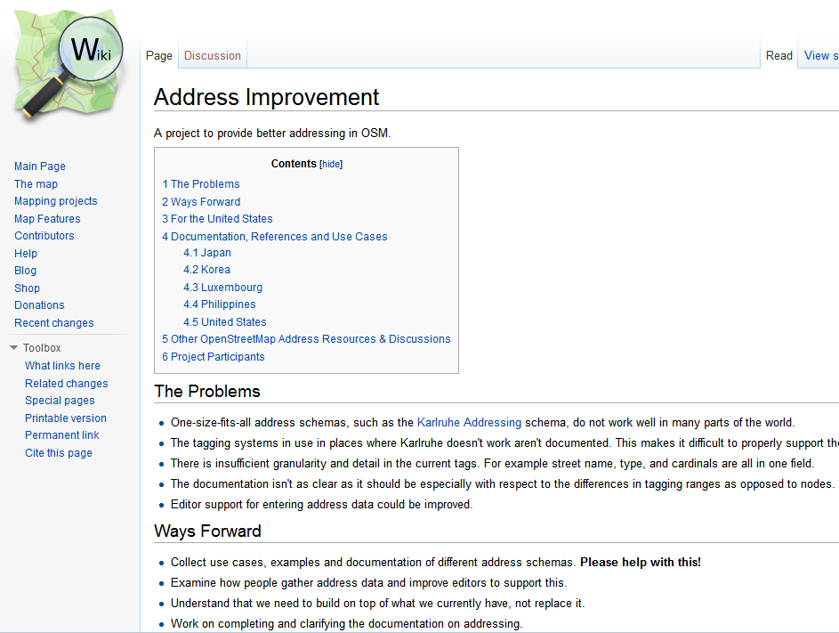
Addressing References/Resources
Address Improvement Wiki Page

Slide 22
Addressing References/Resources
Street-Naming and Property Numbering Systems. Margaret A. Corwin. Planning Advisory Service, Report No. 332.
US Thoroughfare, Landmark, & Postal Address Data Standard
http://www.fgdc.gov/standards/projects/FGDC-standards-projects/street-address/FGDC_endorsedAddressStandard.zip
Governmentality, the Grid, and the Beginnings of a Critical Spatial History of the Geo-coded World. PhD dissertation, Reuben S. Rose-Redwood
https://etda.libraries.psu.edu/paper/6981/2245

Slide 23
Thank You
Questions?
Steven Johnson
(e) sejohnson8@gmail.com
(t) @geomantic
This document licensed in entirety by Creative Commons CC-by-SA. For specific terms of license, see: http://creativecommons.org/licenses/by-sa/3.0/

