Slide 1
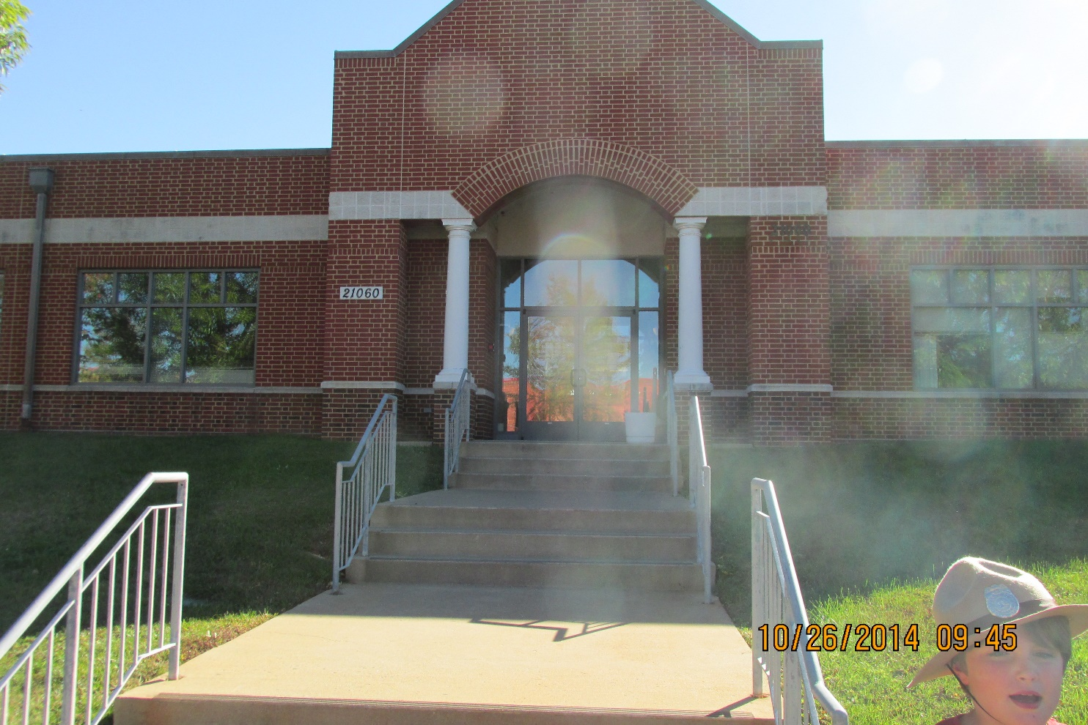

GET OUTSIDE AND EXPLORE: FIELD PAPERS
http://fieldpapers.org/

Slide 2
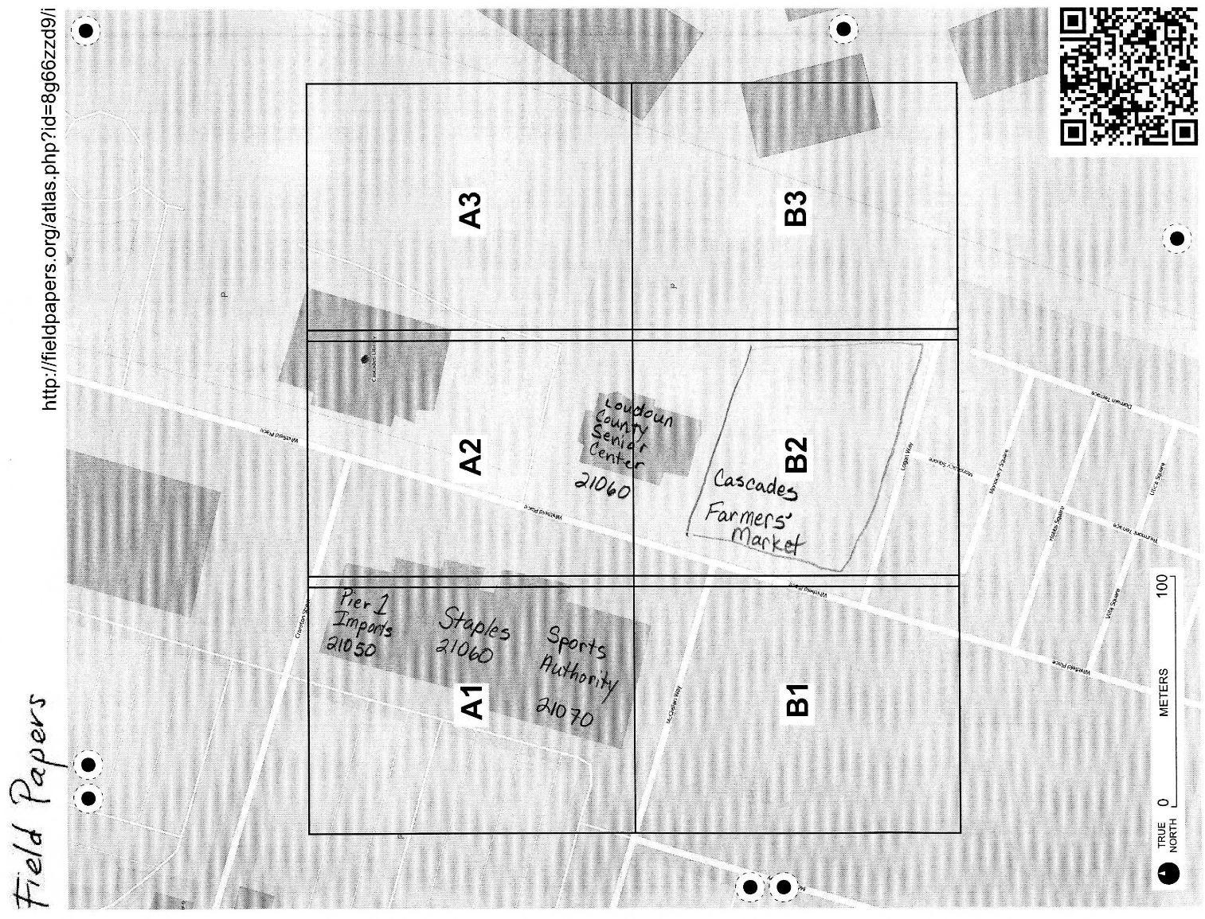
GET OUTSIDE AND EXPLORE: FIELD PAPERS

Slide 3
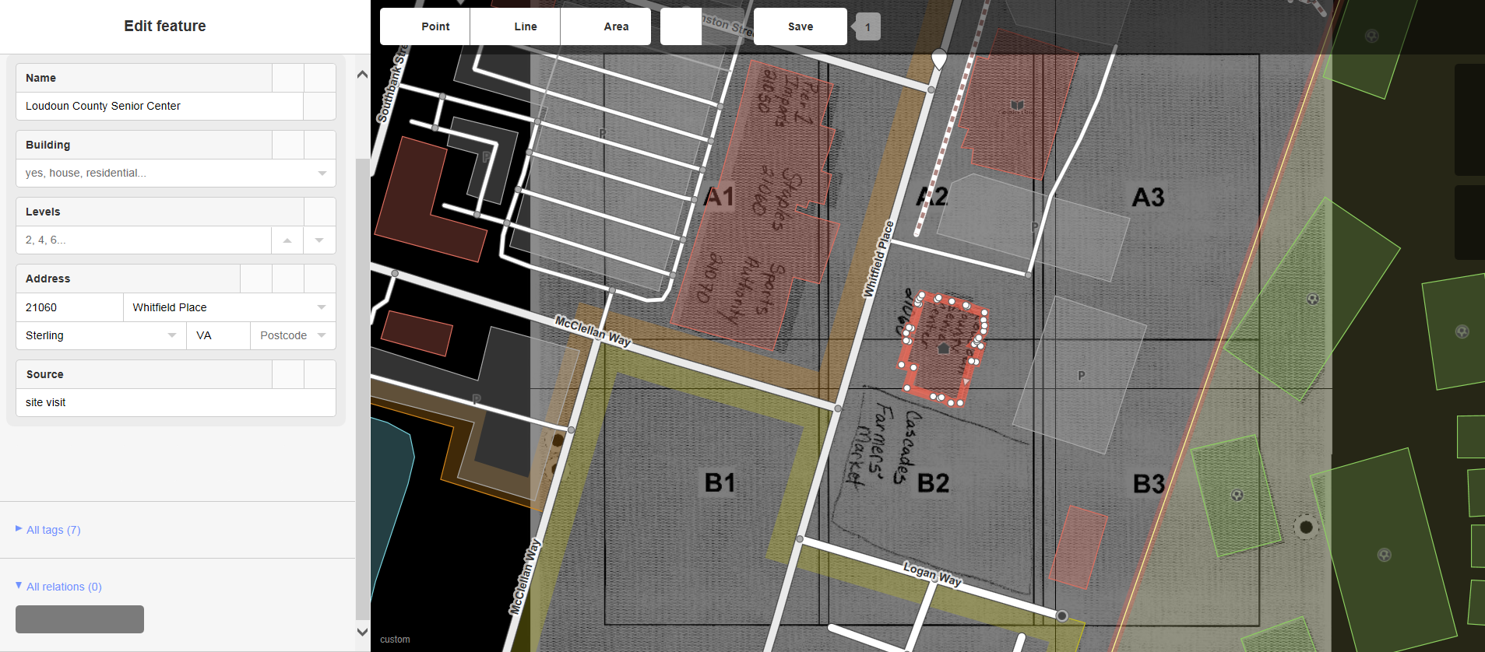
GET OUTSIDE AND EXPLORE: FIELD PAPERS
On site observations:

