Slide 1
Quick Analysis Indonesia’s Population Indicators
Georgia Martha Sari <gmartha.sari@gmail.com>

Slide 2

Project target
Question to be answer and hypothesis
Is there any strong correlation between population indicators and time?
Does the babies death rates decrease with increasing number of community health center?
Process of analysis
Clean data
Search available data
Preliminary images
Regresion results

Slide 3
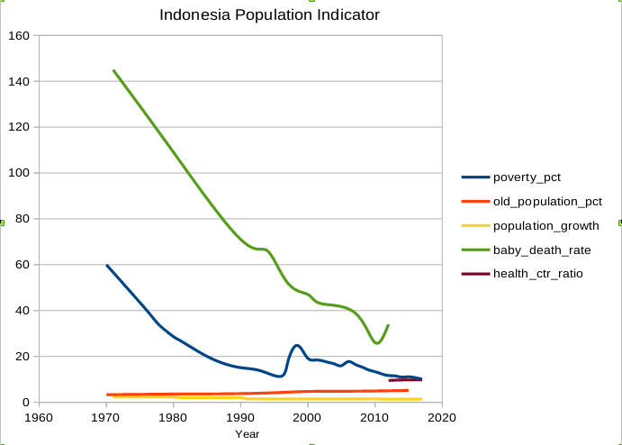
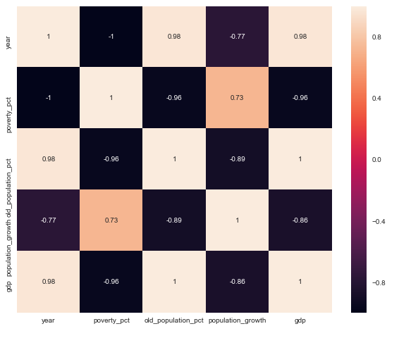
Time related and correlation analyses
© 2017 Udacity. All rights reserved.
1

Slide 4
Conclusion
Quick Analysis Indonesia’s Indicators
From the analysed data, there seems a strong correlation between babies death rates and the number of health facilities

Slide 5
Data Sources
Quick Analysis Indonesia’s Population Indicators
* Basic Statistics, Asia and the Pacific, Year 2018, https://data.adb.org/dataset/basic-statistics-asia-and-pacific
* Population Aged 65 and Older, 1950-2100, https://data.adb.org/dataset/population-and-aging-asia-and-pacific
* Poverty Data in Indonesia, 2007 -2018, https://www.bps.go.id/dynamictable/2016/08/18/1219/persentase-penduduk-miskin-menurut-provinsi-2007---2018.html
* Indonesia's babies and infants death rates 1971-2012, https://www.bps.go.id/statictable/2009/02/20/1270/angka-kematian-bayi-menurut-provinsi-1971--1980--1990--1994--1997--2000--2002--2007--2010--2012-dan-kematian-dibawah-usia-lima-tahun-menurut-provinsi-1971--1980--1990--1994--1997--1999--2007--dan-2012--.htmll
© 2017 Udacity. All rights reserved.
<number>

