Slide 1
Trends in Object-Oriented Software Evolution: Investigating Network Properties
Alexander Chatzigeorgiou George Melas
University of Macedonia
Thessaloniki, Greece
NIER track - 34th International Conference on Software Engineering (ICSE 2012)

Slide 2








Facts
The growth of social networks is phenomenal
Research on Graph Properties
Social
Network
Analysis
social networks are Graphs

Slide 3
… but networks (and software) are not static
Research has focused into the evolution of networks in order to derive models that govern their growth
Software systems can be naturally represented as graphs
Trends in software evolution can be studied using SNA
Macroscopic phenomena at the network level might reveal:
  the presence of design problems
  the application of maintenance activities
  the need to formulate “evolution-oriented” design rules

Slide 4
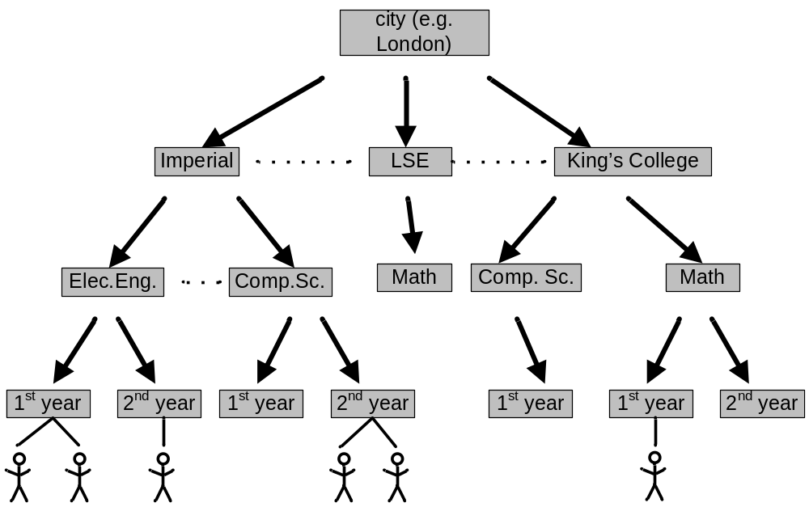
Community Guided Attachment
Social setting: individuals tend to be similar to their friends (homophily)
  we select friends that have similar characteristics (selection)
  we modify our behavior (social influence)

Slide 5
Community Guided Attachment - 2
Obviously software modules do not select their collaborators and do not modify their behavior for social reasons
But, designers of classes make them interact with other classes that are conceptually similar
Usually modules are organized in distinct communities (e.g. packages, namespaces)

Slide 6
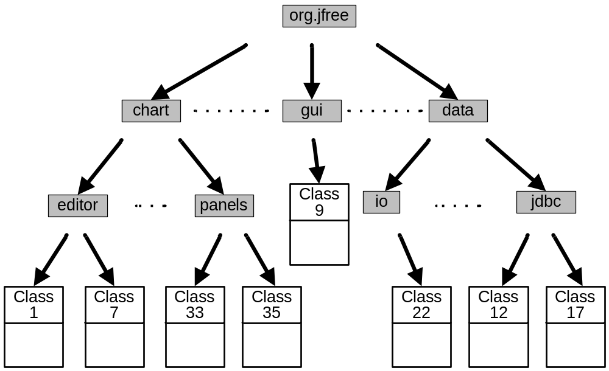

Community Guided Attachment - 3
Intuitive Assumption: Cross-package links should be harder to form than intra-package links
h = 3
h = 2
h = 1
distance = 2

Slide 7
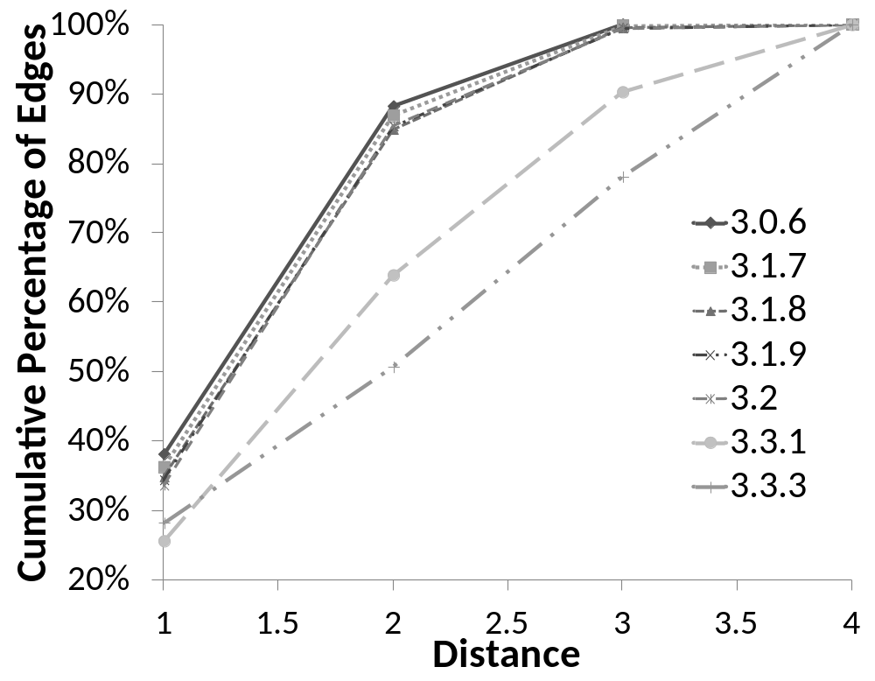

Community Guided Attachment - 4
CGA = large percentage of links among classes in the same package
1st version:
40% of the links connect classes residing in the same package
CGA becomes weaker
last version: only 30% of the links connect classes residing in the same package

Slide 8
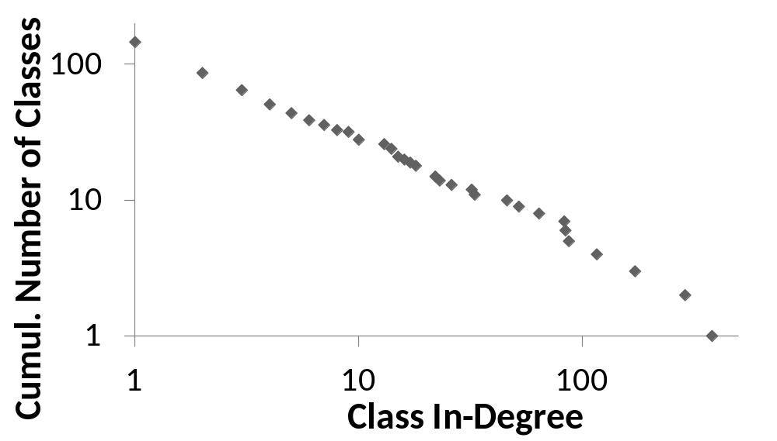
Preferential Attachment
One of the most extensively studied issues in Network Analysis is whether networks are scale-free
According to many researchers, in a scale-free network the degree distribution follows a power law *
The largest percentage of classes have low in-degree
* however power laws in the degree distribution are not sufficient to prove the existence of scale-freeness “Mathematics and the Internet: A Source of Enormous Confusion and Great Potential”, Willinger, Alderson, Doyle, Notices of the AMS, 56, 2009

Slide 9
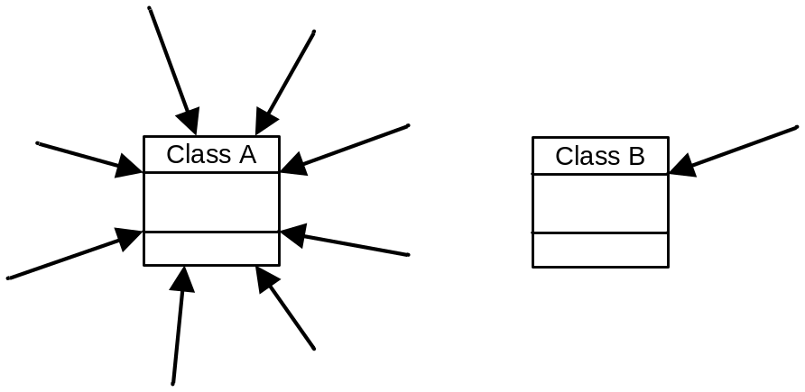

Preferential Attachment - 2
What leads to scale-free networks and power law phenomena ?
PA model: when a network evolves, the number of new links attracted by each node is proportional to its degree
“Rich-gets-richer”: For an OO system implies that God classes act as attractors for new classes that join the network

Slide 10
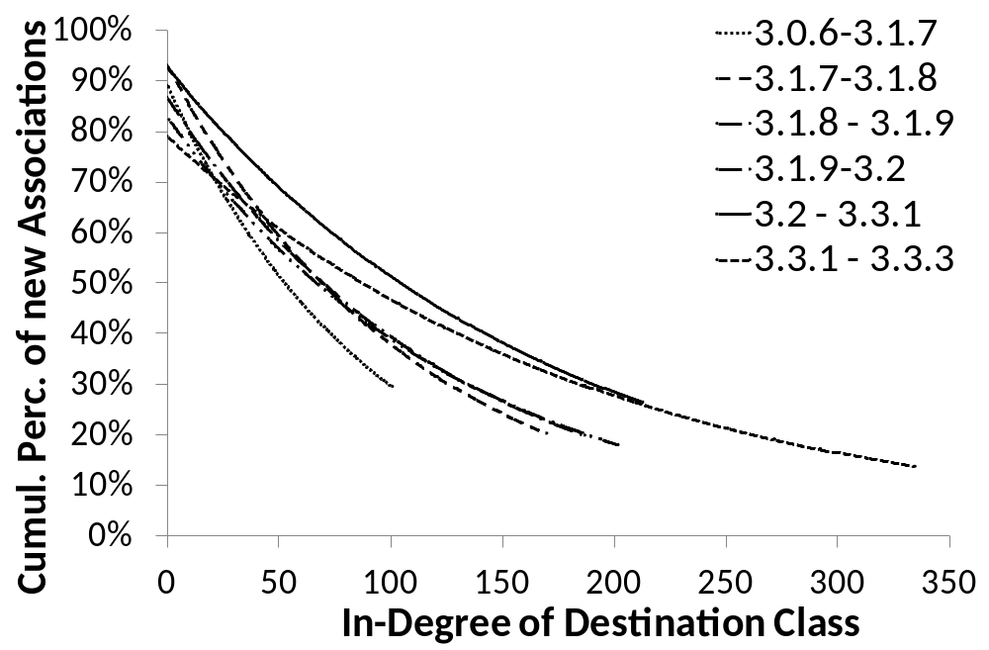
Preferential Attachment - 3
Is PA present in software ?
last version: 50% of new associations attached to nodes having in-degree 100+
last version: 20% of new associations attached to nodes having in-degree 250+
first version: around 50% of new associations attached to nodes having in-degree 50 or higher

Slide 11

Small World Phenomena
A network is said to exhibit the small-world phenomenon if any two nodes have a high probability of being associated through a short path
Popularly known as six degrees of separation

Slide 12
Small World Phenomena - 2
According to Watts and Strogatz this property stems from homophily and the presence of weak ties (edges that connect distant nodes)
Both properties are present in OO systems:
  Classes tend to link to classes in the same neighborhood
  Links are also formed between classes of different packages

Slide 13
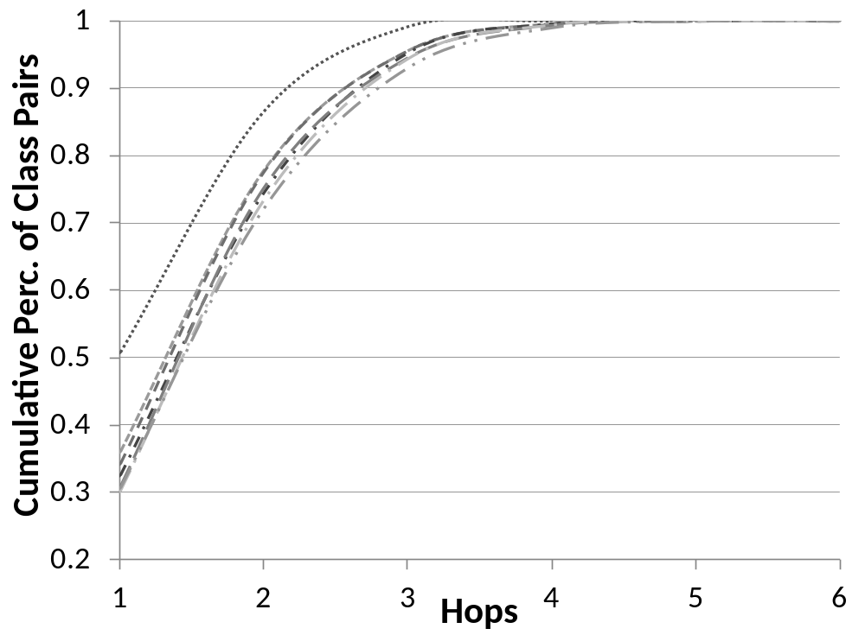
Small World Phenomena - 3
last version: 100% of class pairs are at most 4 hops apart
first version: 100% of class pairs are at most 3 hops apart
Small world phenomenon becomes less intense

Slide 14


Small World Phenomena - 4
Small-world phenomena are expected when the underlying model of growth follows a “forest-fire” model

Slide 15
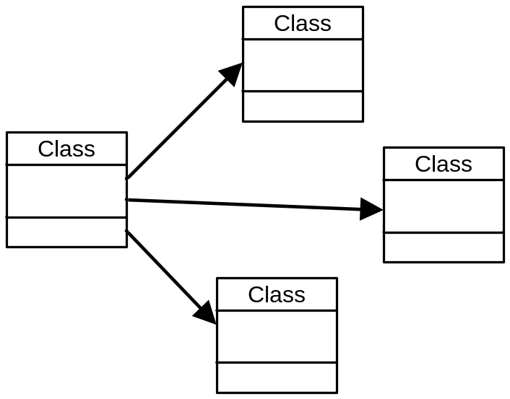
Small World Phenomena - 5
This is not how OO software evolves

Slide 16
Conclusions
The analysis of evolving software to reveal the underlying trends can be a challenging task
Network Analysis can provide valuable insight into evolution phenomena – possibly related to qualitative properties
No model sufficient to explain how software evolves
Major difference between software and social networks: In software we can intentionally modify structure
  Investigate the impact of design improving activities

Slide 17
Thank you for your attention
NIER track - 34th International Conference on Software Engineering (ICSE 2012)

