Slide 1
Equivariant Transformer Networks
ICML 2019

Slide 2
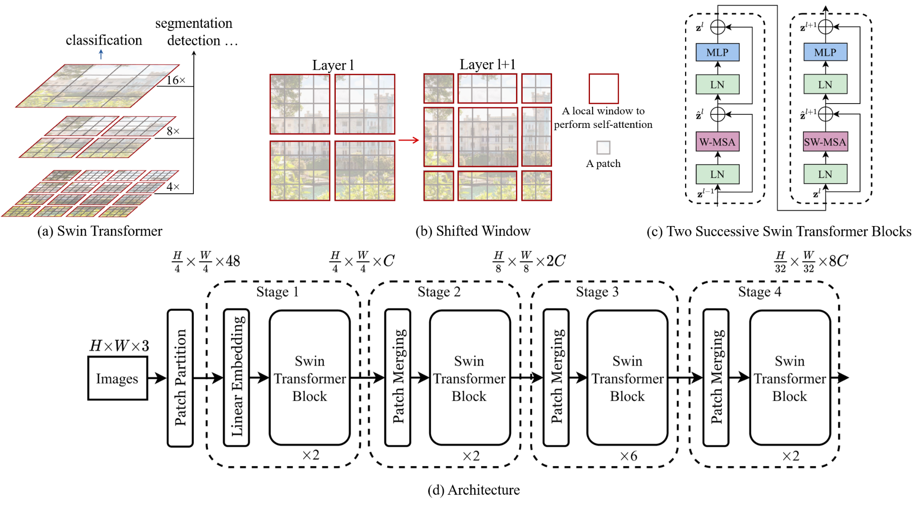
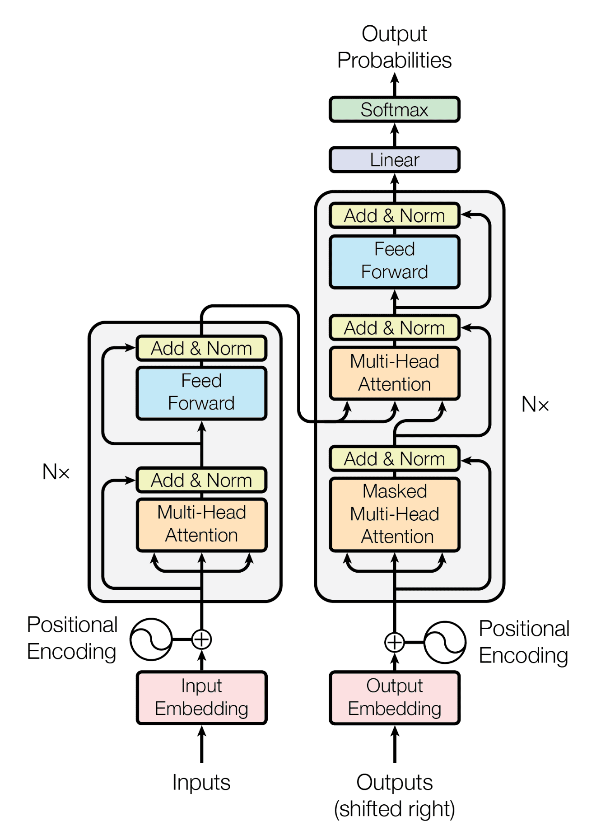
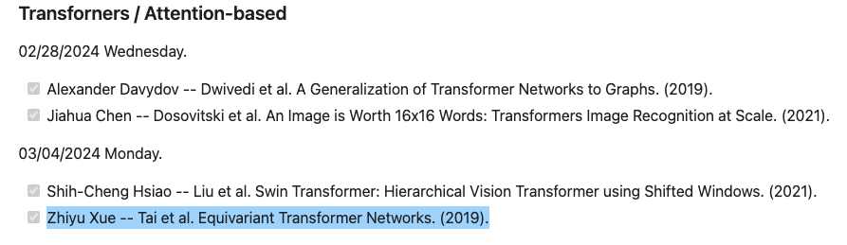
Transformer?
No!
Vaswani, A., Shazeer, N., Parmar, N., Uszkoreit, J., Jones, L., Gomez, A.N., Kaiser, Ł. and Polosukhin, I., 2017. Attention is all you need. Advances in neural information processing systems, 30.
Liu, Z., Ning, J., Cao, Y., Wei, Y., Zhang, Z., Lin, S. and Hu, H., 2022. Video swin transformer. In Proceedings of the IEEE/CVF conference on computer vision and pattern recognition (pp. 3202-3211).

Slide 3
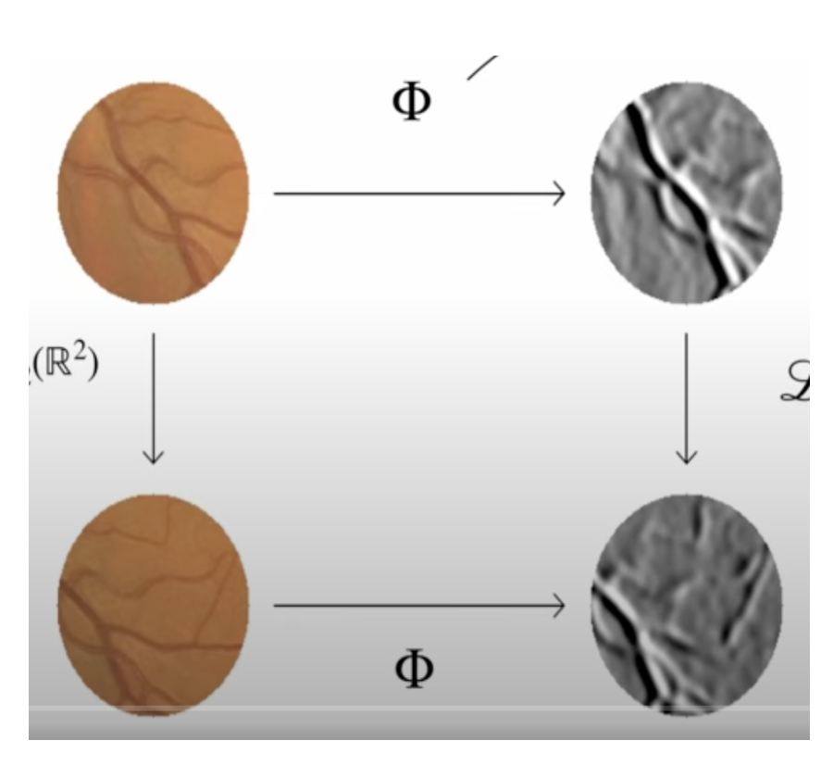
What is Equivariant Transformer (ET)?
Definition: A family of differentiable image-to-image mappings. Equivariance!
Why ET:
Guarantee that transformation equivariance (e.g. Group Equivariant CNNs [1][2])
Group Equivariant CNNs only achieve equivariance on rotation and translations.
ET achieve transformation equivariance on arbitrary pre-defined groups of continuous transformations
Cohen T, Welling M. Group equivariant convolutional networks. InInternational conference on machine learning 2016 Jun 11 (pp. 2990-2999). PMLR.
Cohen TS, Welling M. Steerable cnns. arXiv preprint arXiv:1612.08498. 2016 Dec 27.
Daniel’s Slides, https://github.com/geometric-intelligence/ece594n/tree/main/hw_papers/Cohen-Group_Equivariant_Convolutional_Networks-2016/presentation
Transformation Equivariance [3]

Slide 4
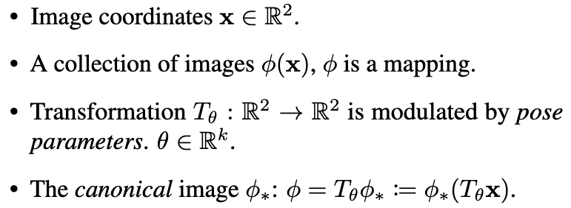
Canonical Image

Slide 5
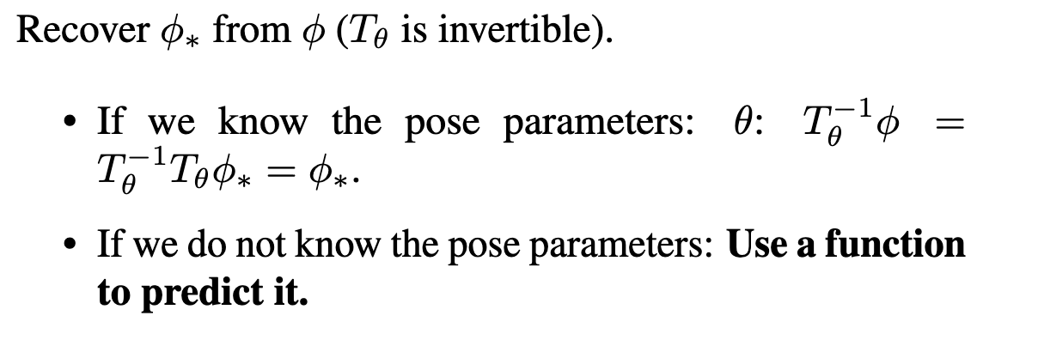
Canonical Image

Slide 6
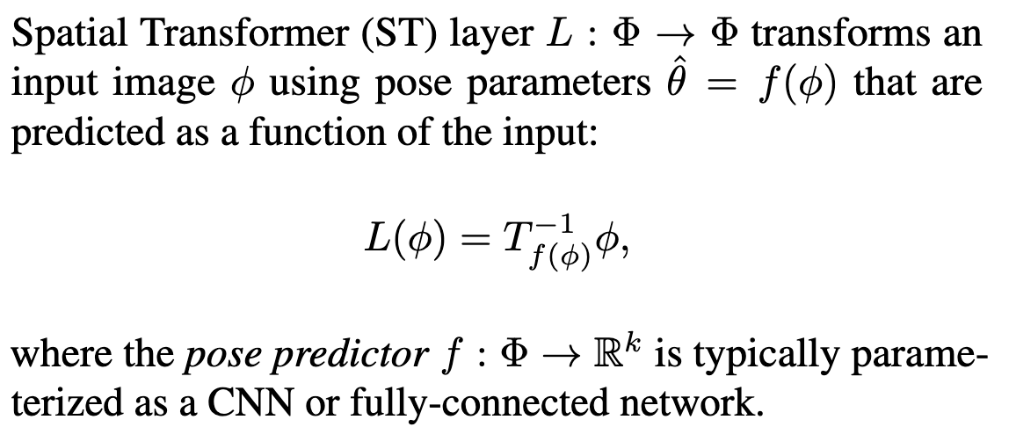
Spatial Transformer (ST) Layer

Slide 7
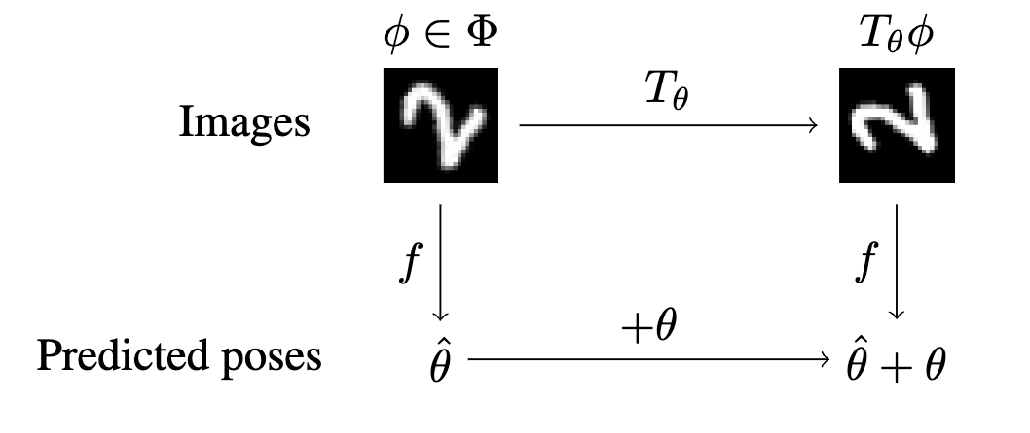
Is ST Layer Good?
No: It does not satisfy self-consistent pose estimation

Slide 8
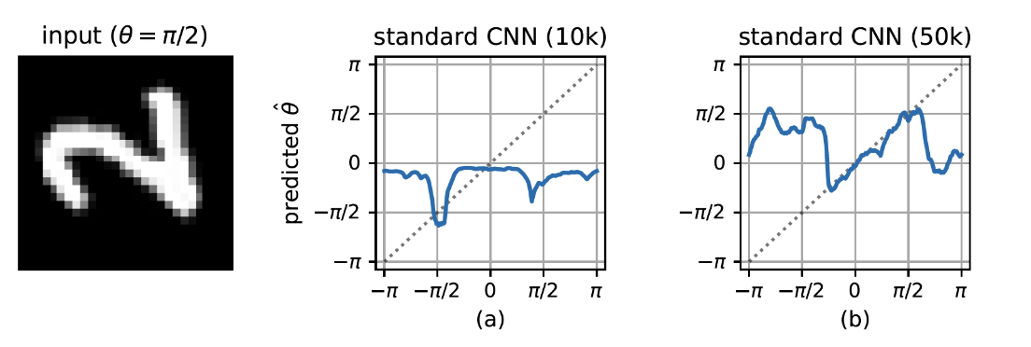
Is ST Layer Good?
No: It does not satisfy self-consistent pose estimation

Slide 9
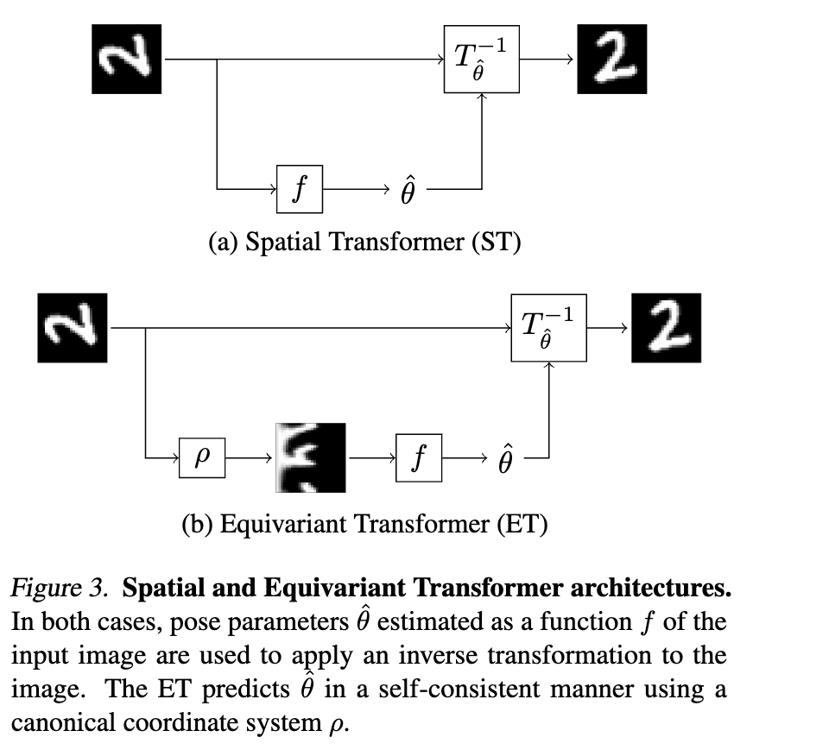
How to Achieve Self-consistency

Slide 10
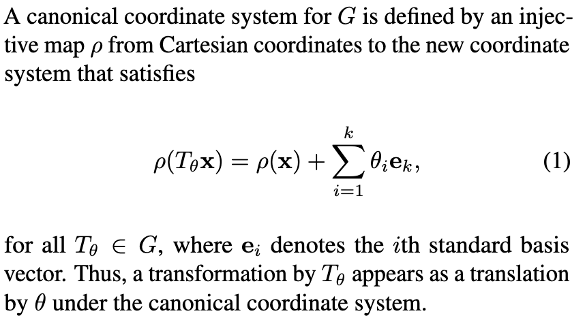
Canonical Coordinate System

Slide 11
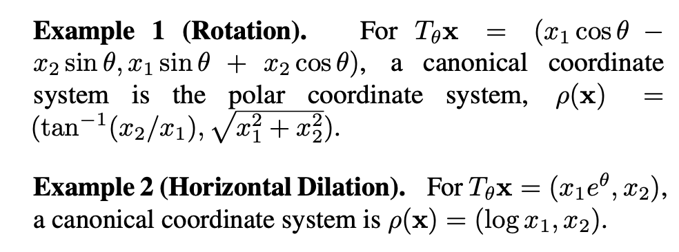
Canonical Coordinate System - Example

Slide 12
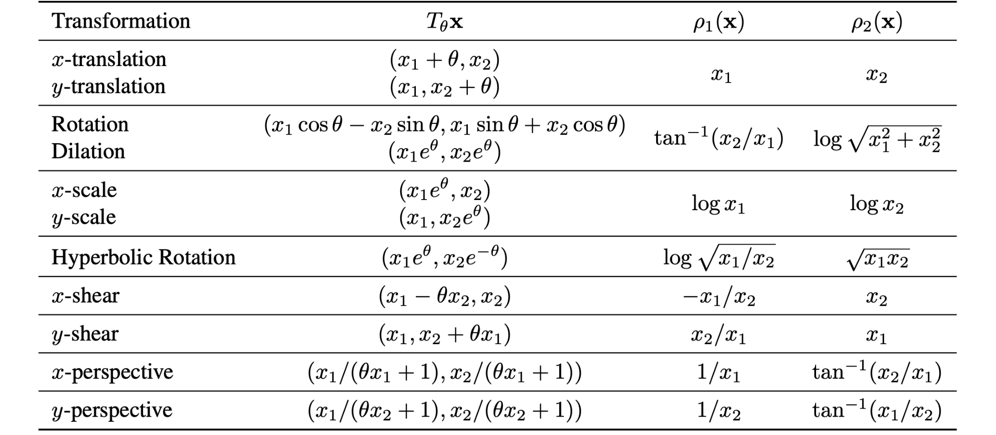
Canonical Coordinate System - Example
Will Introduce How to Construct a Canonical Coordinate System Later

Slide 13
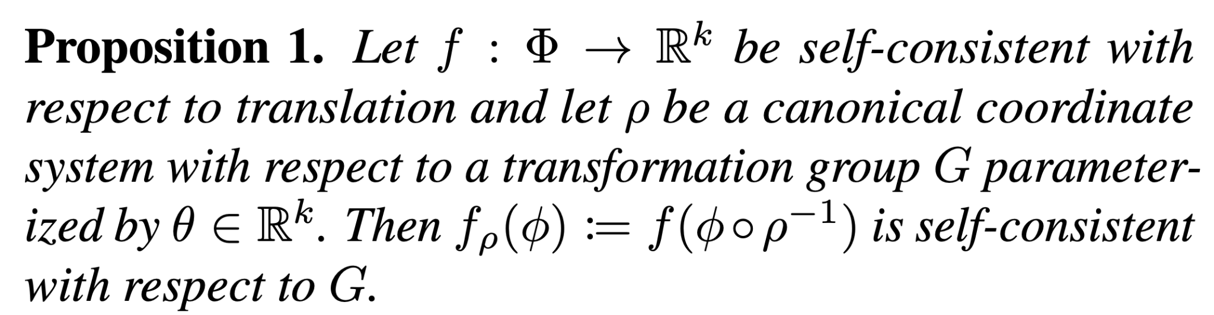
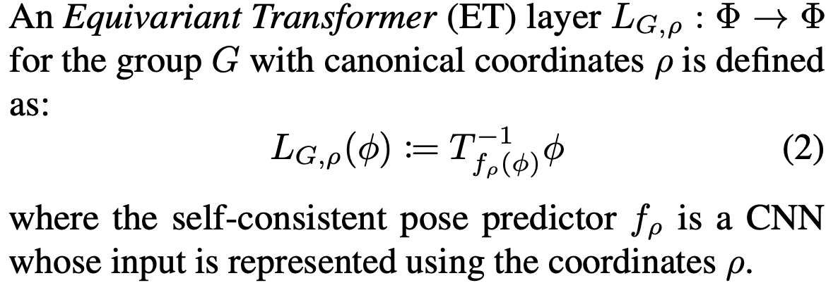
How to Achieve Self-consistency?

Slide 14
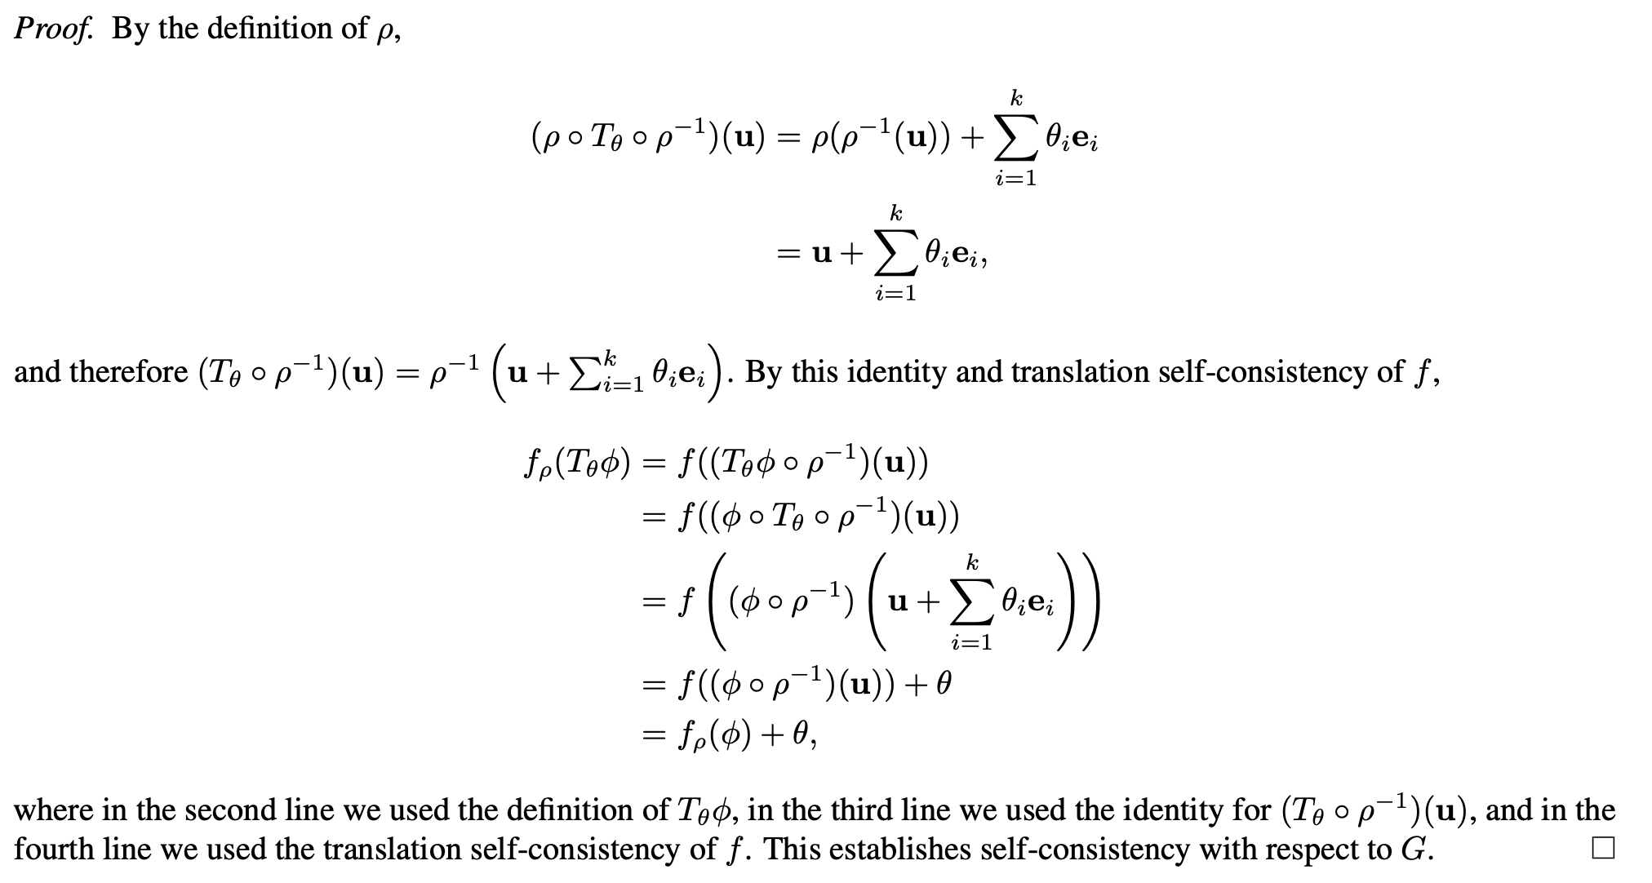
Proof of Proposition 1

Slide 15
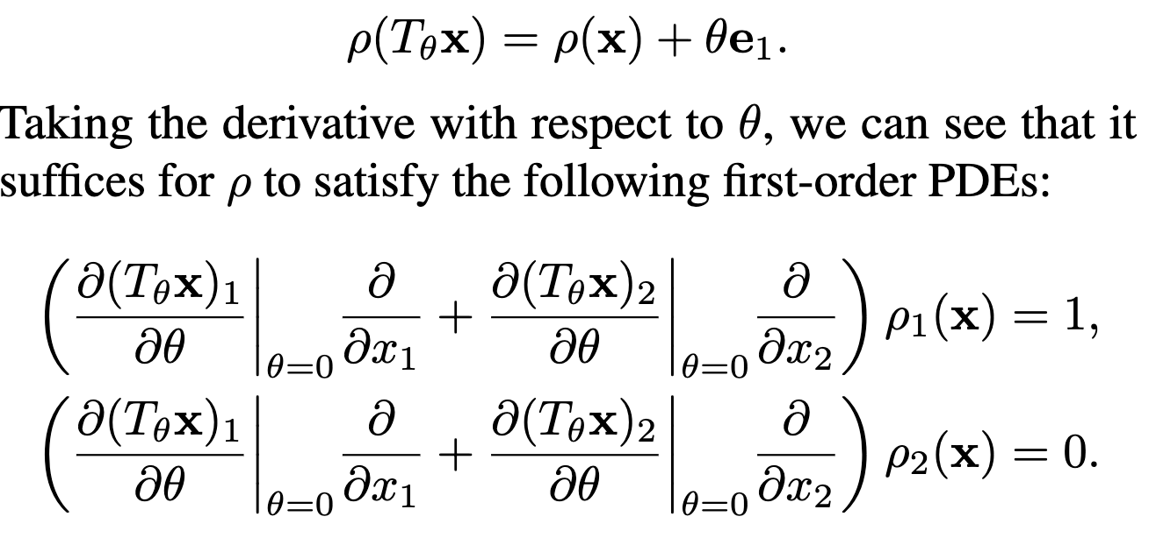
How to Construct Canonical Coordinate System?
One Parameter Case

Slide 16
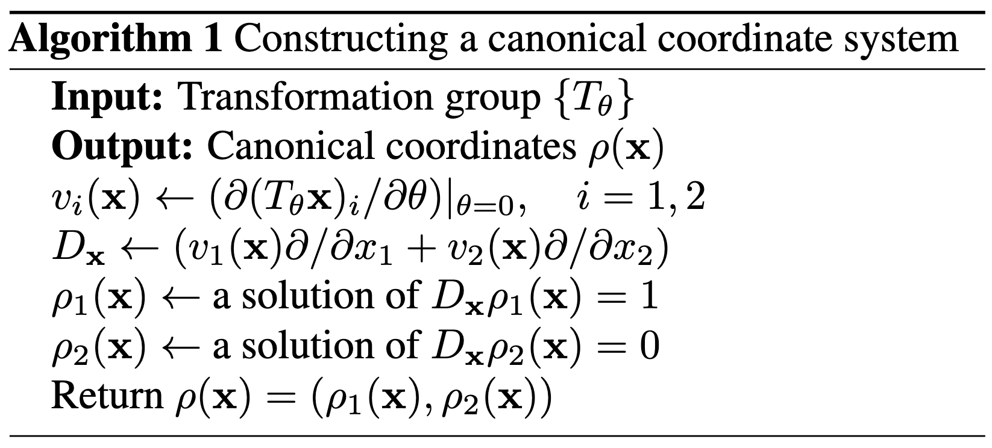
How to Construct Canonical Coordinate System?

Slide 17
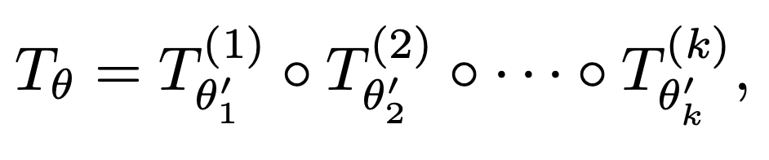
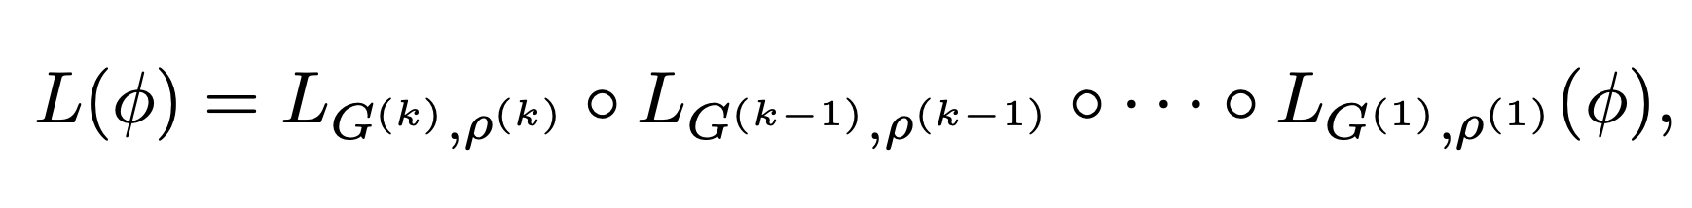
How to Construct Canonical Coordinate System?
K-Parameter Case
Stacked ETs is an empirical method without theoretical guarantee for self-consistency

Slide 18
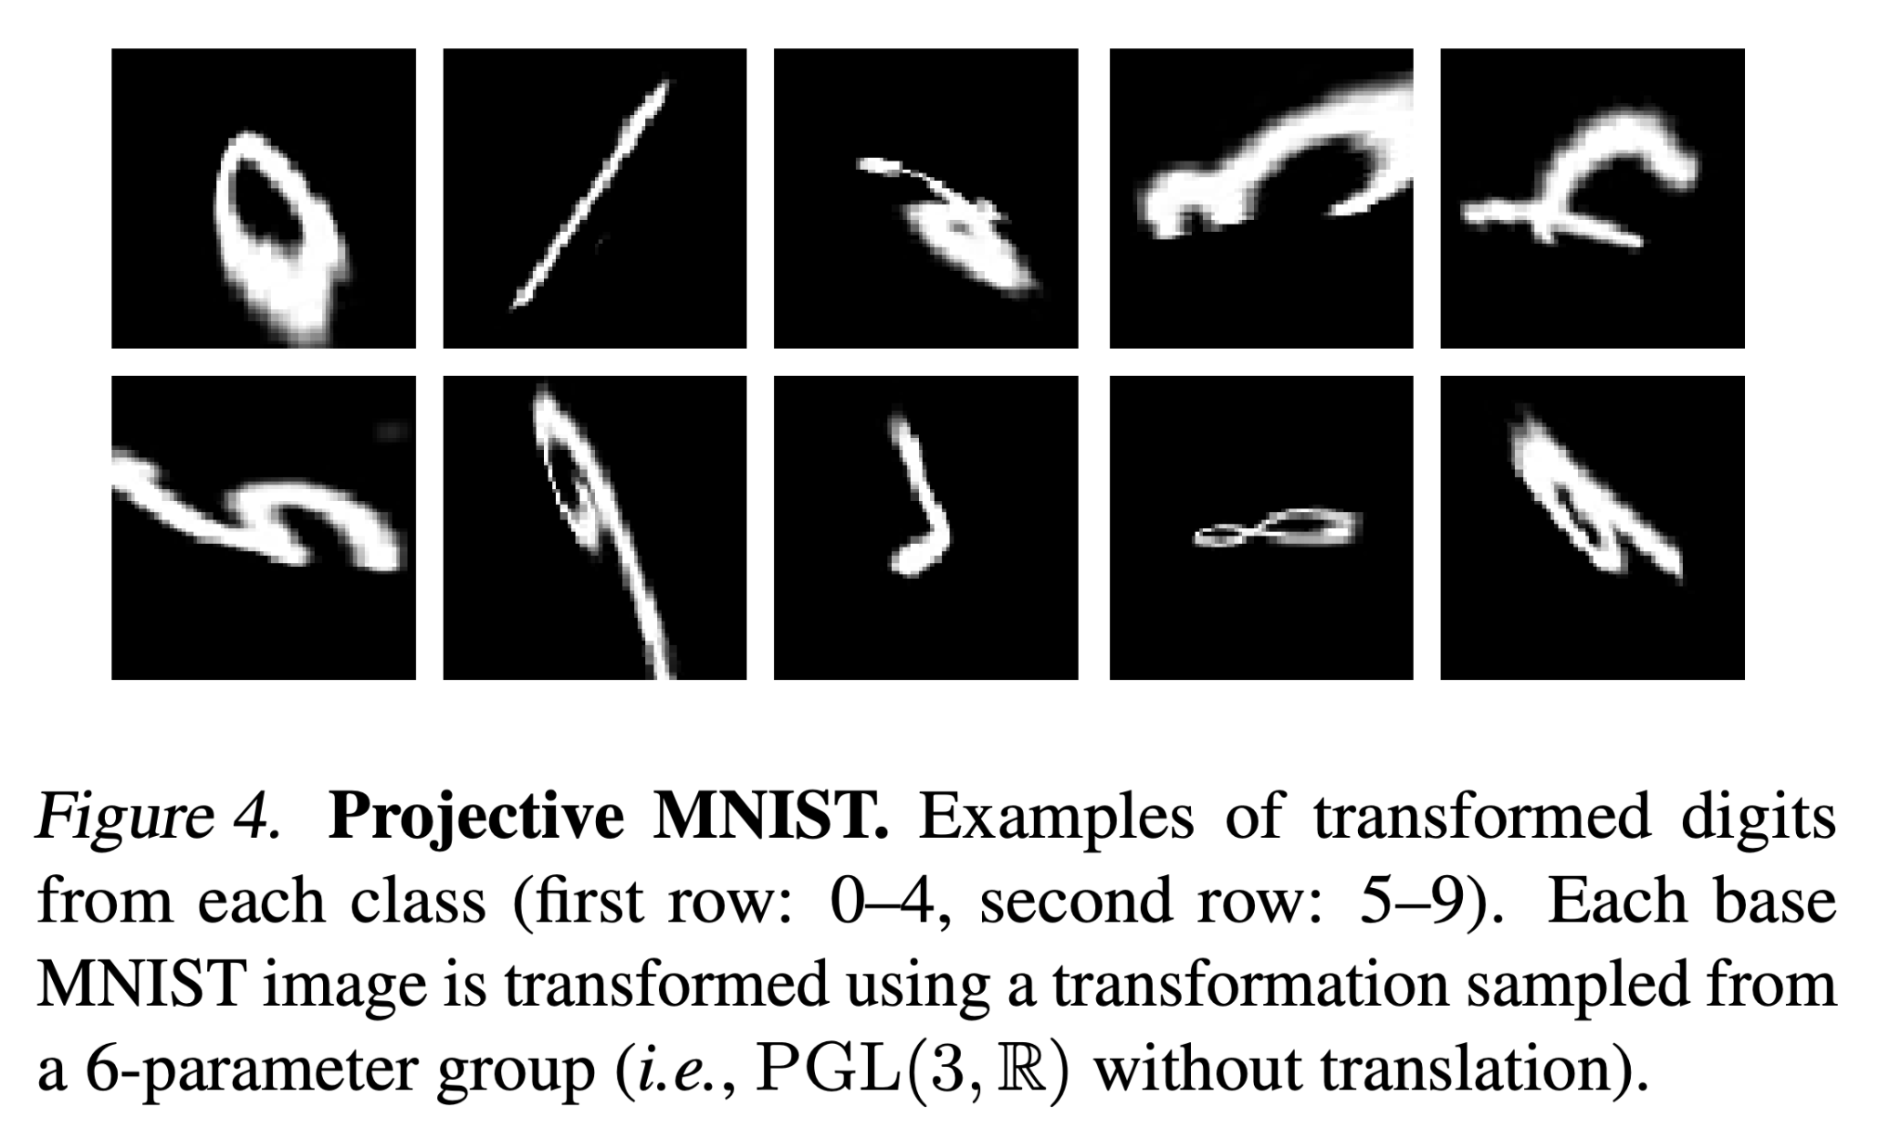
Experiments - Projective MNIST
Rotation
Shear
X-dilation
Y-dilation
X-perspective transformations
Y-perspective transformations

Slide 19
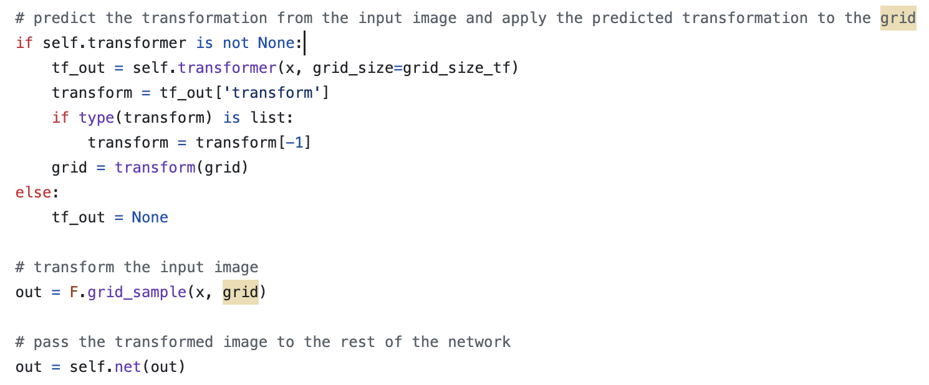
Experiments - Projective MNIST
Network Architecture

Slide 20
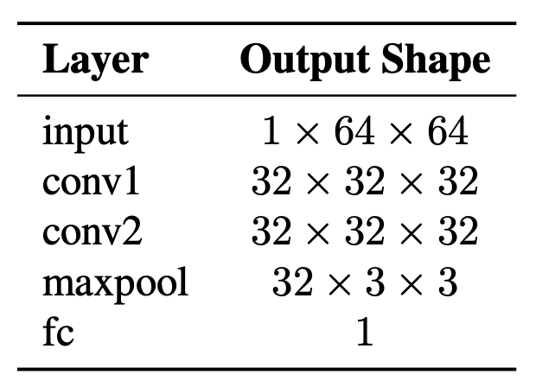
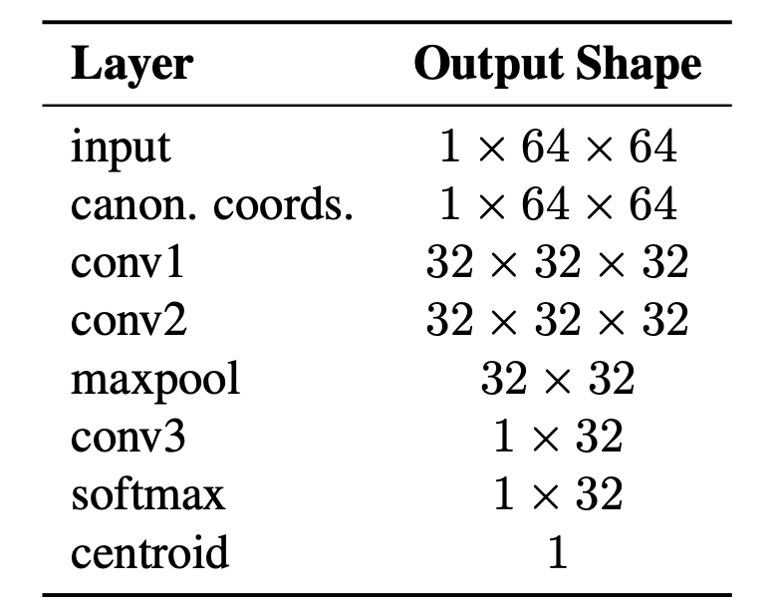
Experiments - Projective MNIST
Network Architecture
ET Layers
CNN

Slide 21
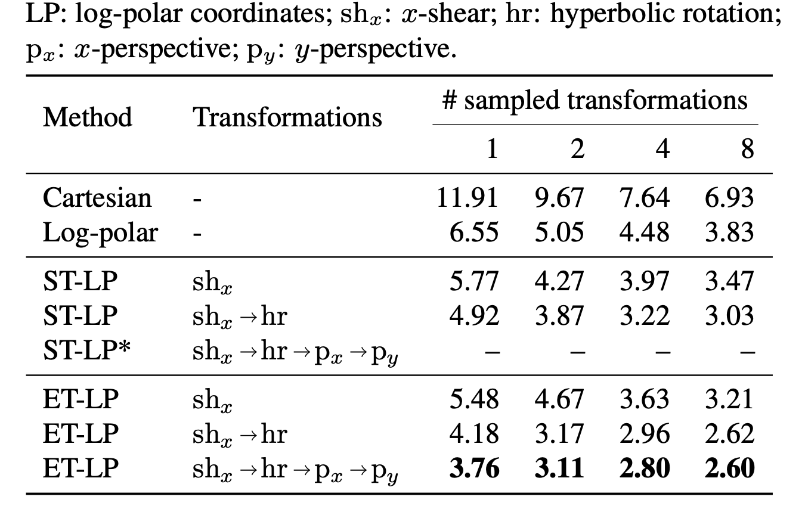
Experiments - Projective MNIST

Slide 22
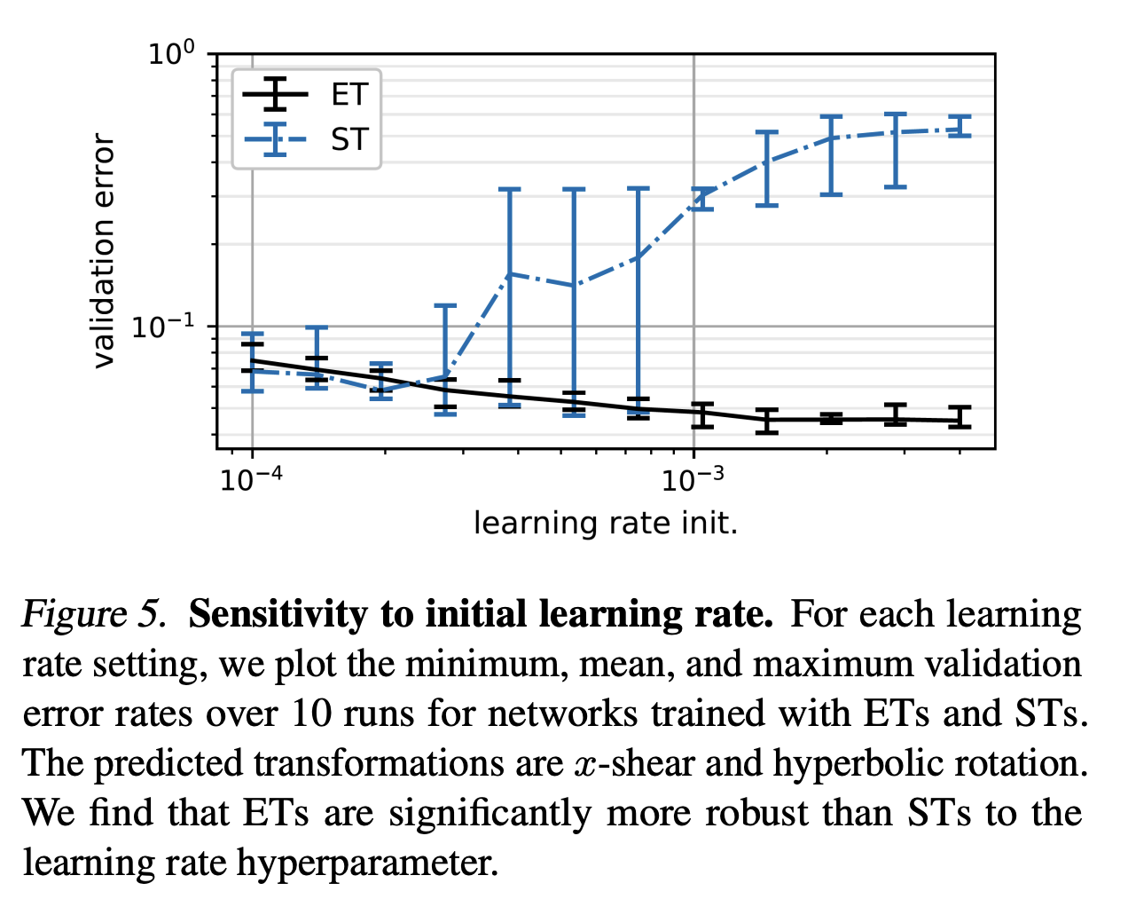
Experiments - Projective MNIST

Slide 23
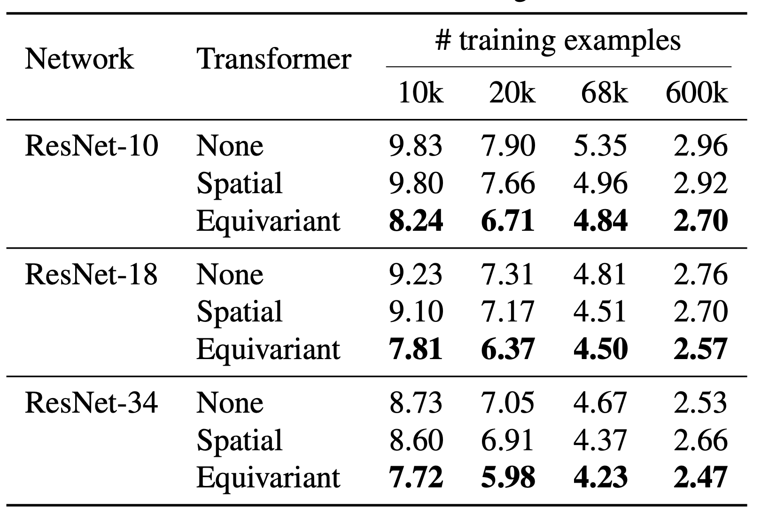
Experiments - SVHN

Slide 24
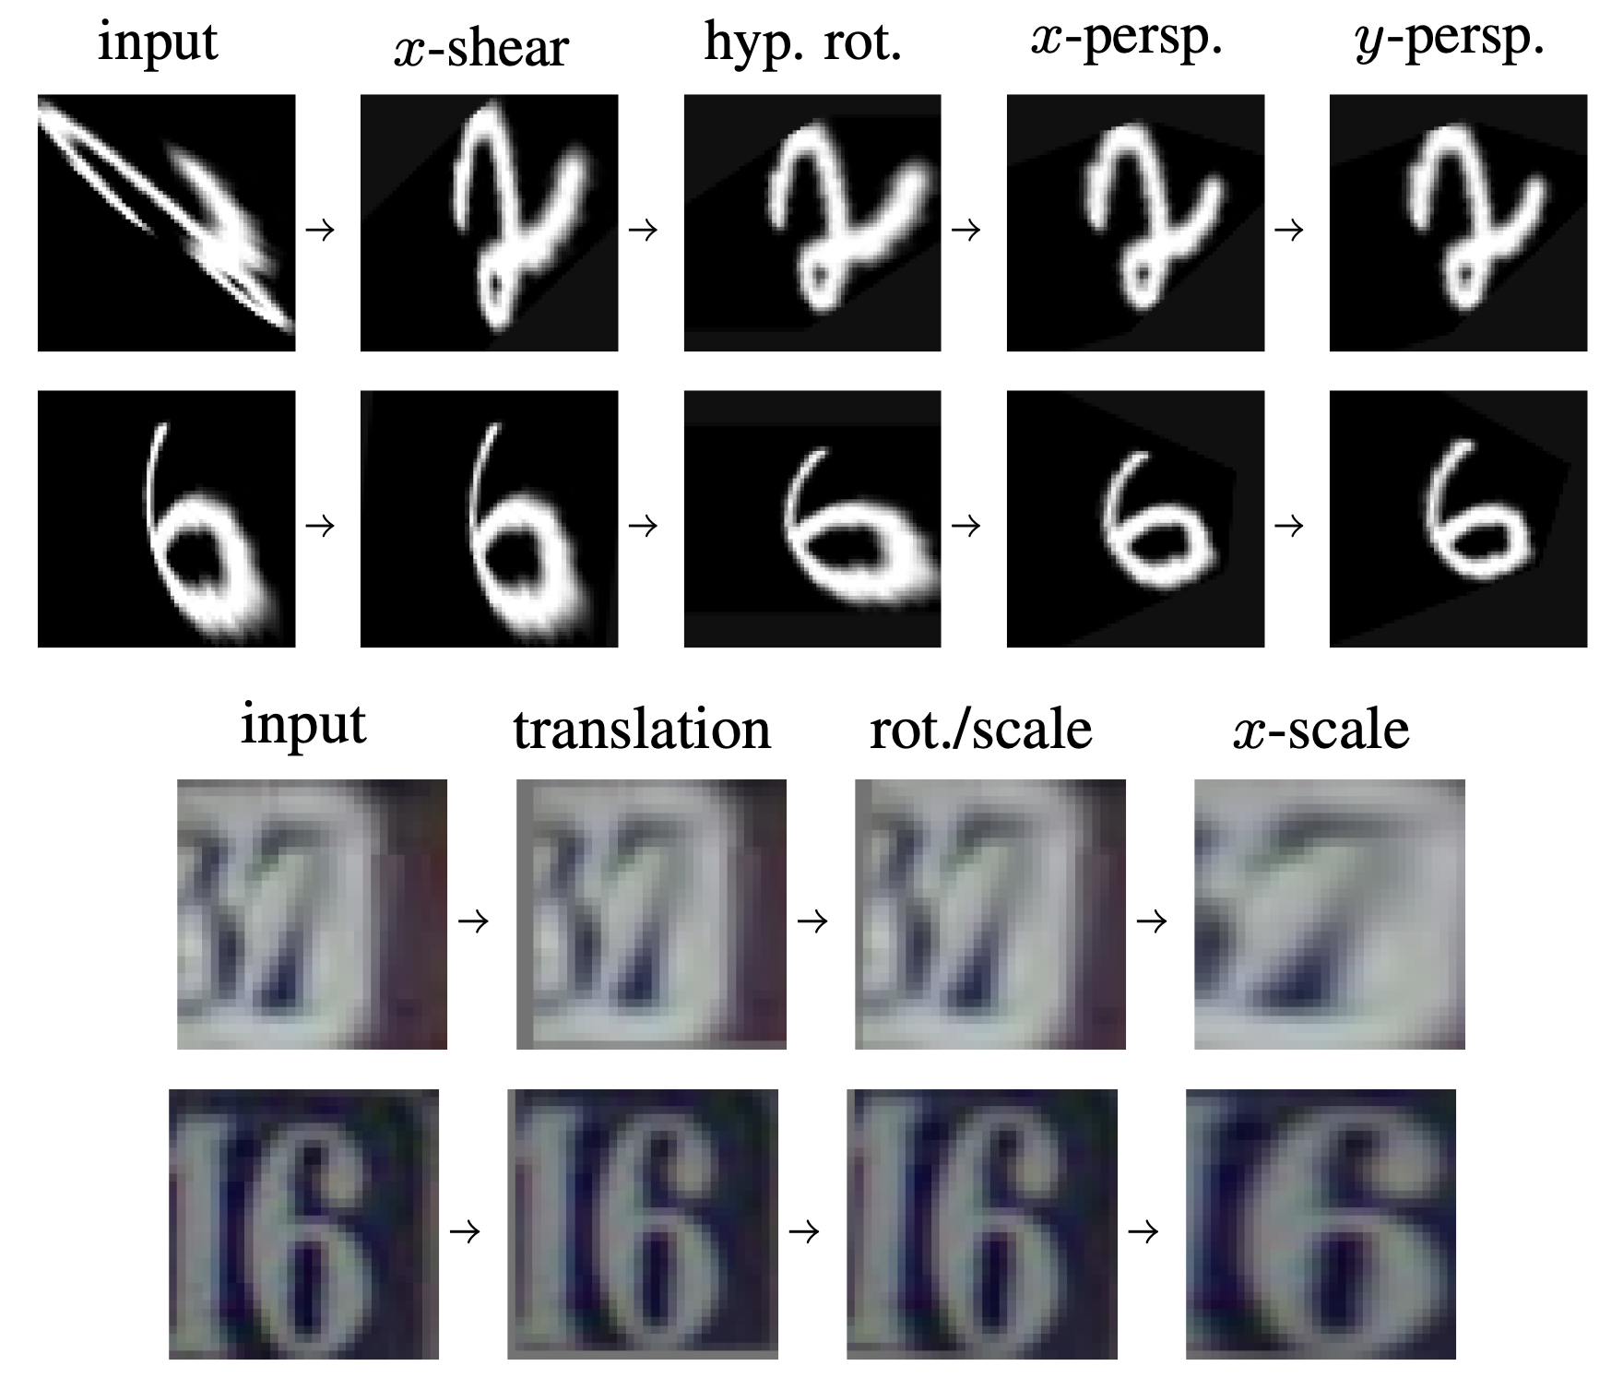
Experiments - Visualization

Slide 25
Limitations
The method of stacking ET layers is ultimately a heuristic approach as it does not guarantee self-consistency with respect to the full transformation group.
Higher-dimensional groups require the use of long sequences of ET layers, resulting in high computational cost.

Slide 26
Codes
Prepare environment by environment.yaml.
Run the codes on run.ipynb

