Slide 1
An Image is Worth 16x16 Words: Transformers for Image Recognition at Scale
Dosovitskiy et al. (2020)
2024.02.28 ECE 594N
Jiahua Chen
Department of Geography

Slide 2
Introduction
In NLP, Transformer (self attention based architecture) is the mode of choice.
In computer vision, efforts has been made to use the Transformer architecture in combination with CNNs or by its own, though the latter models are not effective.
Goal: apply Transformer directly to images

Slide 3
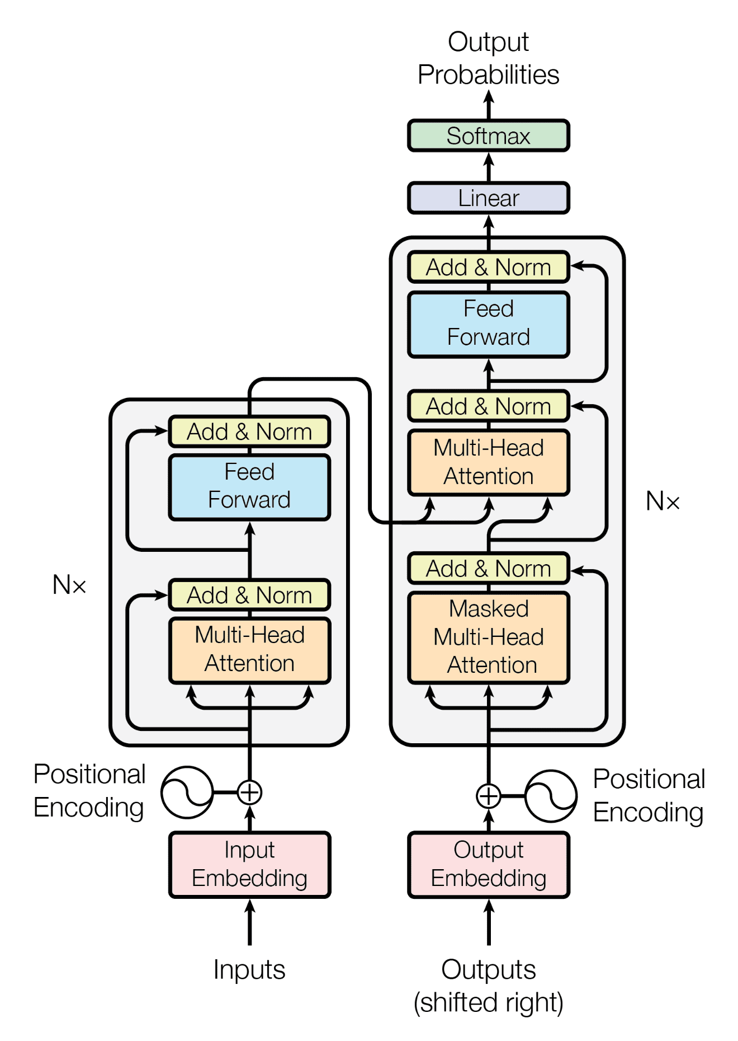
Related works - self-attention
Attention is all you need. Vaswani et al. (2017)

Slide 4
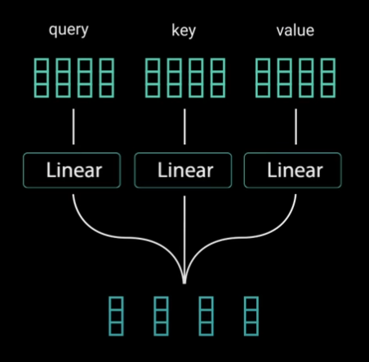
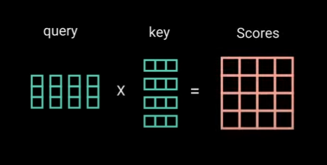
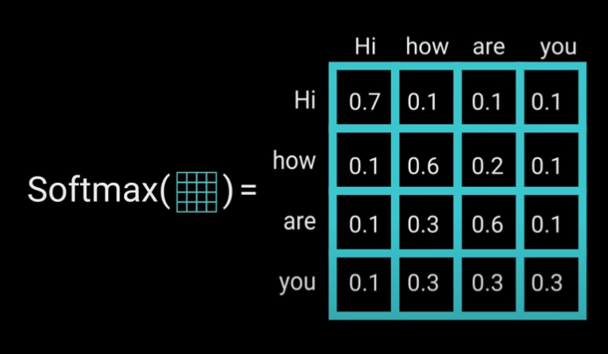
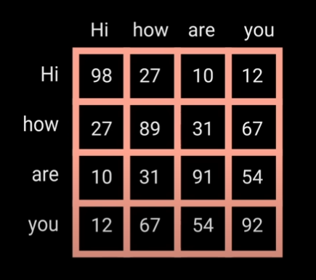
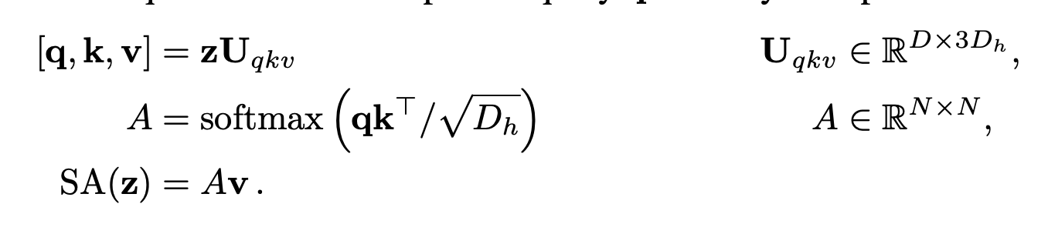
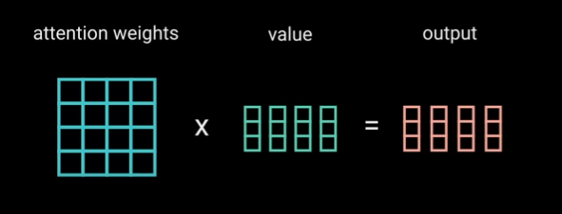
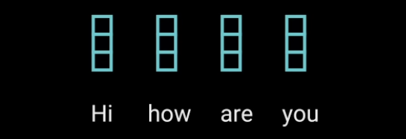
Self Attention
Allow one word in a sentence to associate with other words in the sentence
Notes:
Feed input into three fully connected layers
Dot product multiplication
It determine how much attention should one world put on another word

Slide 5
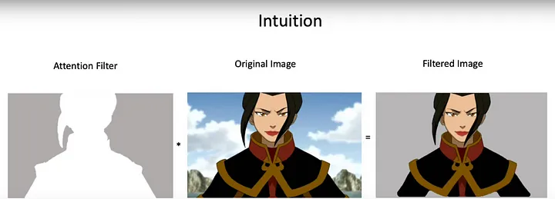
Self Attention
Allow one word in a sentence to associate with other words in the sentence

Slide 6
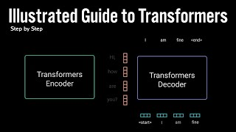

Slide 7
Related work - Image embedding
128 x 128 pixels
Self-attention:
(128 x 128)^2

Slide 8
Related work - Image embedding
Self-attention in local neighborhoods for each query pixel. Parmar et al..2018
Scalable approximations to global self-attention. Child et al., 2019
Self-attention in variable block sizes (e.g. along individual axes) Weissenborn et al., 2019
Self-attention in patches of size 2x2 pixels. Cordonnier et al. 2020
Image GPT: applies Transformers to image pixels after reducing image resolution and color space. Chen et al., 2020a ~ 72% on imageNet
– Accuracy was not satisfying

Slide 9
Related work - Transformer in combination with CNN
Augmenting feature maps for image classification. Bello et al., 2019
Further processing the output of a CNN using self-attention. Hu et al., 2018;
Carion et al., 2020

Slide 10
Related work - dataset size
“When trained on mid-sized datasets such as ImageNet (1.3M) without strong regularization, these models yield modest accuracies of a few percentage points below ResNets of comparable size.”
CNN performance scales with dataset size (14M-300M images) → maybe Transformer will do the same?
ImageNet-21k dataset / the in-house JFT-300M dataset

Slide 11
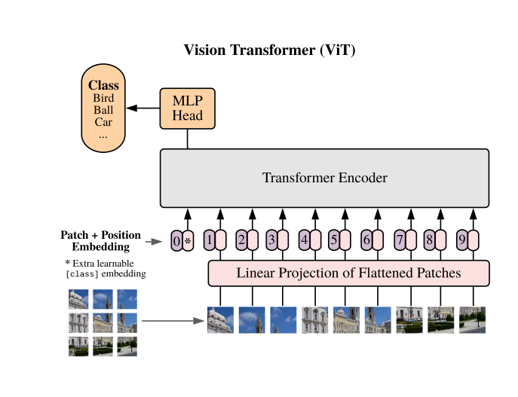
Methods
Image embedding
Linear projection
Positional embedding
Class label
Encoder
Multihead attention
Feedforward network
MLP

Slide 12
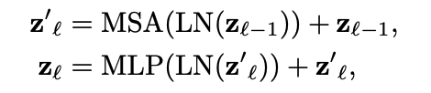

Methods
Image embedding
Linear projection
Positional embedding
Class label
Encoder
Multihead attention
Feedforward network
MLP

Slide 13
Methods: Image embedding
Break down the image into patches
128 x 128 pixels
14 x 14 pixels (16 patches)
16 x 16 pixels (14 patches)
Notes:
Note that the Transformer’s sequence length is inversely proportional to the square of the patch size, thus models with smaller patch size are computationally more expensive.

Slide 14
Methods: Image embedding
Break down the image into patches
128 x 128 pixels
14 x 14 pixels (16 patches)
16 x 16 pixels (14 patches)
Notes:
Note that the Transformer’s sequence length is inversely proportional to the square of the patch size, thus models with smaller patch size are computationally more expensive.

Slide 15
Image embedding: linear projection
Unroll each image patch into an vector [x_{p}¹, x_{p}²,..., x_{p}^{N}]
size = 1 x (P² · C)
Multiply with matrix E
Size = (P² · C) x D
(P,P): resolution of the image patch
C: number of image channels
D: latent vector size used by the transformer throughout the layers

Slide 16
Image embedding: positional embedding

Slide 17
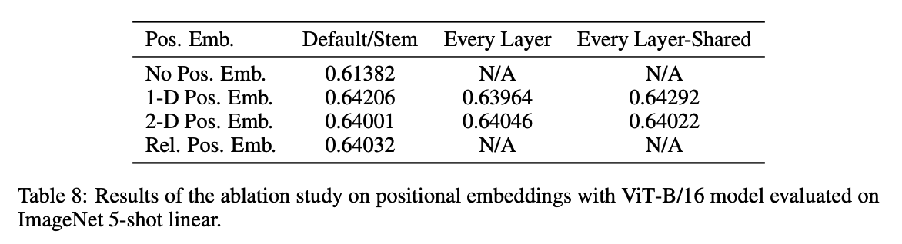
Four ways of positional embedding
No positional information
1-dimensional positional embedding: Considering the inputs as a sequence of patches in the raster order
2-dimensional positional embedding: Considering the inputs as a grid of patches in two dimensions
Relative positional embeddings: Considering the relative distance between patches to encode the spatial information as instead of their absolute position

Slide 18
Image embedding: class label

Slide 19
Methods
Image embedding
Linear projection
Positional embedding
Class label
Encoder
Multihead attention
Feedforward network
MLP

Slide 20
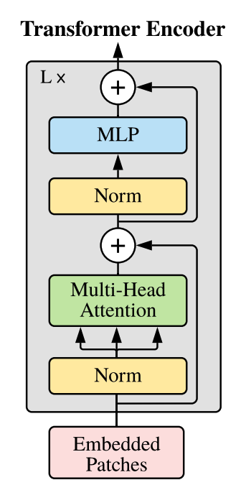
Methods: Transformer Encoder
Inside the encoder:
Multihead attention
Feedforward network
Notes:
Residual connection allows the gradient to flow through the networks directly

Slide 21
Methods: MLP Head
For classification purpose
Take only the first vector

Slide 22
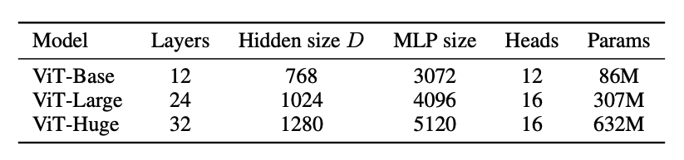
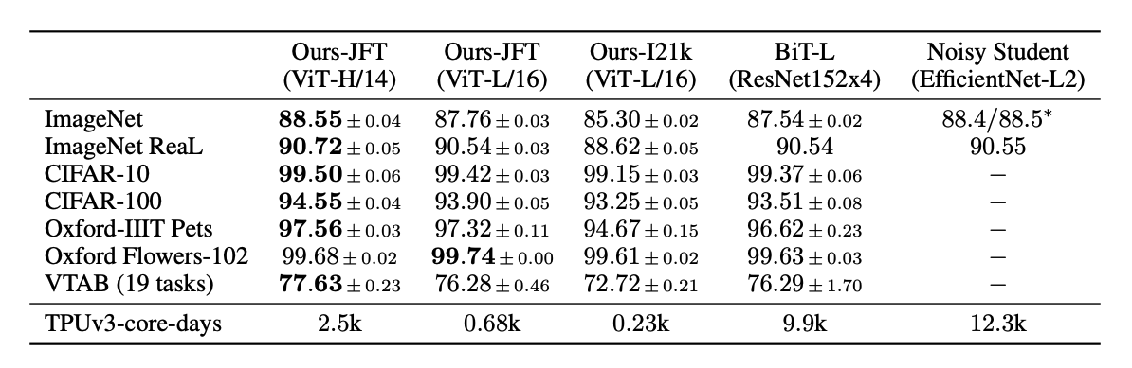
Results - compare with SOTA

Slide 23
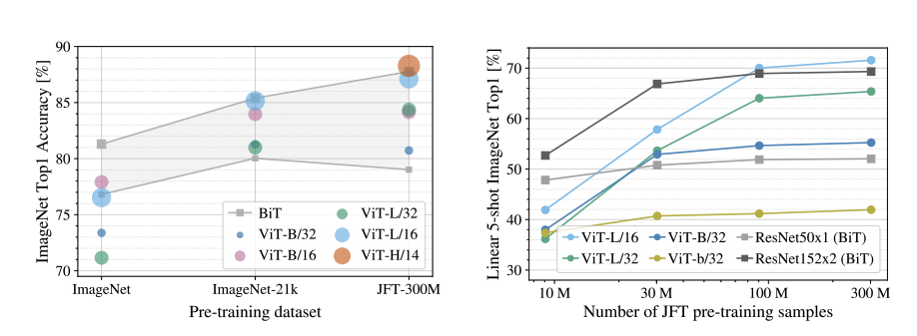
Results - Pre-training data requirements
Convolutional inductive bias is useful for smaller datasets, but for larger ones, learning the relevant patterns directly from data is sufficient, even beneficial.

Slide 24
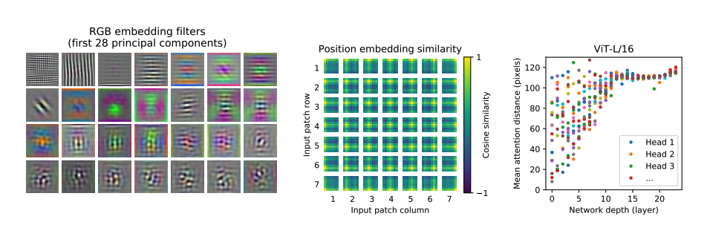
Results - inspection
Notes:
Filters of the initial linear embedding of RGB values
Similarity of position embeddings
Size of attended area by head and network depth.

Slide 25
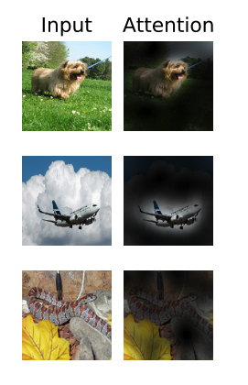
Conclusion - ViT
Interpret an image as a sequence of patches
ViT learns the positional embedding
Process by a standard Transformer encoder as used in NLP
Pre-train on large datasets
Matches or exceeds SOTA on many image classification

