Slide 1
MQTT & ETH Protocol
For Free RTOS, MICRO-ROS, XRCE (Xtreme Resource Constraint Environment) on ST Micro-controllers

Slide 2
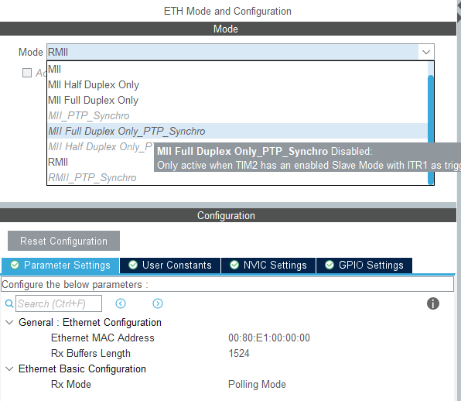

Slide 3
Two Modes of ETH
MII with memory configuration
RMII without memory configuration

Slide 4
Problems
HARDFAULT
FLASH/RAM Shortage (use QSPI or SDRAM )
FLASH > 80 KB or booting from QSPI
RAM > 150 KB or Have other SRAMs

Slide 5
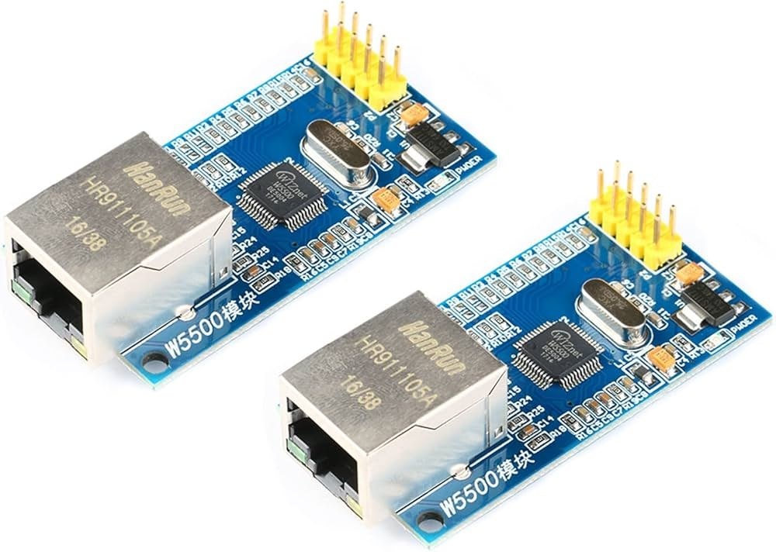

Slide 6
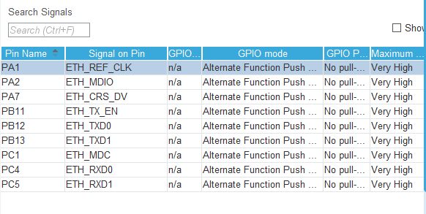
With RMII Configuration

Slide 7
Light Weight IP Configuration

Slide 8
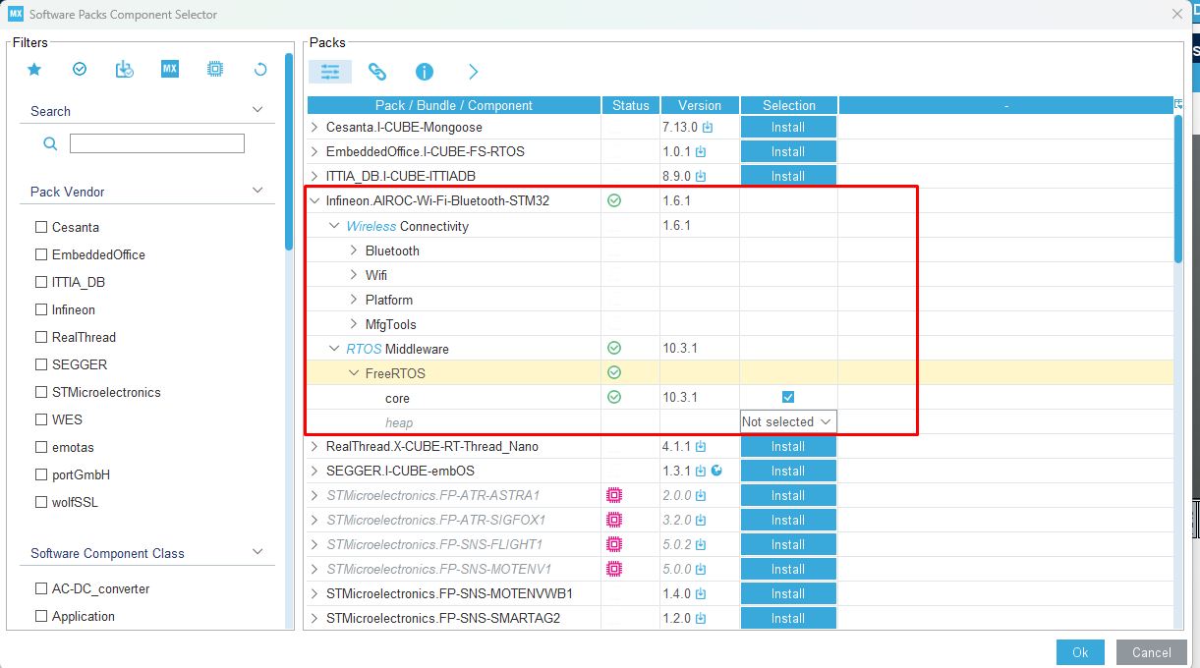

Slide 9
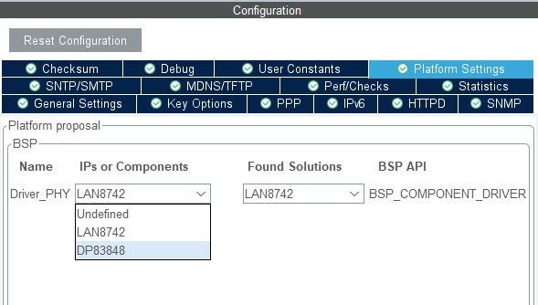

Slide 10
LAN Driver HW ရှာရခက်နေသောကြောင့်
ESP နဲ့ STM Communication ကို ပြန်စဥ်းစားရအောင်ပါ။

Slide 11
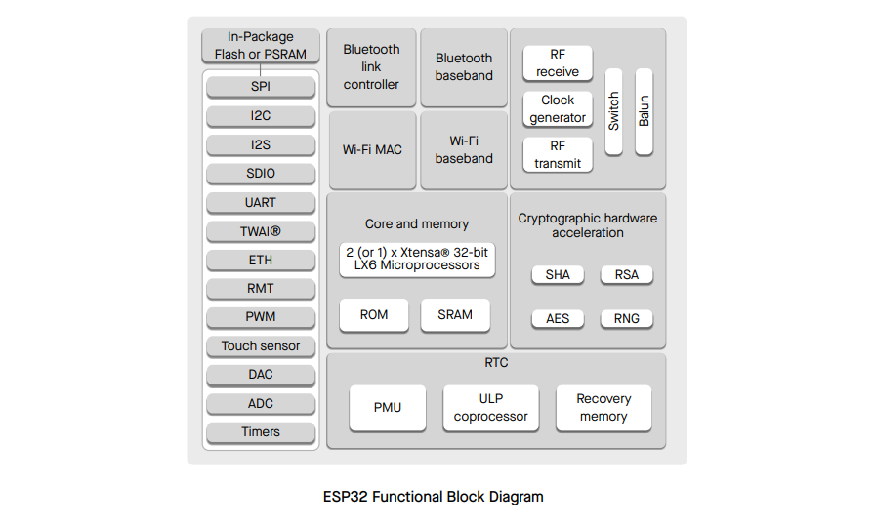

Slide 12
Direct Connect of ETH of STM and ETH of ESP

Slide 14
MQTT Client Setup With UART

Slide 15
MQTT Client Setup With ETH

Slide 16
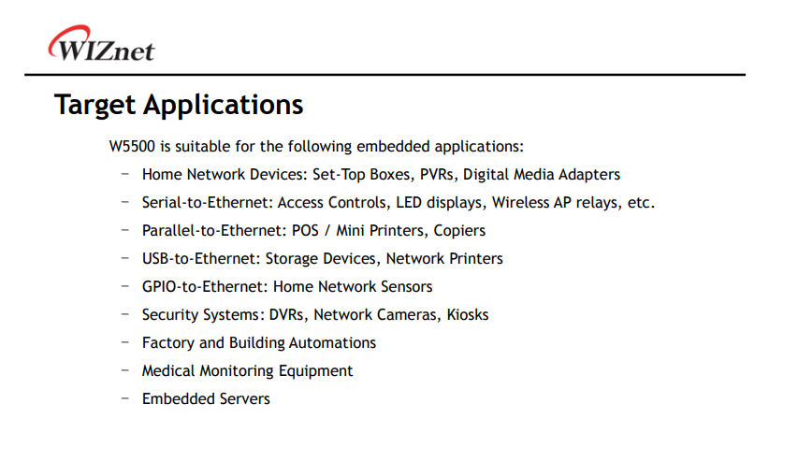

Slide 17
