Slide 1

EnKF Result
1. Saturation Map
2. Permeability Map
3. Recovery Factor

Slide 2
Water Saturation Map

Slide 3
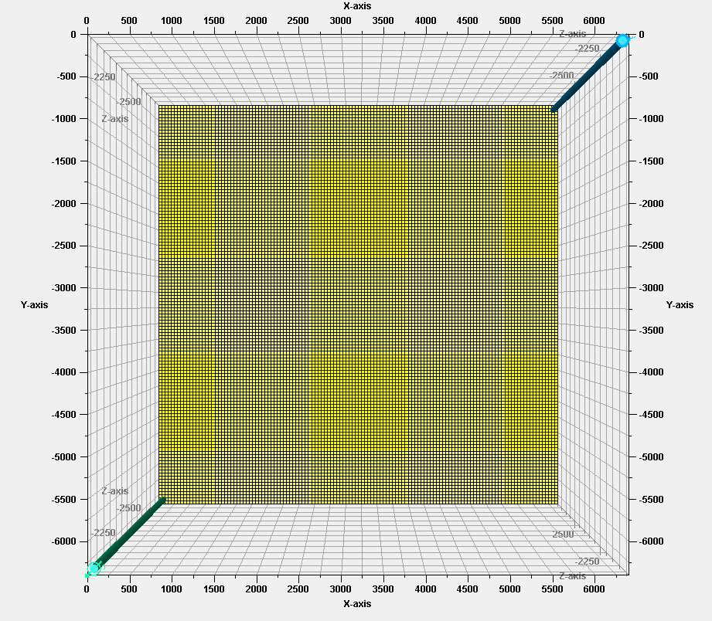
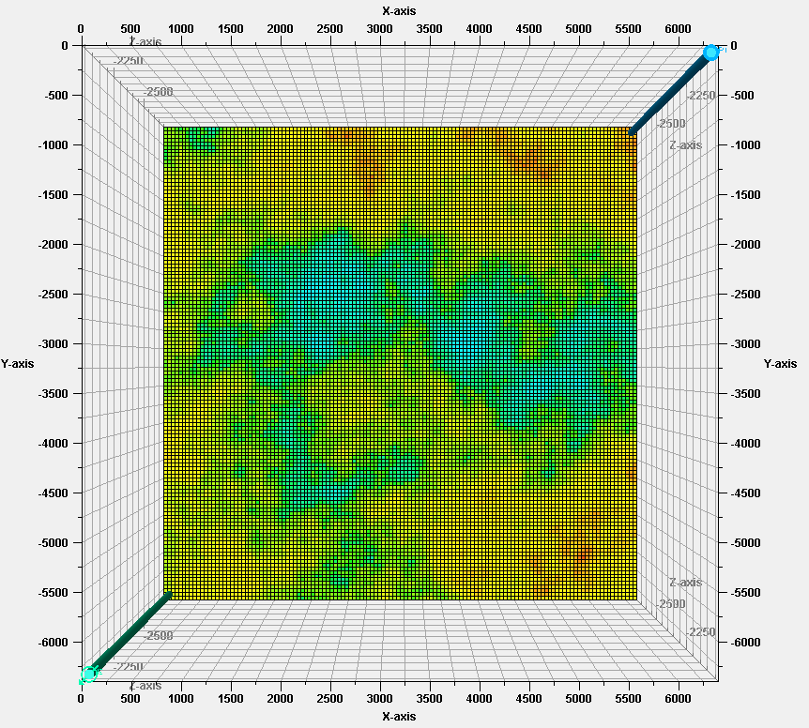
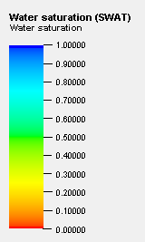
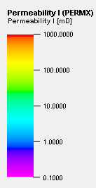
Saturation map Initial State
Permeability map
Producer
Injector

Slide 4
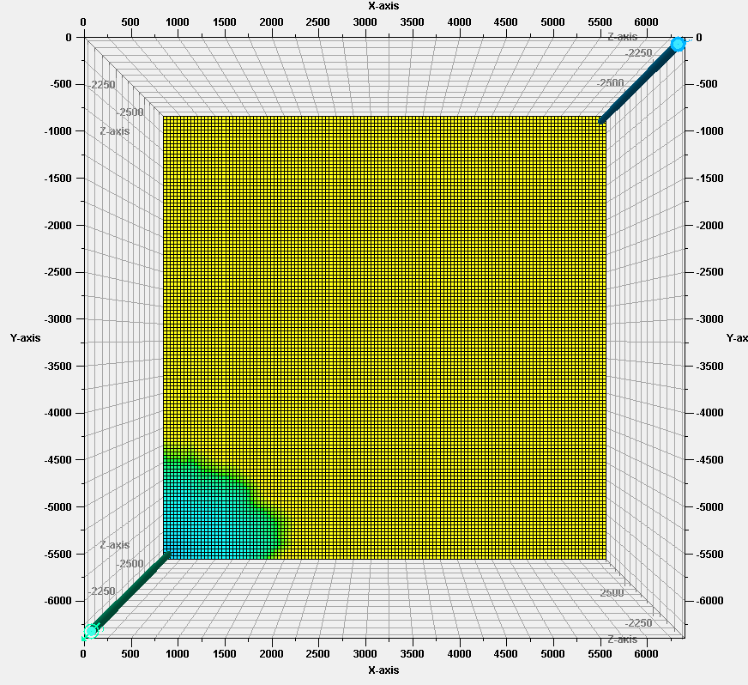
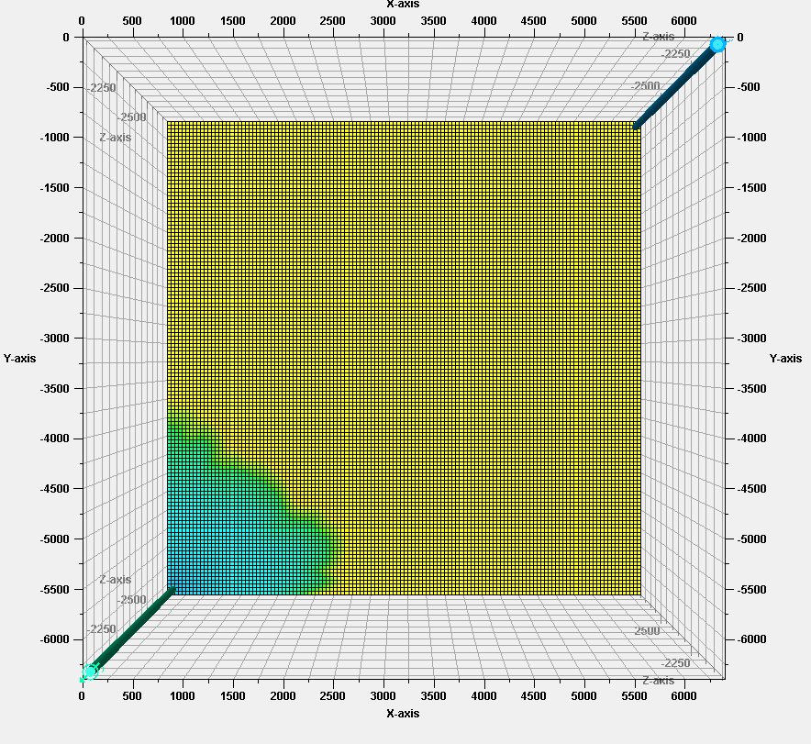
Saturation map
At 0.2 PV injected
At 0.4 PV injected

Slide 5
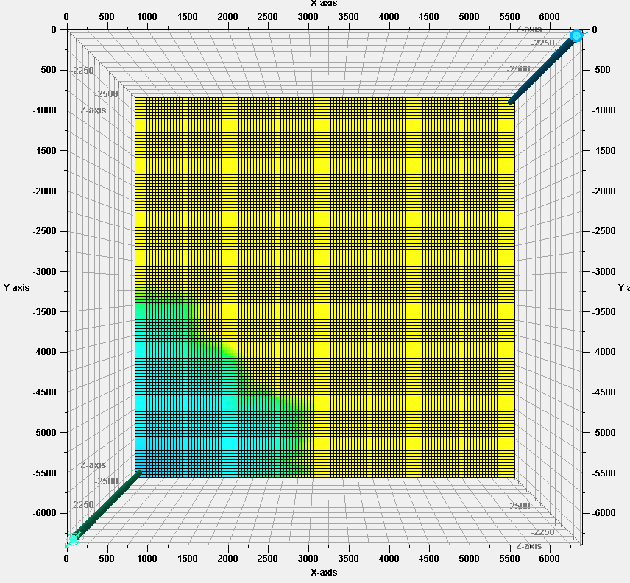
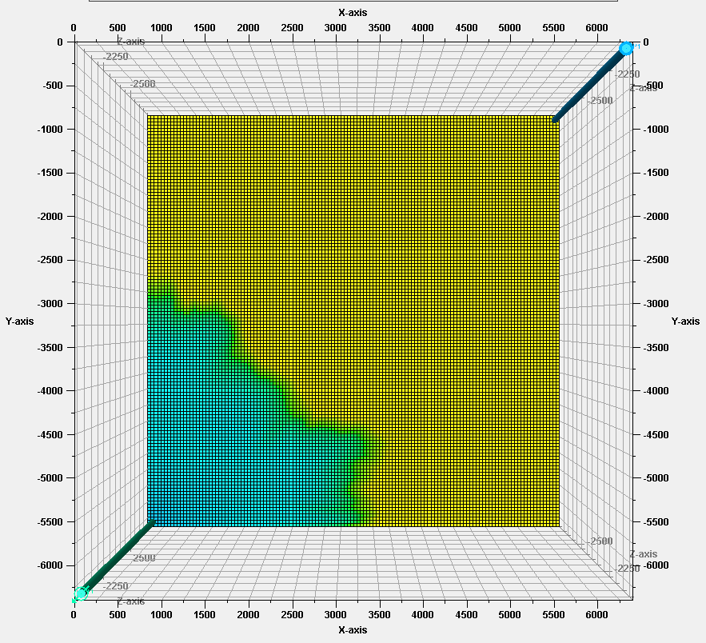
Saturation map
At 0.8 PV injected
At 1.2 PV injected

Slide 6
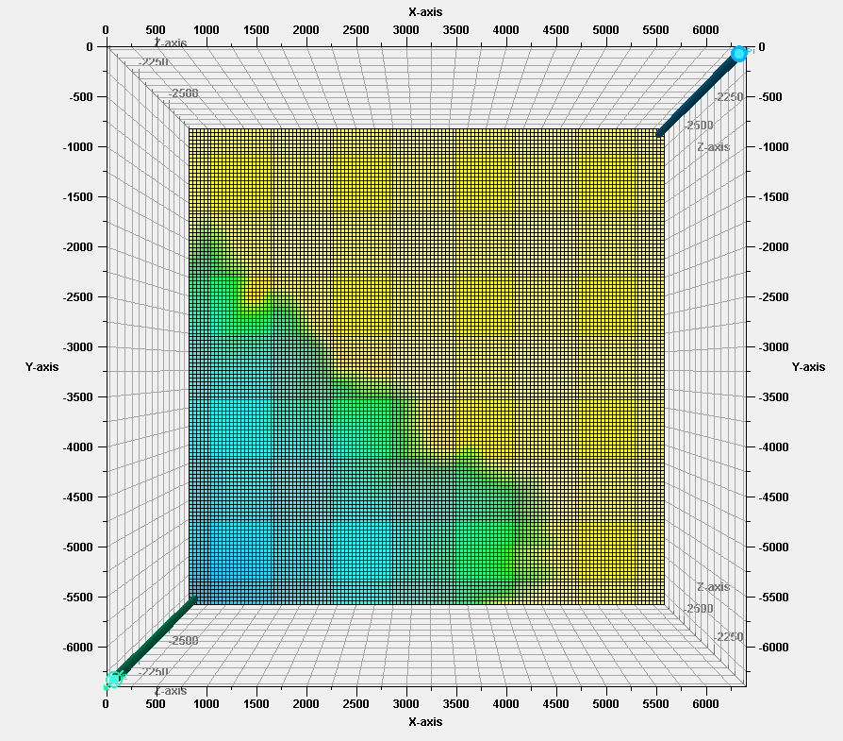
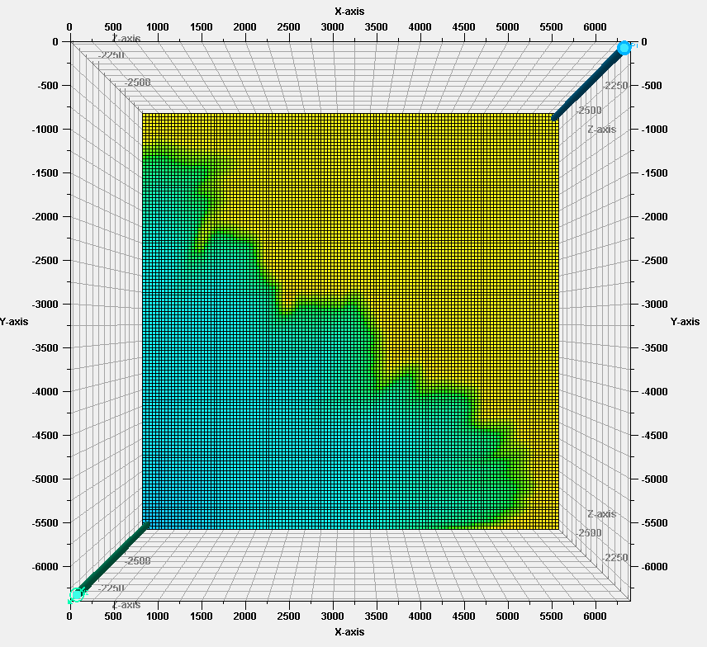
Saturation map
At 2.0 PV injected
At 3.0 PV injected

Slide 7
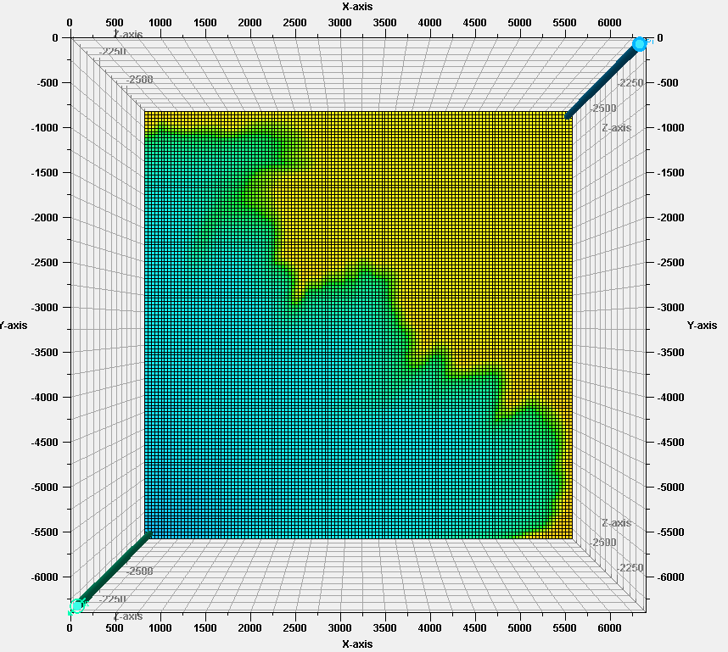
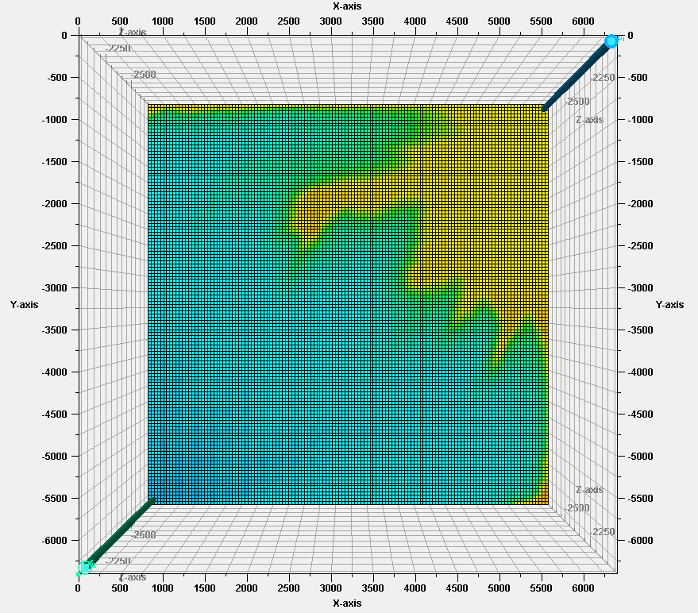
Saturation map
At 4.0 PV injected
At 6.0 PV injected

Slide 8
Saturation map
At 4.0 PV injected
At 6.0 PV injected

Slide 9
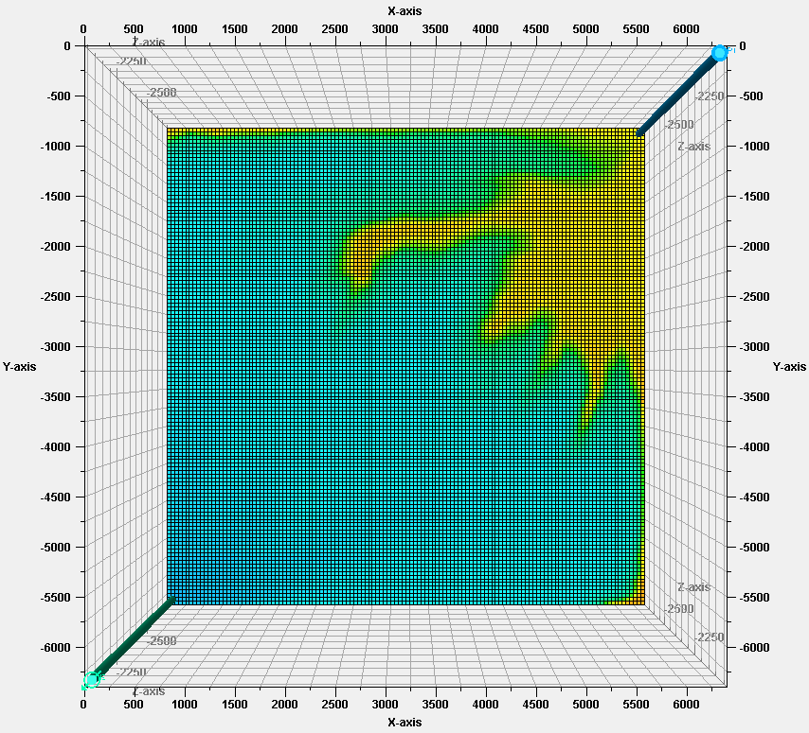
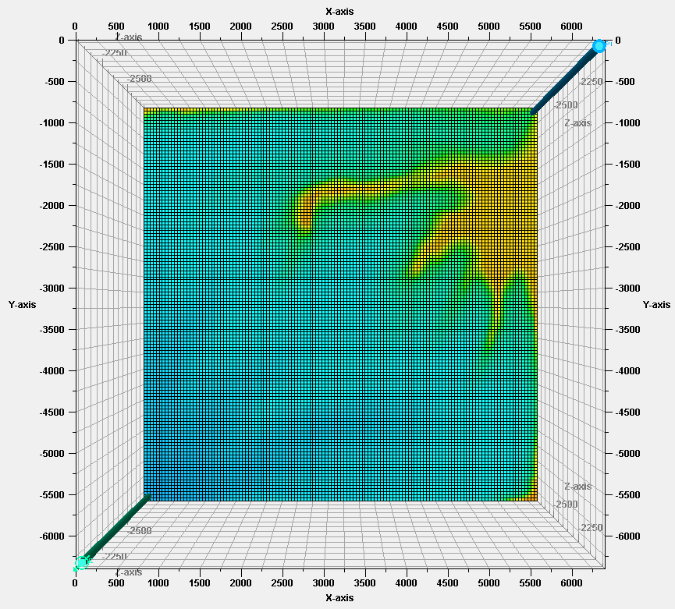
Saturation map
At 7.0 PV injected
At 8.0 PV injected

Slide 10
Permeability Map

Slide 11
Permeability map (log-perm)
Initial Ensemble’s Average Permeability
Ln(md)
Ln(md)

Slide 12
Permeability map (log-perm)
Updated Ensemble’s Average Permeability
Ln(md)
Ln(md)

Slide 13
Permeability map (log-perm) Initial Ensemble Members

Slide 14
Permeability map (log-perm) Initial Ensemble Members

Slide 15
Permeability map (log-perm) Updated Ensemble Members

Slide 16
Permeability map (log-perm) Updated Ensemble Members

Slide 17
Recovery Factor

Slide 18
Recovery Factor
Initial Ensemble Members
Updated Ensemble Members

