Slide 1
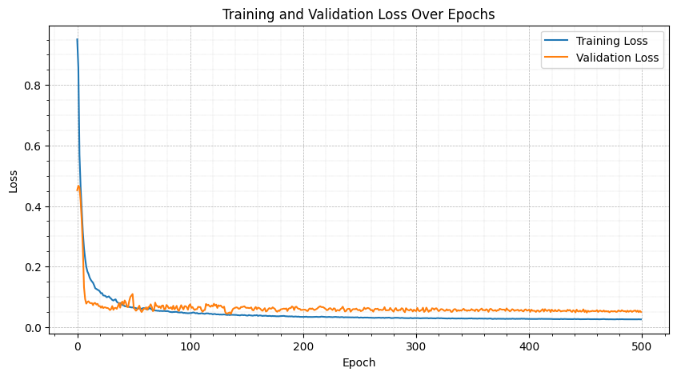
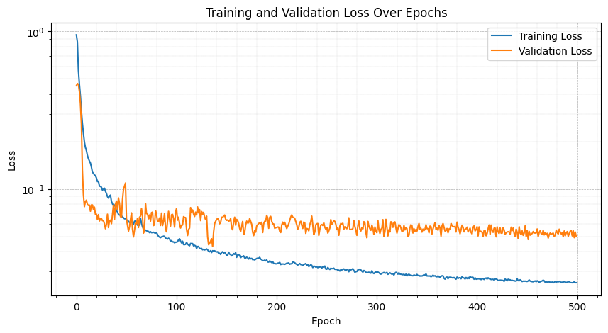
Loss curve (LSTM)

Slide 2

Compare all

Slide 3
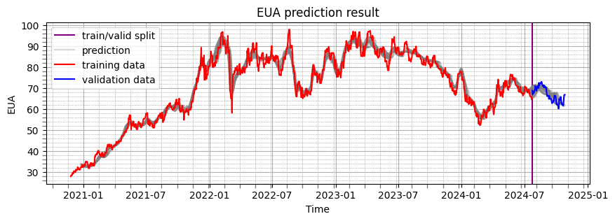
LSTM

Slide 4

GRU

Slide 5
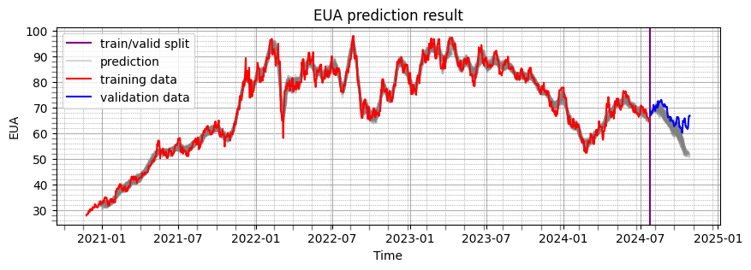
NN

Slide 6
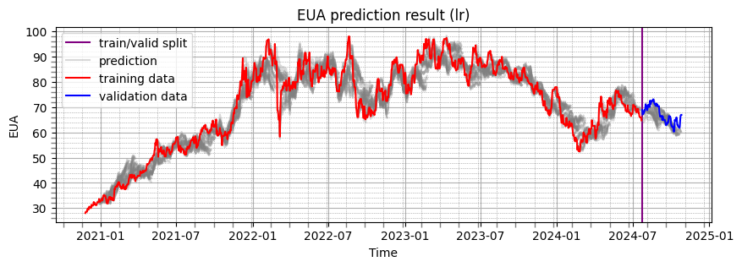
Linear regression

Slide 7
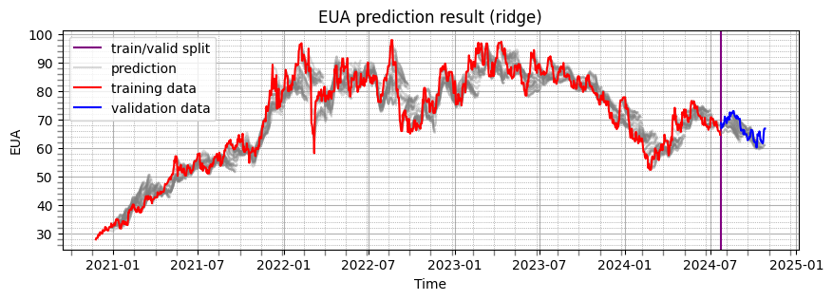
Ridge Linear regression

Slide 8
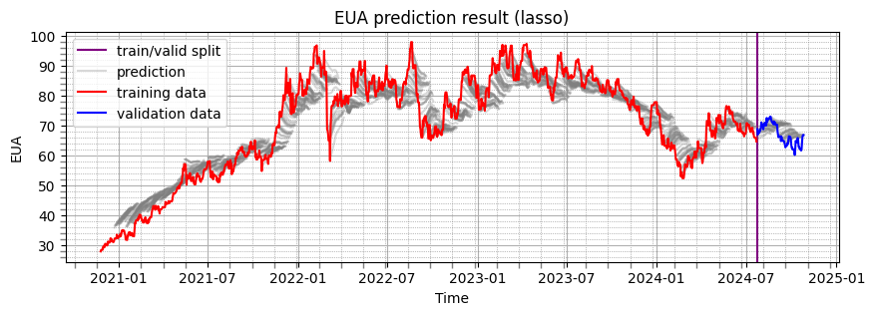
Lasso

Slide 9
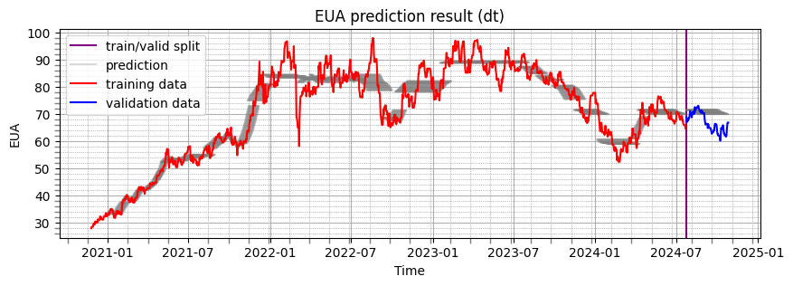
Decision tree

Slide 10
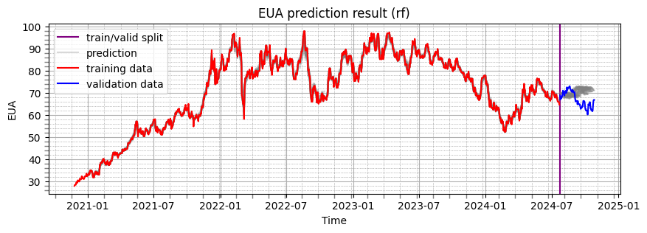
Random forest

Slide 11
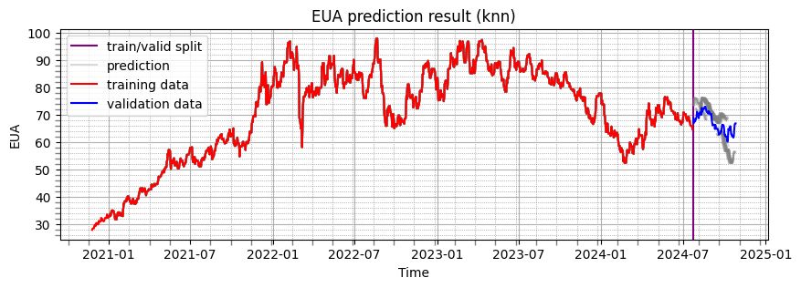
K-nearest neighbor

Slide 12
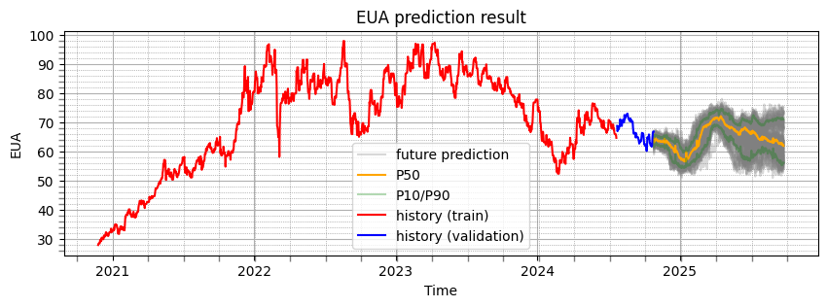
LSTM

Slide 13
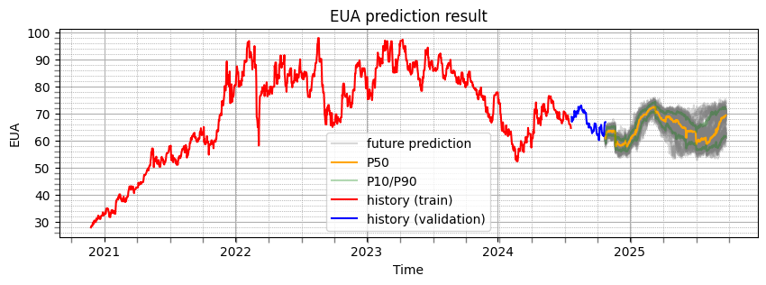
GRU

Slide 14
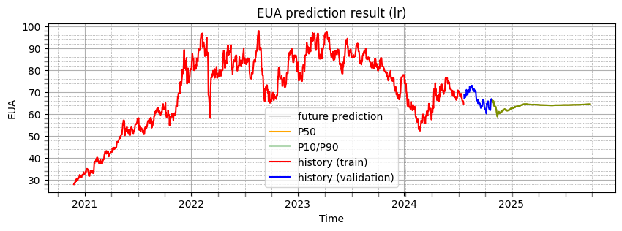
NN

Slide 15
Linear regression

Slide 16
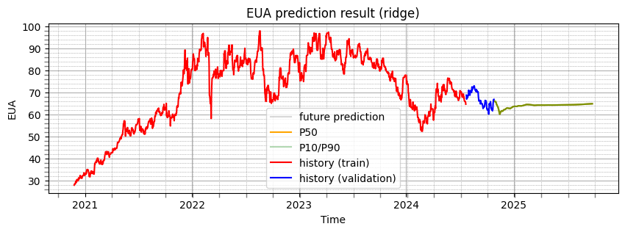
Ridge Linear regression

Slide 17

Lasso

Slide 18
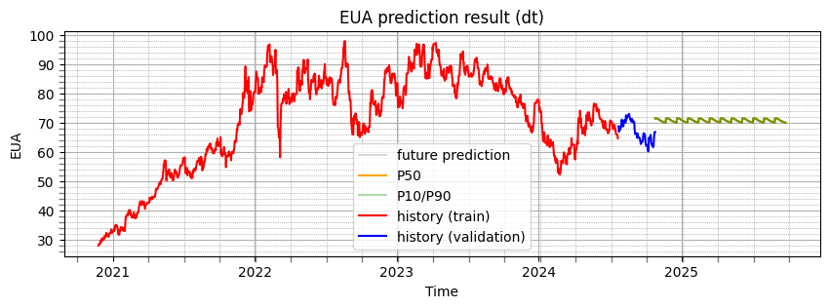
Decision tree

Slide 19

Random forest

Slide 20
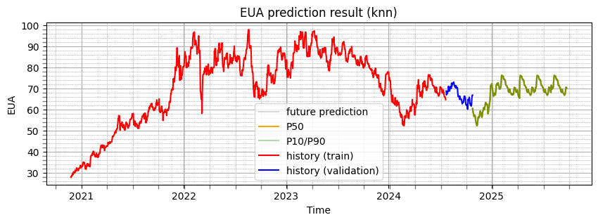
K-nearest neighbor

