Slide 1
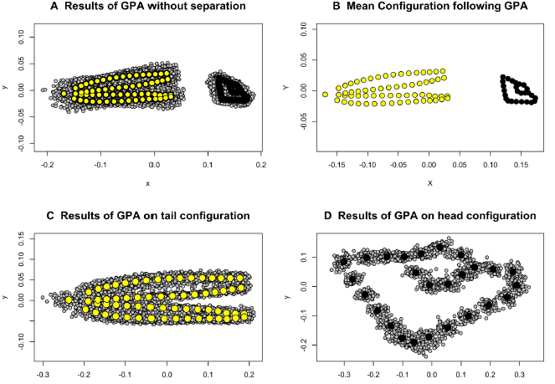
Collyer, Davis and Adams, 2020. Evol. Biol. 47:193-205.

