Slide 1
RNN 실습
TA: 홍지우, 윤은섭
Professor: 유창동
KAIST U-AIM Lab

Slide 2
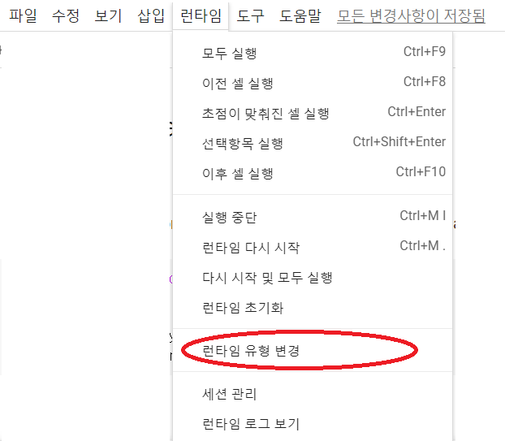
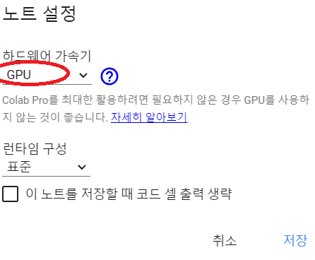
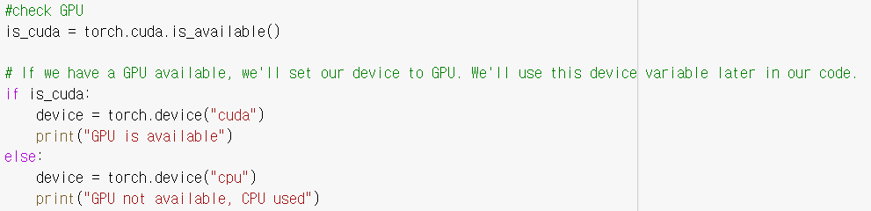
실습 Part 0 : Google Colab setup
Access the following link and save a copy to your google account
(make sure you save a copy and use that copy. You will not be able to modify the notebook otherwise)
https://colab.research.google.com/drive/1Vm8MOwmeQLrylwKzB6i3fsoj0JWaeVm6?usp=sharing
Make sure that you are using the gpu in google colab.
Run the following code at the beginning of the colab document and verify that “GPU is available” is printed

Slide 3
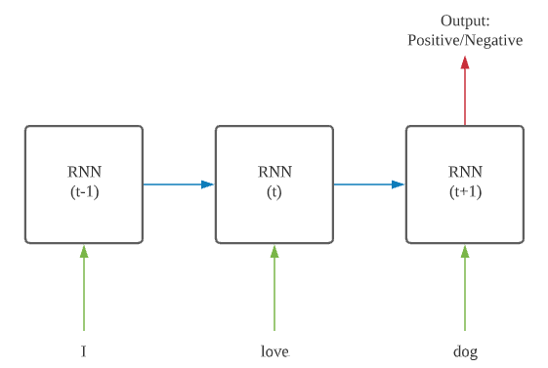
Text Classification
Predict if the given sentence is a positive review or a negative review

Slide 4
Content
Dataset
Word Embedding, Data Preprocessing
Implement vanilla RNN and perform text classification
Implement LSTM and perform text classification

Slide 5
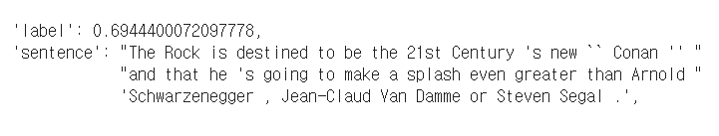
Data
Dataset: Stanford Sentiment Treebank
We are given a sentence and a label. You will round it to either 0 or 1 for binary classification (1 means it is a positive review and 0 means it is a negative review)

Slide 6

실습 Part 1: Dataset
Download python library called datasets
Download Stanford Sentiment Treebank (SST) dataset
Print an example of the dataset
You will only use 'sentence' and 'label' of the data. Please ignore the other values. Note that the label is between 0 and 1. You will round it to either 0 or 1 for binary classification (1 means it is a positive review and 0 means it is a negative review)

Slide 7
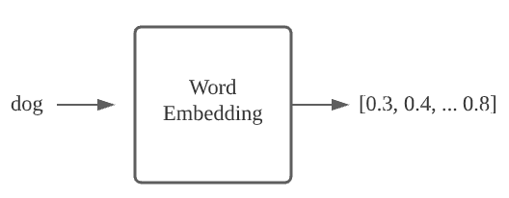
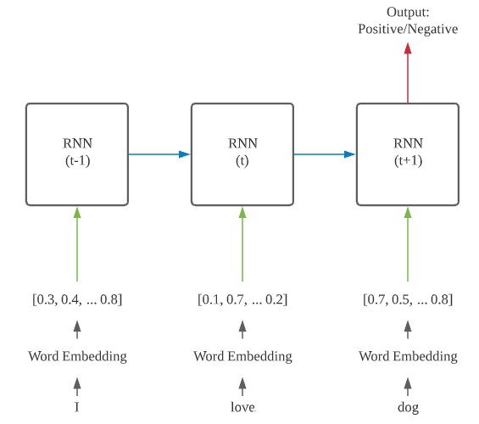
Word Embedding
A word is converted into a vector so that it can go in the network. Usually this is done by a pretrained word embedding (e.g. word2vec, Glove, etc)
You convert each word by a word embedding matrix and input to the network one by one. You should do this as you are inputting to the network, or if you have a pretrained embedding matrix you can convert all the training data beforehand.

Slide 8


실습 Part 2
Download pretrained word embedding called GloVe
Try some examples using GloVe
This will return the vector representation of the word 'apple'
You will observe that words that are not in the word embedding will just return a zero-vector.
Also try
GloVe only has lowercase words

Slide 9
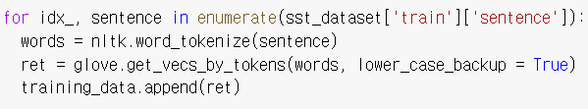
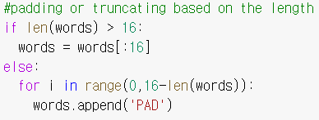
실습 Part 2
Convert all the words in every training sentence to its word embeddings
During this process, we will make all the sentences the same length by padding or truncating. We do this because multiple sentences will be trained together in a batch so they have to be of equal length

Slide 10
실습 Part 2
With what we have done, our training data now can be viewed as a 3d tensor of the shape (# of training data, length, word vector length)
Word vector length = 300
Length = 16
# of training data = 8544

Slide 11
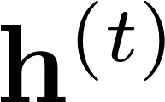
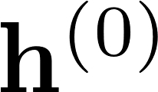
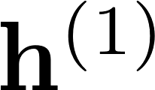
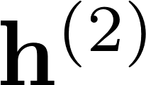
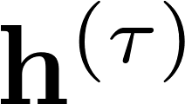
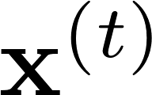
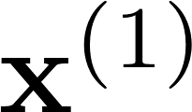
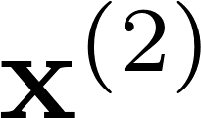
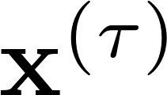
RNN
Recurrent Neural Networks (RNNs)
a family of neural networks for processing sequential data.
can process sequence of variable length
A simple Recurrent Neural Network (SRN):
Hidden
z
z
z
z
z
unfold
Input
z
z
z
z

Slide 12
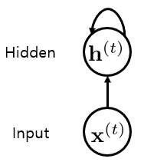
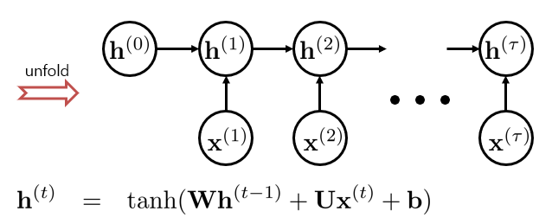

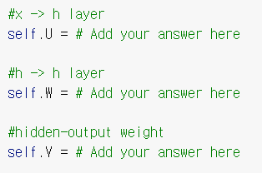
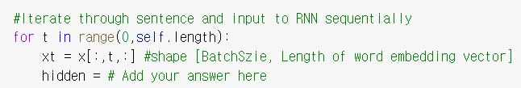

실습 Part 3
In this section, you will be asked to implement a vanilla RNN and perform text classification with it.
$$output$$
There are 5 lines of code you need to add
Hint: Suppose you have a layer defined as “self.layer = nn.Linear(input dimension, output dimension)
Then, you input to the layer and get the output as “output = self.layer(input)”.
Also, if you need activation function like sigmoid or tanh you do “output = torch.sigmoid(self.layer(input))”
Hint: nn.Linear(input dimension, output dimension)

Slide 13








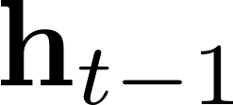


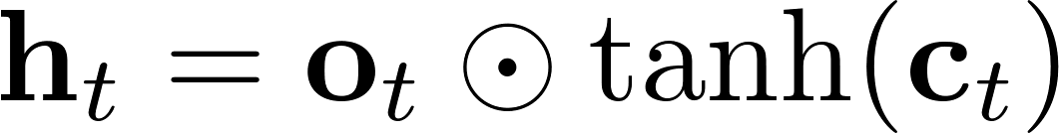
LSTM
cell state
z
cell update
z
forget gate
z
input gate
z
cell input
z
output gate
z
hidden state
z
z
hidden update
z
if f = 1, information from the previous cell state can pass through this step unchanged.
(gradient = 1, no vanishing gradient)
input

Slide 14
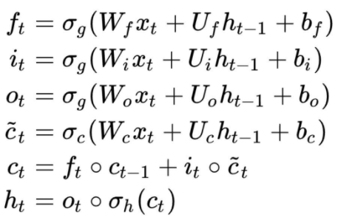
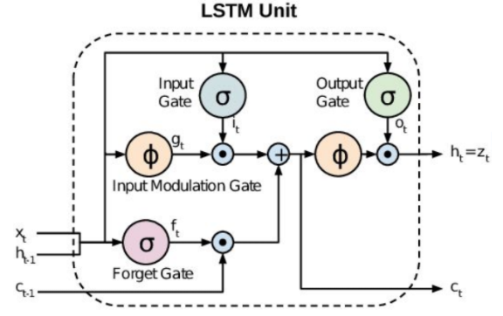
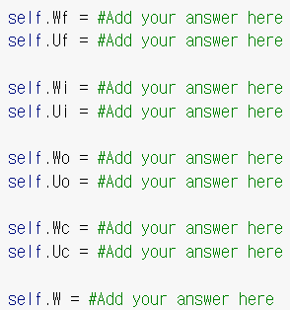
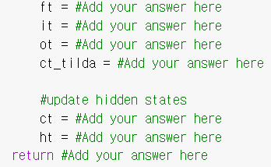

실습 Part 4
In this section, you will be asked to implement a LSTM and perform text classification with it.
$$σ_{g} :sigmoid$$
$$σ_{c} :tanh$$
(
is an element-wise multiplication)
There are 16 lines of code you need to add
Hint: Suppose you have a layer defined as “self.layer = nn.Linear(input dimension, output dimension)
Then, you input to the layer and get the output as “output = self.layer(input)”.
Also, if you need activation function like sigmoid or tanh you do “output = torch.sigmoid(self.layer(input))”
Hint: nn.Linear(input dimension, output dimension)

Slide 15


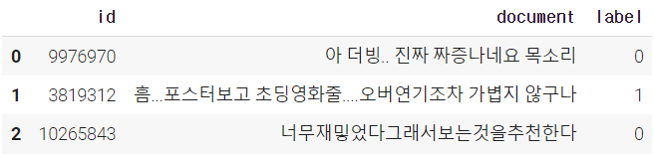

실습 Part 5
In this section, you will train BERT (transformer) for text classification with Naver sentiment corpus
Download the Naver sentiment Corpus dataset
Naver sentiment Corpus Example
For the fast experiment, we will use 20% of total dataset

Slide 16
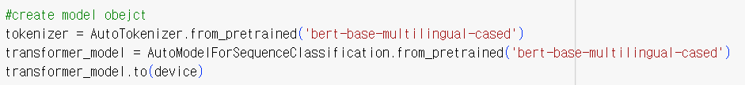
실습 Part 5
Download the pre-trained tokenizer and model
Since the it takes few days to train BERT from scratch, we will use pre-trained model and tokenizer
Also, our dataset mainly contains Korean sentences, so we will use multilingual BERT
To get the correct results, we need to set the model argument identically for model and tokenizer
You can get more information and access to other models in this community
https://huggingface.co/

Slide 17

실습 Part 5
Optimizer
Start Training
Some weights of the model checkpoint at bert-base-multilingual-cased were not used when initializing BertForSequenceClassification: ['cls.predictions.transform.LayerNorm.weight', 'cls.seq_relationship.bias', 'cls.predictions.bias', 'cls.seq_relationship.weight', 'cls.predictions.transform.LayerNorm.bias', 'cls.predictions.transform.dense.weight', 'cls.predictions.transform.dense.bias'] - This IS expected if you are initializing BertForSequenceClassification from the checkpoint of a model trained on another task or with another architecture (e.g. initializing a BertForSequenceClassification model from a BertForPreTraining model). - This IS NOT expected if you are initializing BertForSequenceClassification from the checkpoint of a model that you expect to be exactly identical (initializing a BertForSequenceClassification model from a BertForSequenceClassification model). Some weights of BertForSequenceClassification were not initialized from the model checkpoint at bert-base-multilingual-cased and are newly initialized: ['classifier.bias', 'classifier.weight'] You should probably TRAIN this model on a down-stream task to be able to use it for predictions and inference.
- This warning means current model is only pre-trained model which is not able to perform any downstream tasks

Slide 18
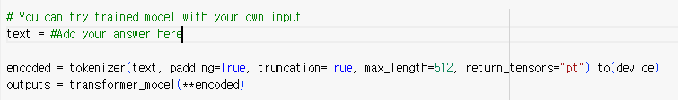

실습 Part 5
Training
By inputting the raw text into the tokenizer, it converts the text into the sequence of tokes
This tokenizer set the input as a same length as max_length (padding, truncation)
Test with your own text

