Slide 1







Developer survey
Georgi Naumov
5 August 2024

Slide 2



OUTLINE
Executive Summary
Introduction
Methodology
Results
Visualization – Charts
Dashboard
Discussion
Findings & Implications
Conclusion
Appendix

Slide 3

EXECUTIVE SUMMARY
Data analysis context and goals
Methodology
Collection of data
Analysis
Visualization
Presentation of results and findings
Discussion
Final research conclusion

Slide 4

INTRODUCTION
Stack Overflow's annual Developer Survey
Purpose: The survey aims to provide insights into the developer ecosystem, including trends in programming languages, frameworks, working environments, and career satisfaction.
Scope: It covers a wide range of topics, from favorite technologies to job preferences and developer demographics.
Participants: Developers from around the world participate, typically numbering in the tens of thousands each year.
Frequency: As the name suggests, it's conducted annually, usually in the first quarter of the year.

Slide 5

METHODOLOGY
Collect the required data using web scraping and APIs.
Data wrangling
Analysis
Data distribution
Outliers
Correlations
Data Visualization
Present our data analysis visually
Dashboards
Current period trends
Future period trends

Slide 6
RESULTS

Slide 7
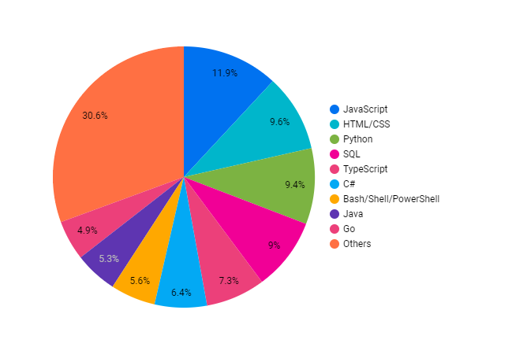
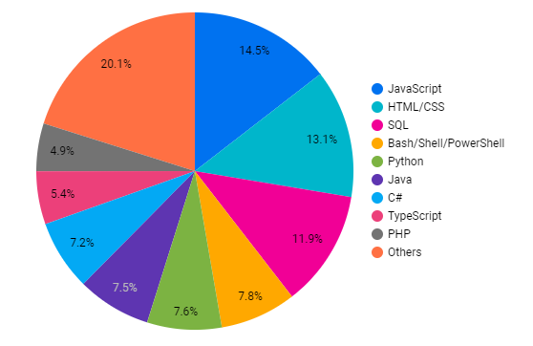
PROGRAMMING LANGUAGE TRENDS
Current Year
Next Year

Slide 8
PROGRAMMING LANGUAGE TRENDS - FINDINGS & IMPLICATIONS
Findings
Python is growing fast
JavaScript will remain the most popular language
PHP will not be in top 10 next period
Implications
JavaScript and TypeScript are relevant and related

Slide 9
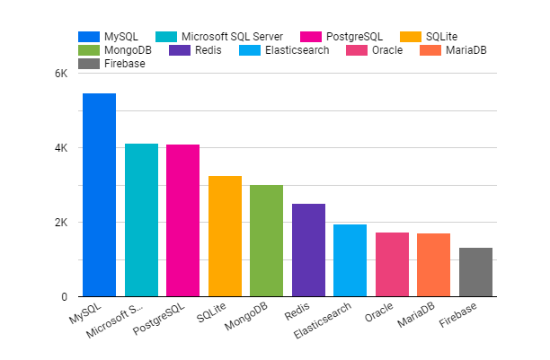
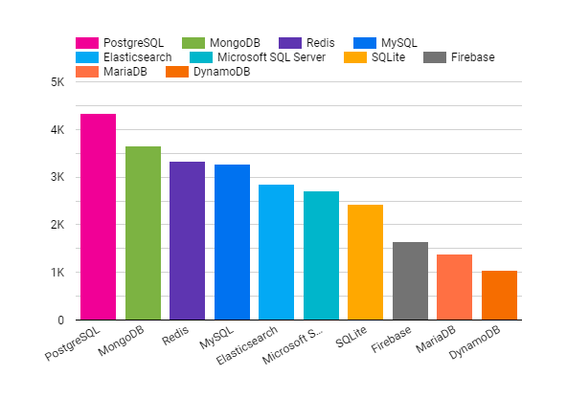
DATABASE TRENDS
Current Year
Next Year

Slide 10
DATABASE TRENDS - FINDINGS & IMPLICATIONS
Findings
Postgres will become the most popular DBMS in the next period
MongoDB is becoming more popular
Microsoft SQL is loosing following
Implications
MySQL and MariaDB are related

Slide 11

DASHBOARD
https://lookerstudio.google.com/reporting/d76d239f-062c-4a65-9e5d-84526da557ce

Slide 12
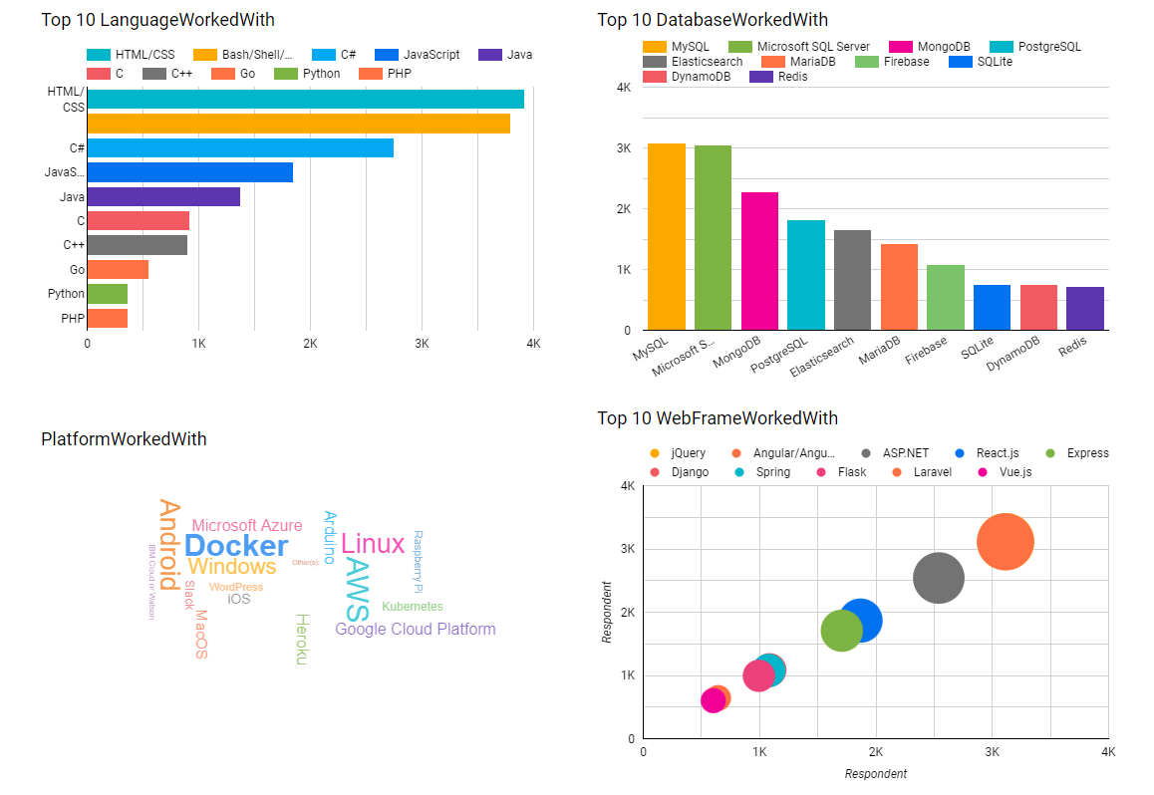
CURRENT TRENDS

Slide 13
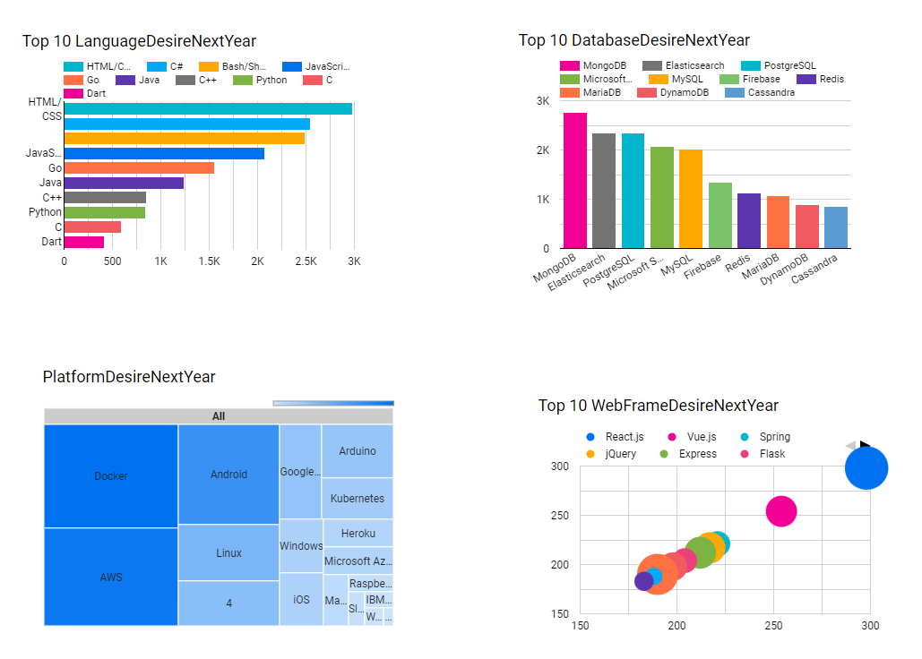
FUTURE TRENDS

Slide 14
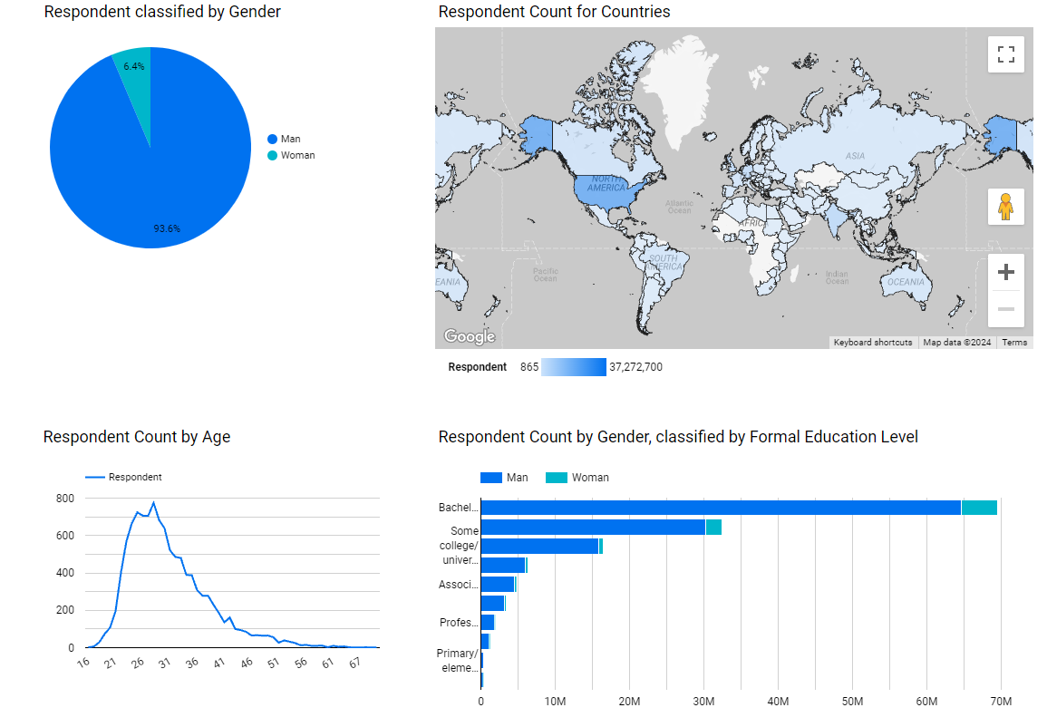
DASHBOARD

Slide 15
OVERALL FINDINGS & IMPLICATIONS
Findings
Most developers are young people
Most developers are male
Most developers are located in developed countries
There is a shift towards open-source technologies
Implications
Data might be biased or over/under-stated or inaccurate in general
StackOverflow’s userbase might not be so generic

Slide 16

CONCLUSION
The software development profession is mostly male-dominated
In contrast with the above, there is a large variety of programming languages and databases
Open-source projects are becoming more popular
Younger people tend to prefer the software developer profession
There are always outliers and small minorities, people who do things differently

Slide 17
JOB POSTINGS

Slide 18
POPULAR LANGUAGES

