Slide 1
Forecasting markers of habitual driving behaviors associated with crash risk
Master of Science Defense
George Panagopoulos
Advisor: Prof. Ioannis Pavlidis

Slide 2
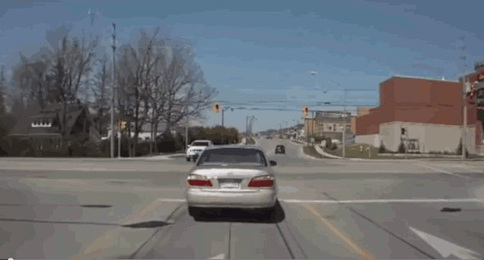
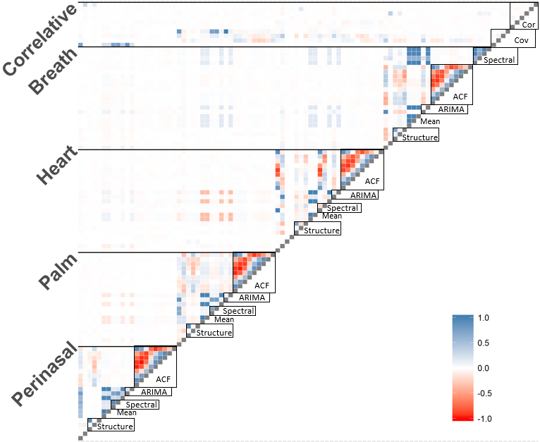
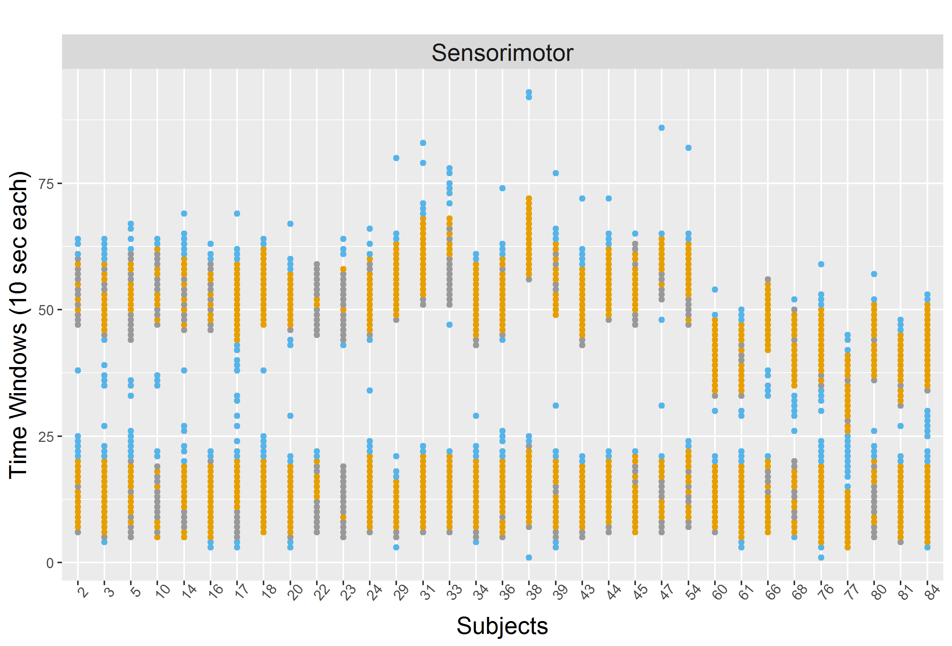

Overview
Introduction
Methodology
Results
Discussion

Slide 3
Problem
Car Accidents
  Nearly 1.3 million dead and 20-50 million injured each year worldwide[1]
  Over 37,000 deaths each year in the US alone
  Rank 13th in causes of death for 2014 [2]
[1] Association For Safe International Road Travel. http://asirt.org/initiatives/informing-road-users/road-safety-facts/road-crash-statistics Accessed March 2018.
[2] National Vital Statistics Reports. https://www.cdc.gov/nchs/data/nvsr/nvsr65/nvsr65_05.pdf Accessed March 2018.
Notes:
A problem that costs more than a million lives each year worldwide

Slide 4
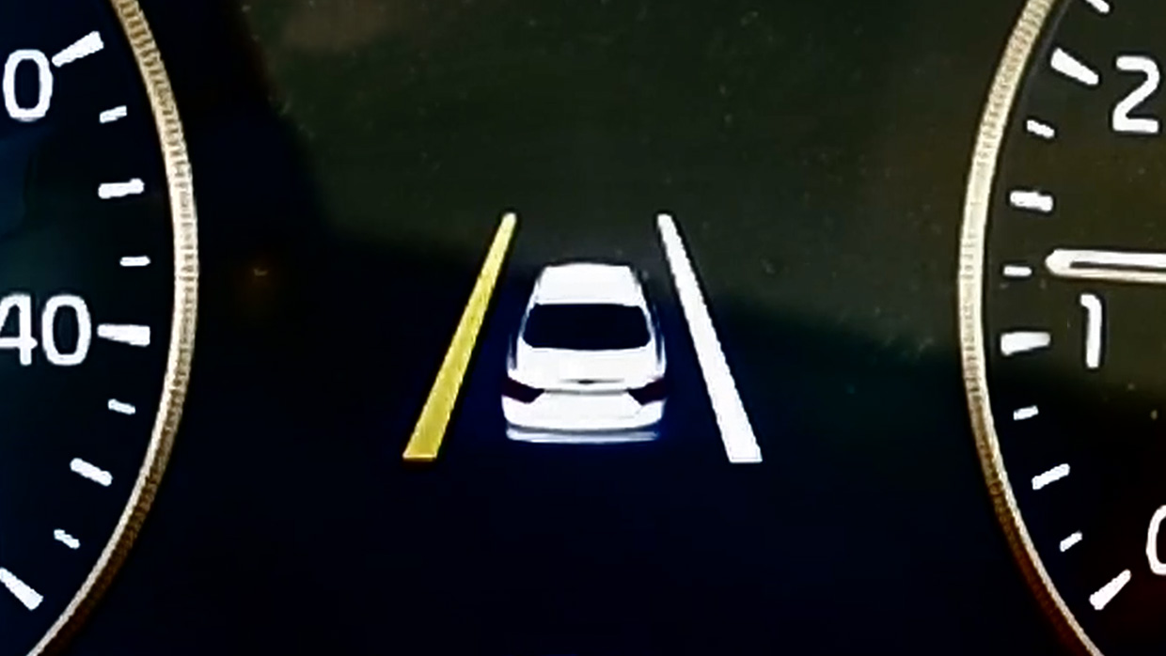
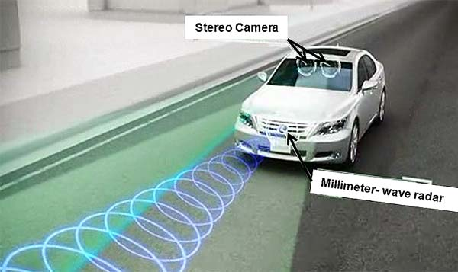
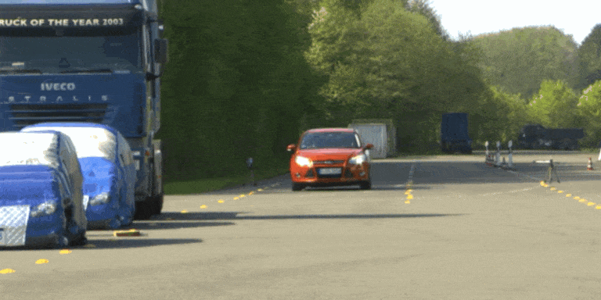
Current Approaches
Driving Assistance Systems (DAS)
  Warning when departing from lanes
  Identify and avoid pedestrians
  Activate the breaks on a potential imminent collision

Slide 5
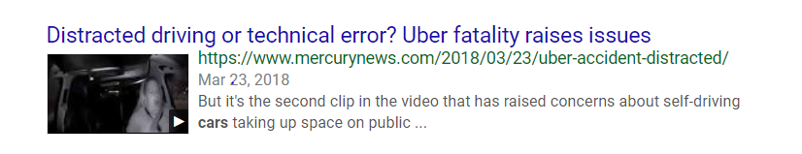
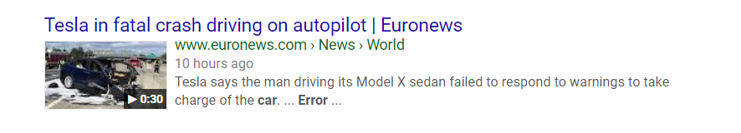
Limitations
Diminished accuracy depending on weather, light etc.
Act after or too close to when the violation happens
Mechanical in nature, overlooking the driver

Slide 6
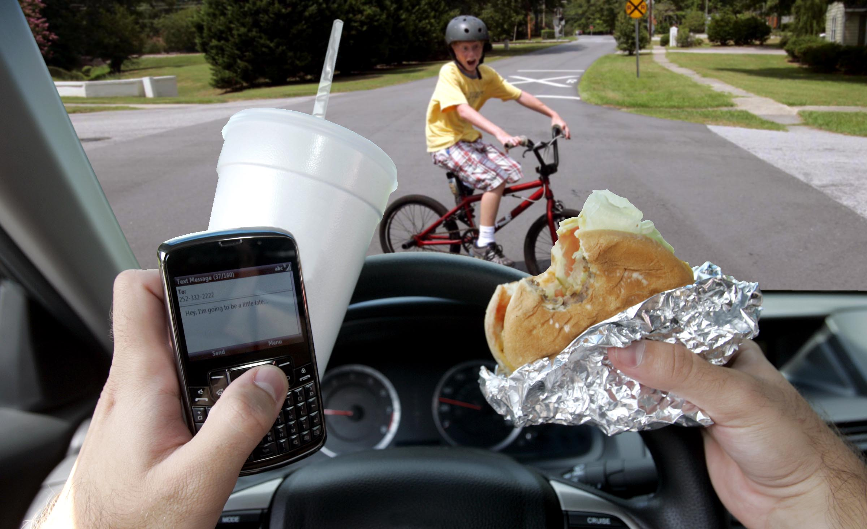
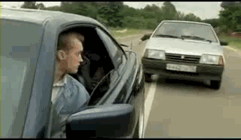
Motivation
90% of motor vehicle crashes are caused at least in part by human error [1]
In the US alone in 2015
  Distracted driving accounts for 3,477 deaths [2]
  Oversteering, erratic maneuvers account for 1,839 and 1,755 deaths [3]
[1] The center for internet and society. http://cyberlaw.stanford.edu/blog/2013/12/human-error-cause-vehicle-crashes Accessed March 2018.
[2] National highway traffic safety administration. https://www.nhtsa.gov/risky-driving/distracted-driving Accessed March 2018.
[3] Insurance Information Institute. https://www.iii.org/fact-statistic/facts-statistics-aggressive-driving Accessed March 2018.
Notes:
More remedial then preventive

Slide 7
Our Approach
Monitoring
{previous 30 seconds}
Driver
Vehicle
Preprocessing
Model
Features
Extreme Gradient Boosting
FT Forecasting
{next 10 seconds}
Distraction
Aggressiveness
x6
Meta Forecasting
Distraction

Slide 8
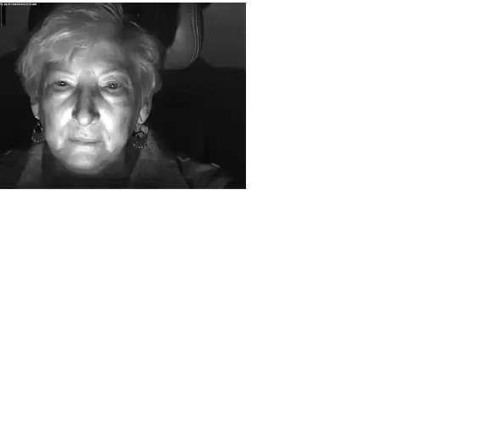
Physiological Monitoring
Monitor the driver’s internal state based on physiology
  Behavioral changes can be manifested in physiology
  Sympathetic arousal is linked to distracted driving [1]
  Emotion and thoughts can be a major cause of accidents [2]
[1] I. Pavlidis, M. Dcosta, S. Taamneh, M. Manser, T. Ferris, R. Wunderlich, E. Akleman, and P. Tsiamyrtzis,
“Dissecting driver behaviors under cognitive, emotional, sensorimotor, and mixed stressors,” Scientific Reports, vol. 6, 2016.
[2] F. McKenna, "The human factor in driving accidents an overview of approaches and problems." Ergonomics, vol. 25, no 10, pp 867-877, 1982.
Notes:
Changes in physiology will cause a change in the driver’s behavior

Slide 9
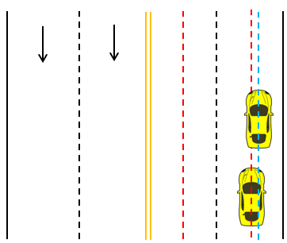
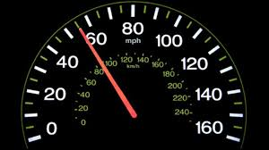
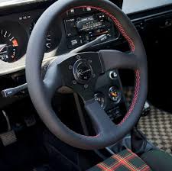
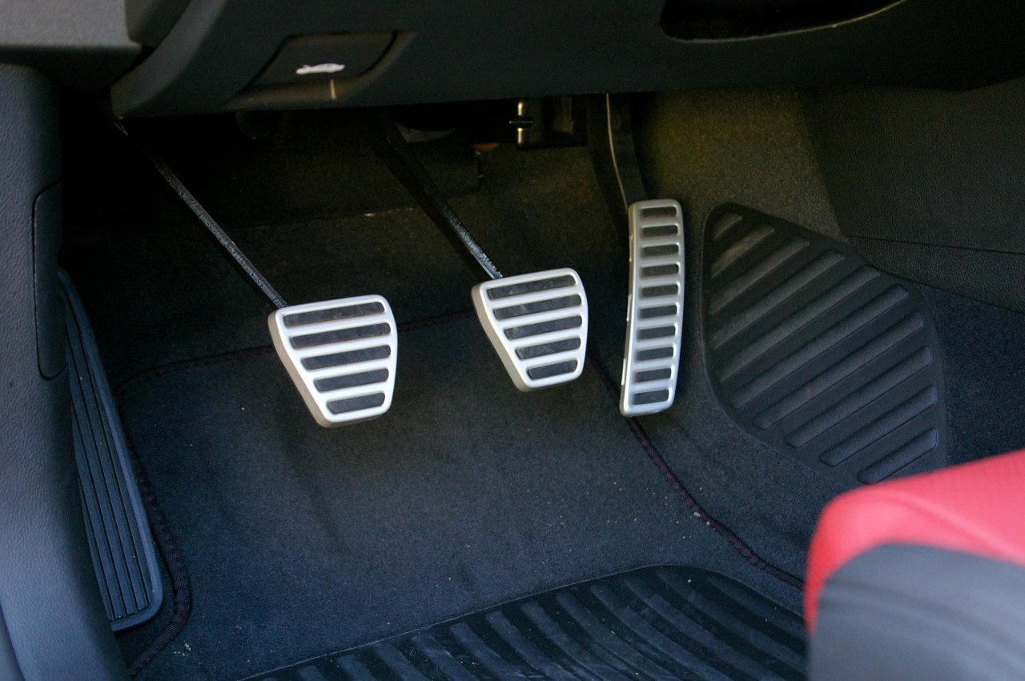
Car Monitoring
Monitor the car’s activity using car sensors
  Current activity is a strong predictor of the subsequent
  Patterns of driving signify the driver’s style

Slide 10
Overview
Introduction
Methodology
Results
Discussion

Slide 11
Dataset
Behavioral experiment [1]
  59 Subjects on a driving simulator
  Over 1.5 hours of driving for each
  Control covariates of age and sex
  Monitor 4 physiological and 5 car signals
Different types of external stimuli are applied on the subject
Distractions
  Esoteric
    Cognitive
    Emotional
  Physical
    Texting
[1] S. Taamneh, P. Tsiamyrtzis, M. Dcosta, P. Buddharaju, A. Khatri, M. Manser, T. Ferris, R. Wunderlich, and I. Pavlidis,
“A multimodal dataset for various forms of distracted driving,” Scientific Data, vol. 4, p. 170110, 2017.

Slide 12
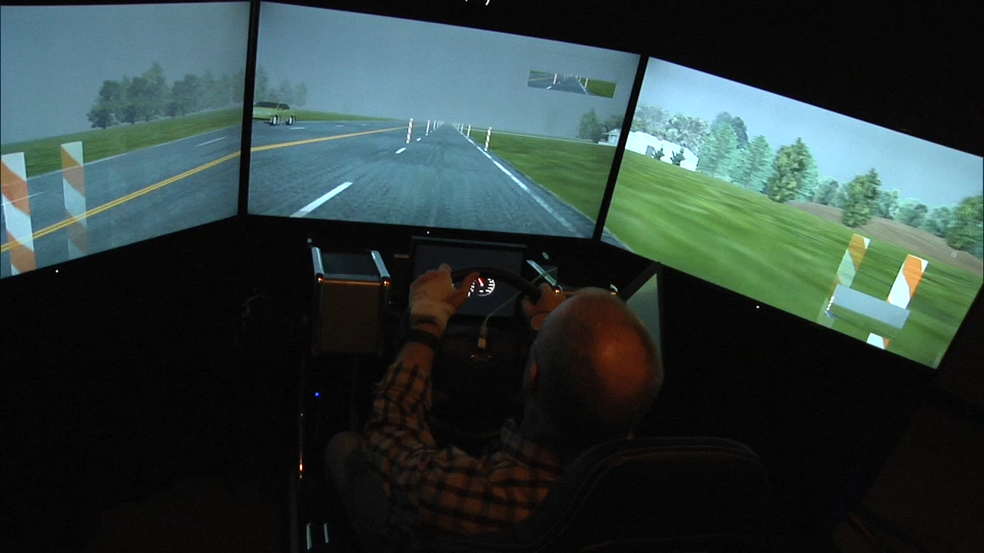
Example of Distraction
Notes:
More remedial then preventive

Slide 13
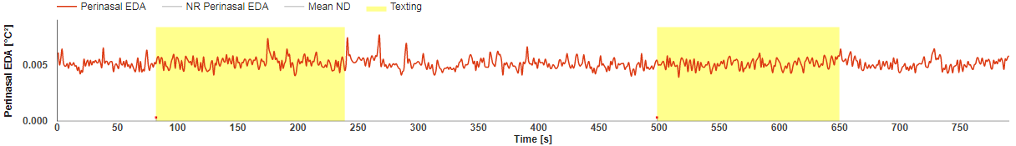
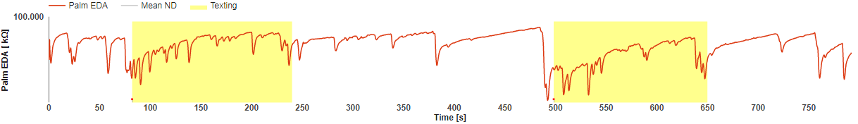
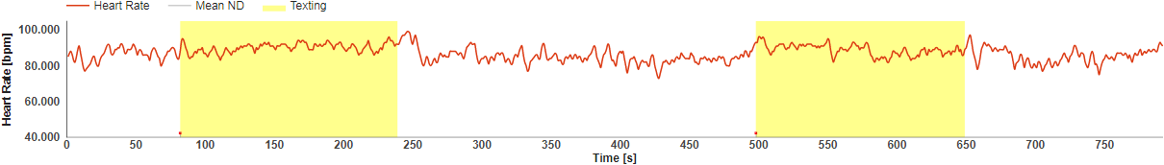
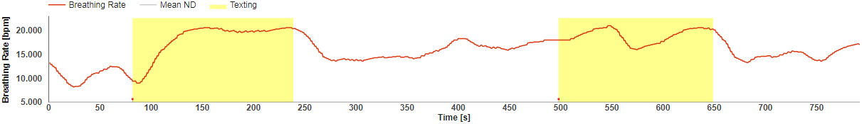
Annotations of Distraction
Subject 2
Sensorimotor Session
*Images from Subjectbook http://subjectbook.times.uh.edu/displaySubject?studyNo=23&SubjectId=T002
Notes:
Ground truth annotations of subject distraction on per second basis
We make a big assumption here, that the distraction of the subject follows exactly the annotations

Slide 14
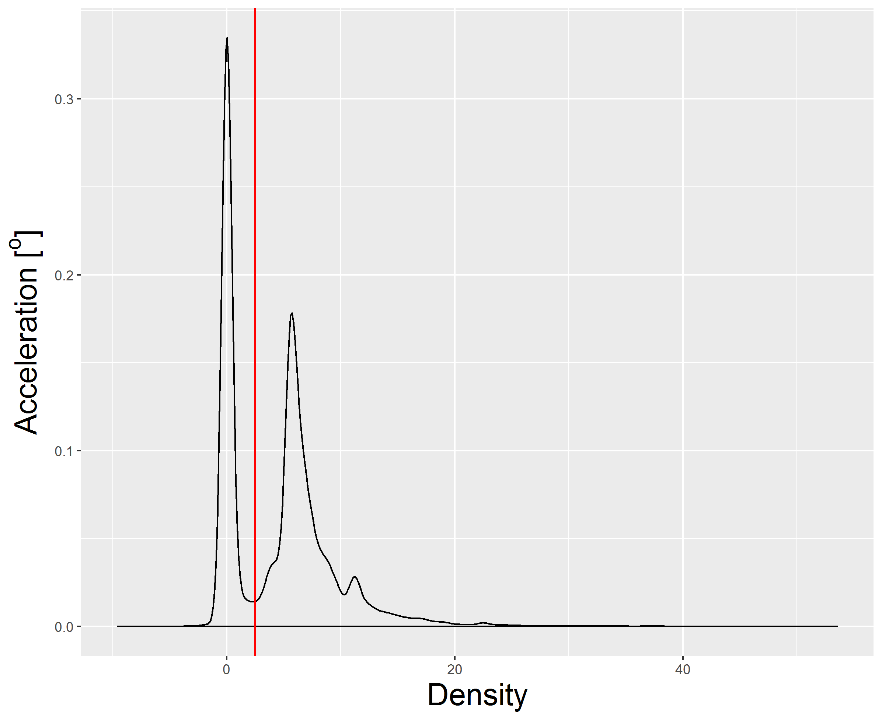
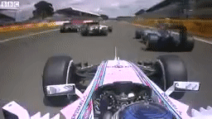
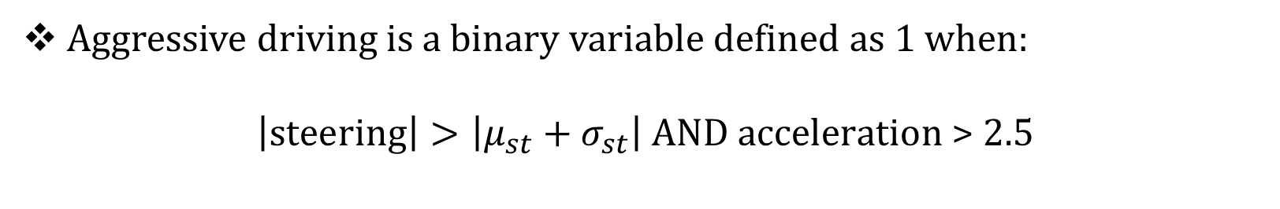
Aggressiveness
Aggressive driving is a binary variable defined as 1 when:
$$\left|steering\right|>\left|μ_{st}+σ_{st}\right| \text{AND} \text{acceleration}\text{ > 2.5}$$
Notes:
Since we don’t have aggressive ground truth, and nowhere is formualized as far as we ‘ve seen, we define it

Slide 15
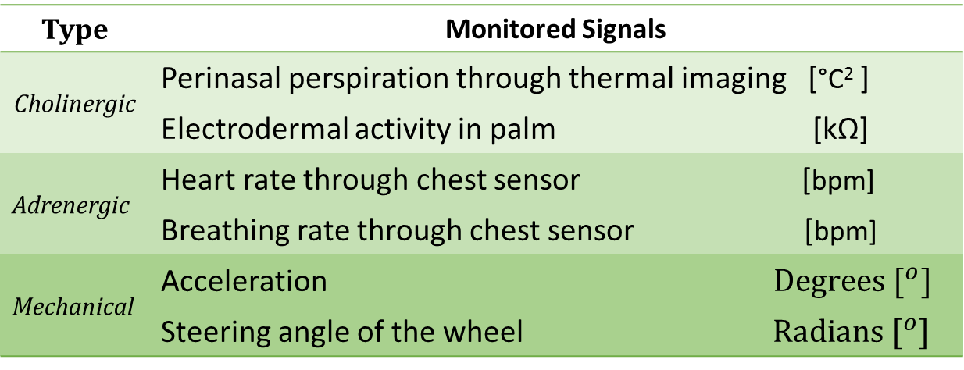
Variables
Type | Monitored Signals
Cholinergic | Perinasal perspiration through thermal imaging [°C² ]
 | Electrodermal activity in palm [kΩ]
Adrenergic | Heart rate through chest sensor [bpm]
 | Breathing rate through chest sensor [bpm]
Mechanical | Acceleration $Degrees [^{o}]$
 | Steering angle of the wheel $Radians [^{o}]$
Preprocessing
Manual curation by experimenters
Resample to 1Hz
Smoothing: 5-sample MA filter
10 second window
Input
Variables to predict
Annotated Distraction {0,1}
Aggressive Driving {0,1}
Output

Slide 16
Biosignal Feature Extraction
ARIMA
ACF
#(2+10)*4
PSD in [0,0.1],
(0.1,0.2],
(0.2,0.3],
(0.3,0.4] Hz
#4
Pairwise Correlation
Covariance Eigenvalues
#6+4
Breathing
Mean,
Median,
Energy
SD & SS
Perinasal Perspiration
Phasic and Tonic PSD and frequency
(Threshold at 0.2 Hz)
#4*5
Palm EDA
#4*2
PSD in [0,0.5],
(0.003,0.04],
(0.04,0.15],
(0.15,0.5] Hz,
ratio of 2nd & 3rd
Heart
#5
Peaks and Onsets
#4*4
Notes:
ARIMA coefs and Param, ACF gives 10
Maximum value of the spectogram in frequencies 0-0.2Hz and >0.2Hz
No of Peaks, Time Peak-Onset, Value Peak-Onset, Time Peak-Peak

Slide 17
Feature Selection
111 initial features
We remove features with
  Constant values
  >10% N/A values
  >0.8 absolute correlation
48 features left
Notes:
Correlation has eigenvalue 1 and 4 found to correlate with palm and perinasal
Autocorelation are very correlated with each other
Mean, median, energy, arima parameters are correlated

Slide 18
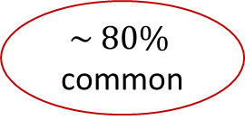
Feature Selection
Top 10
Mean and SD of Perinasal Perspiration
Mean and SD of Heart Rate
Mean and SD of Palm EDA
Mean and SD of Breathing Rate
First Maximum Spectral Density of Perinasal Perspiration
First and Second Maximum Spectral Density of Palm EDA
Very High Frequency Spectral Density of Breathing rate
Second and Third Eigenvalue of Covariance Matrix
Ratio of Low High Frequency Spectral Density of Heart
Palm EDA Rate of Change
Correlation between perinasal perspiration and breathing rate
XGB
Aggressiveness
$$\sim 80\%$$
common
17 features
48 features
LM
Distraction
Input Variables
Feature
Selection
Models
Predicted Variable
Intersection
Mean Acceleration
Mean Steering
Notes:
80% overlap showing the inherent relationship between the two classes
Features from all types of signals
Both distracted and aggressive driving are challenging, that is why physiology changes during them

Slide 19
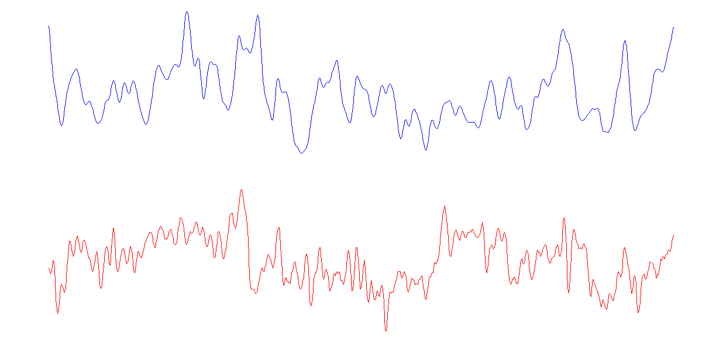


Sliding Window
$$h_{1}$$ | $$h_{2}$$ | $$h_{3}$$ | $$p_{1}^{1}$$ | $$p_{2}^{1}$$ | $$p_{3}^{1}$$ | $$p_{1}^{2}$$ | $$p_{2}^{2}$$ | $$p_{3}^{2}$$ | … | $$A_{4}$$
$$h_{2}$$ | $$h_{3}$$ | $$h_{4}$$ | $$p_{2}^{1}$$ | $$p_{3}^{1}$$ | $$p_{4}^{1}$$ | $$p_{2}^{2}$$ | $$p_{3}^{2}$$ | $$p_{4}^{2}$$ | … | $$A_{5}$$
Perinasal Perspiration
Heart Rate
Aggressiveness
19
Notes:
More remedial then preventive

Slide 20
Extreme Gradient Boosting
A set of classification and regression trees (CARTs)
Developed sequentially
Complementing each other
Advantages
  Interpretability
  Efficient implementation
  Robust to overfitting
  Handles class imbalance
  Surpassed other algorithms in our experiments

Slide 21
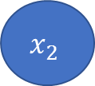
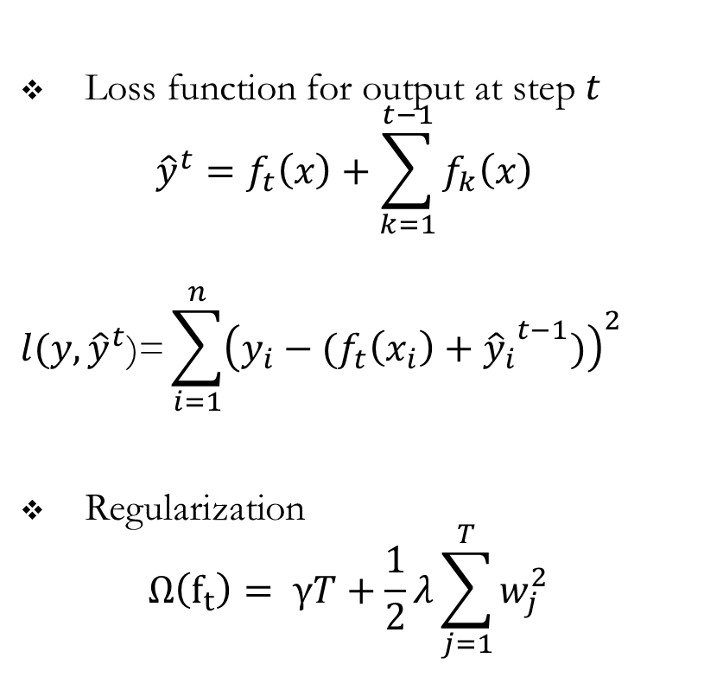
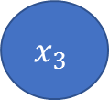
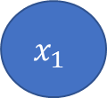

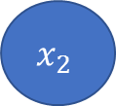
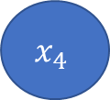
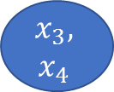
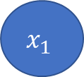
Extreme Gradient Boosting
Loss function for output at step $t$
$${\hat{y}}^{t}=f_{t}\left(x\right)+\sum_{k=1}^{t−1}{f_{k}\left(x\right) }$$
$$l(y,{\hat{y}}^{t}\text{)=}\sum_{i=1}^{n}{{\left(y_{i}−{(f_{t}\left(x_{i}\right)+{\hat{y}}_{i}}^{t−1})\right)}^{2} }$$
Regularization
$$Ω\left(f_{t}\right)= γT+\frac{1}{2}λ\sum_{j=1}^{T}{w_{j}^{2}}$$
1st Tree
2nd Tree
P<8
H<1
N
Y
B>2
P<5
B>5
$$x_{3},$$
$$x_{4}$$
$$x_{1}$$
$$x_{2}$$
$$x_{4}$$
$$x_{3}$$
$$x_{2}$$
$$x_{1}$$
0.5
2.5
${\hat{y}}_{1}=f_{1}\left(x1\right)$+$f_{2}\left(x1\right)=0.5+2.5=3$
Notes:
H B P are features
X are samples

Slide 22

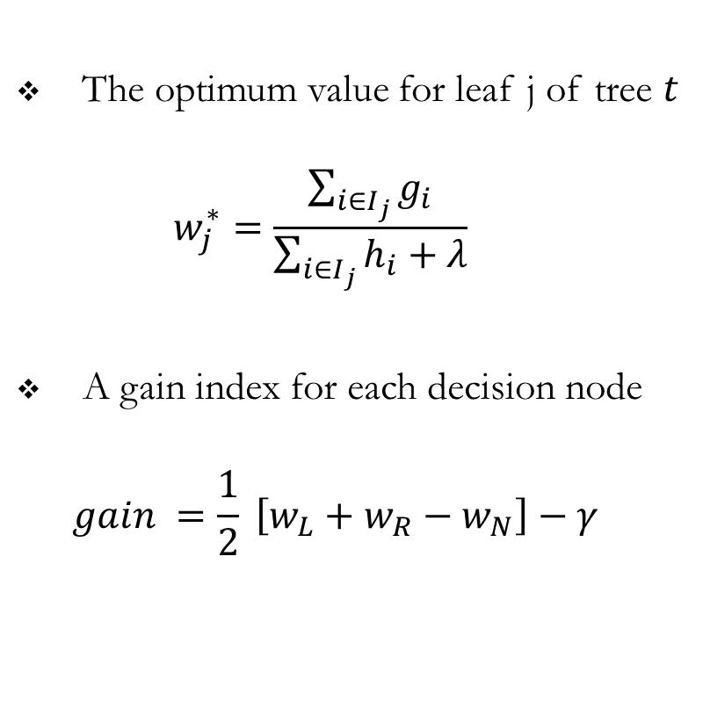
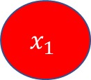
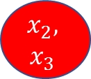
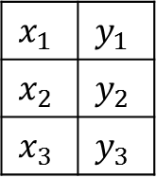

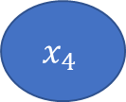

Extreme Gradient Boosting
The optimum value for leaf j of tree $t$
$$w_{j}^{∗}=\frac{\sum_{i∈I_{j}}{g_{i}}}{\sum_{i∈I_{j}}{h_{i}+λ}}$$
A gain index for each decision node
$$gain =\frac{1}{2} \left[w_{L}+w_{R}−w_{N}\right]−γ$$
3rd Tree
Add variable with
maximum gain
H<1
$$x_{1}$$ | $$y_{1}$$
$$x_{2}$$ | $$y_{2}$$
$$x_{3}$$ | $$y_{3}$$
B
P
$$x_{4}$$
?
B>1
$$I_{N}=\{1,2,3\}$$
$$x_{2},$$
$$x_{3}$$
$$x_{1}$$
$$I_{L}=\{2,3\}$$
$$I_{R}=\{1\}$$
Notes:
Gain index measures whether this change moves the ensemble to the global optimum (greedy)
Gain depends on the gradient of the loss of that leaf’s samples in the previous trees

Slide 23
Overview
Introduction
Methodology
Results
Discussion

Slide 24
Results
5-fold cross validation on the whole dataset
Area Under Receiver Operator Curve (AUC) is the main evaluation metric
  Accuracy
  Specificity
  Sensitivity
  Precision
  Negative Predictive Value
Break down the predictions depending on the distraction
  Analyze Cognitive, Emotional, Sensorimotor distraction
Notes:
#negative samples were retrieved correctly #the positive samples were retrieved correctly
#predicted negative samples were negative #predicted positive samples were positive
ND has no distraction, FD is small, so the results are very strong
Interpret the errors connect machine learning findings with statistical findings from previous study
Evaluate patterns associating distraction, driving behavior and physiology

Slide 25
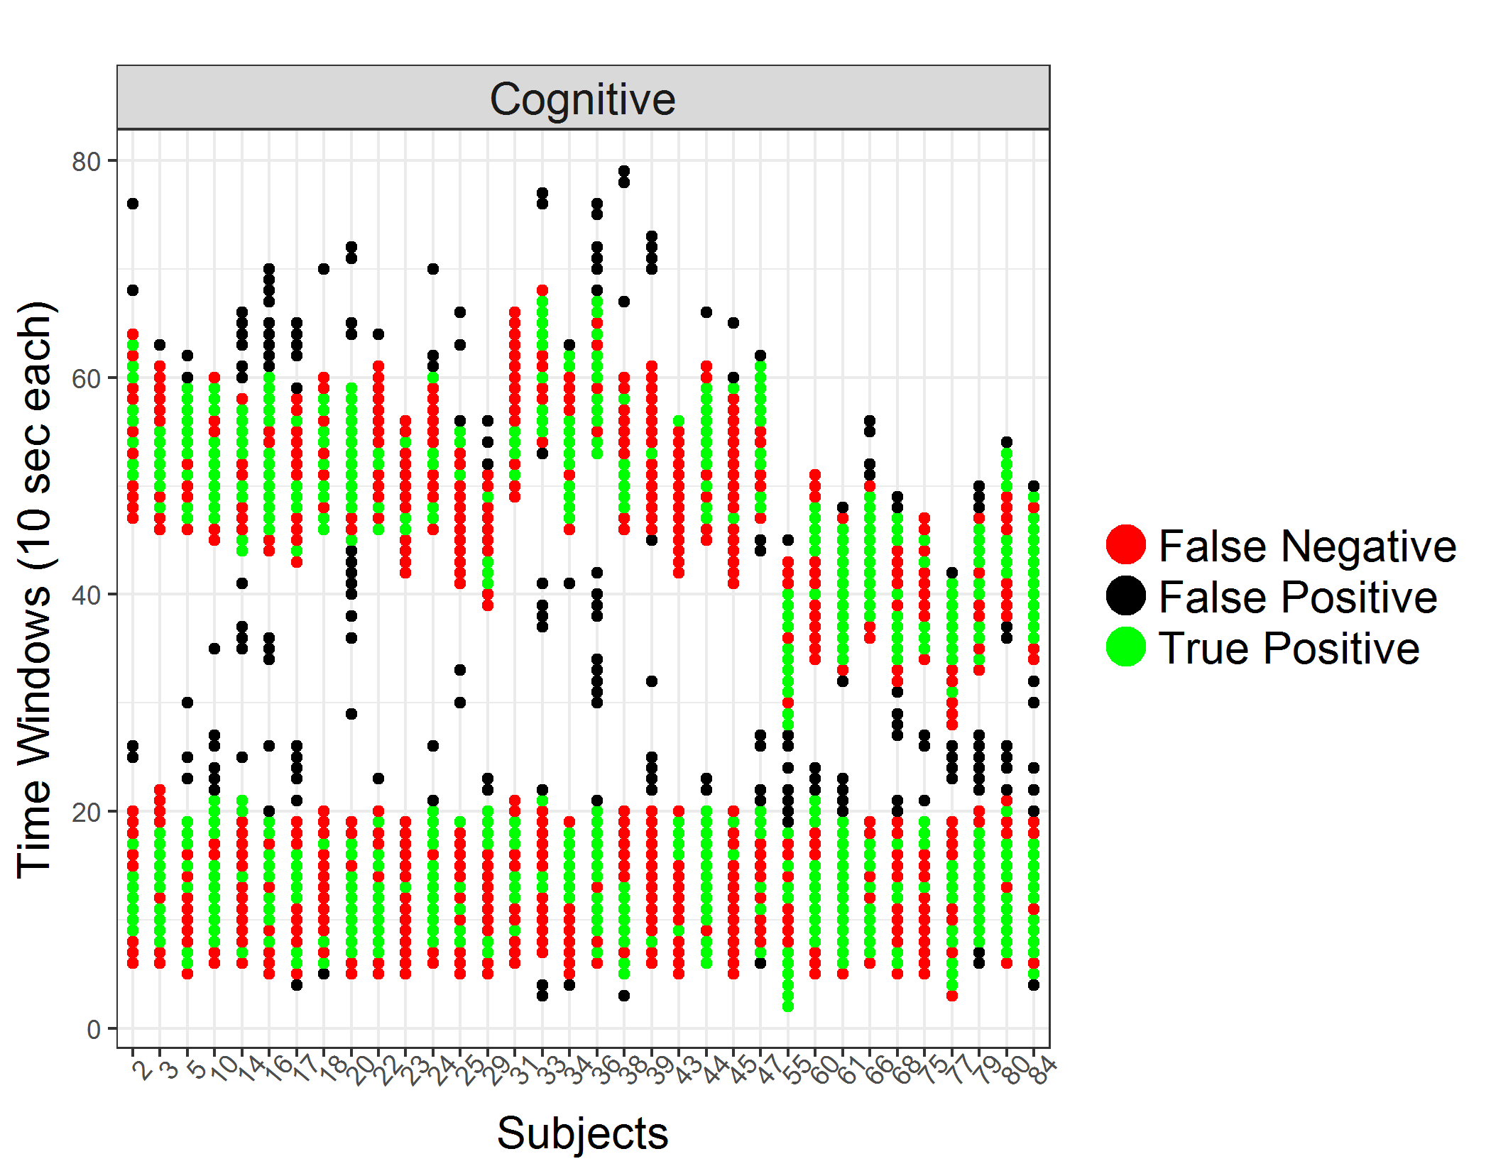
Cognitive Distraction
Metric | Score (%)
AUC | 66.6
ACC | 67.7
Specificity | 65.5
Sensitivity | 72.4
Precision | 5.0
NPV | 83.3

Slide 26
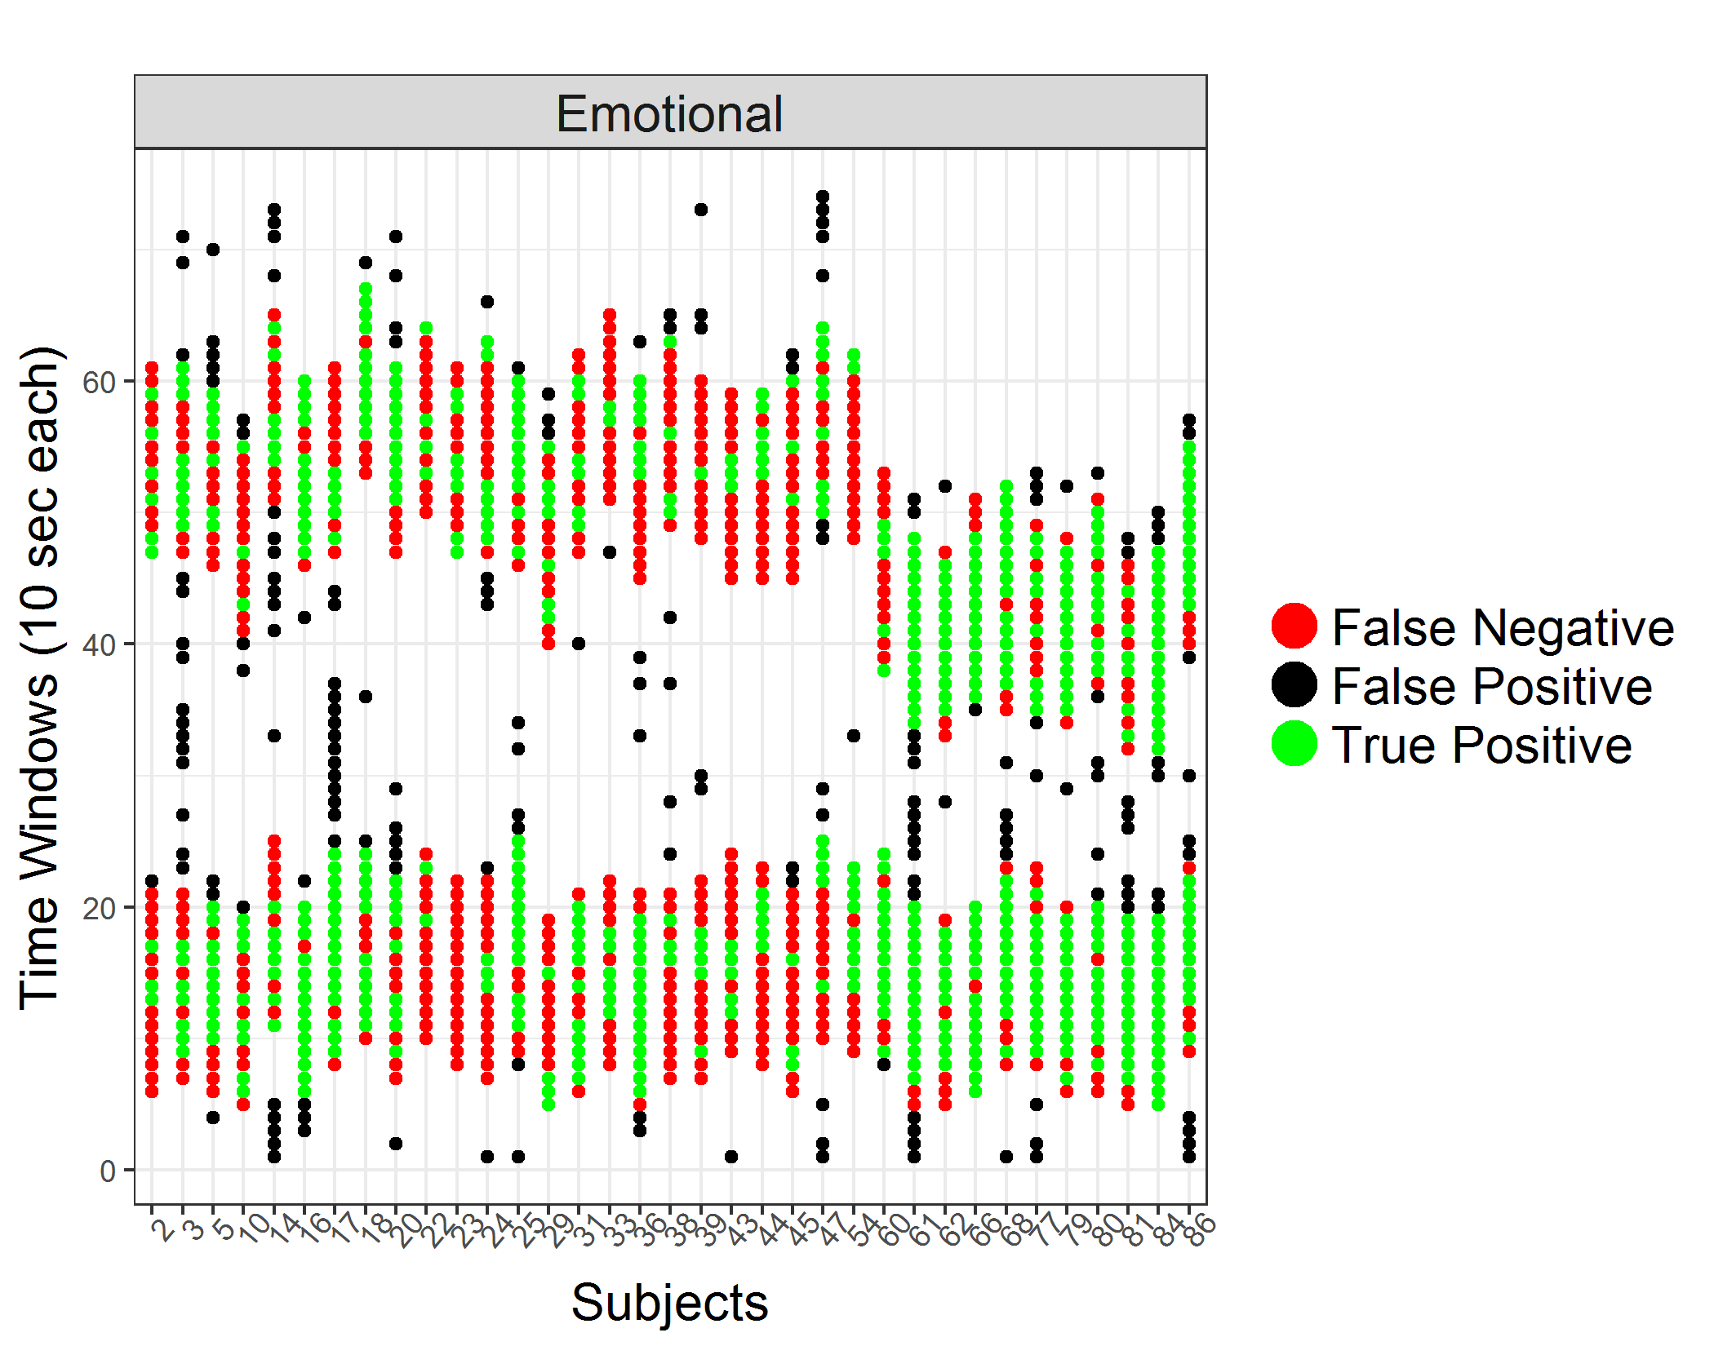
Emotional Distraction
Metric | Score (%)
AUC | 69.0
ACC | 69.9
Specificity | 67.4
Sensitivity | 74.7
Precision | 54.2
NPV | 83.8

Slide 27
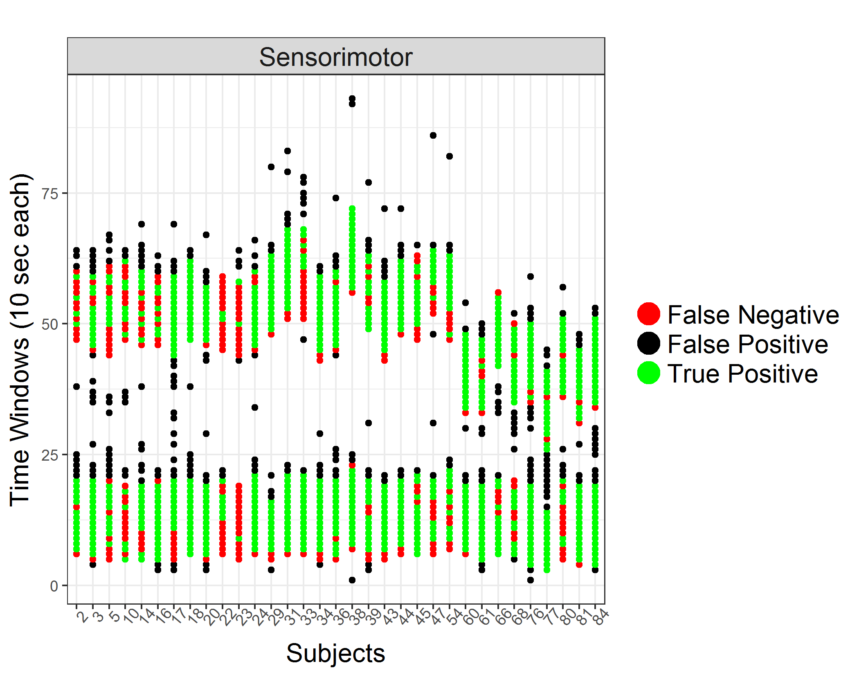
Sensorimotor Distraction
Metric | Score (%)
AUC | 77.3
ACC | 77.5
Specificity | 80.5
Sensitivity | 74.0
Precision | 75.7
NPV | 79.0
Notes:
That study revealed that driving under physical destruction changes significantly your sympathetic arousal and your behavior

Slide 28
Distraction results from the whole dataset
 | Distraction (%)
Area Under Curve | 84.26
Accuracy | 78.36
Specificity | 87.27
Sensitivity | 61.47
Precision | 71.83
Negative Predictive Value | 81.10

Slide 29
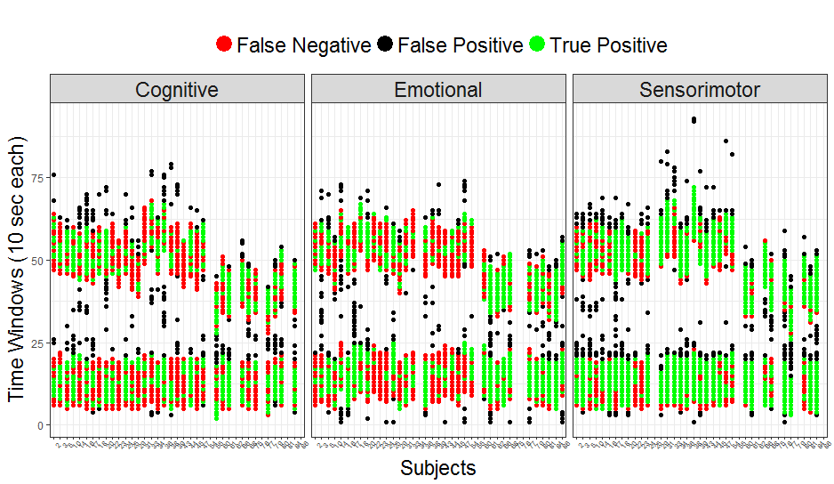
Distraction Prediction
Annotations assume subjects start and stop being distracted without readjustment periods
“Spillover” effect between the two distraction periods
Sensorimotor distraction is the easiest to predict
Notes:
Majority of false negatives happen in the start of a distracting period Majority of false positives happen after its end
In reality the internal state and physiology need readjustment periods
It additionally buttresses the claim that this effect is connected to sympathetic changes, as our model, which has recovered this effect, is based on physiological features

Slide 30
Aggressiveness results from the whole dataset
 | Aggressiveness (%)
Area Under Curve | 87.13
Accuracy | 89.24
Specificity | 95.52
Sensitivity | 48.84
Precision | 62.88
Negative Predictive Value | 92.31

Slide 31
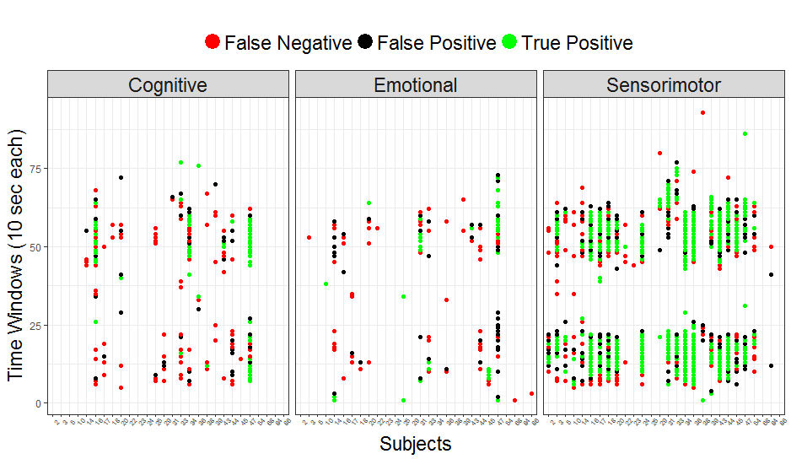
Aggressiveness Prediction
Sensorimotor distraction has the highest aggressiveness (46% of the total aggressive samples) and the highest precision, with more than 65% true positive rate
Notes:
previous findings suggesting that steering, one of the main components of aggressiveness, undergoes significant changes during the physical destruction

Slide 32
Comparison with other algorithms
 | XGBoost | Base | Naïve Bayes | GLM | SVM Radial
Area Under Curve | 84.26 | 50 | 56.6 | 67.2 | 73 | Distraction
Accuracy | 78.36 | 65.4 | 61.9 | 69.1 | 70.5
Area Under Curve | 87.13 | 50 | 50.9 | 76 | 81.3 | Aggressiveness
Accuracy | 89.24 | 86.5 | 53.7 | 87 | 88

Slide 33
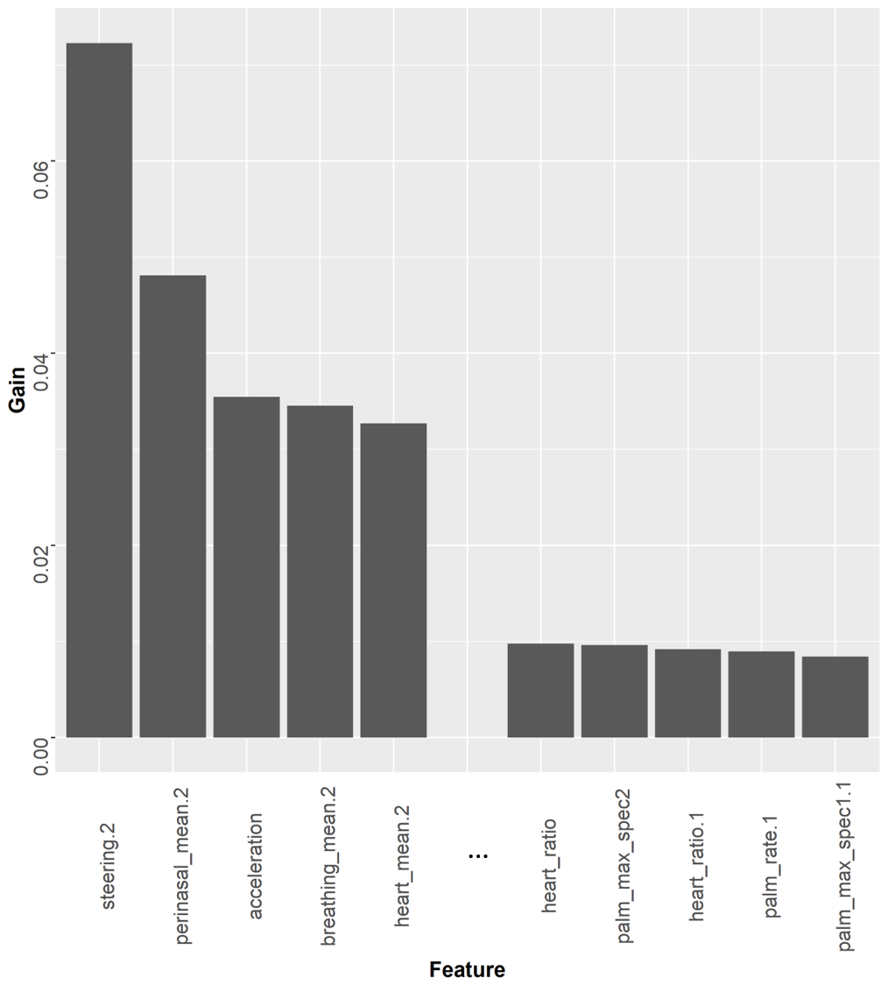
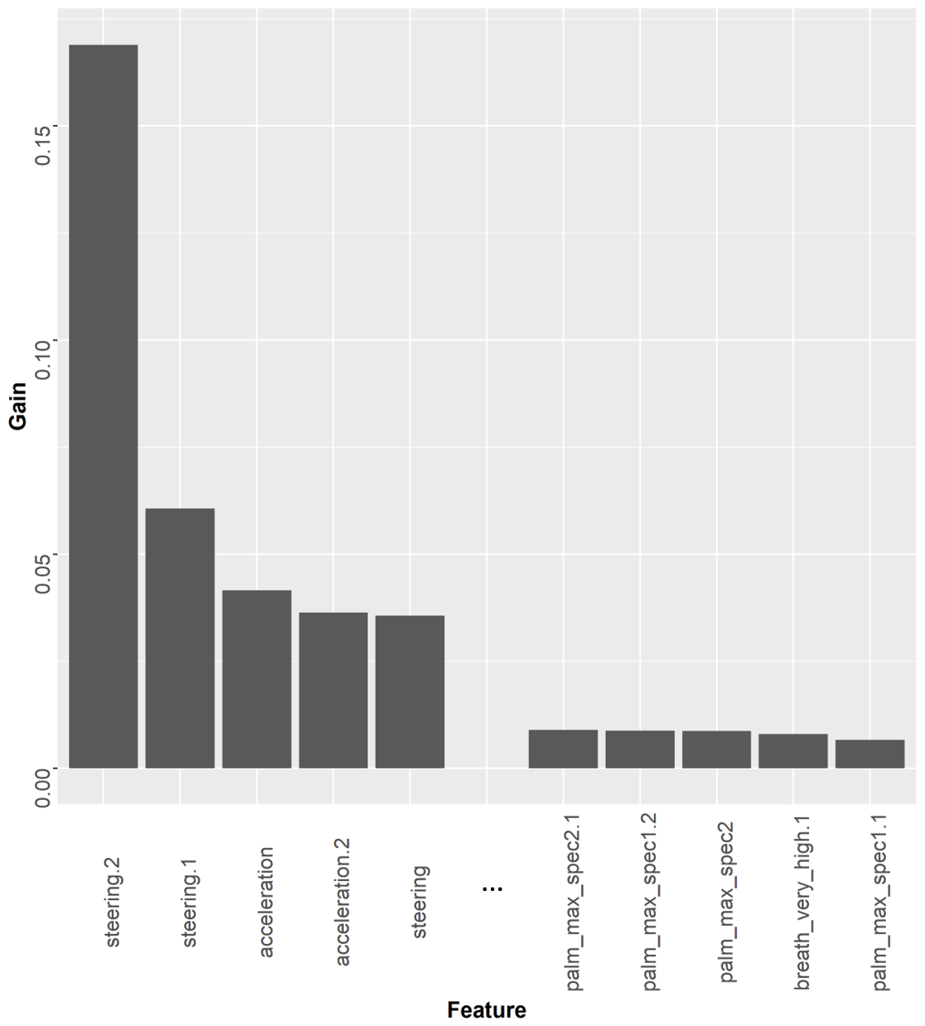
Feature Importance's retrieved by XGB
Distraction
Aggressiveness

Slide 34
Online Visualization
Online data application for visualization per subject and distraction
    Microscopic view: Examine errors sample by sample
  Visualize overlap between
    Distraction and aggressiveness
    Prediction and ground truth
    https://georgepanagopoulos.shinyapps.io/StressAndAggressivenessOnRoadPrediction/

Slide 35
Overview
Introduction
Methodology
Results
Discussion

Slide 36
Discussion
Practical Purpose: Break dangerous habitual traits with repetitive feedbacks
  Feedback mechanism can be studied by HCI community
Drivers are not very keen on using systems that bother them very often
High specificity and negative predictive value
  Very accurate on predicting when the driver is not distracted or aggressive
Fair Precision
  Confident when it predicts positive
Notes:
This is a service for HCI to work on
That would make the driver even more aggressive

Slide 37
Takeaway Message
  Alerts the driver in rare occasions and most of the times will be right
  If the annotations were physiologically sound, accuracy would increase
Notes:
That would make the driver even more aggressive

Slide 38
Contributions/Findings
Identified literature’s most appropriate features for the problem
Found overlap between physiological predictors of aggressive and distracted driving
Competitive prediction of two dangerous habitual driving traits
The model captures aspects of the internal state, despite “noisy” annotations
The results support previous findings from statistical studies
Notes:
Subsequent works will employ these 17 features, instead of 111
Opens questions about the connection of these two traits and its physiological basis
Specificity, precision, 10-second forecast period and subject independent model
Spillover effect between distraction periods
Physiology and driving behavior can predict sensorimotor distraction, but not the rest
Aggressive driving style identified under sensorimotor distraction

Slide 39
Conclusion
Limitations
Distractive annotations:
Biased and hard to be acquired
Unexamined factors:
Weather, traffic, car condition
Machine learning:
Diminished sensitivity
Future Work
Use sympathetic arousal as a proxy
Naturalistic experiments for data acquisition
Sequential algorithms like Recurrent Neural Networks
Notes:
That will cover the first limitation

Slide 40
Acknowledgements
Prof. Ioannis Pavlidis
CPL Lab Members/Alumni
  Dr. Panagiotis Tsiamyrtzis, Dr. Malcolm Dcosta, Dr. Muhsin Ugur, Dr. Salah Taamneh
  Ashik, Amanweer, Dinesh, Emtiaz, Shaila, Shivani

Slide 41
Thank you
gpanagopoulos@uh.edu
http://cpl.uh.edu/people/george_panagopoulos/

