Slide 1
How to abduct humans
By: Jenny James

Slide 2
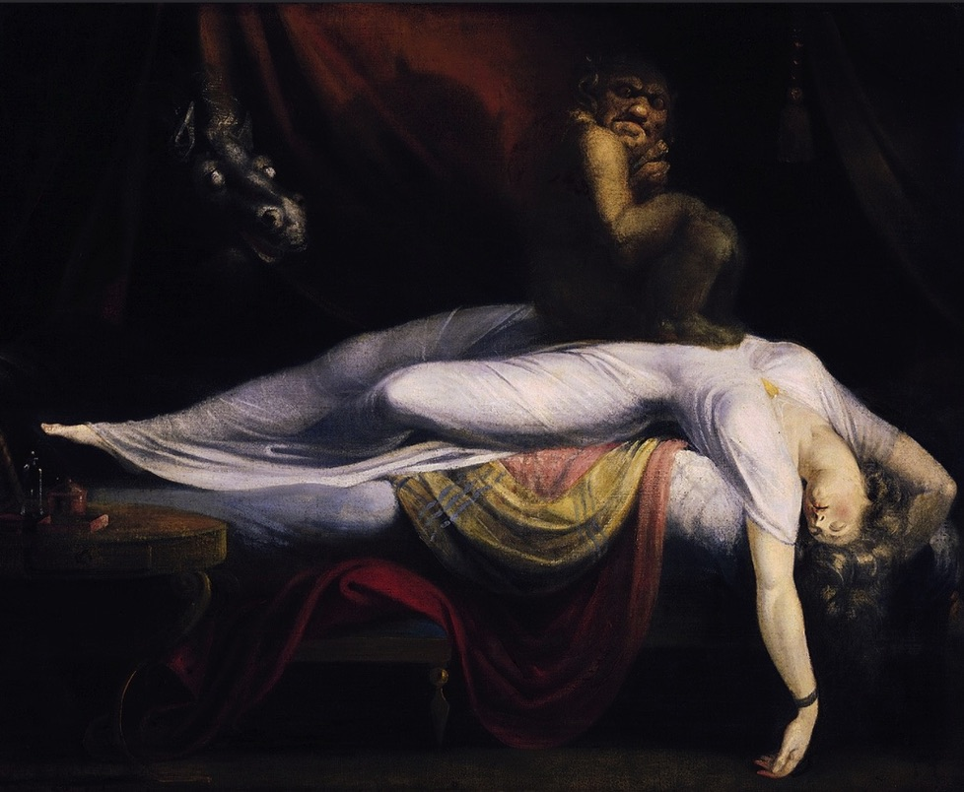
The problem
The nightmare
By Henry Fuseli (1781)
Seeking new information by finding humans that are somewhat easy to abduct but that have not already been abducted.
This is thought to be a depiction of sleep paralysis perceived as a demonic visitation

Slide 3
Data Gathering
I scraped the data from the two subreddits using praw.
After obtaining the data, I went through a cleaning process in which I ensured there were no empty values in the body of the subreddit post.
I also removed the most commonly used English words since they will appear in both subreddits
Reddit!
This is an amazing place on the humans’ internet where I gathered my information. They willingly describe the details of their lives for fun.
I obtained my information using two different searches: Alien Abductions and Sleep Paralysis.

Slide 4
Why Sleep paralysis?
Sleep paralysis is a state, during waking up or falling asleep, in which a person is aware but unable to move or speak. During an episode, one may hallucinate so it is possible you will be considered a hallucination and not be taken seriously

Slide 5
Modeling scores
Logistic Regression
Training Score: .92
Testing Score: .85
K Nearest Nighbors
Training Score: .80
Testing Score: .73
We will choose the Logistic Regression model
5

Slide 6
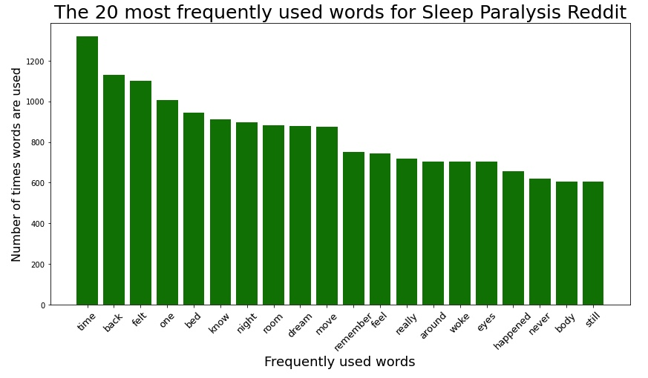
Most used words on the Sleep paralysis reddit

Slide 7
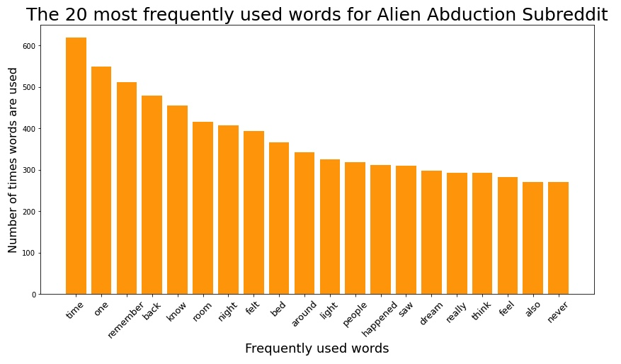
Most used words on the Alien Abduction reddit

Slide 8
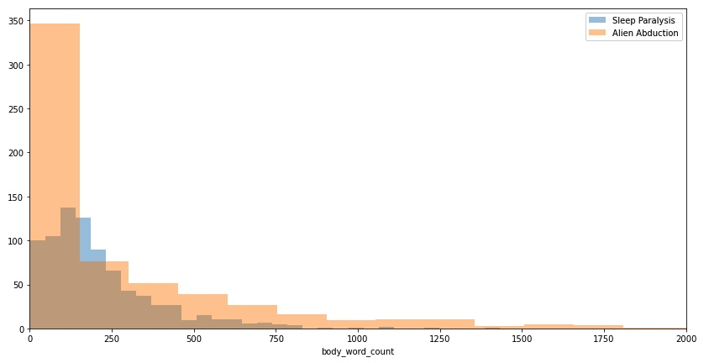
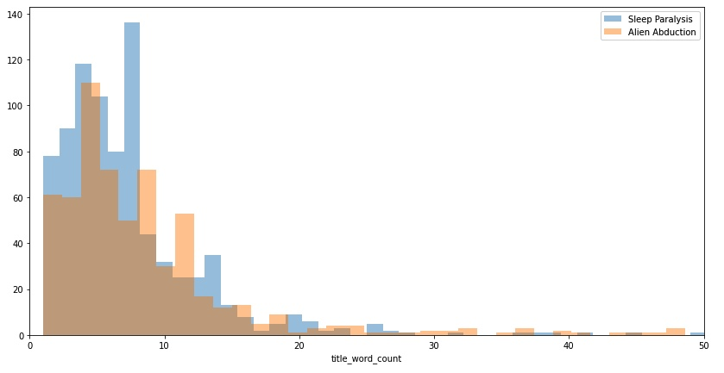
Body Word Count
Title Word Count

Slide 9
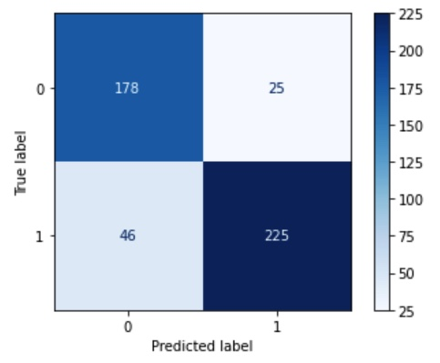




Sensitivity
Out of all the predictions we said would be correct this is the percentage we got correct
$$\frac{TP}{TP+FN}$$
$= \frac{225}{225+46}$ =
85%
.85
Confusion Matrix
TN
FP
Specificity
Out of all the predictions we said would be wrong this is the percentage we got correct
FN
TP
$$\frac{TN}{TN+FP}$$
$= \frac{178}{178+25}$ =
.88
88%

Slide 10
Conclusion
Given some string of words we should be able to predict which subreddit it should belong to with 92% accuracy.
We can even test it out!
Search text | Result
it was dark and i was frozen. i can’t remember what happened' | Alien Abduction
'i was in my bed at night and my eyes were opened. there was a light and i thought it was a dream i could not move for a long time' | Sleep Paralysis

Slide 11
End

