Slide 1
Home Values in Ames, IA
Jenny James
August 14, 2020

Slide 2
Challenge: Increase home values in Ames, Iowa
1.
2.
3.
4.
Collect all available data:
Use any sources available including internet research
Clean the data
And reclean the data
Model the data so we can get our best predictions
Create visualizations to easily explain the data

Slide 3
Kitchen Quality
Total Square Footage
Finished Basement
Above Grade Bedrooms
Garage Area
Remodel Year
Lot Area
Unfinished Basement Square Footage
Fireplaces
1st Floor Square Footage
Overall Condition
Features that could affect the sale price of a house
Year Sold
Wood Deck Square Footage
Half Bath
Lot Frontage
Enclosed Porch
Total Rooms Above Grade
Full Bath
Open Porch Square Footage
Gr Living Area
Basement Half Bath
Age
Total Basement Square Footage
Basement Full Bath
Garage Size
Above Grade Kitchen
Pavement
Overall Quality
2nd Floor Square Footage
Finished Basement Square Footage

Slide 4
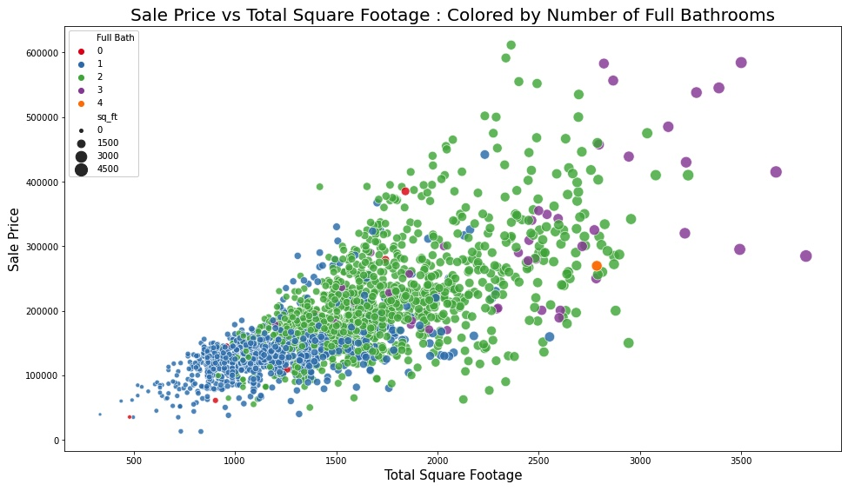


Slide 5
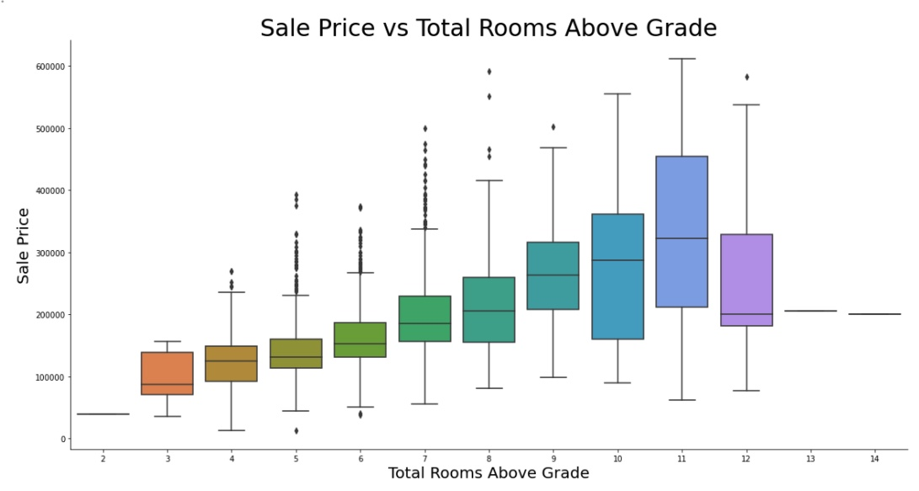
There are some features that increase the sale price of a house but are more difficult to change

Slide 6
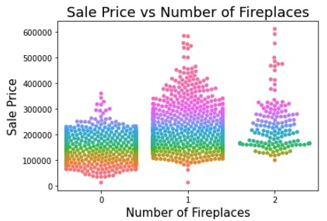
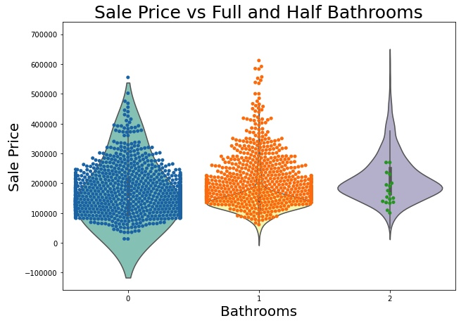
Homes with more bathrooms and fireplaces sell for more
Half Bath
1
2
3
These feature improvements would take major construction and a lot of time

Slide 7
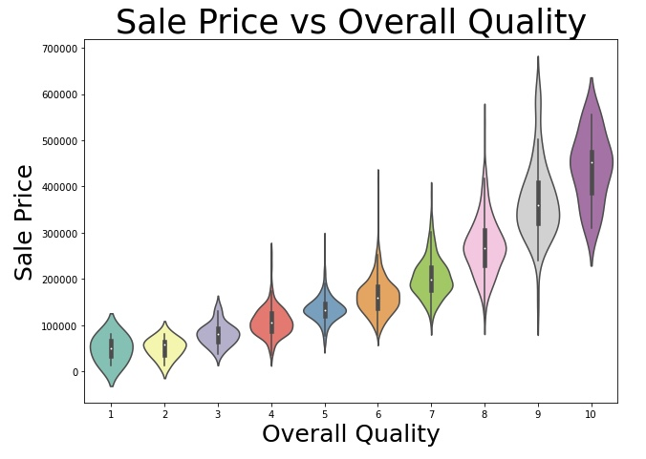
This violin plot shows how overall quality of a house is directly related to the sale price

Slide 8
How can we improve the overall quality of a house?
Interior:
Paint – A new coat of paint can go a long way.
Replace carpets with wood or tile.
Update the kitchen.
Important: Remove any and all popcorn on the ceilings.
Exterior Improvements:
Landscaping – plant a tree or add some low-maintenance landscaping.
Add a privacy fence.
Replace front door and garage doors.
Paint the siding, and even better, install fiber cement siding.

Slide 9
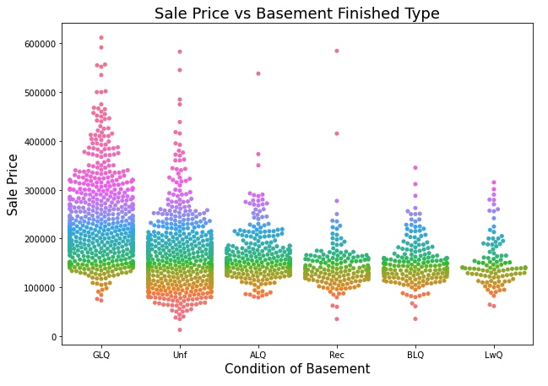
What are some features that can be improved without breaking the bank?
If a home as an unfinished basement:
Finish it!
GLQ – Good Living Quarters
Unf – Unfinished
ALQ – Average Living Quarters
Rec – Average Rec room
BLQ – Below Avg Living Quarters
LwQ – Low Quality

Slide 10

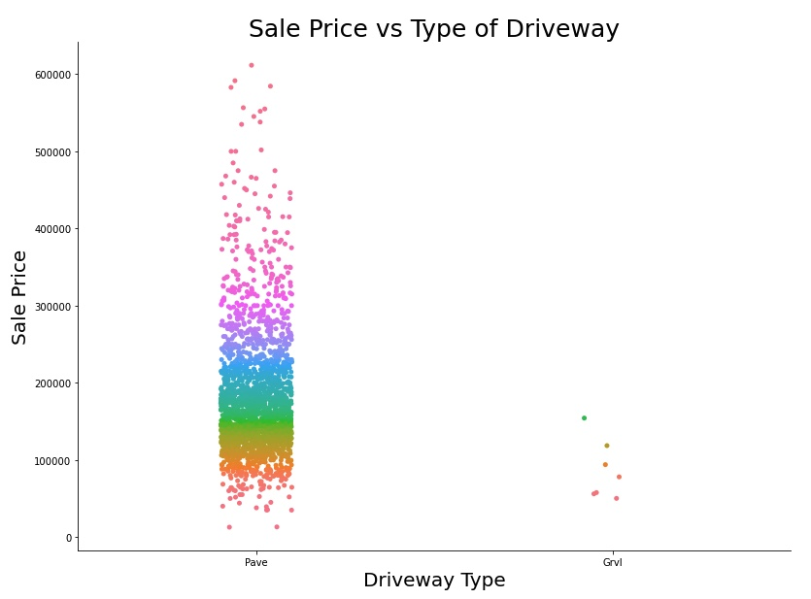
If the driveway is not paved:
Pave it!
Paved
Gravel

Slide 11
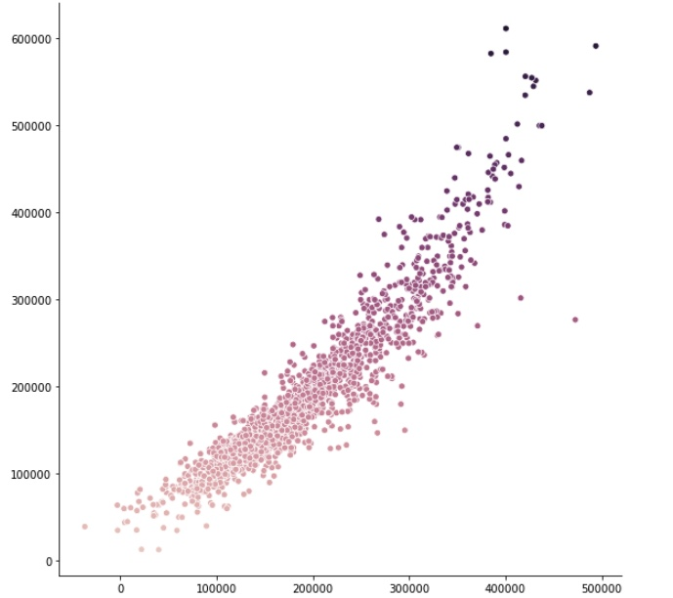
Actualfds
Actual Sale Price vs Predicted Sale Price
The predicted sale prices in my model are strongly correlated to the actual sale prices
Predicted Sale Price
R = .88
RMSE = $26,160
2
Actual Sale Price

Slide 12
Sources
http://web.stanford.edu/class/stats191/data/amesdoc.txt
https://www.hgtv.com/design/remodel/interior-remodel/30-tips-for-increasing-your-homes-value
https://johnmccarterconstruction.com/6-top-exterior-home-improvement-investments-raise-property-values/

Slide 13
END

